Slide 1
Data services discovery
A review of current practices in Australia
Melanie Barlow
2019

Slide 2
Data Services Interest Group
The ARDC convened a Data Services Interest Group around data service provision and consumption across the NCRIS facilities, science agencies, universities, and broader public sector, aiming to improve discovery and use of data and related services across these organisations
“end user” scenarios
Individual researchers looking to “plug data into” their own tool or model using standard services
Virtual laboratories providing tools over data from various common data services
Third party innovators leveraging data across a pool of services for development work (such as a national feature map).
“shared practice”
What information set would a data steward need to possess to satisfy the requests in those scenarios?
In current information technology practice where might such information typically be stored and exposed in data management systems?
ARDC Data and related Services - Discovery and Use (google doc)

Slide 3
Specific ARDC Project: Harmonising Data Services across the Data-enhanced Virtual Laboratories (DeVLs) and Research Data Cloud (RDC) Projects
Selected ARDC projects involved:
Climate DeVL
Geosciences DeVL
Marine DeVL and RDC
Eco DeVL and RDC
Agriculture RDC
Culture and Communities DeVL
Project Goal: Developing shared practices for exposing information about data and related services through:
Identifying a common approach to description and provision of data services for satisfying the requests in those scenarios
Investigating, in current information technology practice, where service descriptions are stored and exposed in data management systems

Slide 4
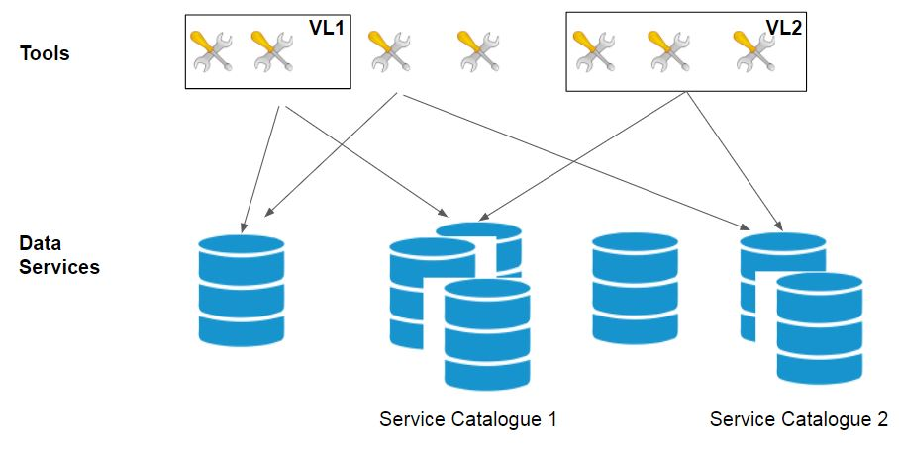
Interaction between Tools and Data Services

Slide 5
Interaction between Tools and Data Services
Data and Service metadata
Dataset Metadata
Service
Metadata
Service
Metadata
Service
Metadata
Service
Metadata

Slide 6
Data and related Services, schemas - Community Consultation
 | Metadata Schemas
Concepts | DCAT | OpenAPI | ISO19115-3 |  | OGC WebService
 | Service metadata | Service metadata | Data metadata | Service metadata | Service metadata at service API
Service URL | dcat:DataService - dcat:endpointURL | servers/url | mdb:MD_Metadata.mdb:distributionInfo.mrd:MD_Distribution.mrd:distributor.mrd:MD_Distributor.mrd:distributorTransferOptions.mrd:MD_DigitalTransferOptions.mrd:onLine.cit:CI_OnlineResource/cit:linkage | mdb:MD_Metadata.mdb:identificationInfo.srv:SV_ServiceIdentification.srv:containsOperations.srv:SV_OperationMetadata.srv:connectPoint | OperationsMetadata.DCP.HTTP
Service Type (function, protocol, version) | dcat:DataService - dct:conformsTo - dctt:type | openapi | mdb:MD_Metadata.mdb:distributionInfo.mrd:MD_Distribution.mrd:distributor.mrd:MD_Distributor.mrd:distributorTransferOptions.mrd:MD_DigitalTransferOptions.mrd:onLine.cit:CI_OnlineResource.cit:protocol | mdb:MD_Metadata.mdb:identificationInfo.srv:SV_ServiceIdentification.srv:serviceType | ServiceType ServiceTypeVersion
Service Title | dcat:DataService - dct:title | info.title | mdb:MD_Metadata.mdb:distributionInfo.mrd:MD_Distribution.mrd:distributor.mrd:MD_Distributor.mrd:distributorTransferOptions.mrd:MD_DigitalTransferOptions.mrd:onLine.cit:CI_OnlineResource.cit:name | mdb:MD_Metadata.mdb:identificationInfo.srv:SV_ServiceIdentification.mri:citation.cit:CI_Citation.cit:title | Title
Data and Data-Service Metadata Concepts and Schemas (google sheet)
Data and Data-Service Metadata Concepts and Schemas (google sheet)

Slide 7
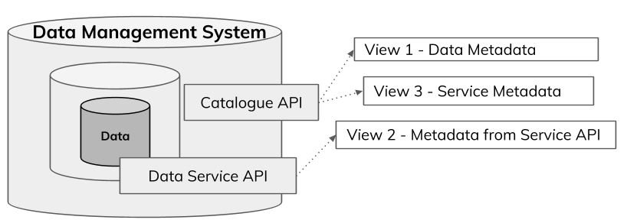
Interaction between Tools and Data Services
Data and Service metadata, in Views
Data and related Service, Metadata Views - Sourced and Generated (google slides)
Data and related Services - Metadata Views (google doc)

Slide 8
Data and related Services, Views
Concepts - for data-services and related data | View 1 Data metadata record | View 2 Service description available from service API | View 3 Service metadata record
Service URL
Service Type (function, protocol, version)
Service Title
Data Subject
Data and Data-Service Metadata Concepts and Schemas (google sheet)
Data and related Services - Metadata Views (google doc)

Slide 9
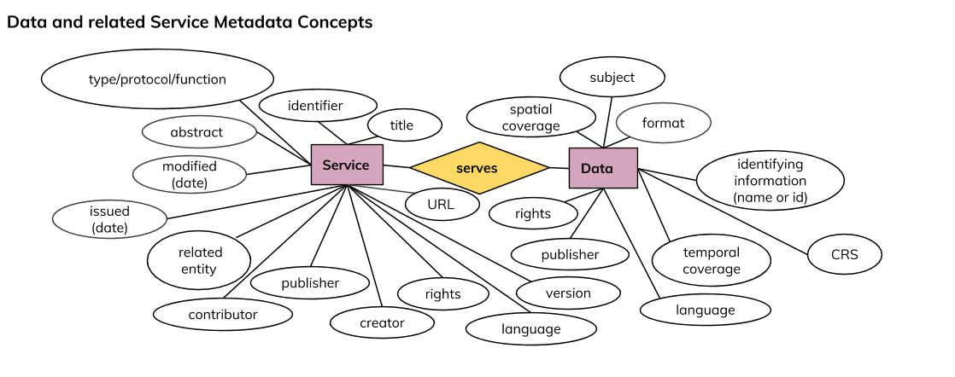
Data and related Services, concepts
Through an environmental scan of standards and conventions in use by data services harmonisation project members, a set of ‘Concepts - for Data and related Services’ have been identified as commonly populated within Data and Related Service, Metadata Views.
Data and related Service, Metadata Views - Sourced and Generated (google slides)
Data and related Services - Metadata Views (google doc)

Slide 10
Interaction between Tools and Data Services
Data and Service metadata, in Concepts

Slide 11
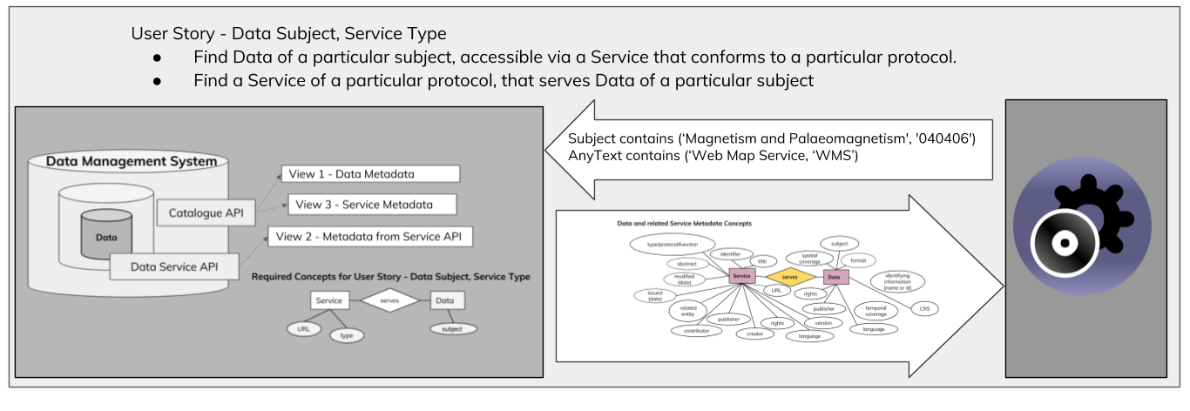
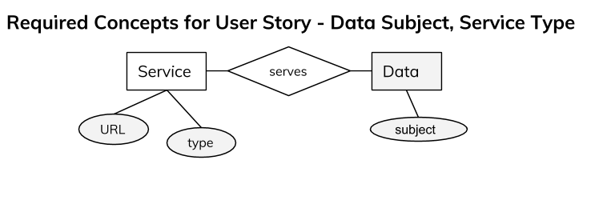
Which concepts, when and why
Finding Data and related Services in Metadata Registry (User Stories and required System Knowledge)

Slide 12
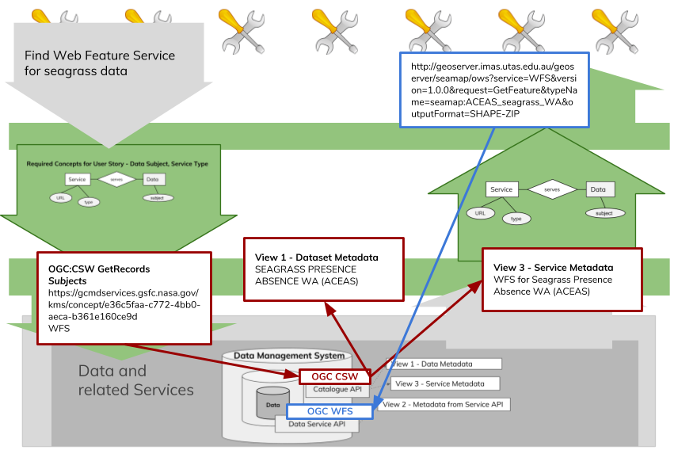
Use Case - Find Web Feature Service (WFS) for seagrass data

Slide 13
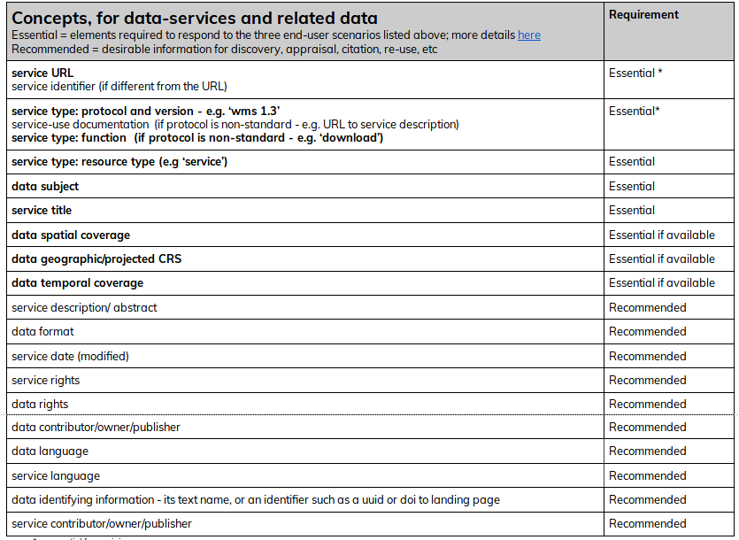
Information set for Data and related Services
ARDC Data and related Services - Discovery and Use (google doc)

Slide 14
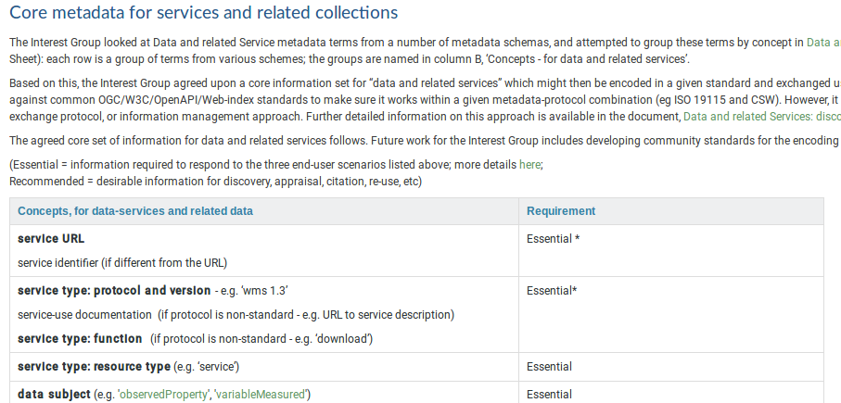
ARDC Good Practice Guide
ARDC - Metadata for Services and related Collections: Good Practice Guide (web page)

Slide 15
Research Data Australia

Slide 16
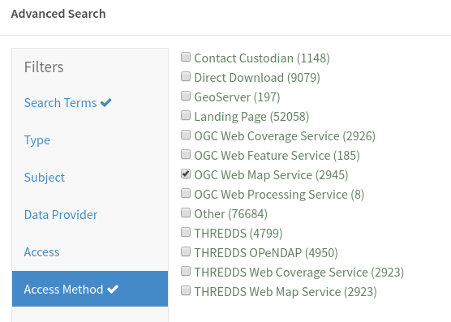
Finding data by service type ‘WMS’ in Research Data Australia

Slide 17
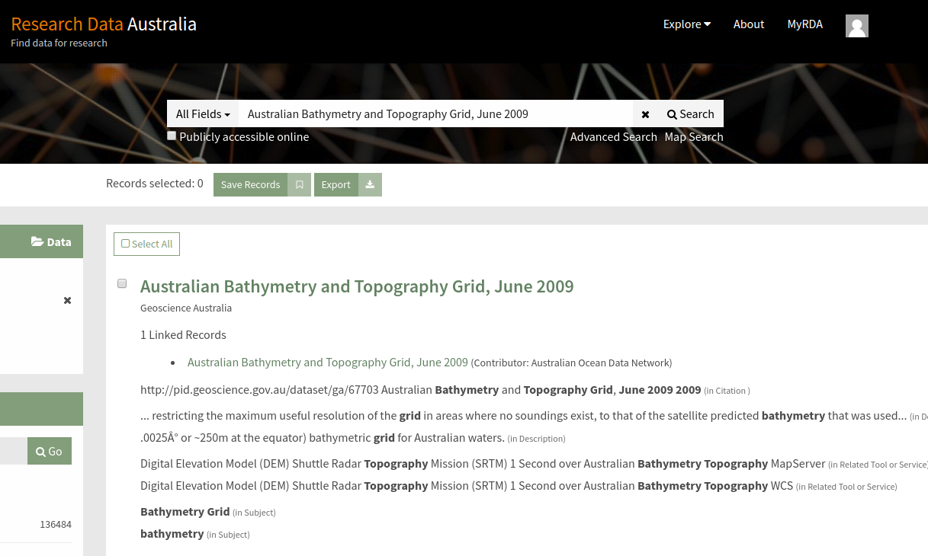
Dataset found after searching for data by service type ‘WMS’

Slide 18
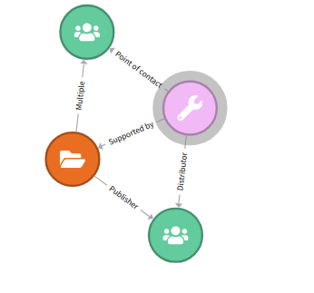
RDA page for dataset available over multiple service types

Slide 19
RDA page for Service of type ‘WMS’, related to Dataset

Slide 20
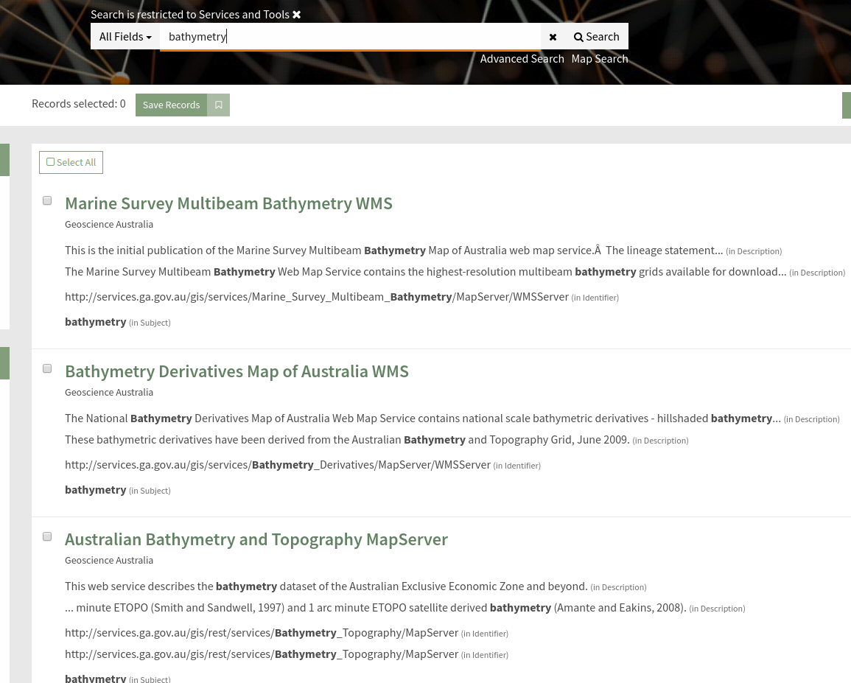
Finding data Services in Research Data Australia

Slide 21
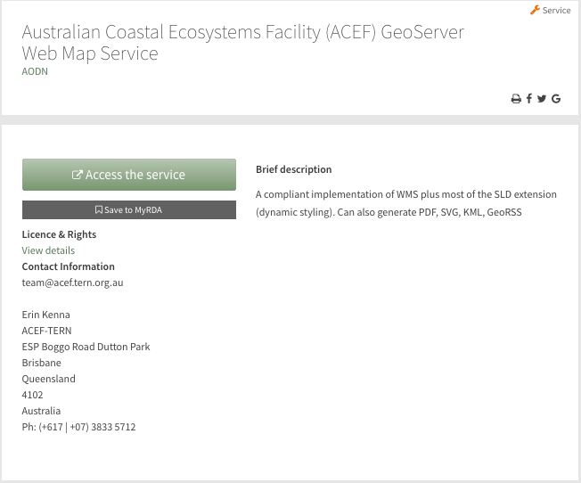
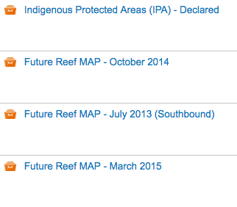
RDA automatic Service record creation and registration
Collection records
Discovered shared service URL
Generated service record
http://acef.tern.org.au/geoserver/wms
Description at Service URL
Title
GeoServer Web Map Service
Contact
Australian Coastal Ecosystems Facility (ACEF)
Abstract
“A compliant implementation of WMS plus most of the SLD extension (dynamic styling). Can also generate PDF, SVG, KML, GeoRSS”

Slide 22
RDA OGC CSW API
Subject contains (‘Earth Sciences', '04')
AnyText contains (‘Web Map Service, ‘WMS’)
OGC:CSW
GetRecords
Dataset Metadata
Earth Sciences
http://www..service.url/wms/to_dataset
Service Metadata
Earth Sciences
http://www..service.url/wms

Slide 23
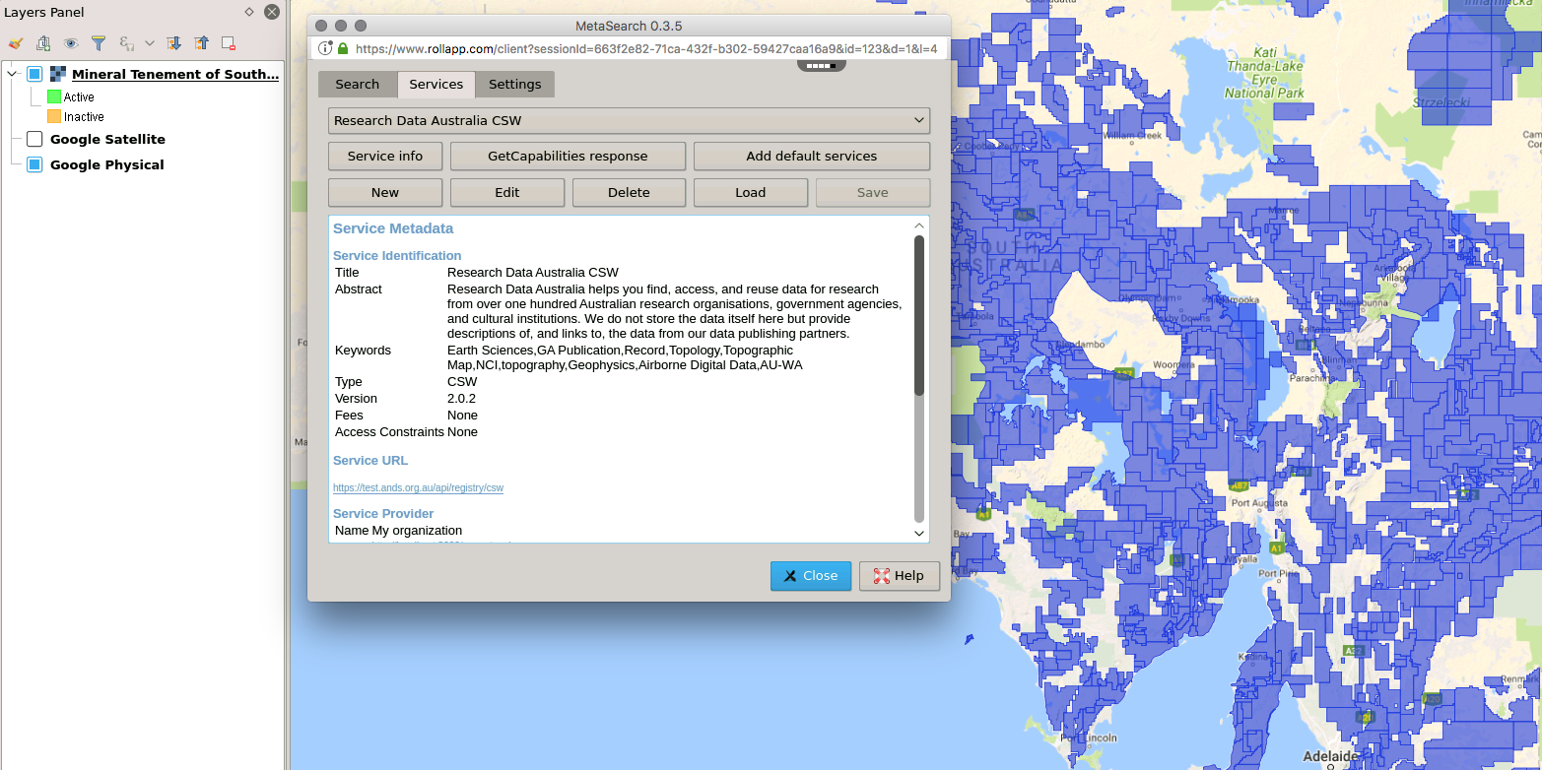
RDA OGC CSW API used in QGIS
Research Data Australia CSW service configured in QGIS

Slide 24
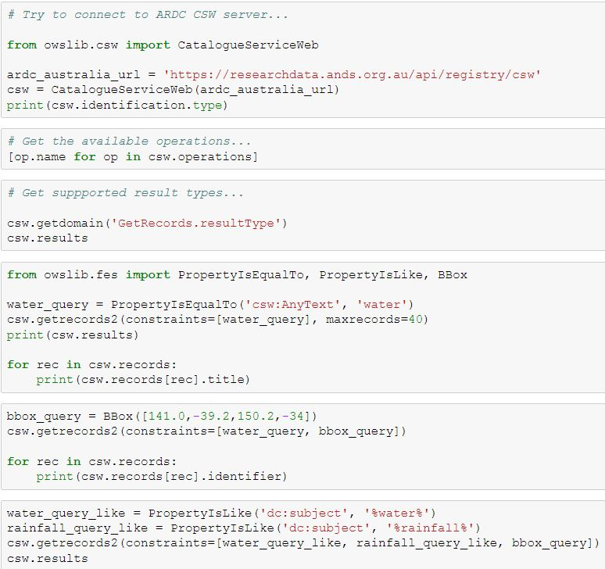
RDA OGC CSW API used in Jupyter Notebook
https://researchdata.ands.org.au/api/registry/csw

Slide 25
melanie.barlow@ardc.edu.au
Notes:
Harmonising Data Service Description - Current Practice

