Slide 1
Workshop 1:
Metadata for Data Dictionary
Irina Bastrakova
2 June 2022
ANZLIC/ICSM MDWG Meeting #10

Slide 2
Acknowledgments:
  Evert Bleys (ISO)
  Amelia Davies, Diana Crow, Shaun Copley and Briony Ankor (ABS)
For all your support, contributions and discussions
Thank you!!!

Slide 3
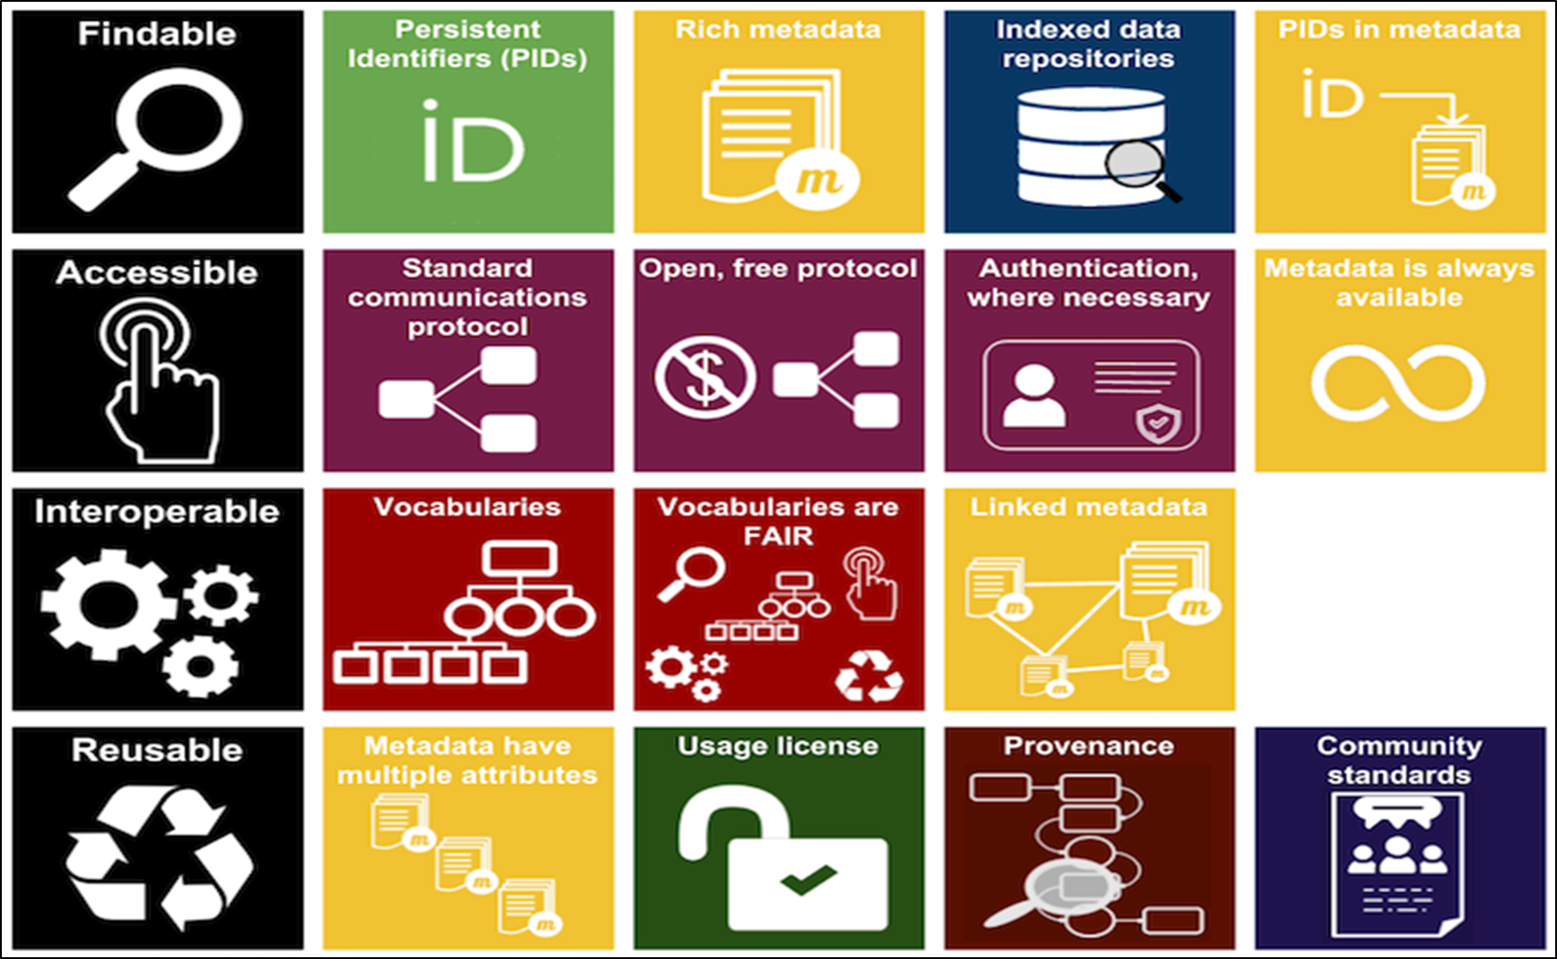
FAIR Implementation Principles
Framework based on standards, published in 2015
Cover data, vocabularies, services, …
Applicable to any domain or discipline
Focus on share to enable maximum reuse
Emphasise machine-actionability
Highlight importance of fit for purpose metadata
https://www.go-fair.org/fair-principles
Findable: (Meta)data - findable by humans and computers; globally unique persistent identifiers (PID) for metadata statements and described resource (e.g. dataset); searchable resource. Data have rich metadata.
Accessible: (Meta)data - retrievable by PIDs; use standardised communications protocol (universally implementable); allows authentication/authorisation. Metadata is accessible, even when the data is not.
Interoperable (Meta)data - use broadly applicable language for knowledge representation; use data dictionaries and vocabularies; (meta)data by using PIDs.
Reusable: (Meta)data - richly described and fit for purpose; known license and other constraints; detailed provenance; meet domain-relevant community standards.

Slide 4
Why data dictionary level metadata is important
Data Dictionary:
  a collection of names, definitions, and attributes about data elements that are being used or captured in a database or information system.
  A data dictionary is used to catalogue and communicate the structure and content of data, and provides meaningful descriptions for individually named data objects.
FAIR principles, especially for the “R” (Reusable) and “I” (Interoperable): improves understanding of a dataset structure, meaning of its elements
Facilitates machine actionability: significant efficiency gain for data finding and analysis
Improved searchability: finding datasets by a search on a specific parameter or data element

Slide 5
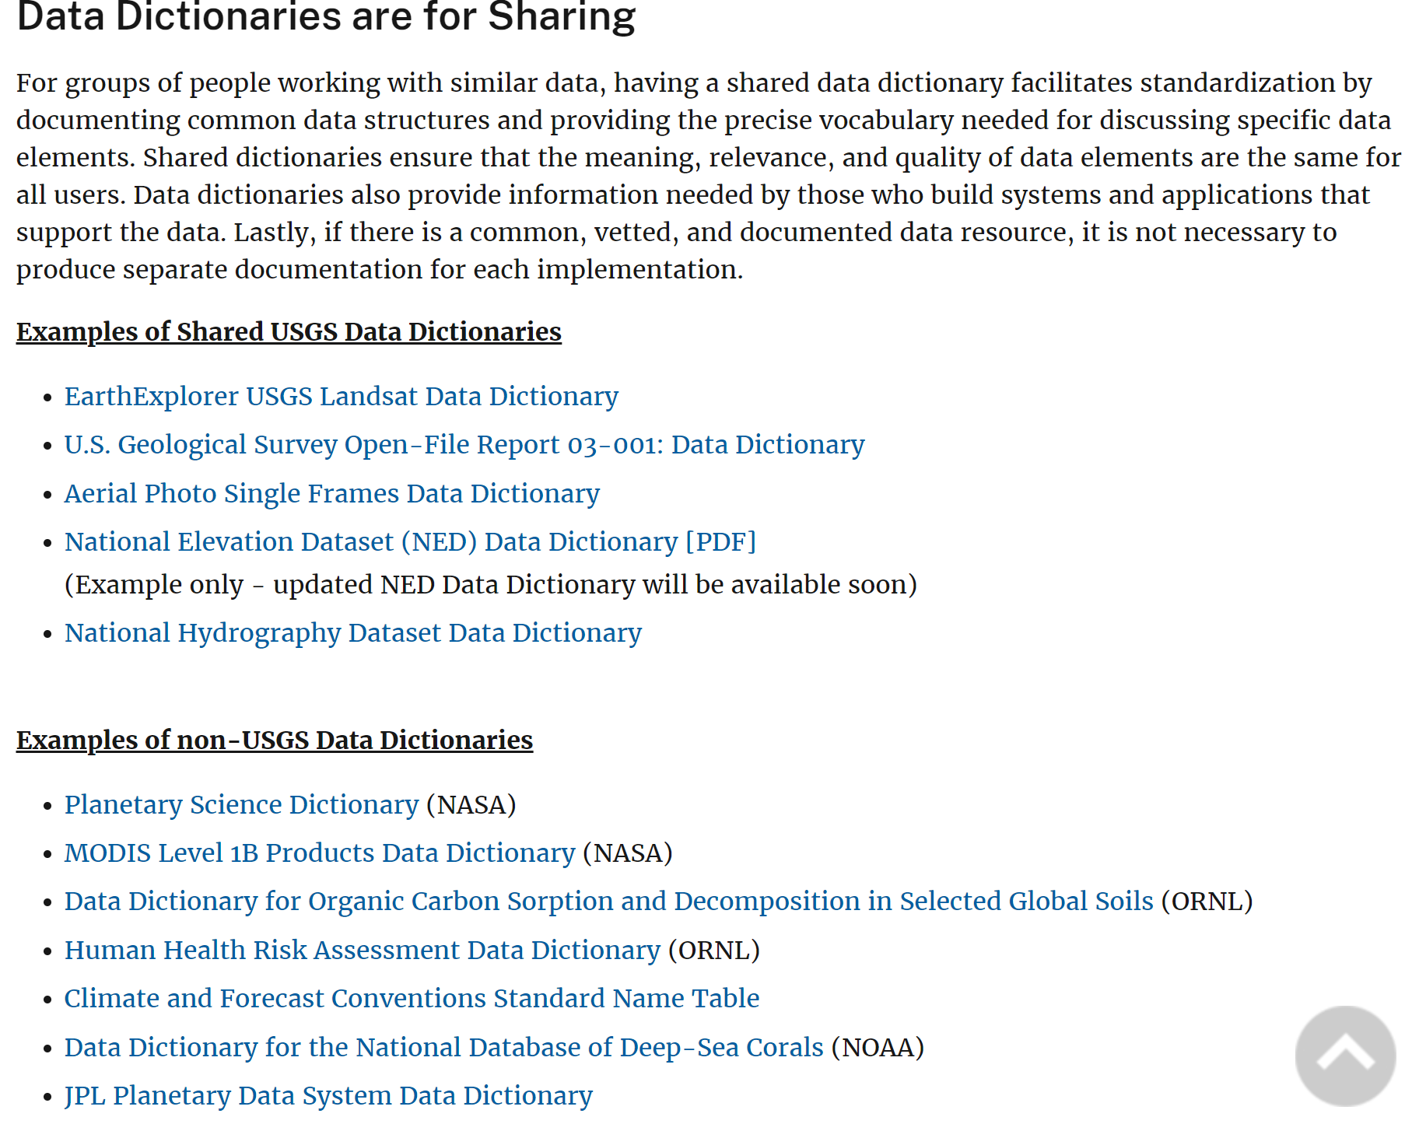
Metadata for Data Dictionary implementation examples
None for the ISO 19115-1
  (current metadata standard)
☹
But
USGS implemented metadata for data dictionaries for the ISO 19115 (superseded standard) (https://www.usgs.gov/data-management/data-dictionaries)

Slide 6
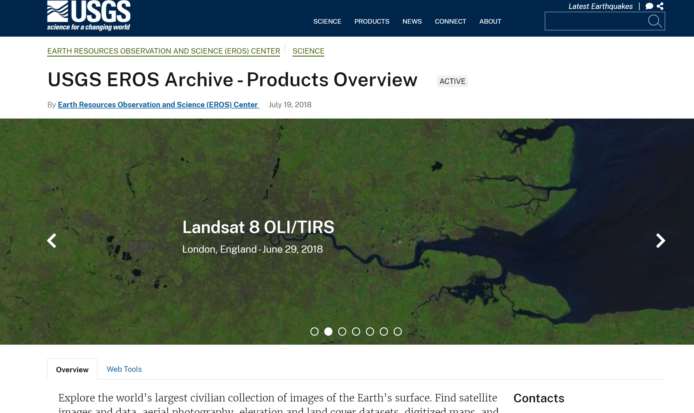
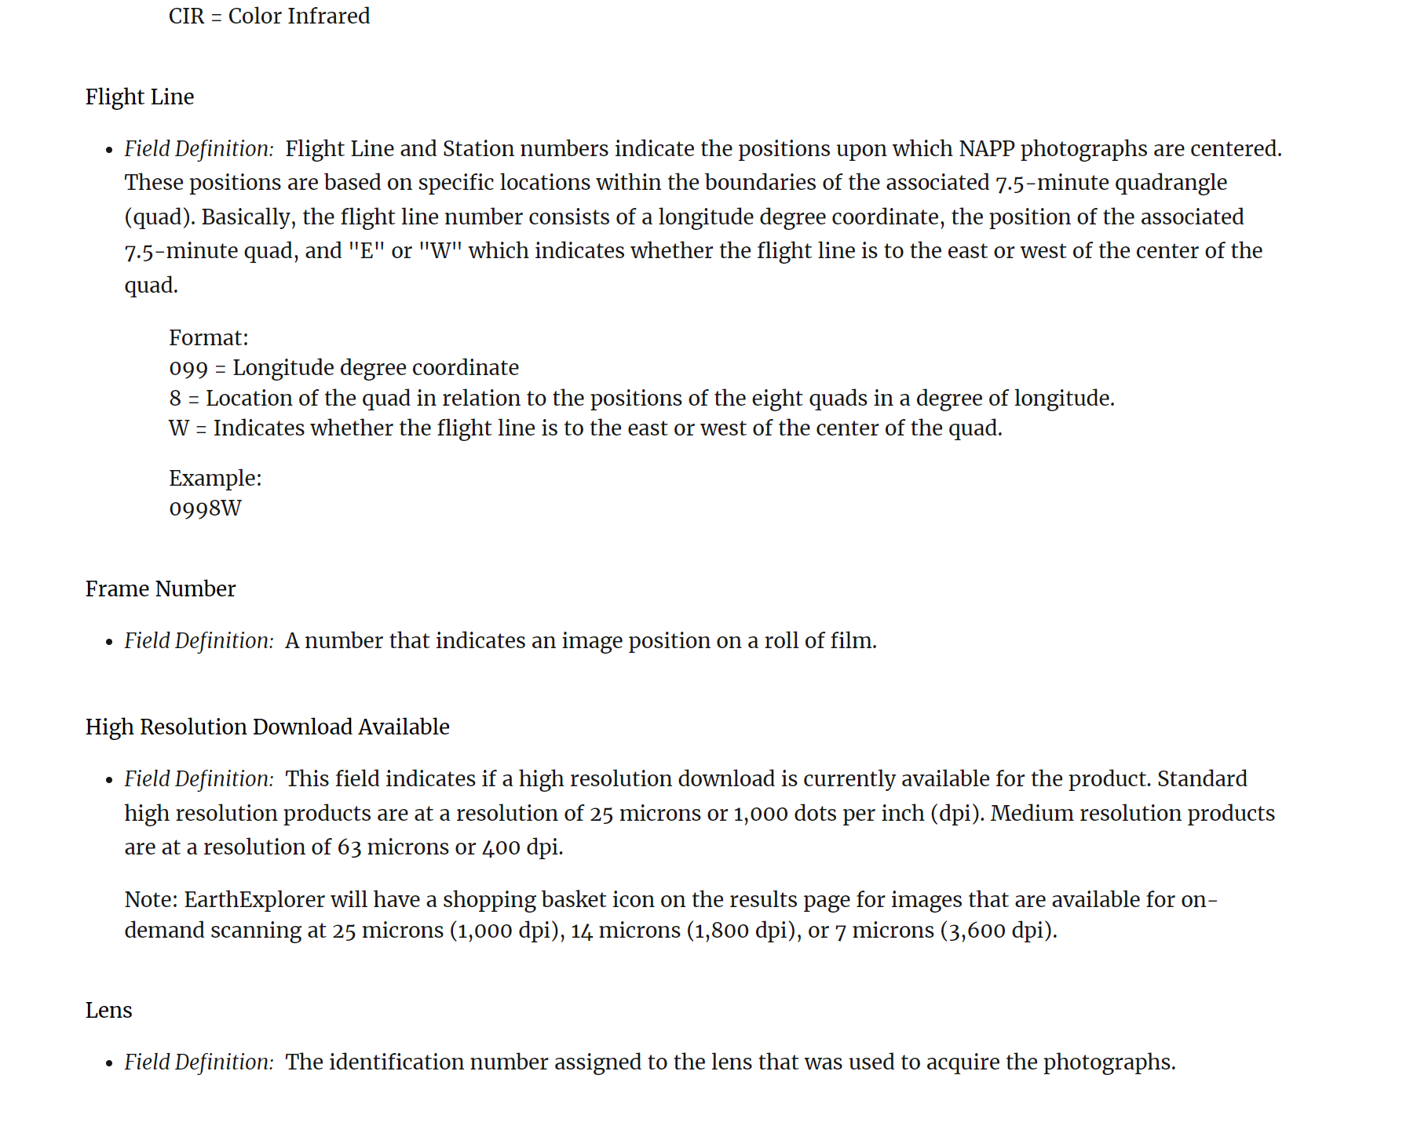
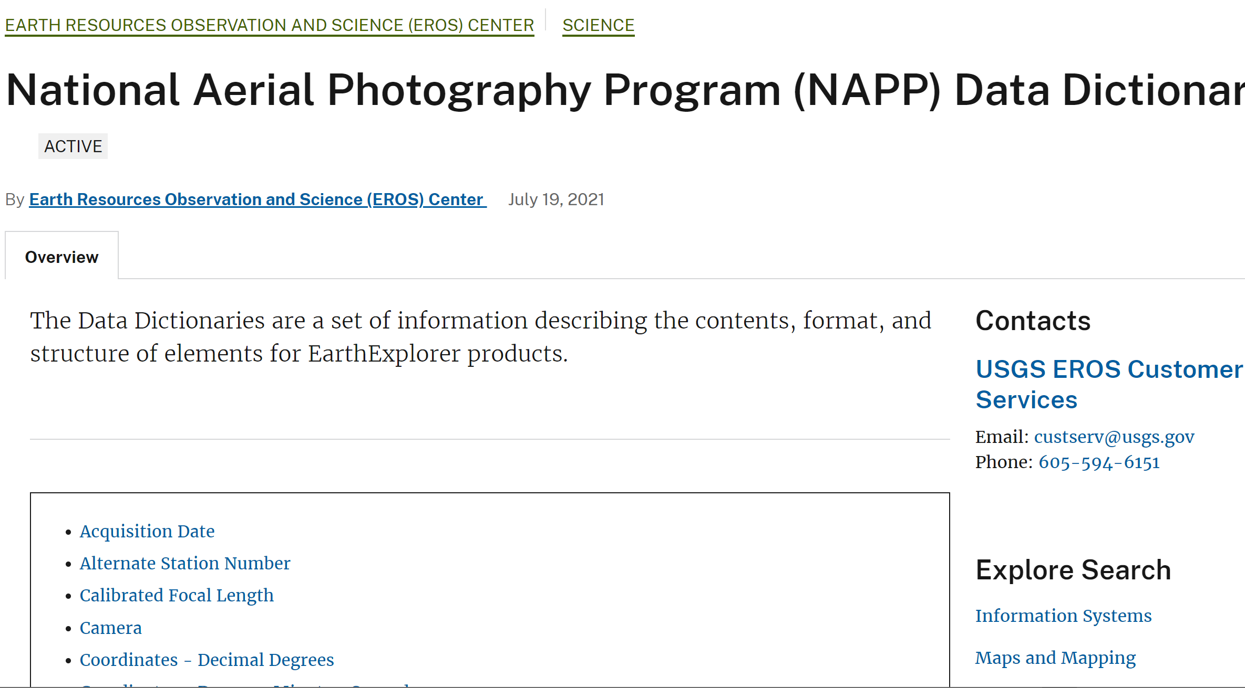
USGS example- Aerial Photography Archive
https://www.usgs.gov/centers/eros/science/usgs-eros-archive-products-overview

Slide 7
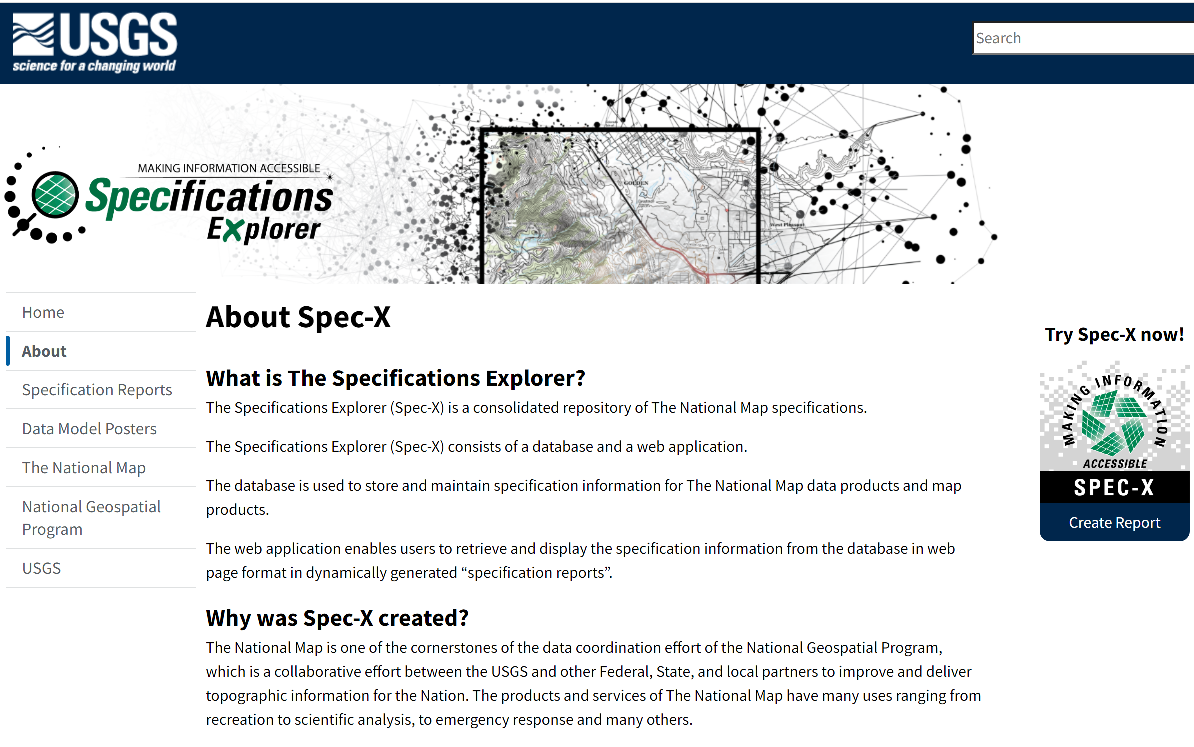
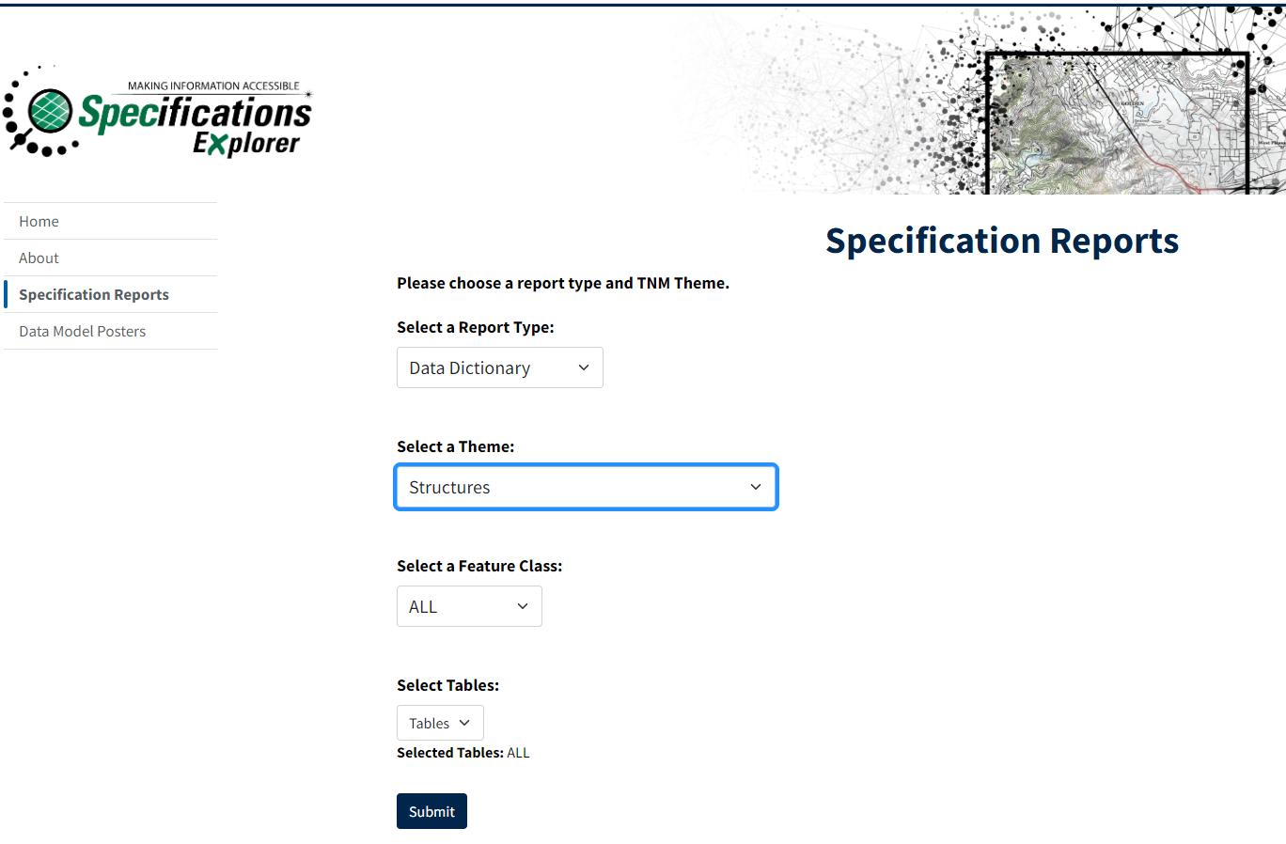
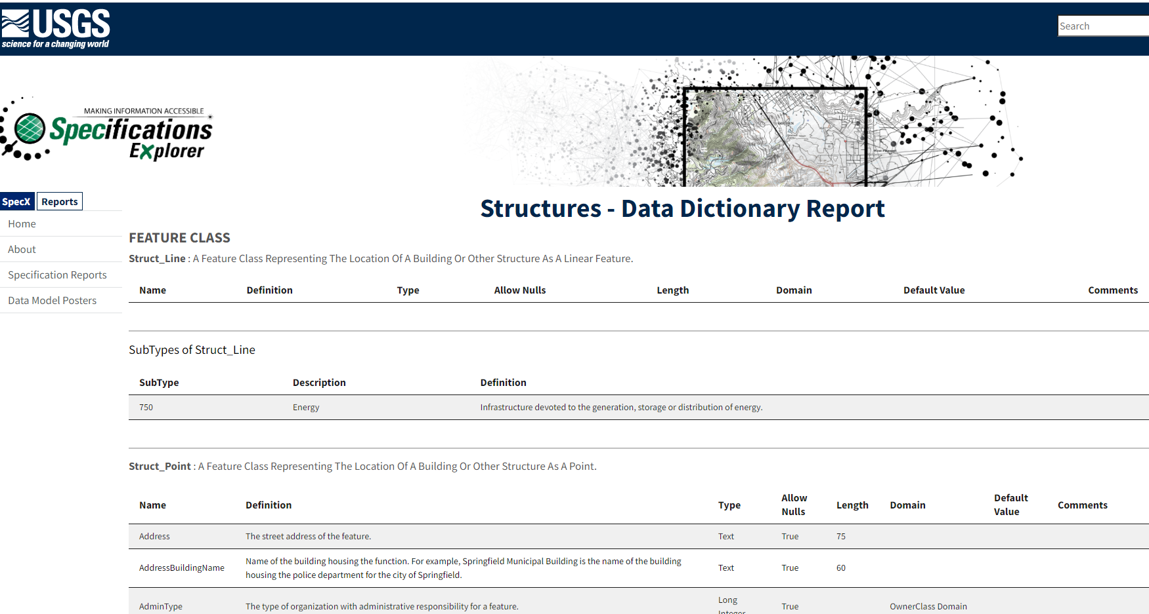
USGS example- Aerial Photography Archive
https://specx.nationalmap.gov/reports/DD/?report_type=2&theme=5248&feature_class=all&table=All

Slide 8
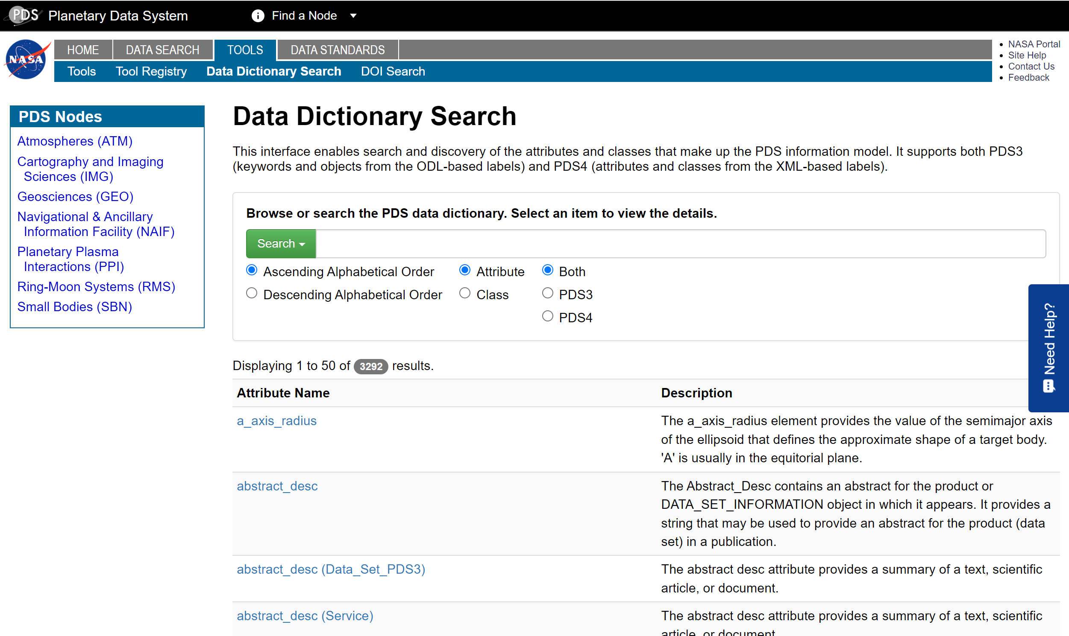
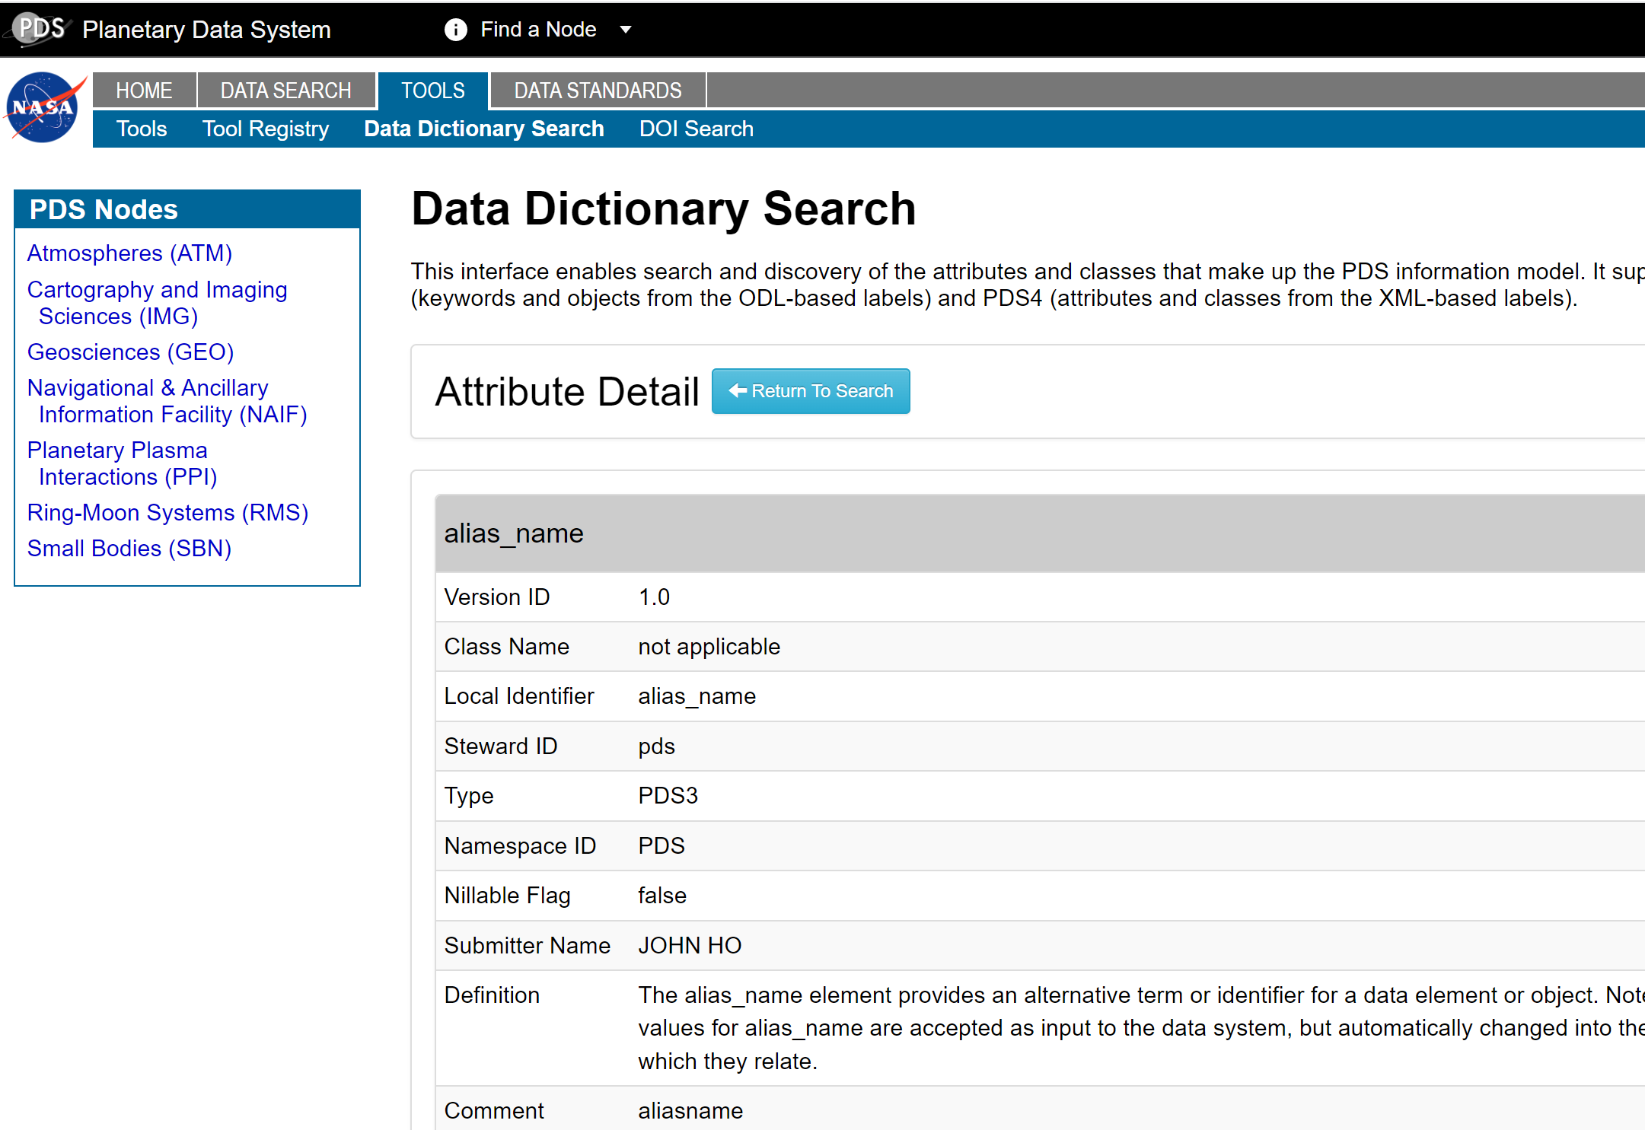
NASA Example - Planetary Science Dictionary
https://pds.nasa.gov/tools/dd-search/

Slide 9
Focus of this workshop
Data dictionary components
Data dictionary descriptions
Defining a data dictionary through the ISO 19115-1 and ISO 19110
XML example for a simple data dictionary
- Work in Progress -

Slide 10
Data Dictionary components
Data Dictionary
  Tables
    Fields/Attributes (columns within tables)
      Codelists (values which constraint some attributes, e.g. codelist of colours)
Definition of relationships between data dictionary components is not part of this workshop

Slide 11
Metadata elements: Data Dictionary
Data Dictionary Metadata | Cardinality | Definition | Example
Identifier | O | Unique Persistent Identifier | e.g. DOI: https://doi.org/10.1038/sdata.2018.89
Name | M | Name of a data dictionary | e.g. Data Dictionary for Transport dataset
Description | M | Description of the data dictionary | e.g. This Data Dictionary records a structure of the Transport dataset, defining a network of means for moving people, goods and freight, and other services from one location to another.
Provider | M | Party that accepts accountability and responsibility for the resource and ensures appropriate care and maintenance of the resource | e.g. ICSM Permanent Committee for Topographic Information

Slide 12
Metadata elements: Table
Table Metadata | Cardinality | Definition | Example (FSDF)
Name (label) | M | Name of a table (feature class) | e.g. Roads
Description | M | Description of the table | e.g. This table consists of an Australia-wide road data. Roads are described as paths for the transfer of goods or movement of vehicles and people that do not have fixed tracks for vehicular movement like a railway.
Provider | O | Party that provided data for that table | e.g. Geoscape Australia

Slide 13
Metadata elements: Field/Attribute
Field Metadata | Cardinality | Definition | Example (FSDF)
Name (label) | M | Name of a field/attribute | Le.g. ength
Alias | O | Alternative name of a field/attribute | e.g. Tot-Lngth
Description | M | Description of a field/attribute | e.g. Total length of the road
Provider | O | Party that provided data for that field/attribute | e.g. Geoscape Australlia
Type | O | Type of a field/attribute value such as integer, float, double, date, text, objectID, etc. | e.g. integer
Width | O | Max width or number of characters of a field/attribute value | e.g. 100
Precision | O | Numerical field/attribute length | e.g. 10
Scale | O | Number of decimal places | e.g. 2

Slide 14
Metadata elements: Codelist
Codelist: Road Types
Codelist metadata | Cardinality | Definition | Example (FSDF)
Name (label) | M | Label of a codelist member | e.g. Highway
Code | O | Code of a codelist member | e.g. HWY
Description | M | Description of a codelist member | e.g. A main road, especially one connecting major towns or cities

Slide 15
Describing data dictionary through ISO Standards
Many standards:
ISO 19115-1:2014 - Geographic information — Metadata — Part 1: Fundamentals
ISO 19110:2016 - Geographic information — Methodology for feature cataloguing
ISO/IEC 11179-3:2013 - Information technology — Metadata registries (MDR) — Part 3: Registry metamodel and basic attributes
    might be used in situations where a complete metadata registry is not appropriate
This workshop will focus on describing data dictionary through ISO standards created for Geographic Information

Slide 16
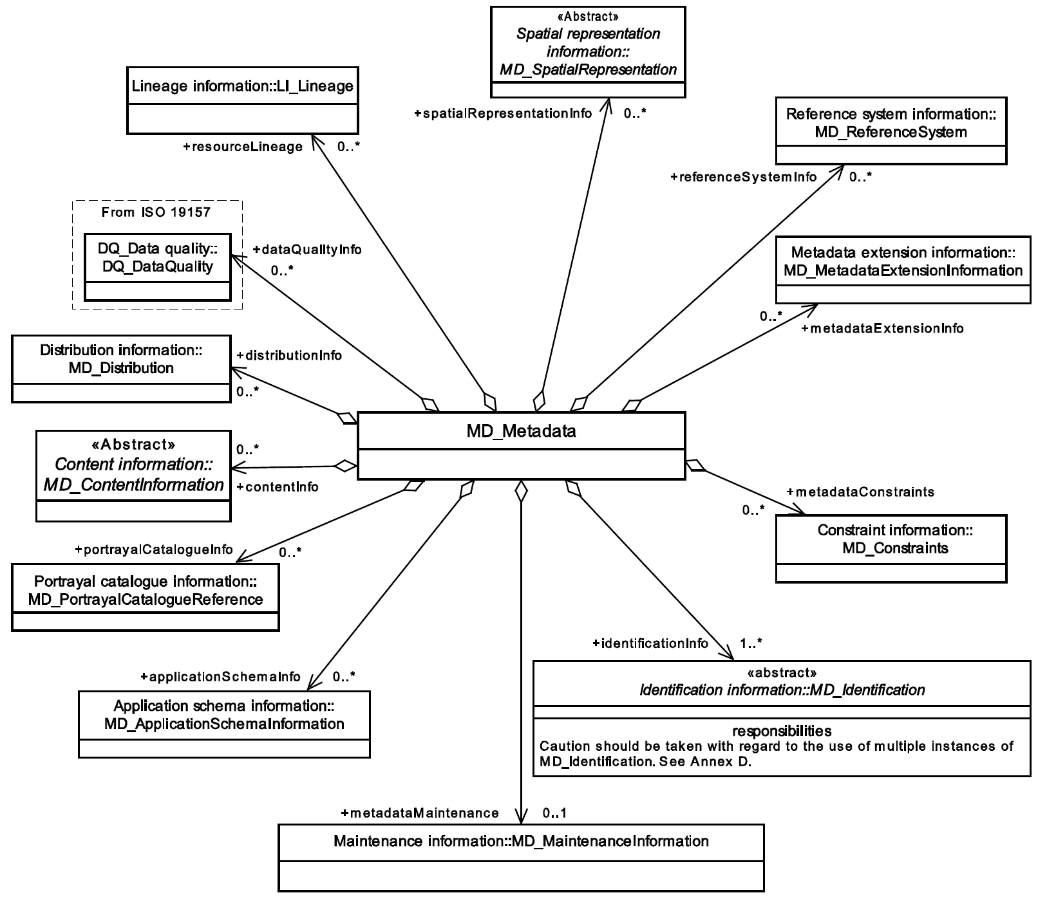
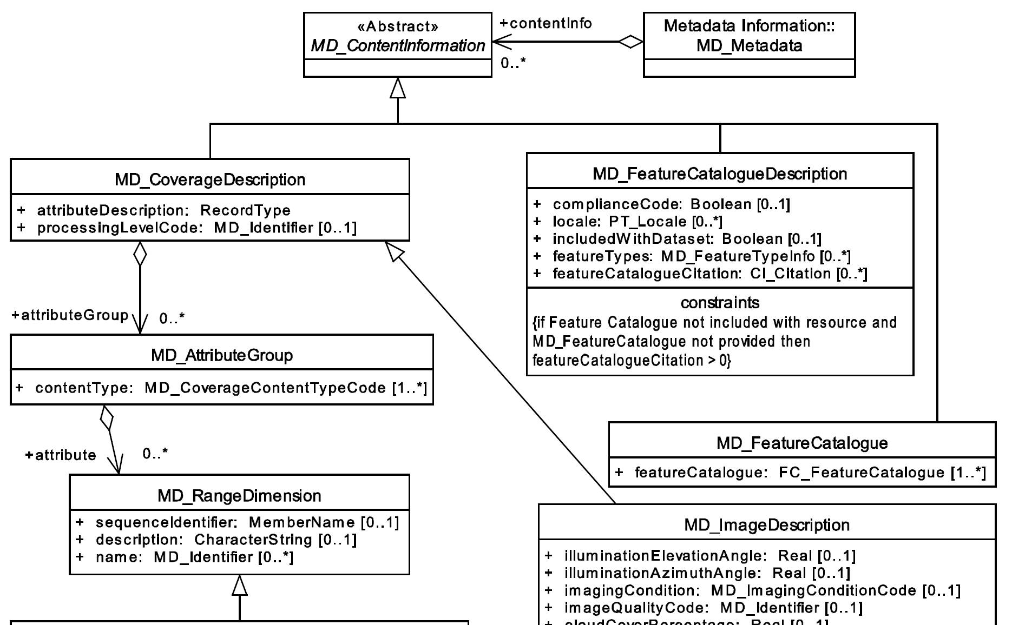
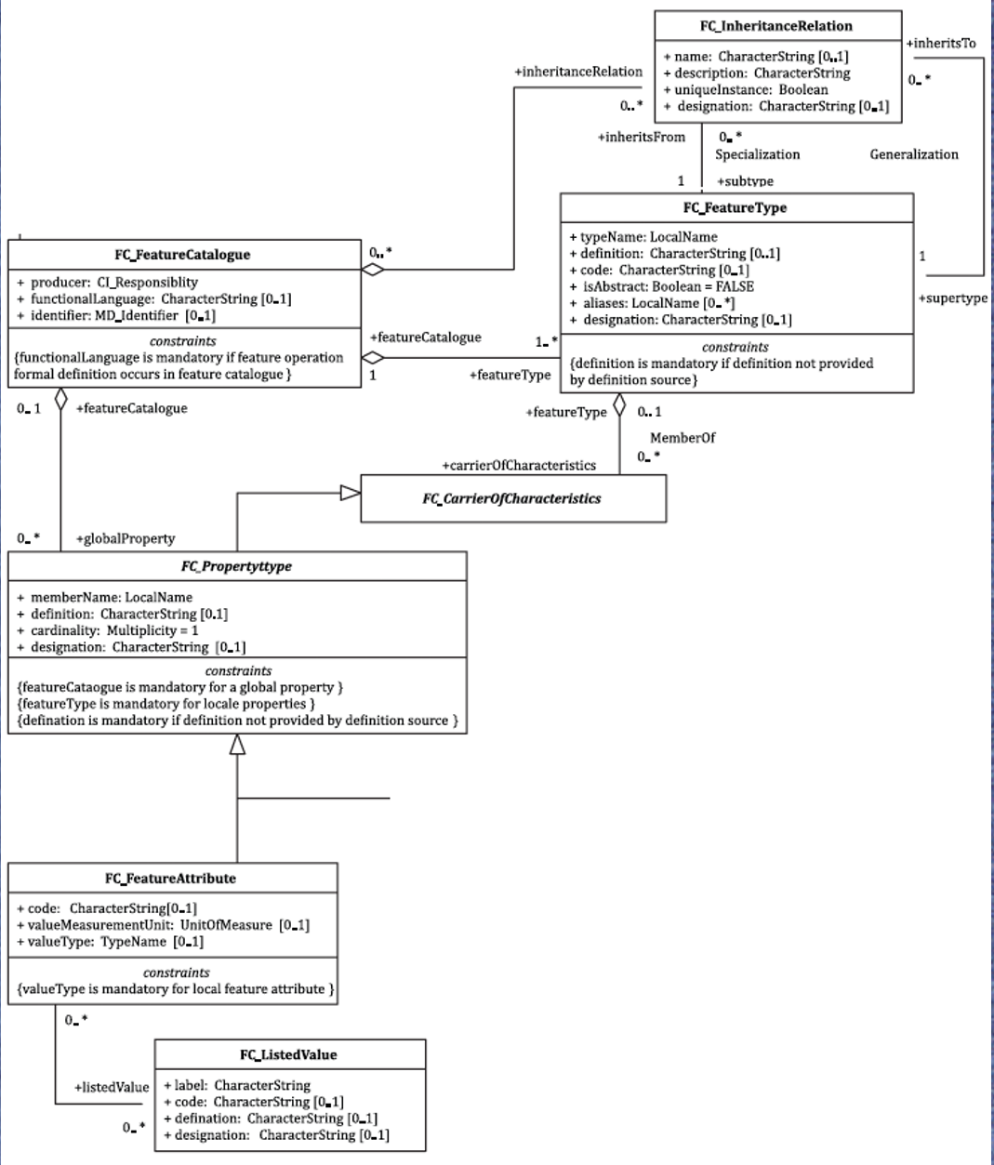
The ISO Standards to define metadata
ISO 19115-1:2014 ISO 19110:2016
General dataset metadata: title,
description, geographic and temporal
extents, lineage, etc.
Data dictionary
components

Slide 17
Crosswalk from requirements to the ISO 19110 (draft)
Data Dictionary
Table
Field/Attribute
Codelist

Slide 18
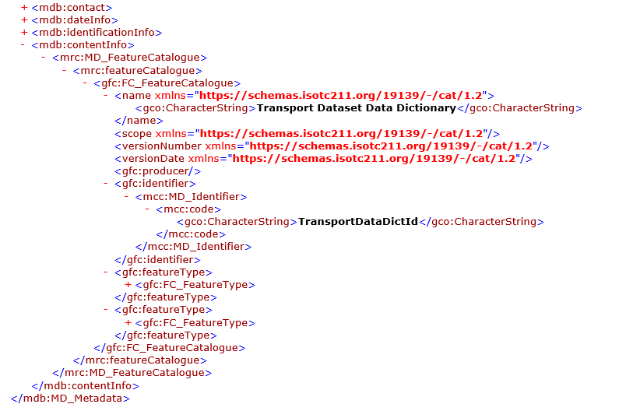
XML implementation example (Draft)
Metadata for Transport Data Dictionary

Slide 19
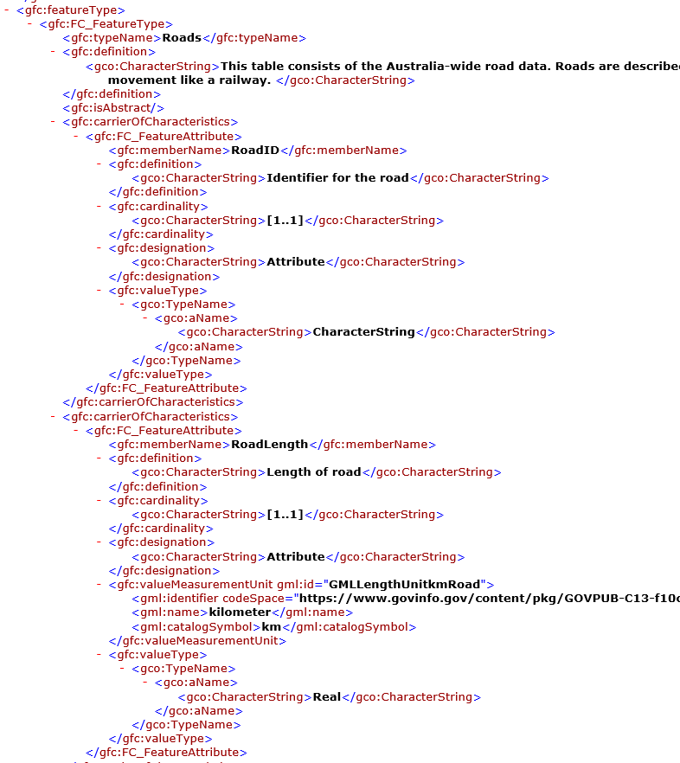
XML implementation example (Draft)
Metadata for Roads, including descriptions for two fields (RoadId and RoadLength)

Slide 20
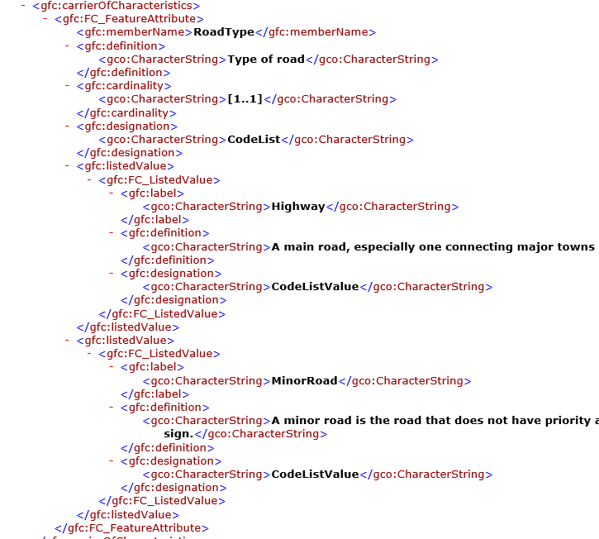
XML implementation example (Draft)
Metadata for a Road Type field, including codelist values

Slide 21
Next steps
Your feedback is important! Please share your thoughts with us via email:
  ANZ_MDWG@ga.gov.au
Finalise the XML example for data dictionary
Publish the XML example (ICSM website)
Create a new template Geonetwork to enable data dictionary recording
Add the ‘Data Dictionary’ template to the ANZMet Lite v2 toolkit
Work with Esri on Esri Metadata Roadmap to improve compliance with the ISO 19115-1 (and DCAT2), and to include metadata for Data Dictionary into the metadata workflow

Slide 22

Questions?
Comments?
Feedback?

