Slide 1
Workshop 1: Community requirements for Metadata for Imagery
Irina Bastrakova
ANZLIC/ICSM Metadata Working Group Meeting No 5, Canberra
28-29 October 2019

Slide 2
ISO 19115-2:2019 - Extensions for acquisition & processing
Published in January 2019
Focuses on metadata for imagery and gridded data
Extended to include:
Metadata for the entire process chain from acquisition to processing and production
Geographic information from all sources (e.g. remote sensing data, scanned maps, field data collection)
Metadata for the geometry of the measuring process and the properties of the measuring equipment to support the production process
Properties of measuring systems, numerical methods and computational procedures used to derive geographic information from the data acquired by them
Issues with the new version
Type errors (wrong namespaces, names and references)
Integration of ISO 19115-3 with the yet to be generated XML for the updated ISO 19115-2
ISO 19115-3 does not use date as specified in ISO 19103.

Slide 3
Stakeholder Groups in ICSM
FSDF: Imagery, Elevation and Depth Themes in particular
Enhanced Location Value Infrastructures (ELVIS) Steering Committee:
Request to advise on best practice metadata for managing Elevation (LiDAR) products and to prepare some education on how to use and manage
ANZLIC MDWG members
Others

Slide 4
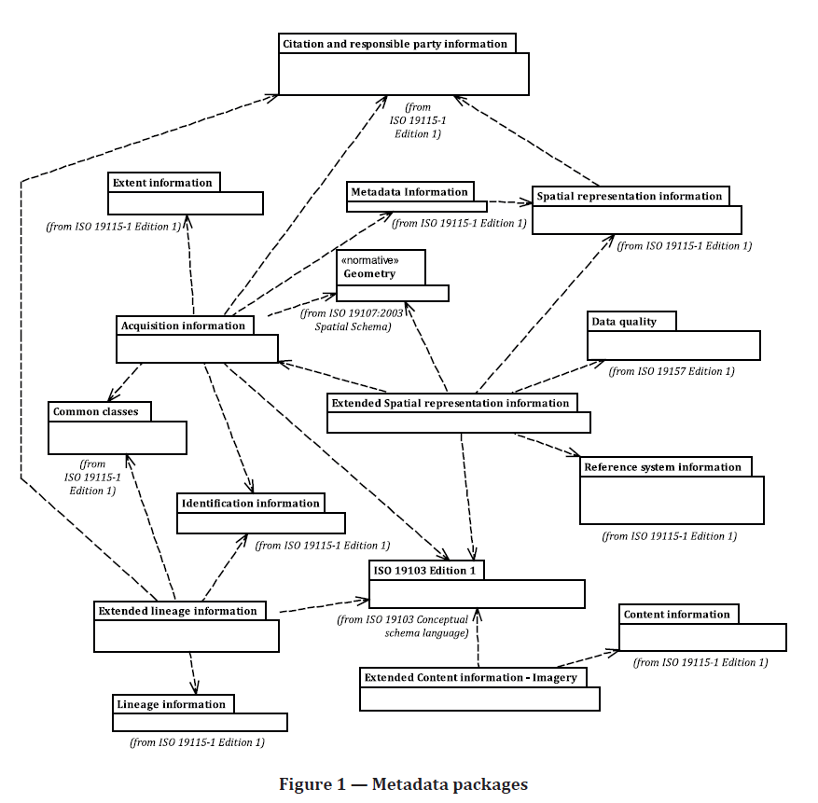
ISO 19115-2:2019
Reuse of many classes from the ISO 19115-1, ISO 19157 and other ISO standards
Extension on acquisition information, sensors and methods
Extended content information

Slide 5
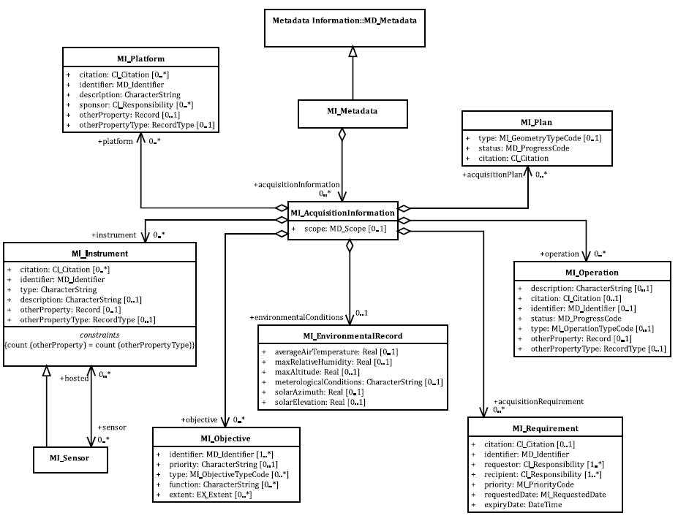
ISO 19115-2:2019 – Structure and Summary of Classes

Slide 6
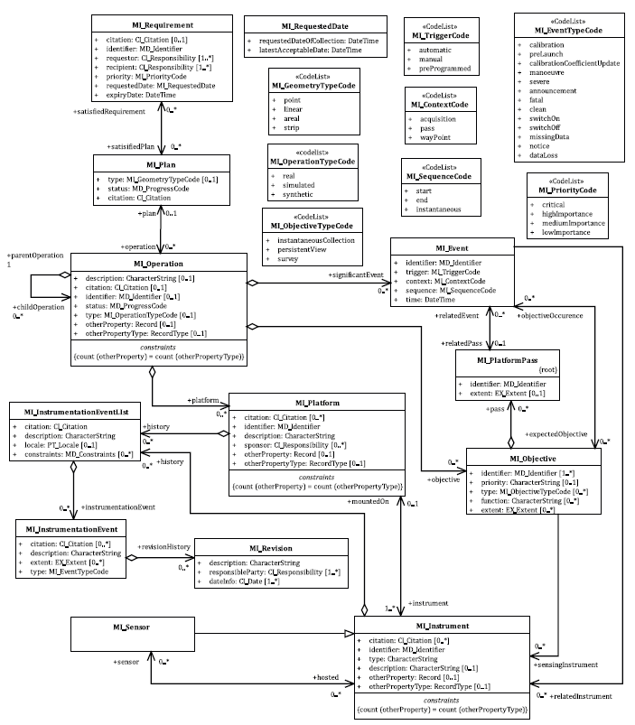
Acquisition details

Slide 7
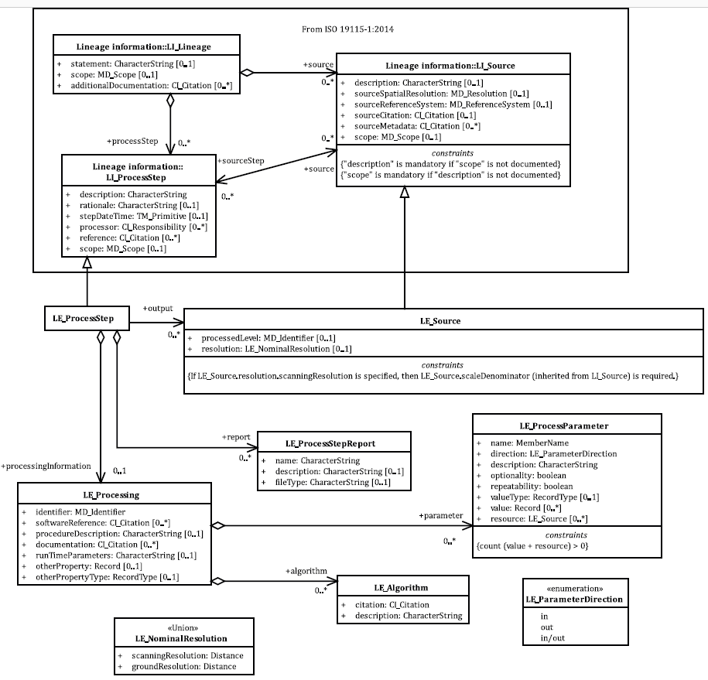
Extended Lineage Information
Supports the provision of additional information about:
Sources and
Production processes used in producing geospatial data

Slide 8
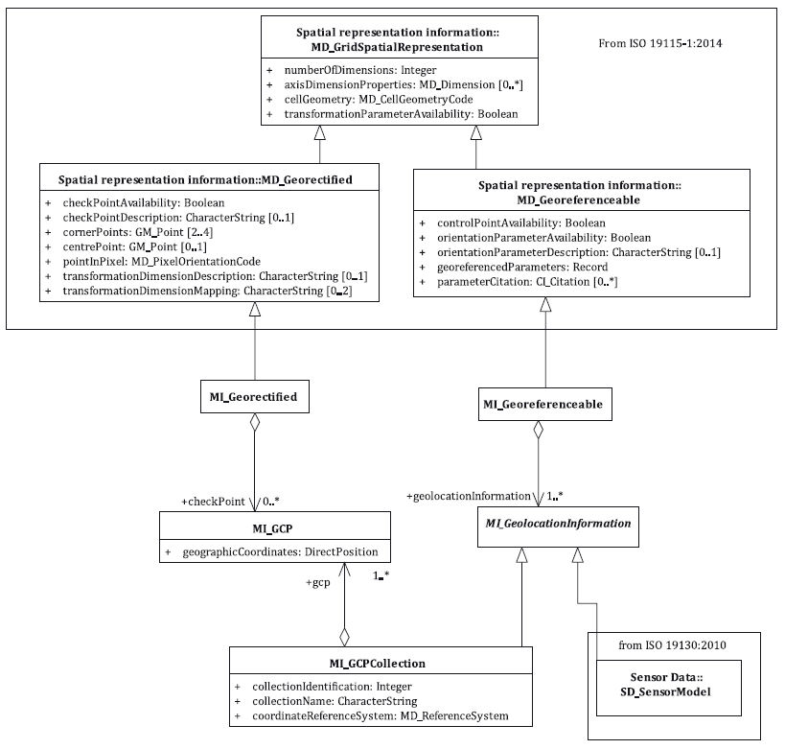
Extended Spatial Representation Information — Geolocation Information

Slide 9
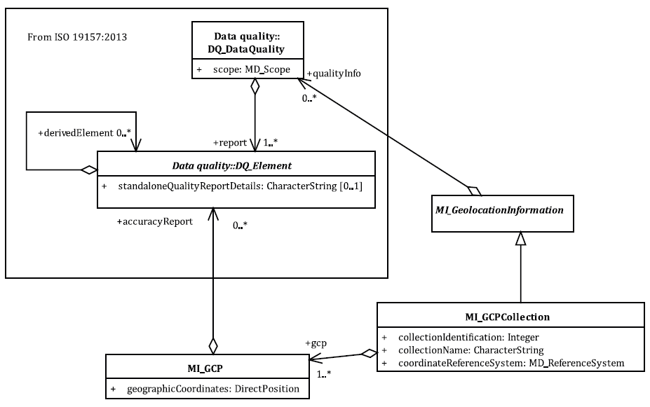
Ground Control Point Quality

Slide 10
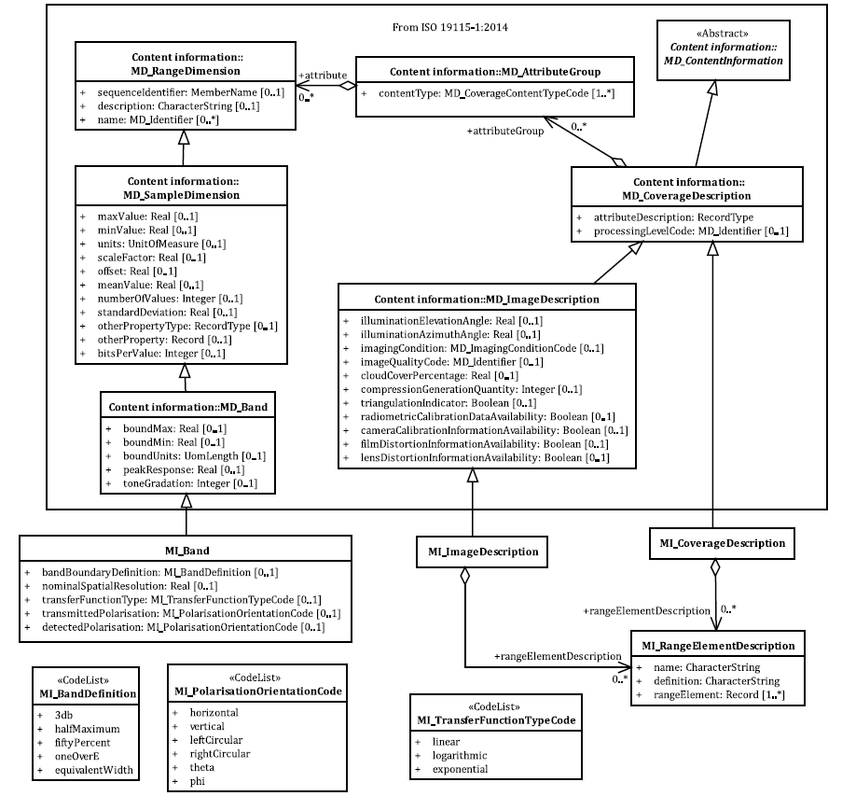
Extended Content Information — Imagery
Extended attribution and contend description of a coverage dataset

