Slide 1
ANZ Metadata WG
LINZ Metadata Evolution
Jeremy Palmer - Chief Technical Leader

Slide 2
Geospatial Metadata
What is metadata?
Metadata is data information that provides information about other data. Contains these types:
Descriptive - Describes a resource for purposes such as discovery and identification. E.g title, abstract, author, purpose and keywords.
Structural – Defines the metadata elements for components within the data. E.g table/layer, column/attribute or row/feature definitions
Administrative - metadata provides information to help manage a resource, and other system information such as date created, spatial extents of data
Reference - metadata describes the external definitions (such as accuracy or classifications) or relationships with other data
CC BY: rdrcollection @ flickr.com

Slide 3
Geospatial Metadata
Why
Helps customers to understand the details of the data, timeliness, accuracy and lineage to drive decisions re-use of the data on https://data.linz.govt.nz:
  Provides discoverability/searchability
  Is it fit for intended purpose
  Drives correct use of dataset
  Reduce customer calls
  Can be used to drive automated workflows
BOTH Externally (LINZ Data Service) and Internally (Data Lake)
CC BY: rdrcollection @ flickr.com

Slide 4
Geospatial Metadata
Drivers for change
Poor search experience on the LDS.
Internal dataset management and software/system improvements to support this. Coastal mapping (LIDAR, joining land and sea Vertical Datums), National Elevation Programme (LIDAR), Depth (Bathymetry)
Improving internal data management i.e. Data Lake/Warehouse. Simplifying around core requirements and getting better tooling for management
Cloud based data storage and access e.g AWS S3, Cloud Optimised Geotiffs (COGs)
Improved workflow automation for processing chains and consumption/reuse (industry interoperability needed here)
CC BY: rdrcollection @ flickr.com

Slide 5
Geospatial Metadata
Current State (LINZ)
Metadata is created via multiple methods:
  ISO 19115/19139:2003 (ANZLIC Profile) using XML files and editor
  PDF data dictionaries from word docs or scripts
  HTML data dictionaries
CC BY: rdrcollection @ flickr.com

Slide 6
Geospatial Metadata
Current State (LINZ)…
Metadata is presented per dataset by:
LDS as ISO XML, General webpage, Dublin core (derived from ISO XML)
PDF website downloads
Catalog Web Service API (CSW) for ISO XML
Topo Data Dictionary
HTML website for Data dictionaries (readthedocs)
CC BY: rdrcollection @ flickr.com

Slide 7
Geospatial Metadata
Current State (LINZ)…
Metadata is used for discovery:
ISO metadata import into LDS drives search index, google index tags
LDS provide metadata catalogue for data.govt.nz (only drives < 1% of traffic to our data) to scrape using DCAT feed https://data.linz.govt.nz/services/dcat/data.json.
CC BY: rdrcollection @ flickr.com

Slide 8
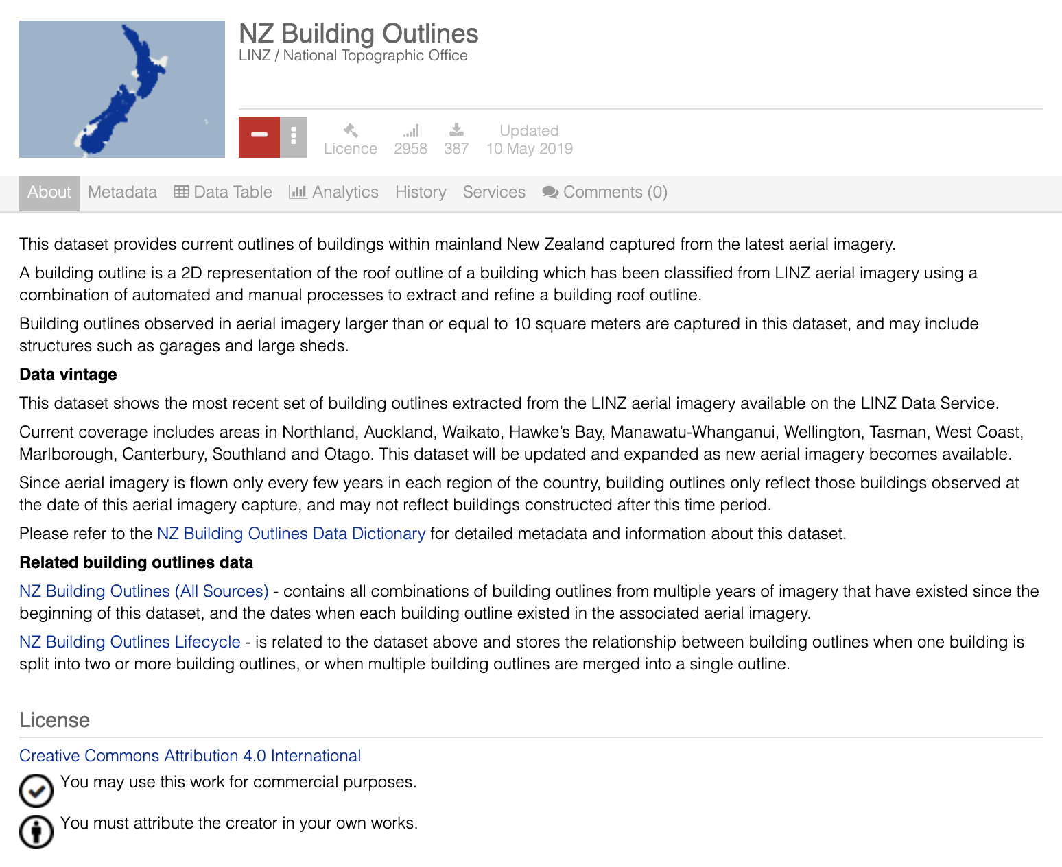
User Metadata

Slide 9
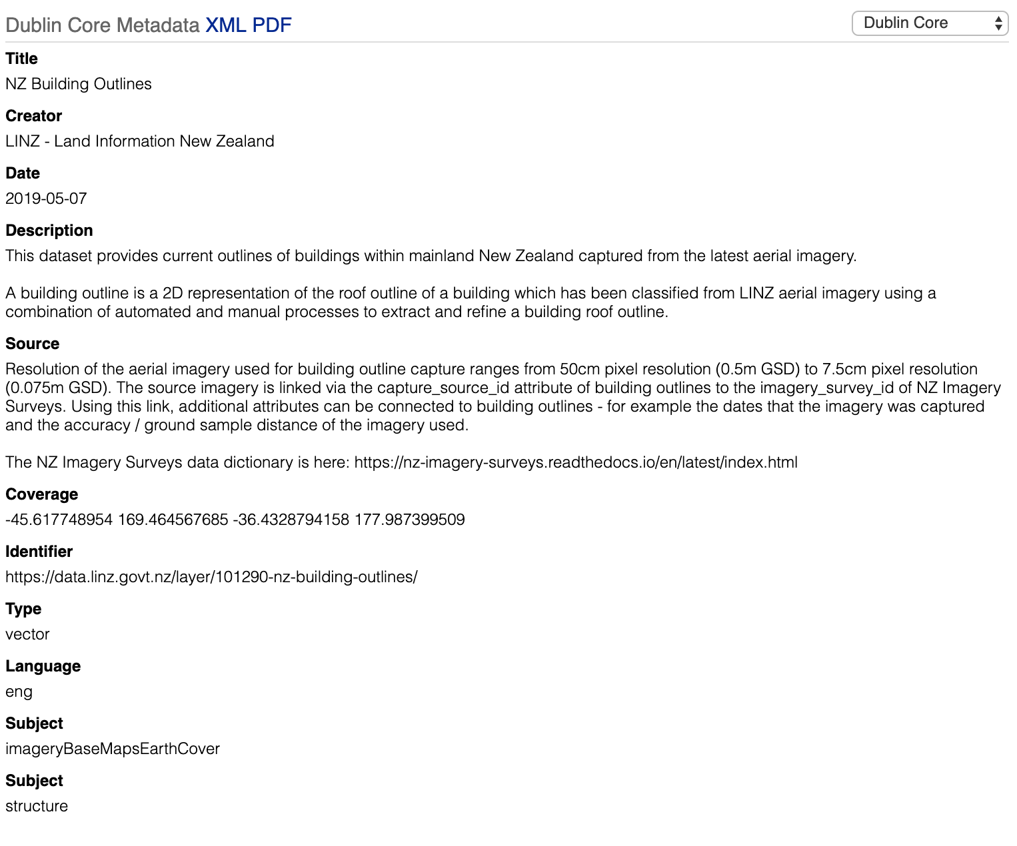
Dublin Core

Slide 10
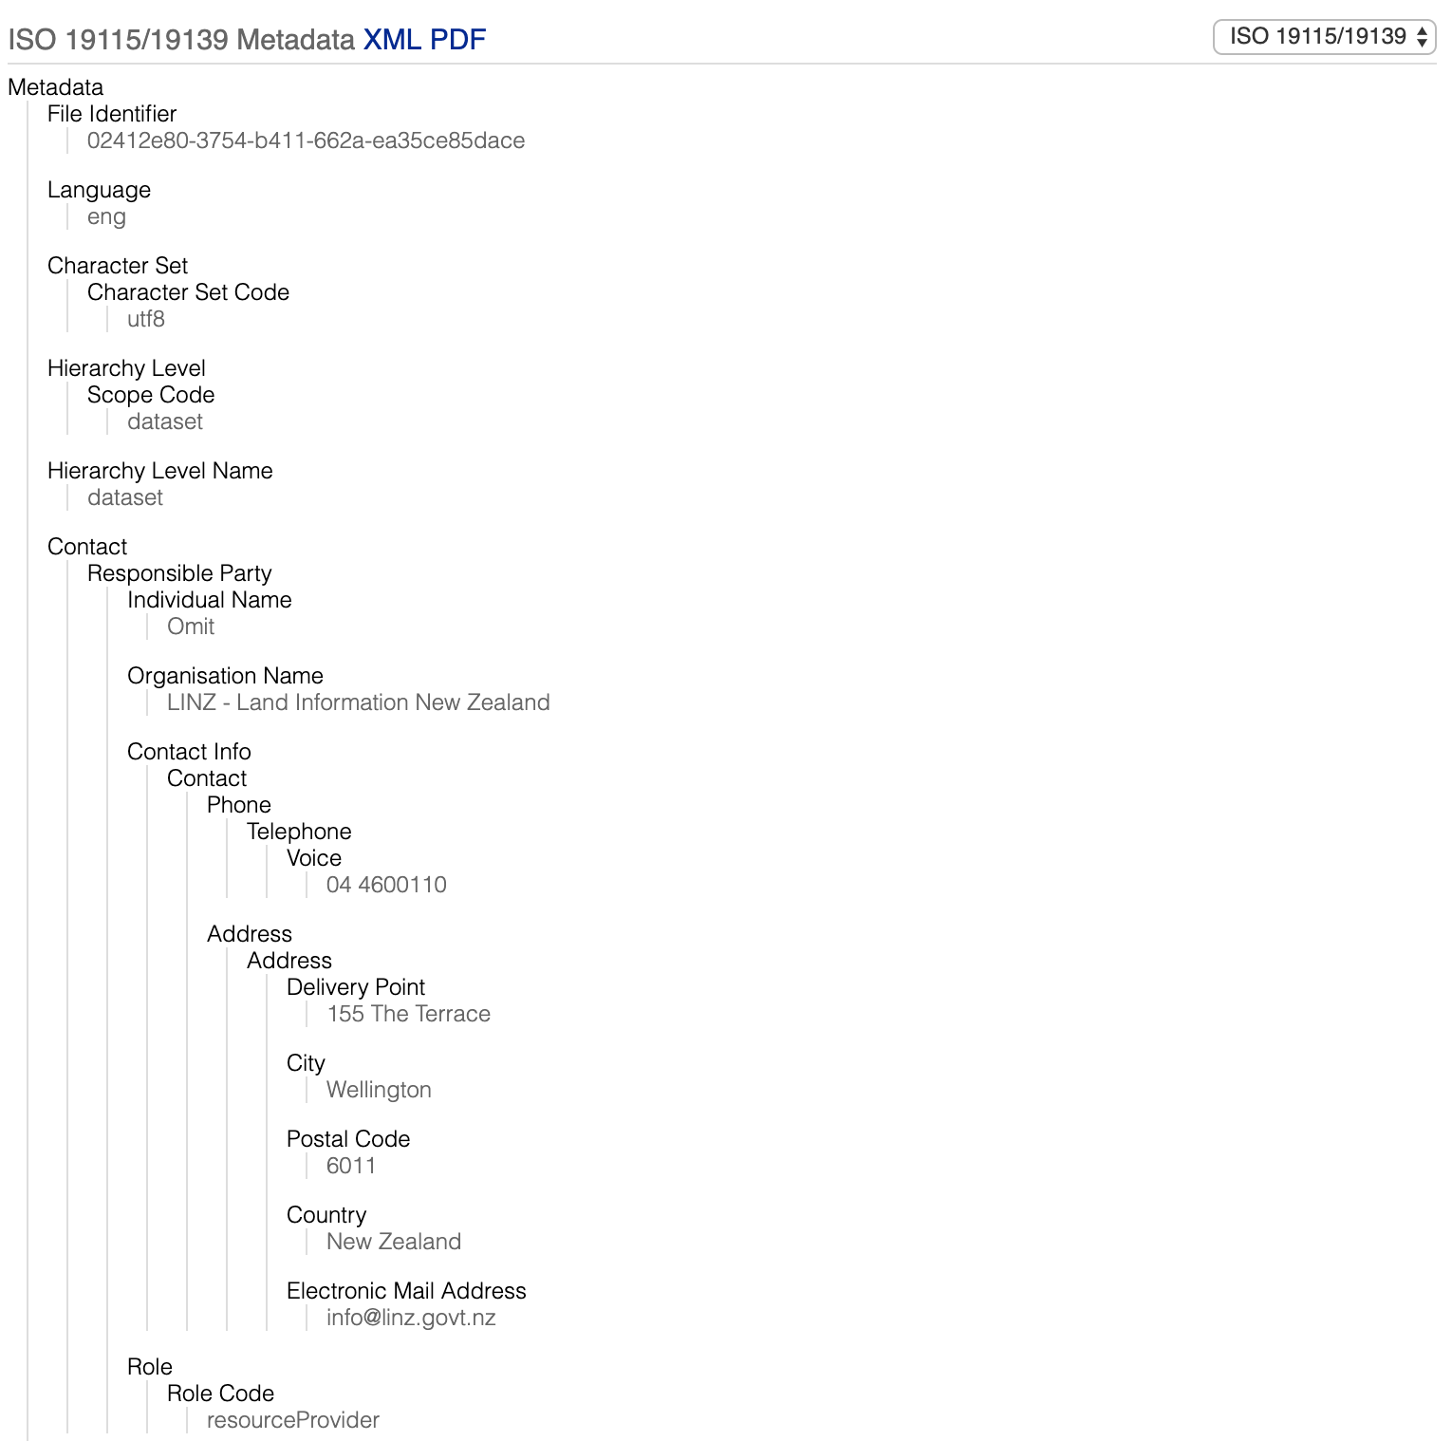
ISO 19115/19139

Slide 11
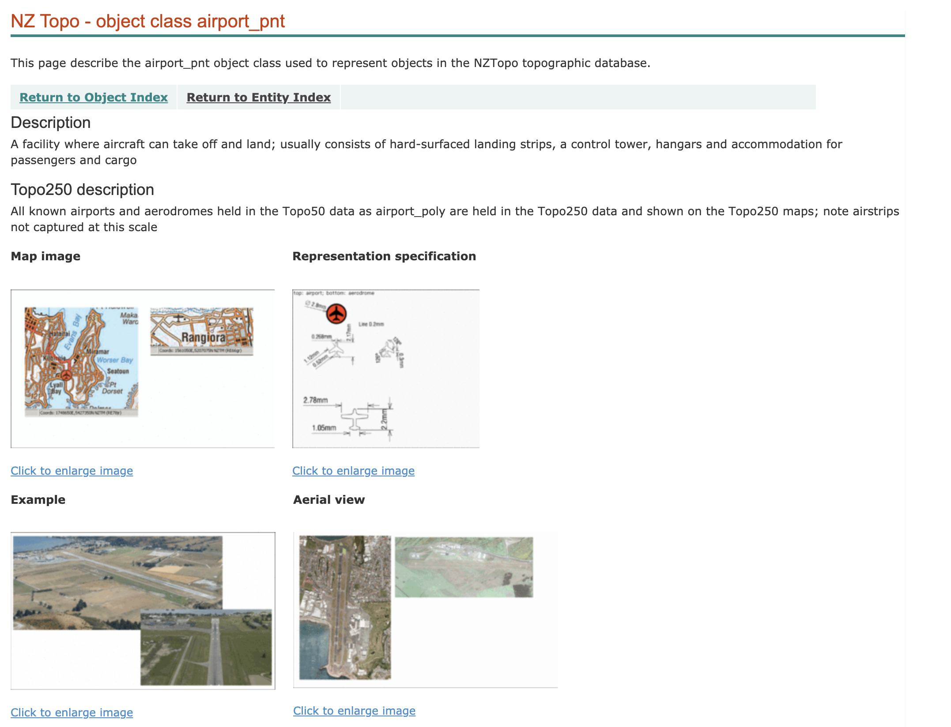
Topo Data Dictionary

Slide 12
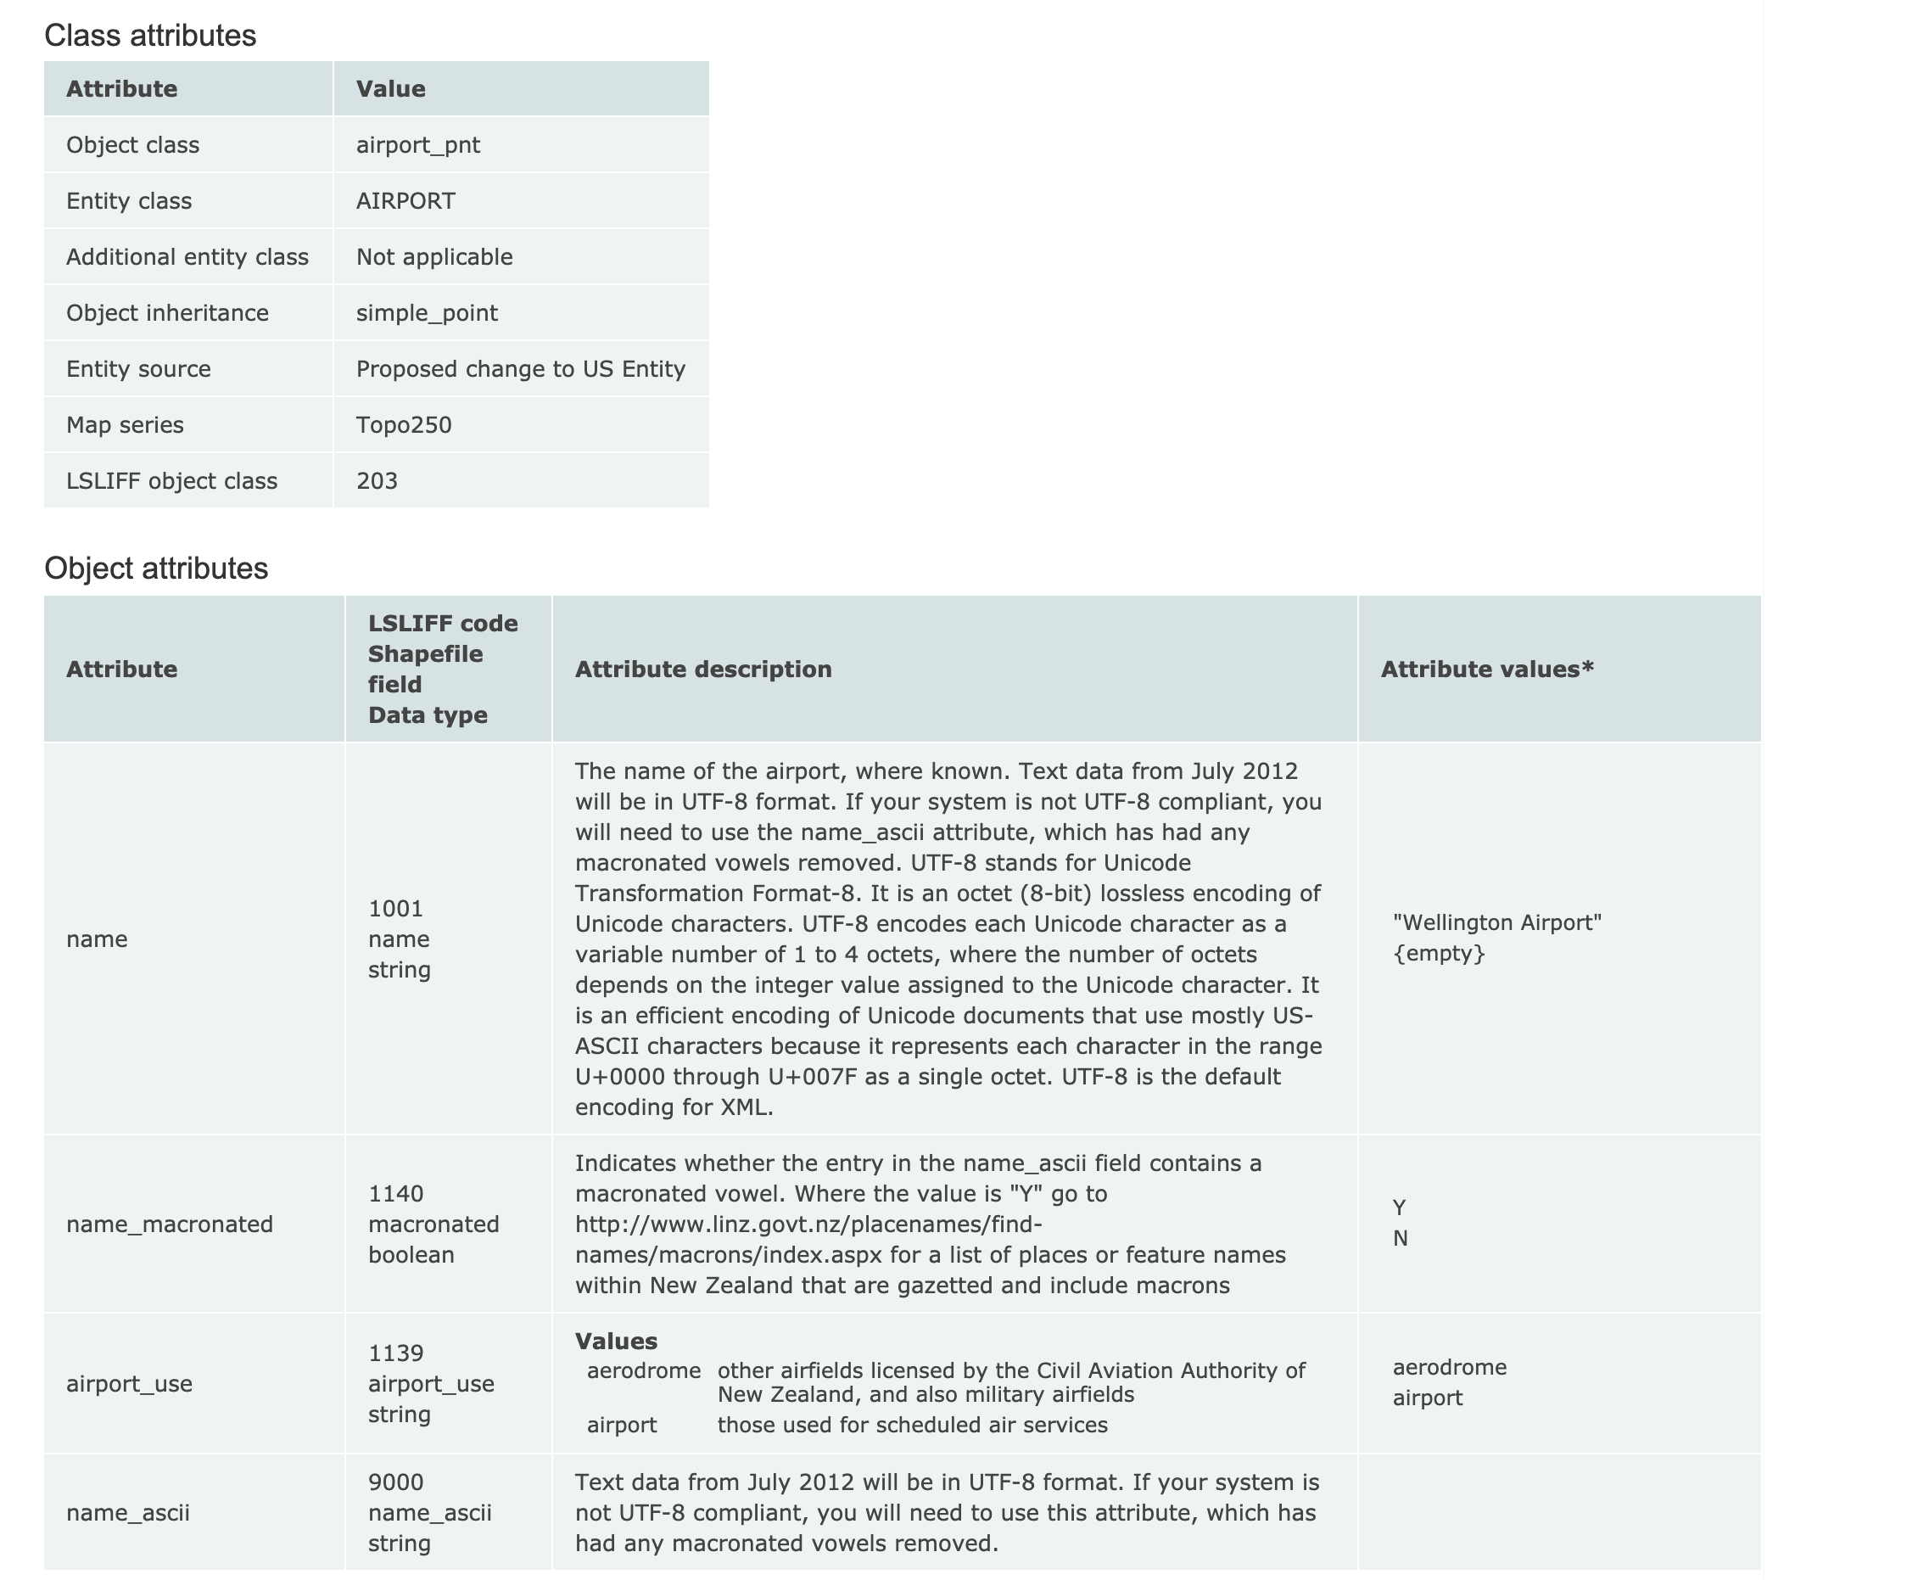
Topo Data Dictionary

Slide 13
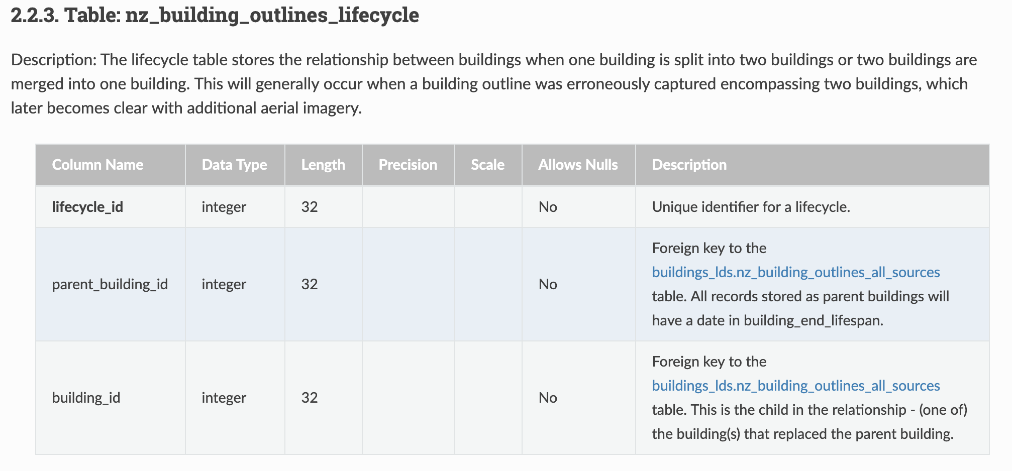
Structural Table/Column

Slide 14
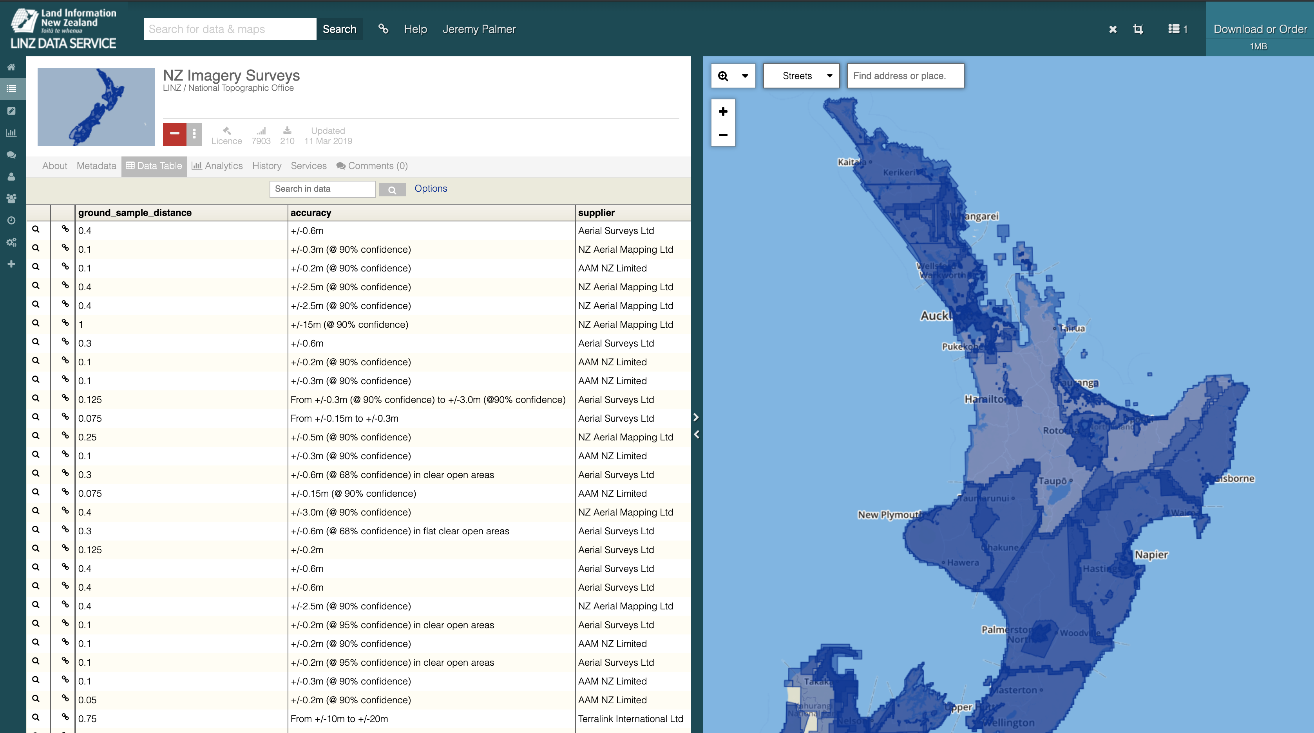
Layer Metadata

Slide 15
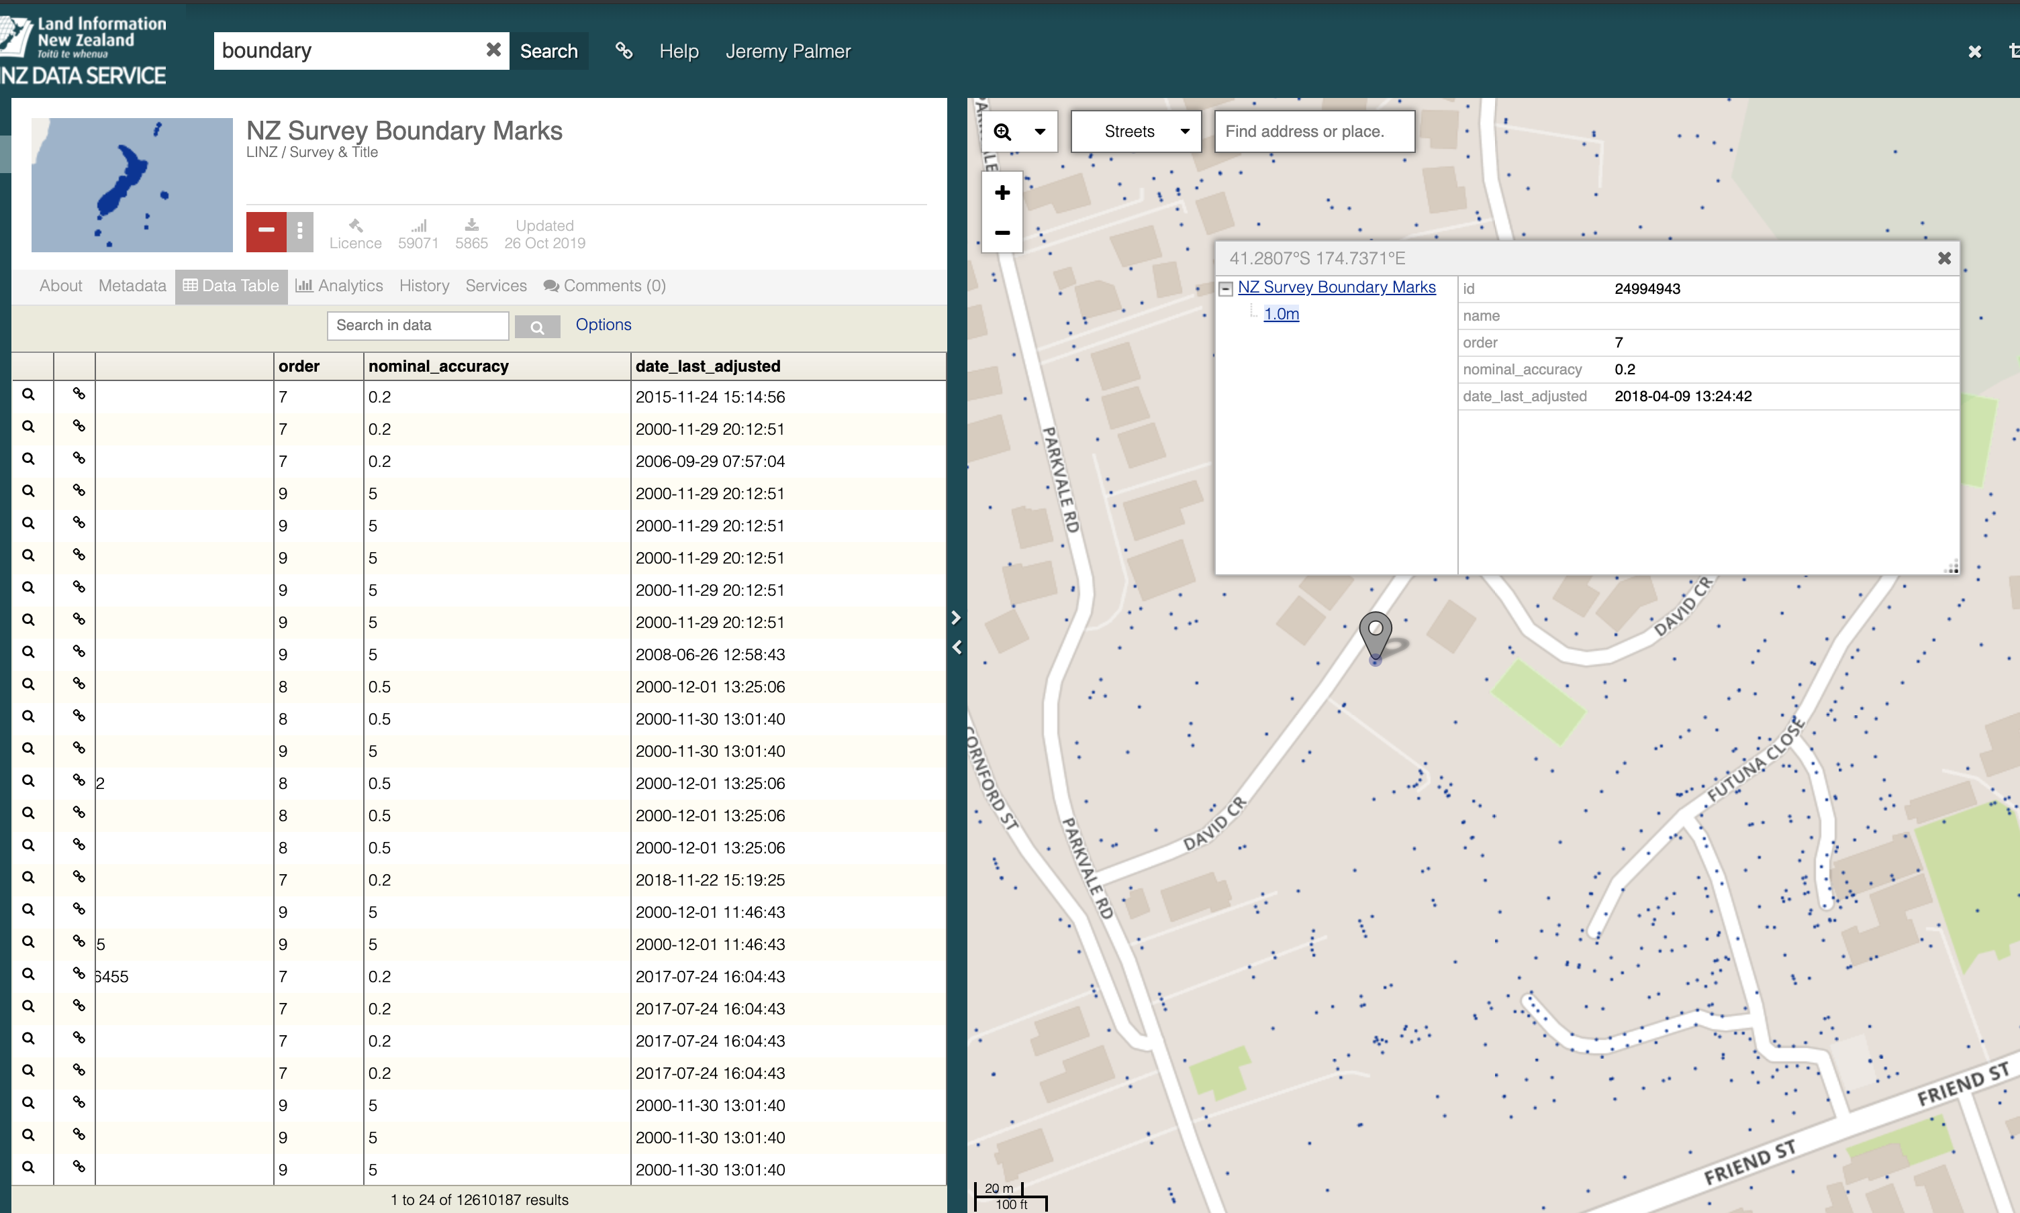
Feature/row level Metadata

Slide 16
Geospatial Metadata
Issues
ISO 19115:2003 is retired, however ISO 19115/2014 not implemented/promoted, no mature tools readily available.
ANZLIC Metlite tool is no longer maintained
ISO metadata is not used by customers, admins see it as compliance task. Overly complex for admins and users – has many fields not used or understood by users
CC BY: rdrcollection @ flickr.com

Slide 17
Geospatial Metadata
Issues cont.
Don’t have consistent approach to metadata creation and taxonomy, hurting layer discoverable
Attribute/column metadata is poor in some cases, little column value metadata. Not immediately viewable for some users.
Don’t have standard approach for delivery of “structured” attribute or processing (e.g imagery, LIDAR, Table/Vector) metadata. Meaning automatic processing is not easy.
CC BY: rdrcollection @ flickr.com

Slide 18
Geospatial Metadata
Issues cont.
Get the right balance of creating external metadata for datasets. E.g should metadata be part of the dataset records.
Need operational simple API for driving automatic workflows e.g SpatioTemporal Asset Catalog (STAC)
External Metadata sharing. Best approaches for web searching/HTML pages. E.g Web page metadata, DCAT. What is important?
CC BY: rdrcollection @ flickr.com

Slide 19
Geospatial Metadata
 | Proposed Actions (draft)
1 | Review all metadata for discoverable and create standardized taxonomies/tagging for customer searches
2 | Review need for ISO 19115:2014 metadata. Should we simplify to what our customers need. e.g. DCAT2, STAC, Dublin core
3 | Investigate options for providing structured attribute metadata, or processing info for customers to use in a consistent way
4 | Get Involved in ICSM Metadata working group to determine if we can get help
5 | Review the need for providing LDS API services (e.g CWS, OGC API Catalogues, STAC)
CC BY: rdrcollection @ flickr.com

