Slide 1
Update on ANZ MDWG Activities: March – September 2021
8 October 2021
ANZ MDWG Meeting No 9

Slide 2
Roadmap 2 – summary of priorities
Four major priority areas:
Support for transformation pathways - access to expertise
Development data specific profiles and implementation examples
Metadata creation/editing and validator tools
Improving technical governance

Slide 3
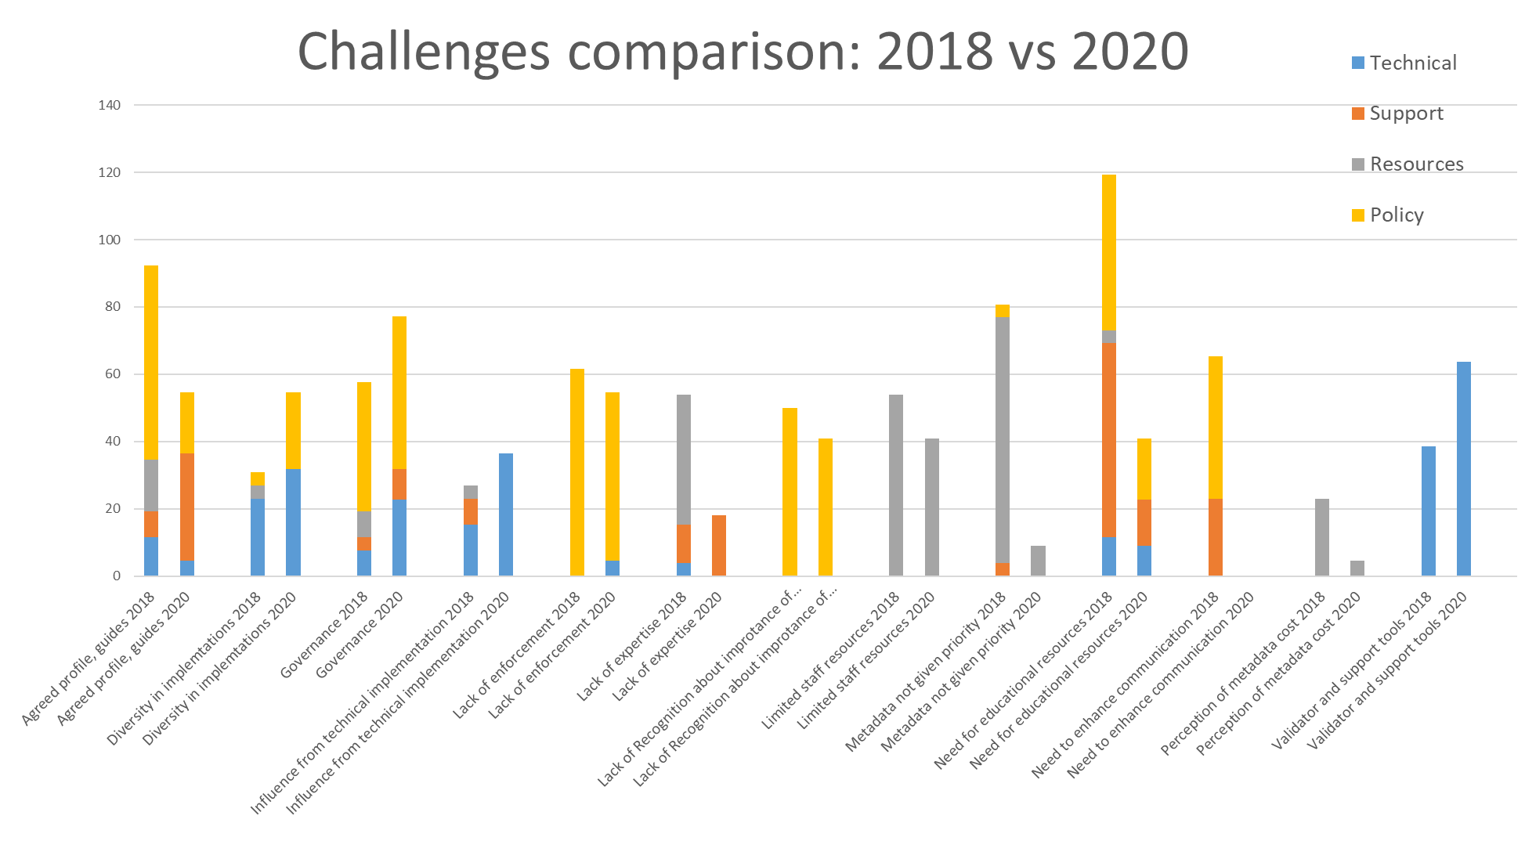

Slide 4
Requirement comparison: 2018 vs 2020

Slide 5
Activities: February – September 2021
Tools, but also improving technical governance:
Creation of ANZMet Lite V2 - metadata entry/export tool and replacement of ANZMet Lite
Creation metadata templates for EM (data and services)
Transformation pathways / access to expertise:
Development of metadata community profiles: EM (completed) and Elevation (initial draft)
Provision of advice on implementation and use of the metadata
Provision of feedback to the ISO 19115-1 (-3)
Education, but also improving technical governance:
New publications:
updated Best Practice documents,
new video, Fit for purpose metadata… Why do we need it?
link to ANZMet Lite V2 and ‘How to’ access and use ANZMet Lite V2
Participation in:
UN-GGIM 3rd edition of Guide on the Role of Standards
Development of International Community Guidelines for Sharing and Reusing Quality Information of Individual Earth Science Datasets
APS Metadata Management and Data Interoperability Project – metadata recommendation for Federal Government Agencies

Slide 6
Survey May-June 2021
Goals:
Update on progress with adoption of the ISO 19115-1 metadata standard
Understand requirements for a metadata creation tool within ESRI environment
Participants:
ANZ MDWG
EMSINA
Spatial Capabilities CoP
The survey received 47 responses from 38 organisations (Australia and New Zealand). Similar survey in June 2020 had 22 organisational responses.

Slide 7
Adoption of the ISO 19115-1 standard
 | June 2020 | June 2021 | Combined
 | No of responses | No of responses | No of responses
Total responding | 22 (100%) | 38 (100%) | 46 (100%)
Yes, ISO 19115-1 or ISO 19115-3 (xml) | 12 (55%) | 19 (50%) | 24 (52%)
No, Adoption ISO 19115-1 | 9 (41%) | 19 (50%) | 22 (48%)
Not sure | 1 (4%)

Slide 8
Does your organisation have a metadata catalogue?
Does your organisation create metadata for datasets (D) and for spatial web services (S)?

Slide 9
Can your organisation provide an example of xml for metadata?
Does your organisation provide access to metadata via Catalogue Service for the Web (CSW)?

Slide 10
Can your organisation validate metadata?
Does your organisation have an automated process for transition to ISO 19115-3?

Slide 11
Requirements for ESRI supported metadata tool
Current situation
Developed by ESRI Australia to support creation of the ISO 19115 metadata
Maintained by GA
The tool based on a superseded version of the standard, which s not supported by ANZLIC
GA and the ANZ MDWG received many questions about plans to upgrade to the ISO 19115-1 standard
Issues
Metadata statements generated by the ESRI tool:
are not compliant with new version of metadata
have limited interoperability
cannot be easily integrated in central catalogues
additional steps are required to convers to the new standard
Metadata for services is not supported

Slide 12
Requirements for ESRI supported metadata tool
Does your organisation use ESRI software for managing spatial data and products?
Has your organisation used the ESRI ANZLIC Metadata Tool before?
Will your organisation use upgraded ESRI ANZLIC Metadata Tool?

Slide 13
Future Activities - TBC
Tools:
Creation metadata templates for other datasets – priority and funding to be identified
Assist with access/testing of the ANZMet Lite V2 and EM metadata tools
Assist/provide advice on implementation metadata catalogues
Liaise with ESRI Australia on upgrade to the metadata tool (started)
Transformation pathways:
Identify potential collaboration areas and pilot project to improve consistency and access to metadata
Investigate metadata standards used across geospatial community in AUS and NZ:
Conduct survey
Develop crosswalks
Provide advise/feedback on the ISO 19115-1 (-3) related matters
Education:
Publish advice on
transformation between the ISO 19115 and ISO 19115-1
how to validate the metadata and where to find the validation tools
Development guidelines for recording metadata on Data Quality and Uncertainty

Slide 14
Questions and comments???

