Slide 1
ISO 19165-1 Data Preservation Metadata
Shanti Rowlison
Notes:
Image by Darwin Laganzon from Pixabay

Slide 2
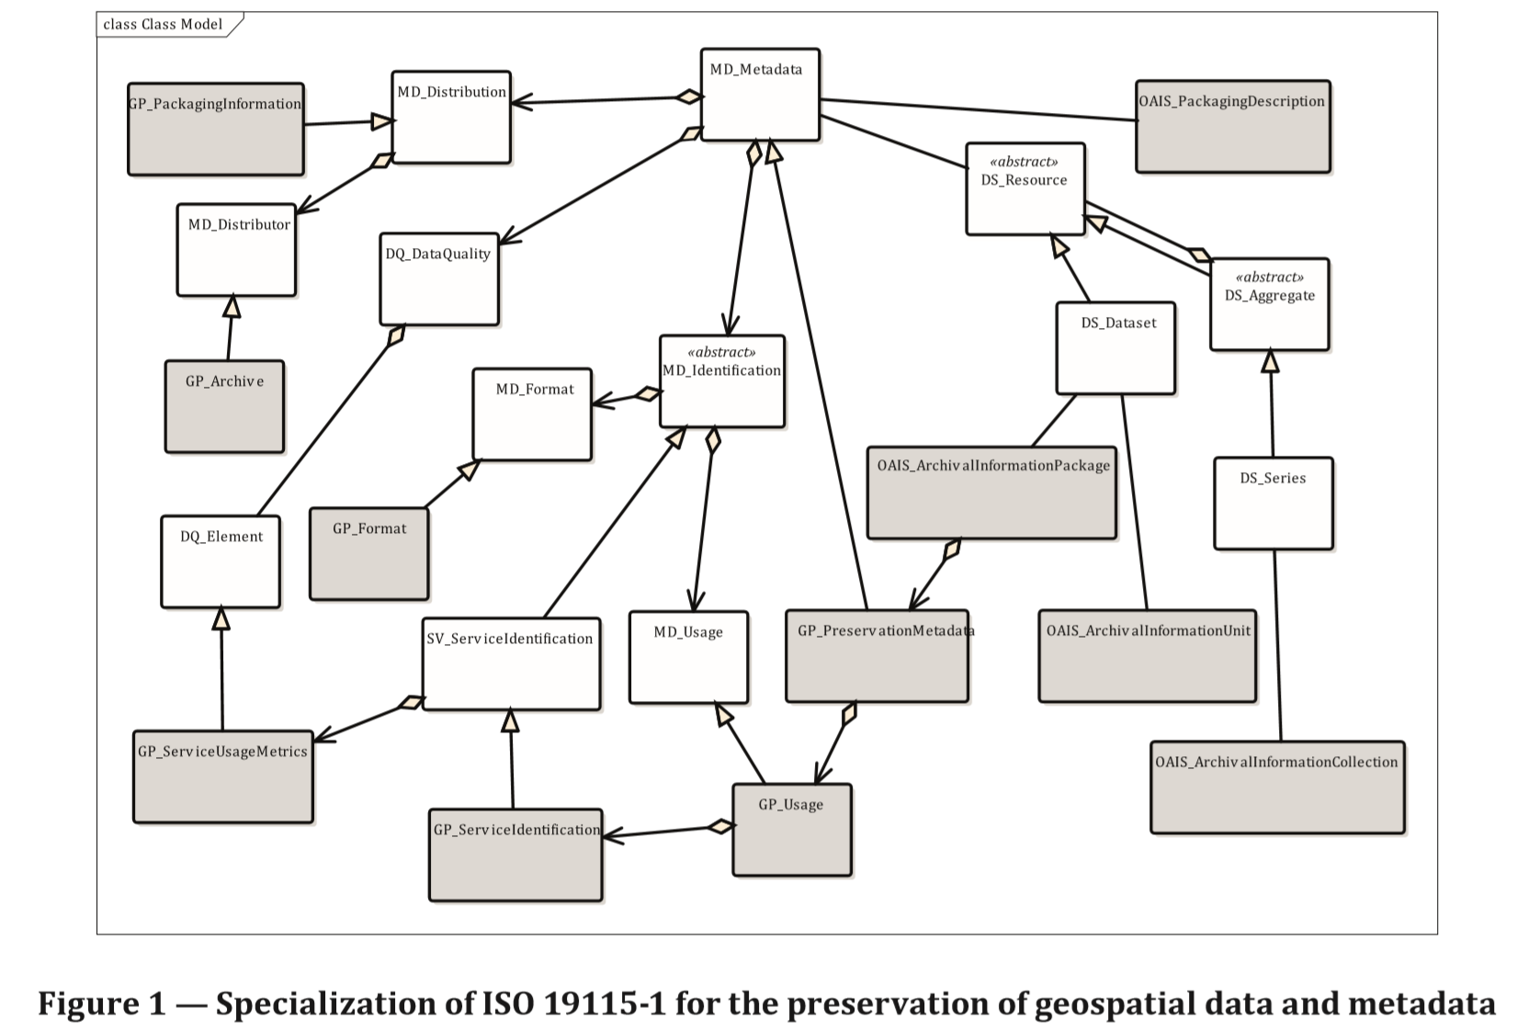
What part of ISO 19115-1does ISO 19165 extend?

Slide 3
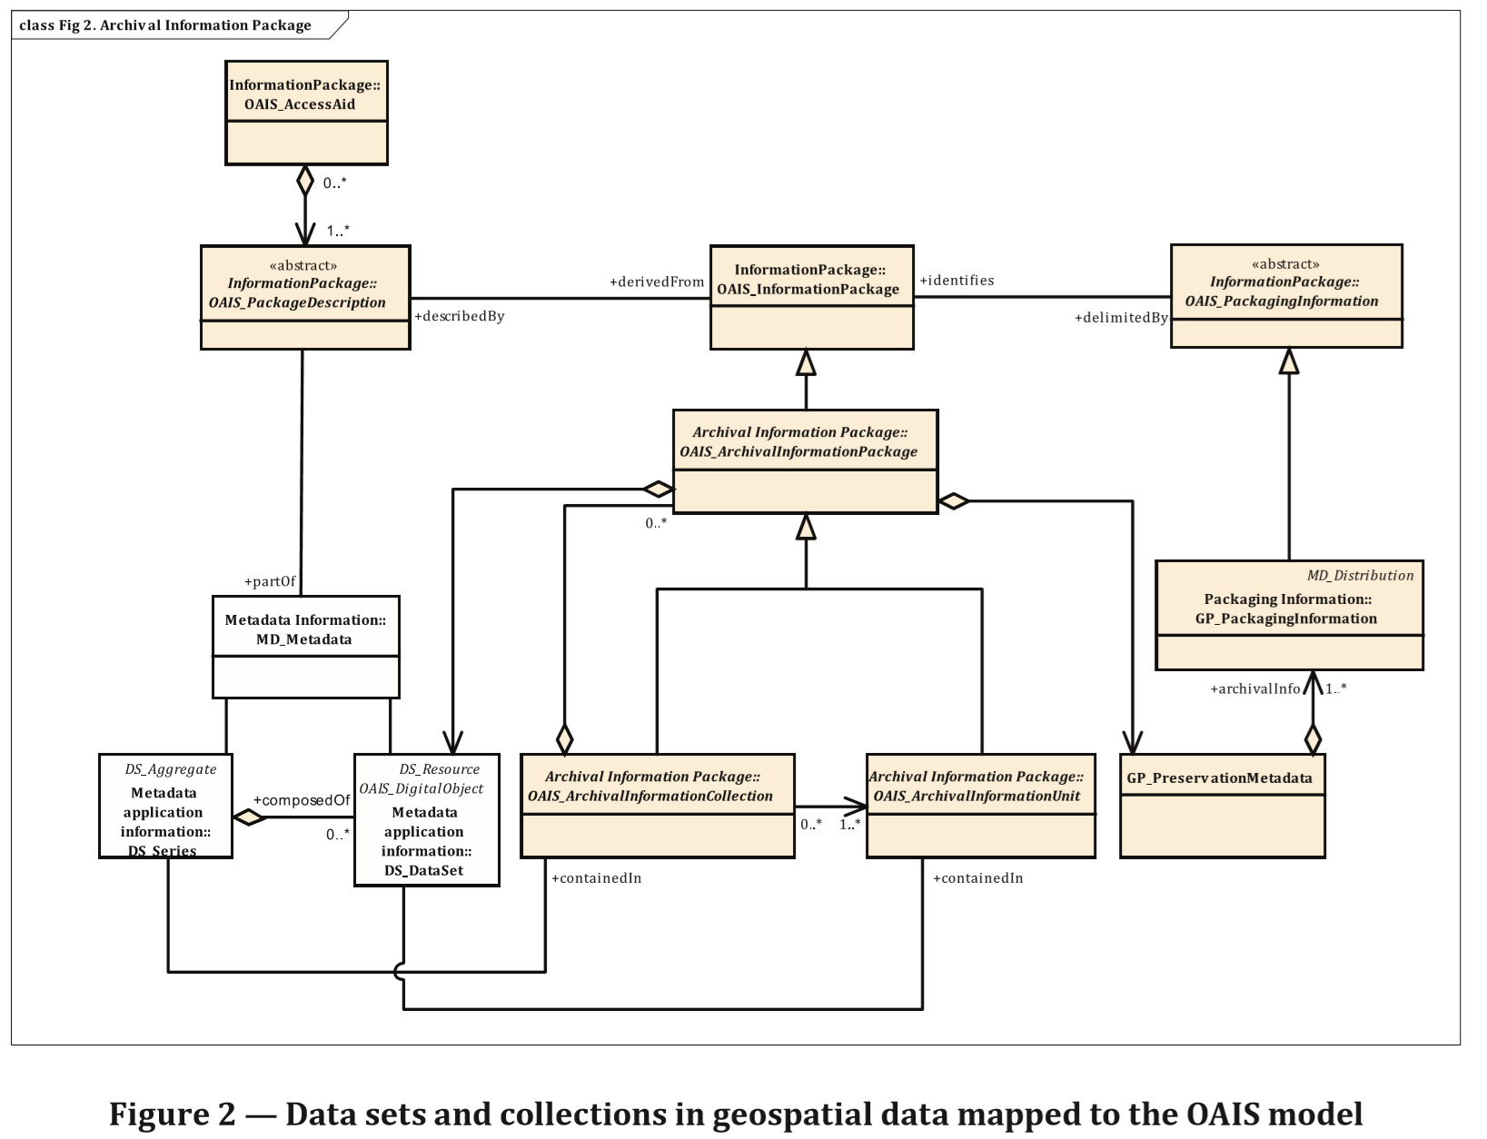

Slide 4
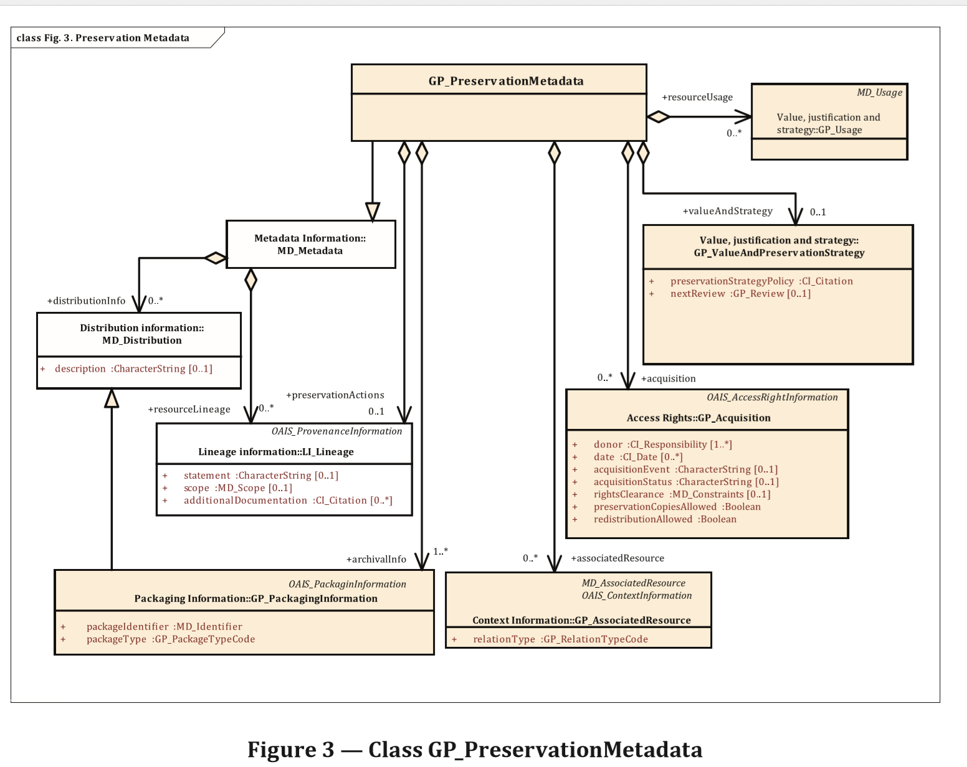

Slide 5
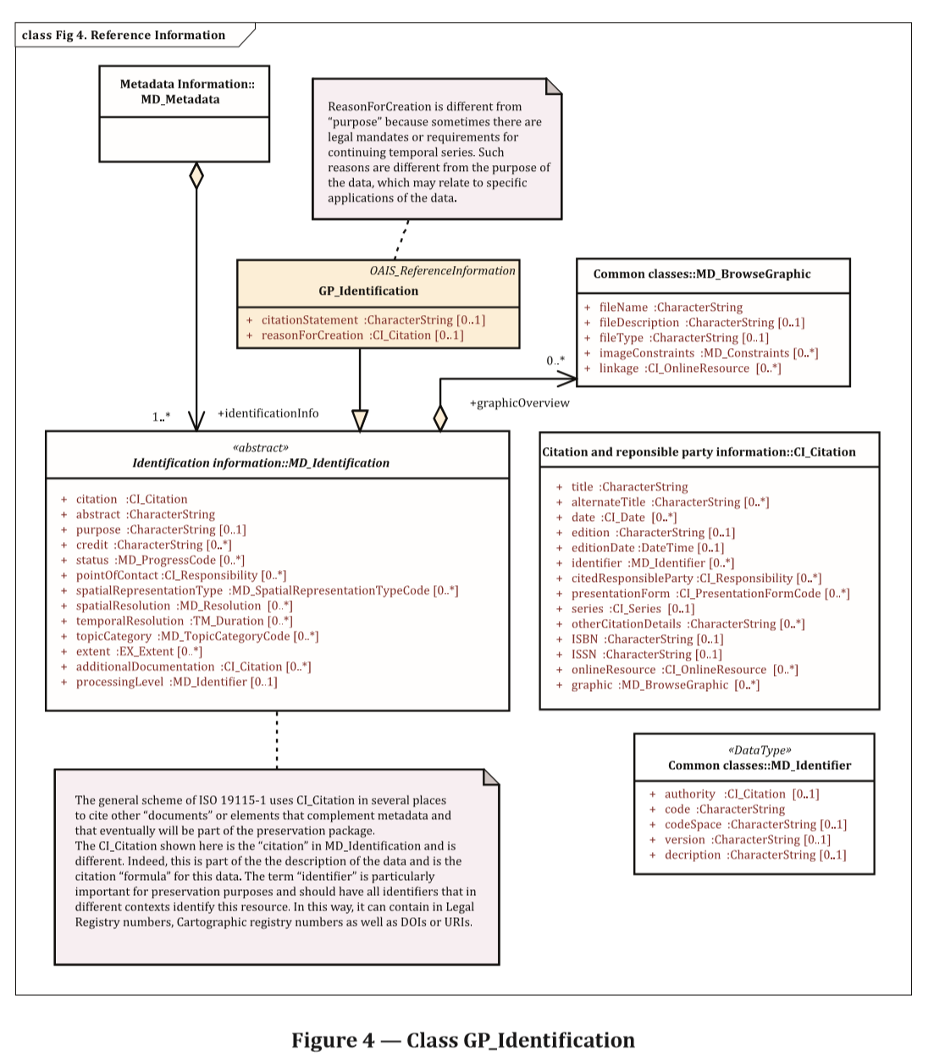

Slide 6
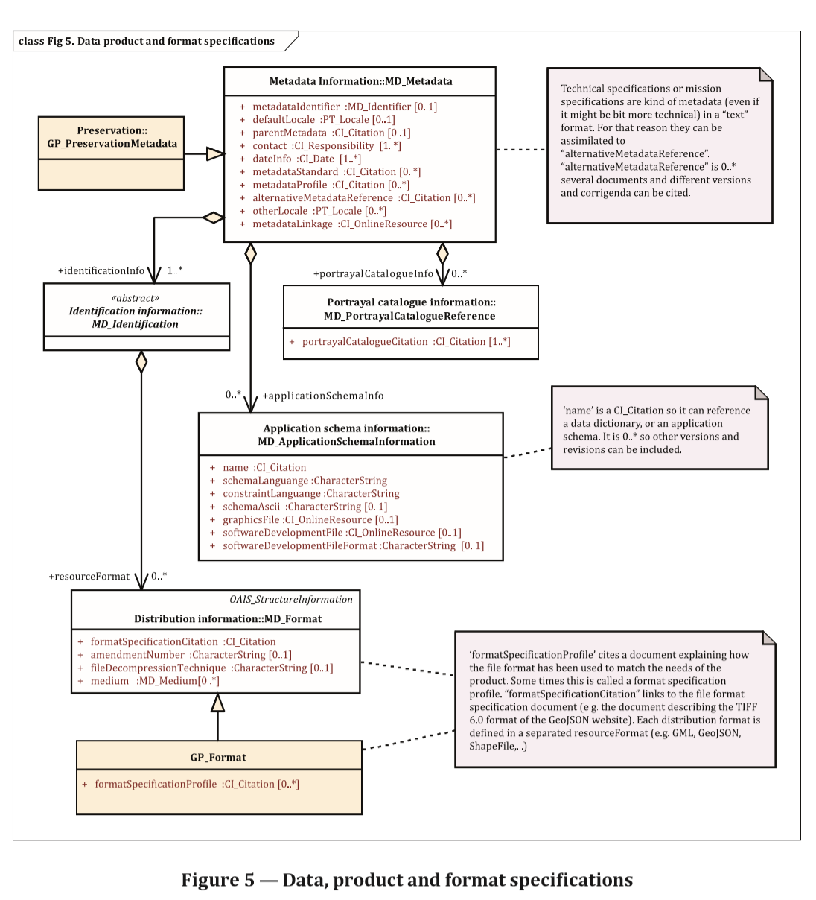

Slide 7
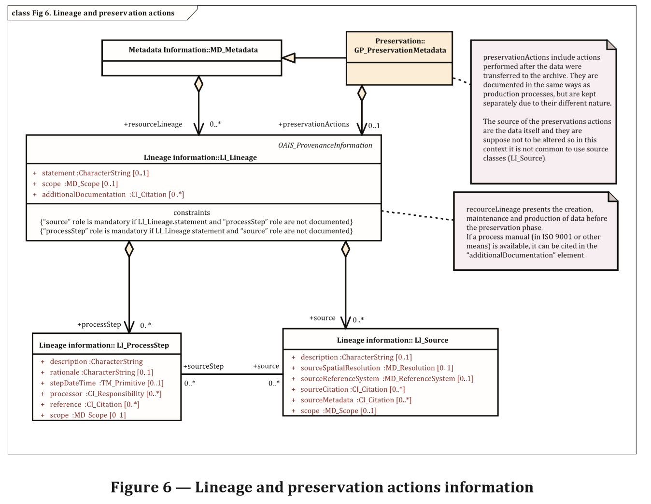

Slide 8
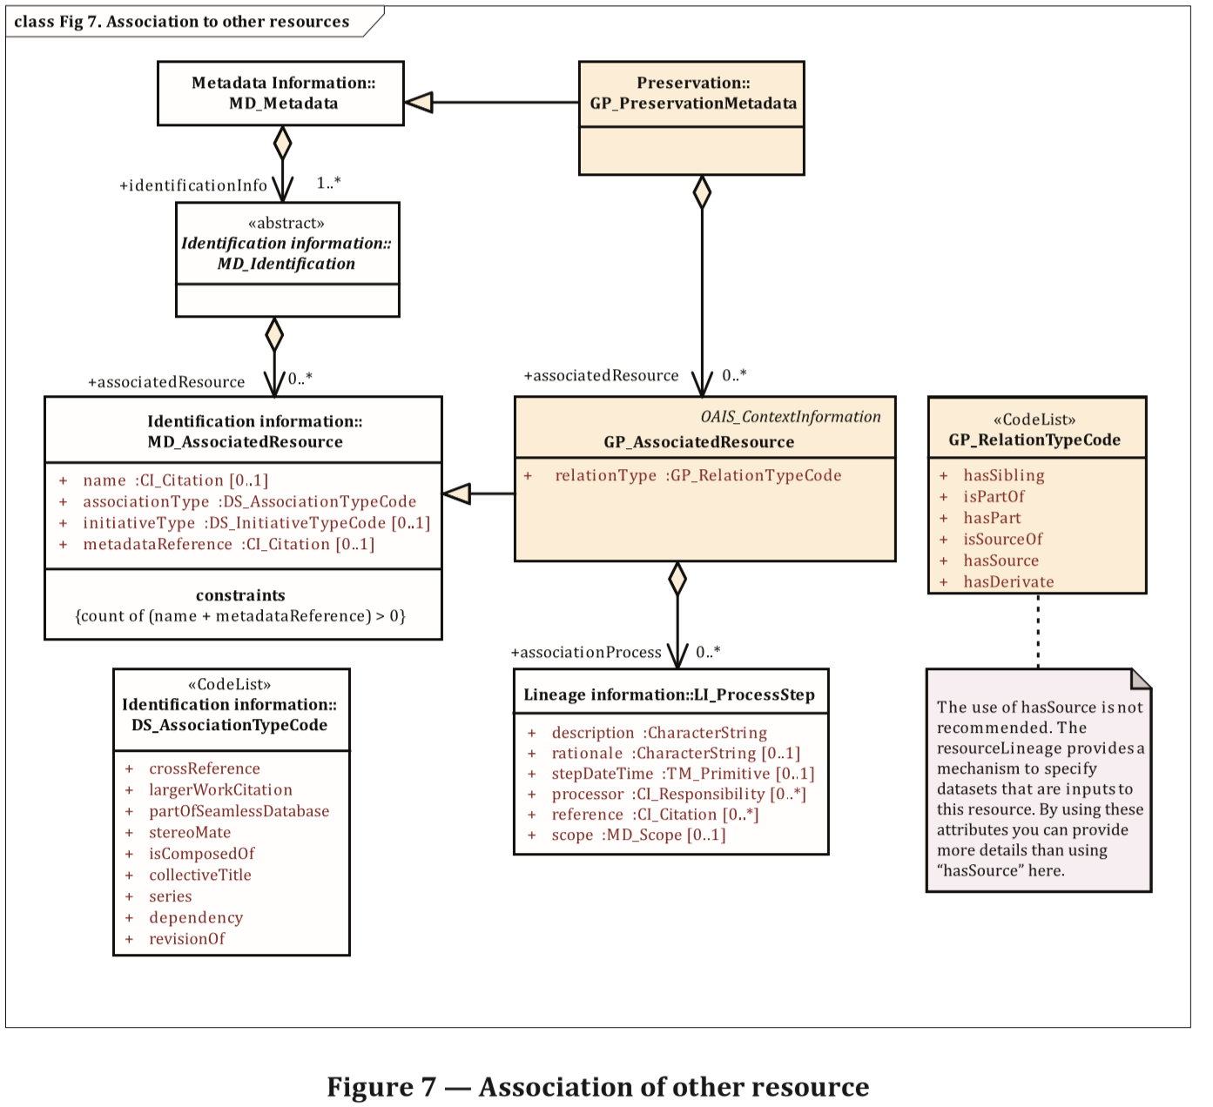

Slide 9
ISO 19165 – Data Preservation Metadata
What? – what does ISO 19165 add?
Who? needs to implement
What? is timeframe
When? does is need to be implemented
ICSM MDWG action? do we need to provide guidance and have a section in our guide on it

