Slide 1
Metadata, Catalogues, Records
ICSM/ANZLIC MDWG 19115-3
Byron Cochrane – OpenWork Ltd
The 120th OGC Member Meeting 14 September 2021

Slide 2
OGC Metadata, Catalogue and Records
Topics for discussion
OGC API Records – formerly know as CSW 4.0
STAC – Spatio-Temporal Asset Catalogue
ISO 19115 – MDWG work

Slide 3
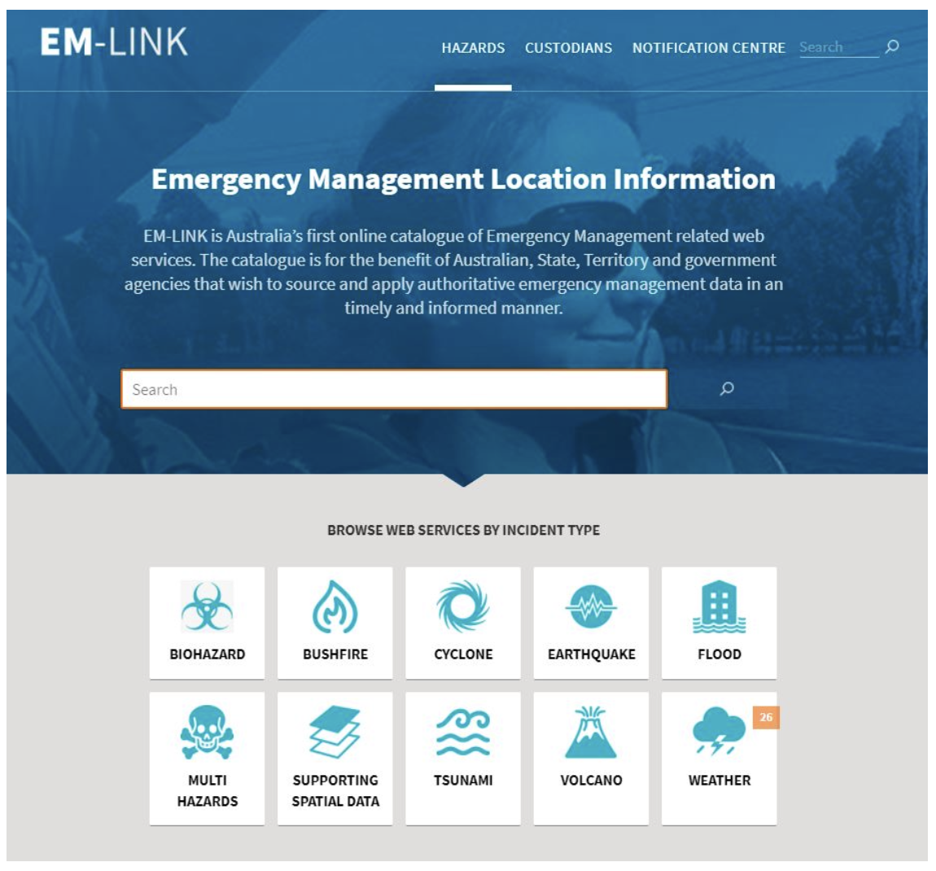
ANZLIC / ICSM Metadata Working Group
History
ANZLIC Metadata Profile - An Australian/New Zealand Profile of AS/NZS ISO 19115:2005
Deprecated 2015 by MDWG in preference of unaltered ISO 19115-1(3)
2015 - 2017 Confusion reigns

Slide 4
MDWG reforms and regroups
Did not desire to replicate the overhead of a formal Profile
Favoured a small ”p” profile approach
Based on Geoscience Australia implementation of 19115-1
Common Best Practice guidance developed by MDWG
Governance of rules at appropriate level
Common template records
Common opensource metadata tool based on GeoNetwork
Embedded “How to” guidance linked to ICSM Best Practice

Slide 6
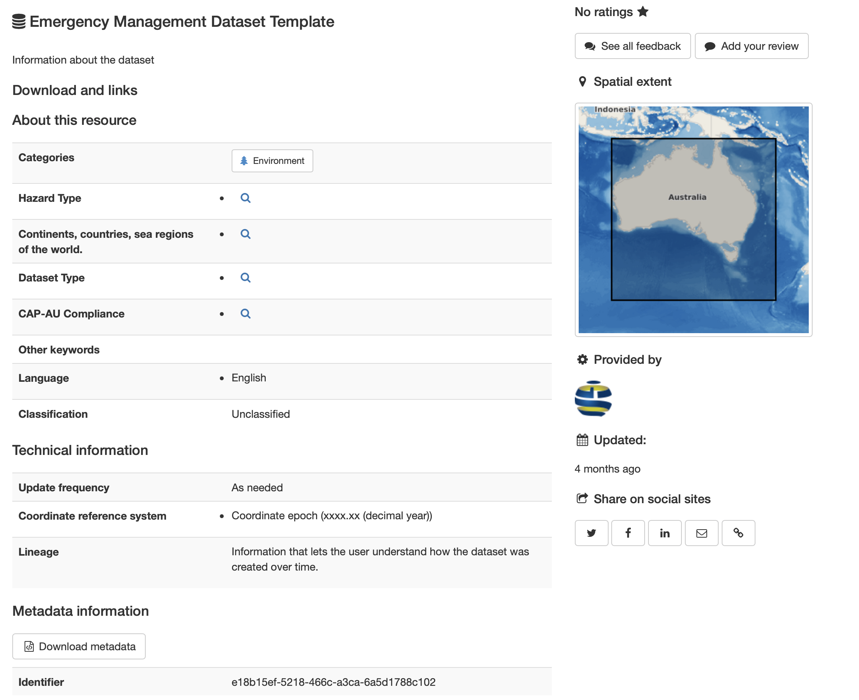
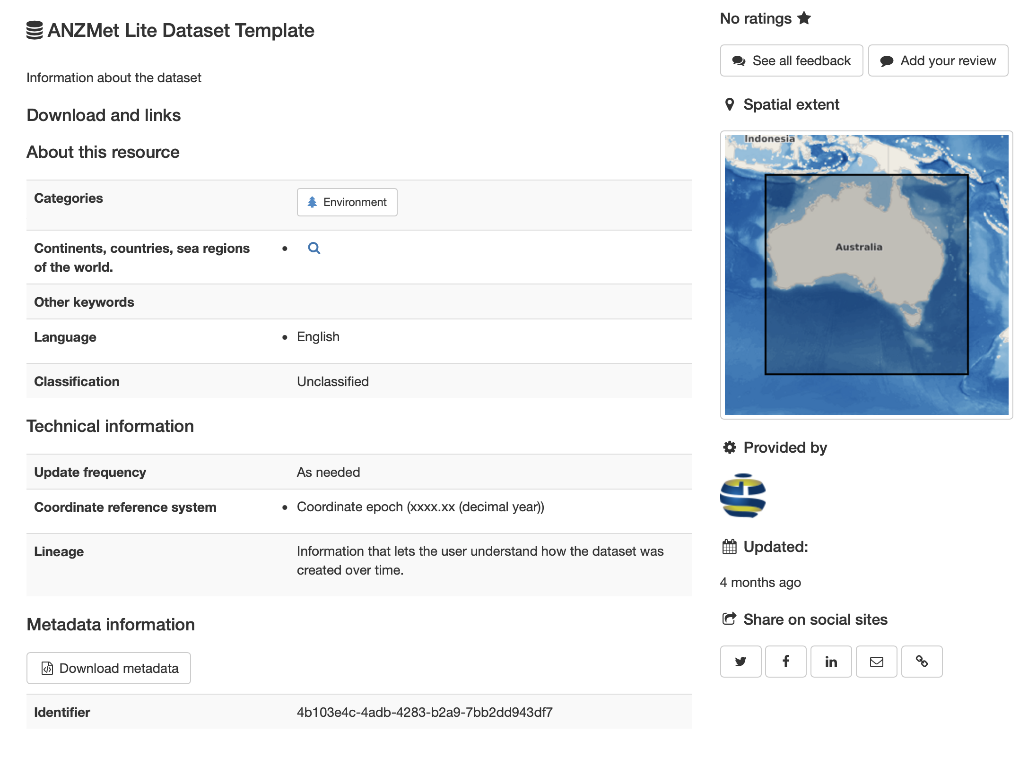

Slide 7
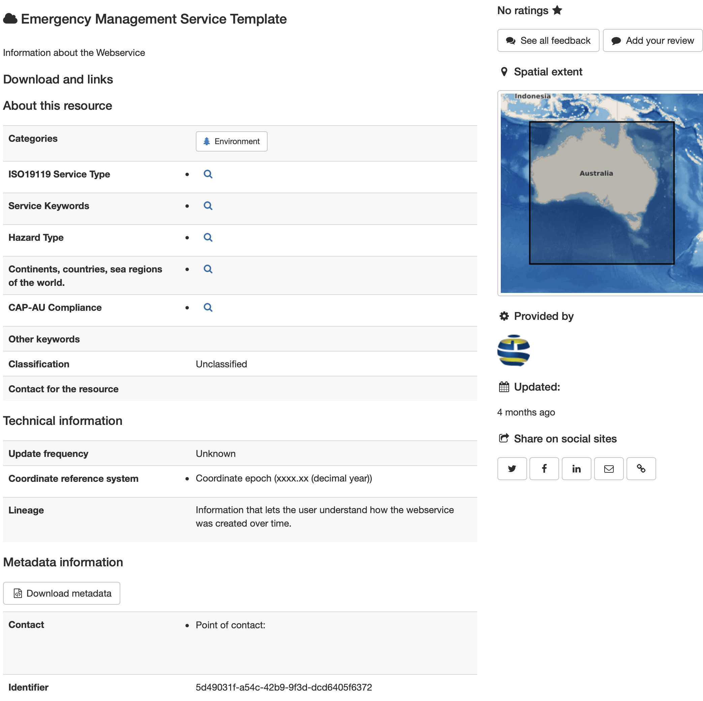
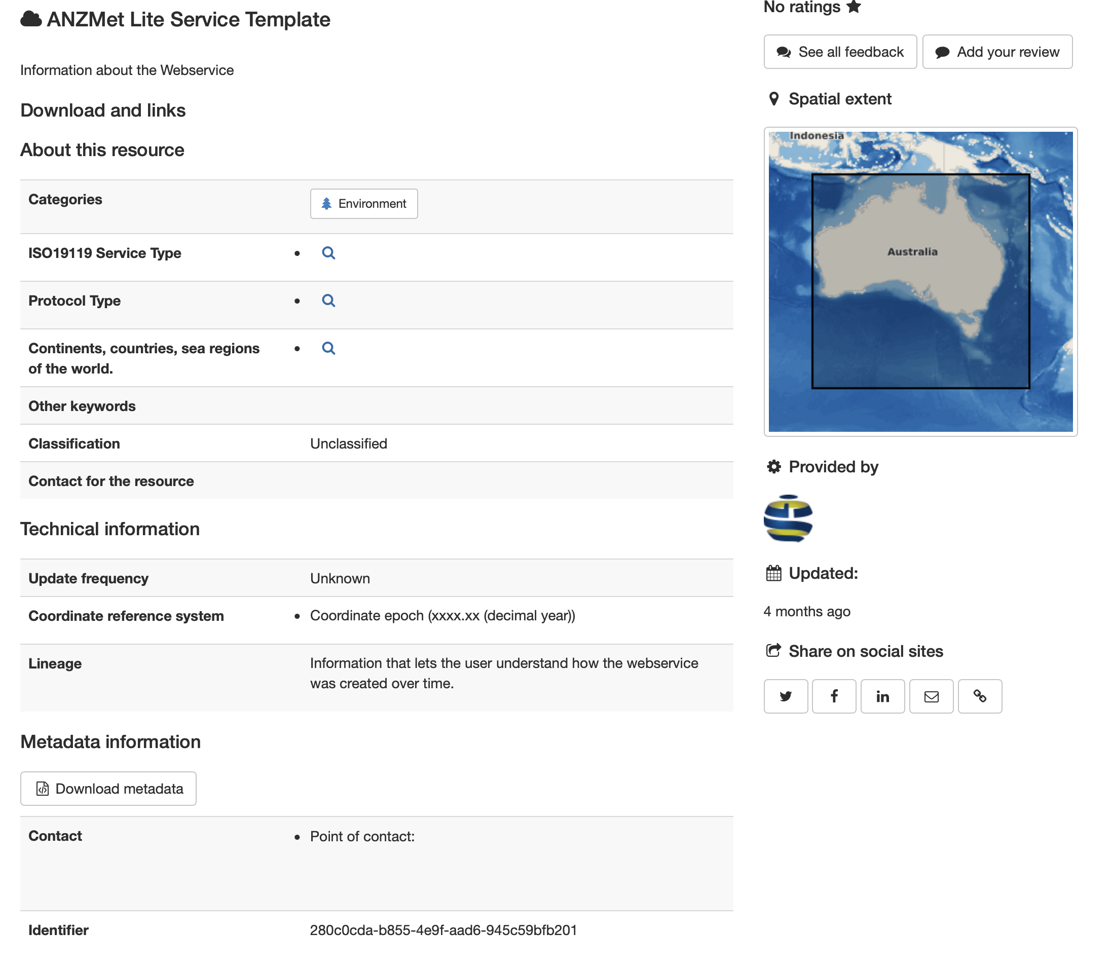

Slide 8
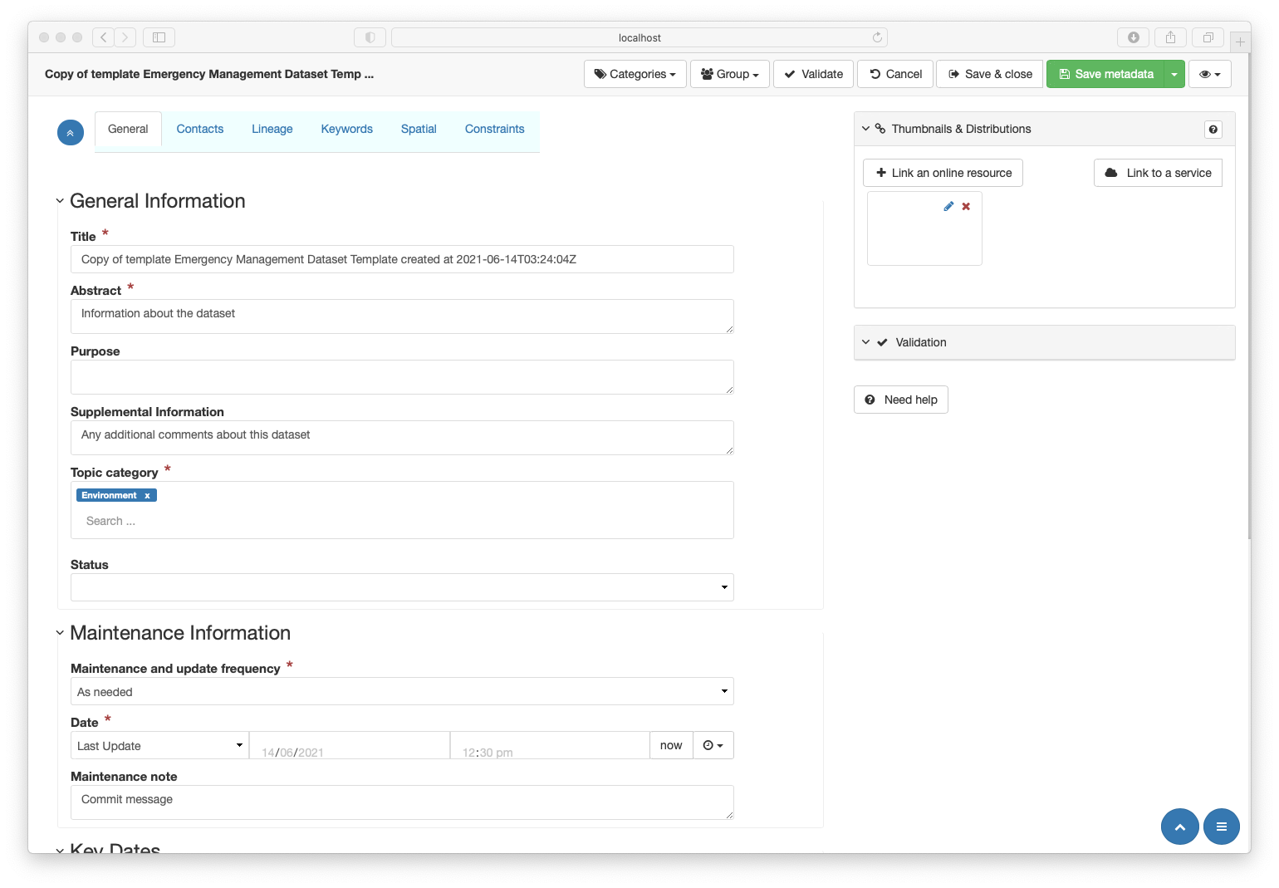

Slide 9
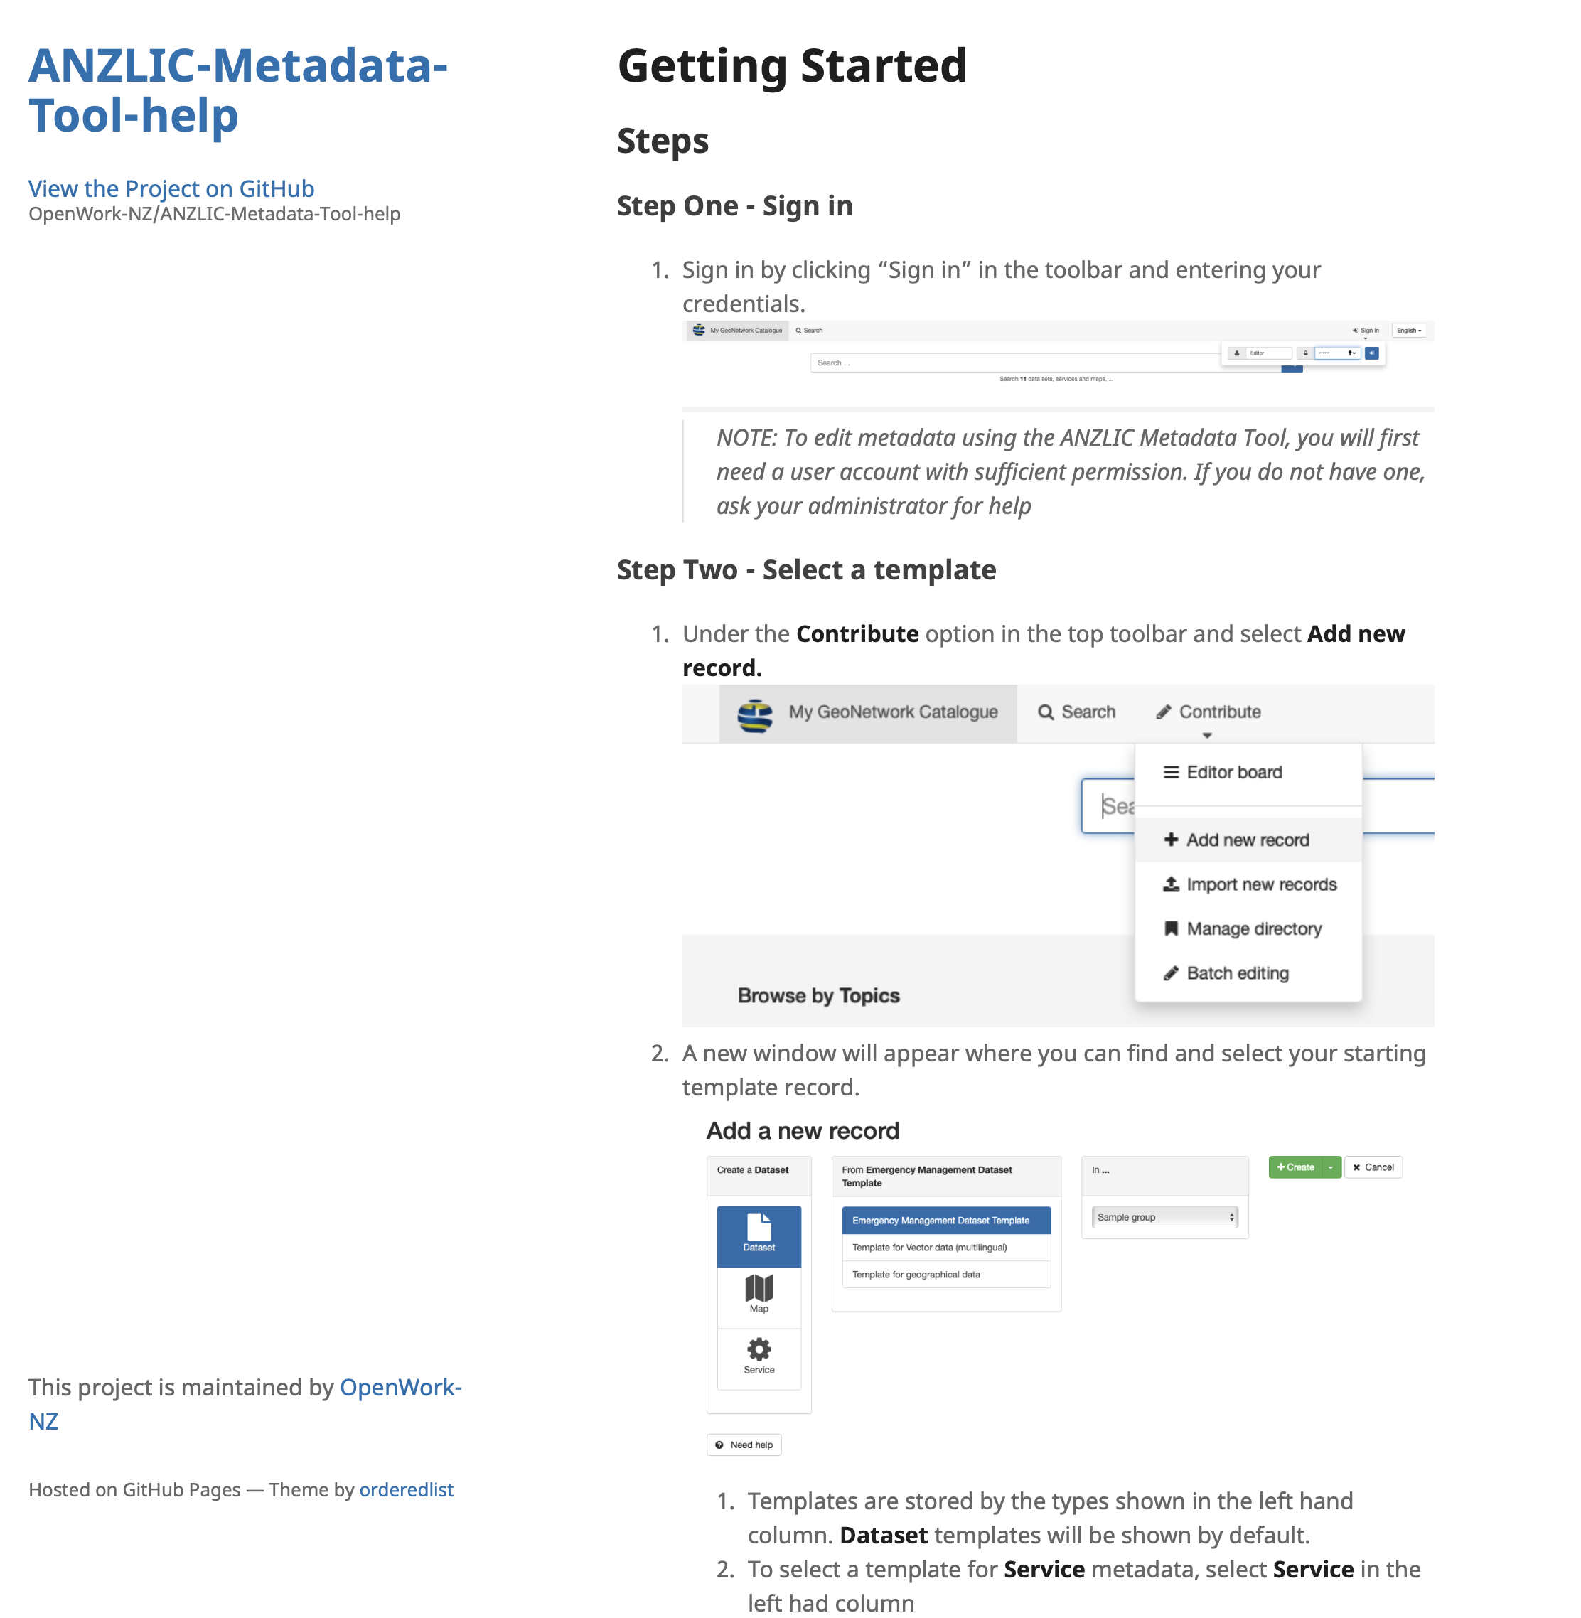

Slide 10
Summary
ICSM Strongly endorses ISO 19115-1 for spatial metadata
- But not at the cost of other standards – interoperability is key
It is important that governance for metadata elements falls at the right level – Domain, Agency, Regional, International
A meta-model for metadata and catalogues is needed to ensure components are as interoperable as possible.
It is not that metadata is too complicated or too hard, it is that guidance is lacking. Tutorials, Cookbooks, Reference and Discussion

Slide 11
OpenWork Ltd https://openwork.nz Nelson NZ byron@openwork.nz
Questions?
Byron Cochrane
ICSM Metadata Best Practice
https://openwork-nz.github.io/mdwg/defs
ANZLIC Metadata Tool https://dev.geodata.nz/geonetwork

