Slide 1
Standards Update (Standards Australia, ISO & OGC)
Chris Body (Independent Chair - IT-004 Geographic Information/Geomatics – Standards Australia and
OGC – Australia/New Zealand)
ISO/TC 211

Slide 2
Standards Australia
Standards Australia continues to publish ISO/TC 211 Standards as AS/NZS
AS/NZS ISO 19168-1:2020 Geographic Information – Geospatial API for Features – Part 1: Core
Increase coordination of committees requiring spatial & positioning knowledge and information
Building Information Modeling
Intelligent Transport System
Smart Cities/Digital Twin
Next IT-004 meeting April

Slide 3
ISO/TC 211
Over the last 12 months there has been a number of announcements:
Sweden to step down as chair Dec 2021
UK (Ordnance Survey) – Peter Parslow will then take over as chair
No face-to-face meeting until Dec 2021
A number of WG conveners have retired:
Peter Parslow (WG1) replace by Dr Ryan Ryu
Dr Jean Brodeur (WG7) replaced by Prof. Yuqi Bai
Dr John Herring (WG9) replaced by Prof. Liping Di
Have formed a number of new Advisory Groups to assist the TC in addressing specific issues
Smart Cities; Land Cover & Land Use; ISO Registers

Slide 4
ISO/TC 211
Published
ISO 19115-1/Amd 2 Geographic Information – Metadata – Part 1: Fundamentals – Amendment 2
ISO/TS 19163-2 Geographic Information – Content Components and Encoding Rules for Imagery and Gridded Data – Part 2: Implementation Schema
ISO 19165-2 Geographic Information – Preservation of Digital Data and Metadata
ISO 19168-1 Geographic Information – Geospatial API for Features – Part 1: Core

Slide 5
ISO/TC 211
Systematic Review (Ballot)
ISO 19103 Geographic Information – Conceptual Schema Language
ISO 19104 Geographic Information – Terminology
ISO 19108 Geographic Information – Temporal Schema
ISO 19109 Geographic Information – Rules for Application Schema
ISO 19119 Geographic Information – Services
ISO 19128 Geographic Information – Web Map Server Interface
ISO 19130-2 Geographic Information – Imagery Sensor Models for Geopositioning – Part 2: SAR, InSAR, Lidar and Sonar
ISO 19139-1 Geographic Information – XML Schema Implementation – Part 1: Encoding Rules
ISO 19159-1 Geographic Information – Calibration and Validation of Remote Sensing Imagery Sensors and Data – Part 1: Optical Sensors

Slide 6
ISO/TC 211
Systematic Review (Completed)
ISO 19150-1 Geographic Information – Ontology – Part 1: Framework was to be revised
ISO 19150-2 Geographic Information – Ontology – Part 2: Rules for Developing Ontologies in OWL was confirmed
Current Work Program
ISO 19101 Geographic Information – Reference Model – Part 1: Fundamentals (this will restart as a preliminary work item)
ISO 19105 Geographic Information – Conformance and Testing (publish mid 2021)
ISO 19116 Geographic Information – Positioning Services (amendment 1 – publish mid 2021)
ISO/TS 19130-3 Geographic Information – Imagery Sensor Models for Geopositioning – Part 3: Impementation Schema (publish early 2021)

Slide 7
ISO/TC 211
Current Work Program
ISO 6709 Standard Representation of Geographic Point Location (Ballot out for DIS)
ISO 19111 Geographic Information – Referencing by Coordinates (amendment to be published late 2021)
ISO 19115-2 Geographic Information – Metadata – Part 2: Extensions for Acquisition and Processing (amendment to be published early 2021)
ISO/TS 19115-3 Geographic Information – Metadata – Part 3: XML Schema Implementation for Fundamentals Concepts
ISO 19123-1 Geographic Information – Schema for Coverage Geometry and Functions – Part 1: Fundamentals
ISO/TS 19124 Geographic Information – Calibration and Validation of Remote Sensing Data and Derived Products – Part 1: Fundamentals
ISO 19126 Geographic Information – Feature Concepts Dictionaries and Registers
ISO 19144-2 Geographic Information – Land Cover/Land Use

Slide 8
ISO/TC 211
Current Work Program
ISO 19150-6 Geographic Information – Ontology – Part 6: Service Ontology Registry
ISO 19152-1 Geographic Information – Land Administration Domain Model (LADM) – Part 1: Fundamentals
ISO 19156 Geographic Information – Observations and Measurements
ISO 19157-1 Geographic Information – Data Quality – Part 1: General Requirements
ISO 19159-4 Geographic Information – Imagery Sensor Models for Geopositioning – Part 3: Implementation Schema
ISO 19160-2 Addressing – Part 2: Assigning and Maintaining Addresses for Objects in the Physical World
ISO 19160-6 Addressing – Part 6: Digital Interchange Models
ISO 19170-1 Geographic Information – Discrete Global Grid Systems

Slide 9
ISO/TC 211
Current Work Program
ISO 19148 Geographic Information – Linear Referencing
ISO 19166 Geographic Information BIM to GIS Conceptual Mapping
New arrangements of hosting isotc211 and registration authority for the ISO geodetic register – Ribose and UNGGIM
Closer collaboration with other ISO committees, UNGGIM, OGC and IHO
Standards being linked to SDGs
Next meeting virtual – 7-11 June 2021

Slide 10
ISO/TC 211
Australian/New Zealand Participation/Membership
Evert Bleys
Mike Judd
Robert Gibb
Margie Smith
Nick Car
Ivana Ivanova
Nick Brown
Matt Purss
Norman Mueller
Kate Roberts
Glenn Newnham
Chris Body

Slide 11
OGC
Standards & Reports
6 Standards
4 Best and Community Practices
24 Engineering Reports
5 Discussion or White Papers
2 New Standards Working Groups
Location Powers Summit – Urban Digital Twins
Divided into two locations (Europe/US & Australia/Asia)
Towards a Future Connected City
Tech Depth and Applications
https://www.locationpowers.net/events/2101urbanvirtual/
Testbed 17
Thread 1: Advance Sensor Integration
Thread 2: Security, Clouds and Model Driven Architecture
Thread 3: Interoperability through APIs

Slide 12
OGC
Next Meeting 17-26 March (Virtual)
Health Summit
Developer Track
Various DWG & SWG
Agriculture
Blockchain and Distributed Ledger Technologies
Coordinate Reference System
CityGML
3D Information Management
Discrete Global Grid Systems
Defence & Intelligence
Ground Water
Model for Underground Data Definition and Integration
Points of Interest
Smart Cities
Routes
https://portal.ogc.org/meet/?p=meeting

Slide 13
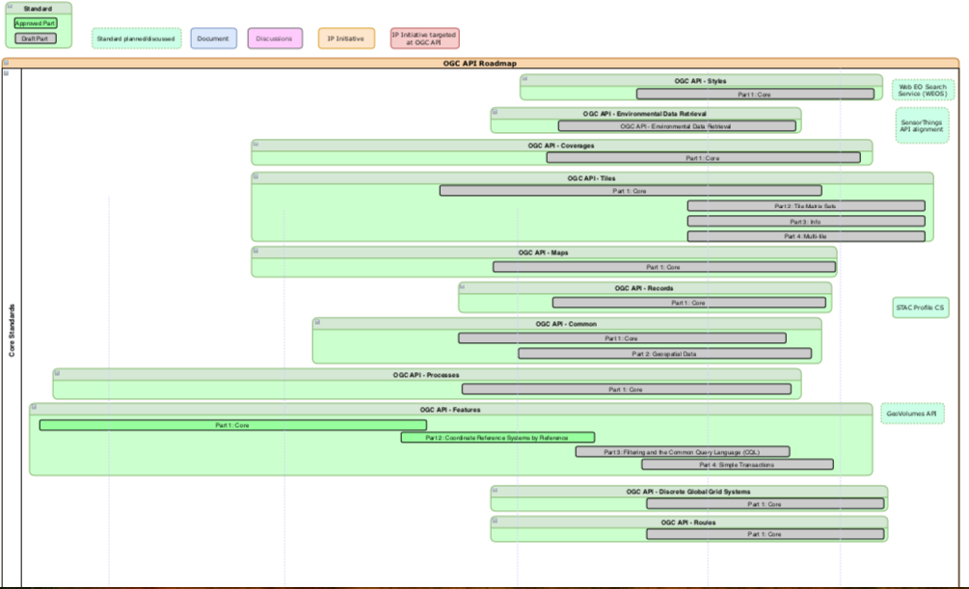
API Roadmap

Slide 15
UNGGIM
OGC, ISO/TC 211 and IHO
Contributed to the Integrated Geospatial Information Framework (IGIF)
Developed the Guide to the Role of Standards in Geospatial Information Management
Supporting UNGGIM work program in the areas of:
Land Administration and Management
Statistical and Geospatial Information Integration
Marine and International Boundaries
Geographic Names
Fundamental Geospatial Data Themes
Addressing
Land Cover & Land Use
Next Meeting (4-6 Aug)

