Slide 1
Profiles Guidance & Vocabulary
at the ANZLIC Metadata WG
Nicholas Car| Senior Experimental Scientist
21 February 2019
Land & Water

Slide 2
DXWG Profiling work in relation to DCAT
Motivation
seeing the proliferation of profiles of DCAT
DXWG members’ knowledge of profiles elsewhere
Scope of profiling work:
indicated by the 3 profile deliverables
Profile Guidance - https://www.w3.org/TR/dx-prof/
Profiles Vocabulary - https://www.w3.org/TR/dx-prof-guide/
Profile Negotiation - https://www.w3.org/TR/dx-prof-conneg/

Slide 3
DXWG Profiling work in relation to DCAT
Motivation
seeing the proliferation of profiles of DCAT
DXWG members’ knowledge of profiles elsewhere
Scope of profiling work:
indicated by the 3 profile deliverables
Profile Guidance - https://www.w3.org/TR/dx-prof/
Profiles Vocabulary - https://www.w3.org/TR/dx-prof-guide/
Profile Negotiation - https://www.w3.org/TR/dx-prof-conneg/
First Public Working Draft within weeks

Slide 4
DXWG Profiling work in relation to DCAT
Motivation
seeing the proliferation of profiles of DCAT
DXWG members’ knowledge of profiles elsewhere
Scope of profiling work:
indicated by the 3 profile deliverables
Profile Guidance - https://www.w3.org/TR/dx-prof/
Profiles Vocabulary - https://www.w3.org/TR/dx-prof-guide/
Profile Negotiation - https://www.w3.org/TR/dx-prof-conneg/
First Public Working Draft released in Dec, 18

Slide 5
Profile Guidance
ABSTRACT
“A profile is a named set of constraints on one or more identified base specifications, necessary to accomplish a particular function.
This document aims to provide guidance on how to create, describe and publish profiles.”

Slide 6
Profiles Vocabulary
ABSTRACT
The Profiles Vocabulary is an RDF vocabulary to describe profiles of (one or more) standards for information resources.
It describes the general pattern of narrowing the scope of a specification with additional, but consistent, constraints, and is particularly relevant to data exchange situations where conformance to such profiles is expected and carries additional context.
The Profiles Vocabulary enables profile descriptions to specify the role of resources related to data exchange such as schemas, ontologies, rules about use of controlled vocabularies, validation tools, and guidelines.
The ontology may however be used to describe the role of artifacts in any situation where constraints are made on a the usage of more general specifications.

Slide 7
Profile Negotiation
ABSTRACT
This document describes how Internet clients may negotiate for content provided by servers according to profiles. This is distinct from negotiating by Media Type or Language: the profile is expected to specify the content of information returned, which may be a subset of the information the responding server has about the requested resource, and may be structured in a specific way to meet interoperability requirements of a community of practice.

Slide 8
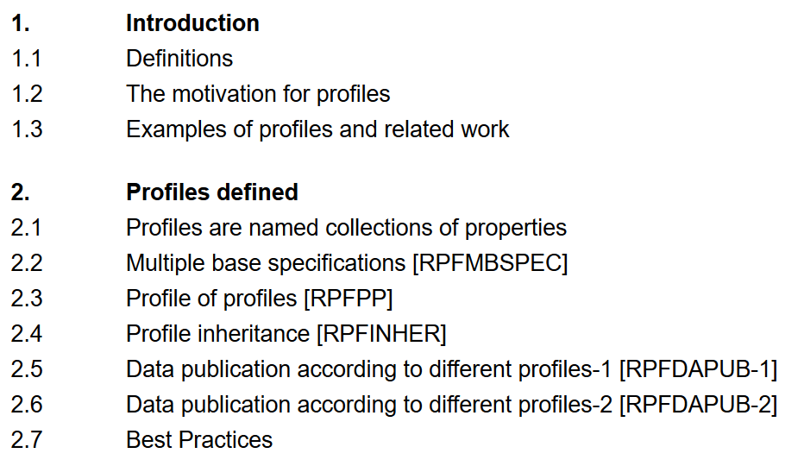
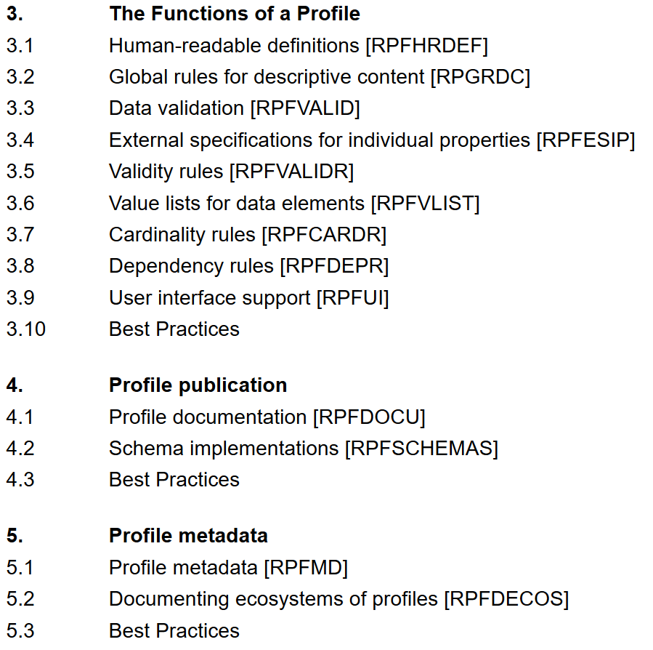
Profile Guidance – content

Slide 9
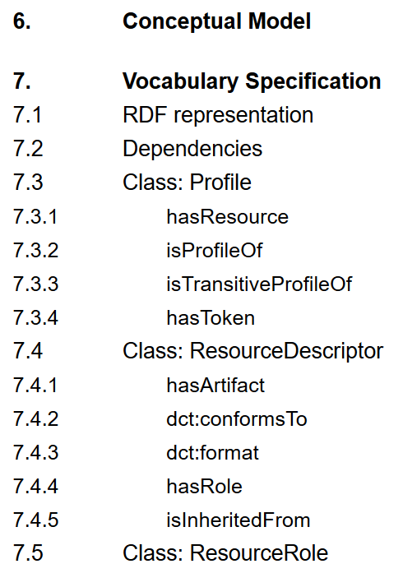
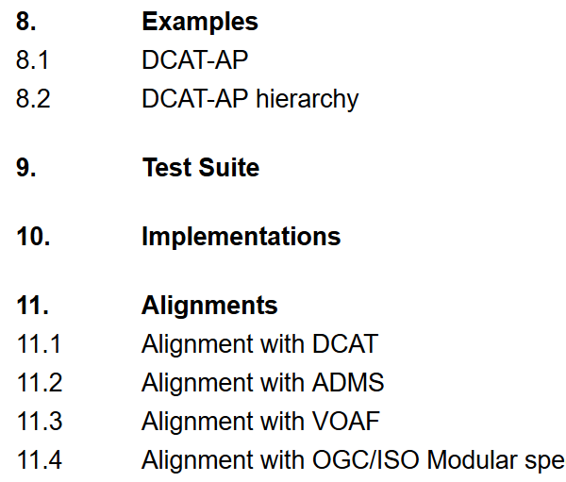
Profiles Vocabulary - content

Slide 10
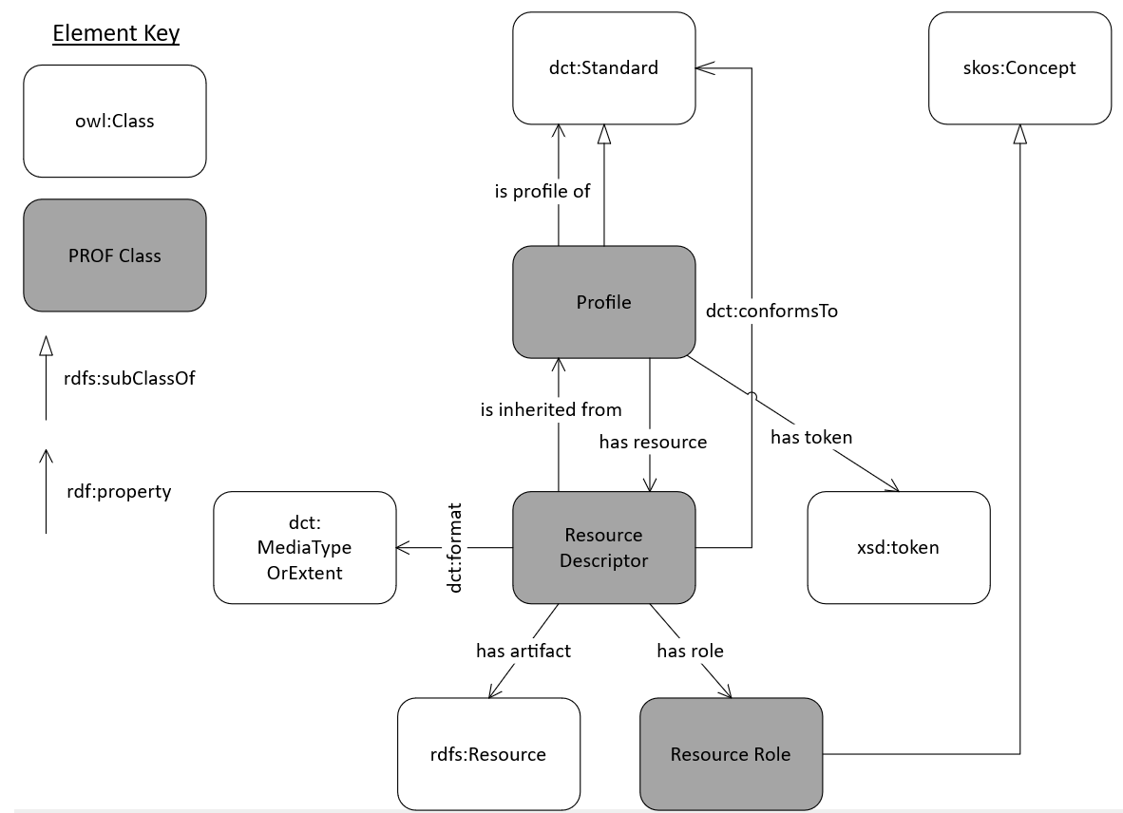
Profiles Vocabulary – model overview

Slide 11
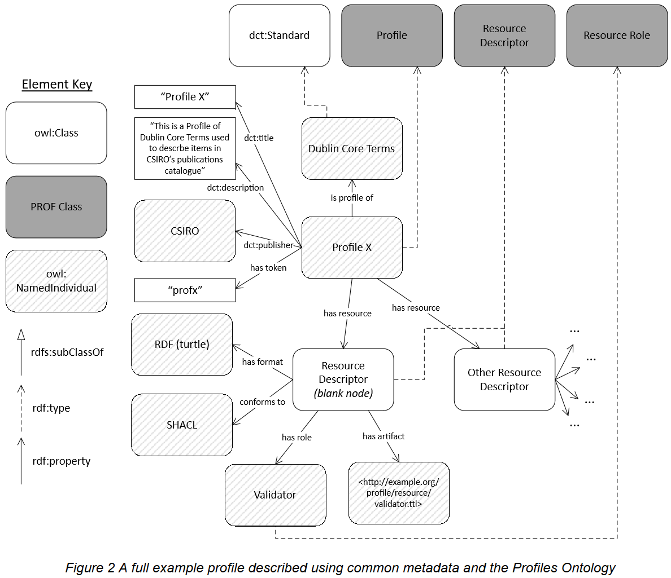
Profiles Vocabulary - example

Slide 12
Profiles Vocabulary – use of hierarchy
The Voc allows for:
Profiles of Standards & other Profiles
Parts of profiles to be defined
Parts of profiles inherited from Profiles/Standards
The Voc enables:
Reduced effort to define a profile
Human & Machine (H&M) methods to access profile parts
constraints
H&M mechanics to ‘flatten’ profile parts in a hierarchy

Slide 13
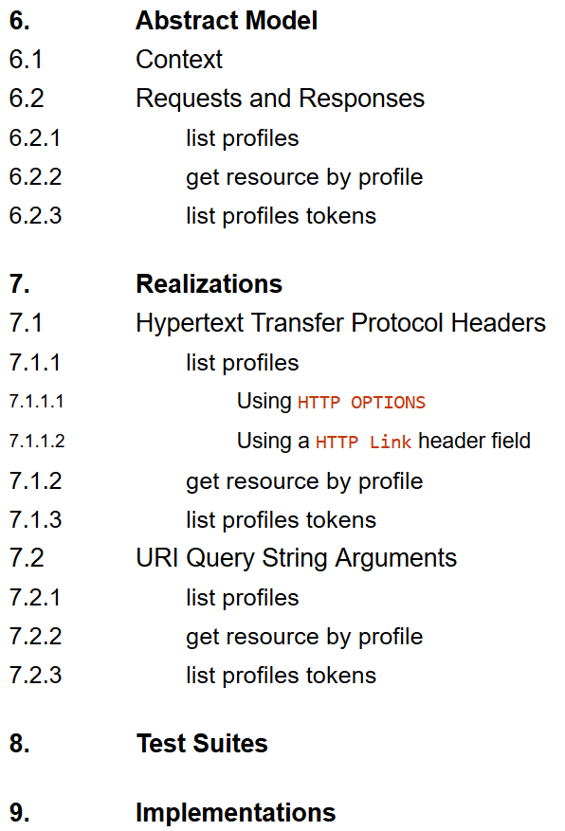
Profile Negotiation - content

Slide 14
Profile Negotiation - model
list profiles a client requests the list of URIs of profiles for which a server is able to deliver conformant resources
get resource by profile a client requests a representation of the requested resource represented conforming to a particular profile

Slide 15
Profile Negotiation - model
list profiles – example
Request:
GET <some-resource-URI>
Response:
resource per default profile
listing of other profiles resource can be delivered according to

Slide 16
Profile Negotiation - model
list profiles – example via HTTP
Request:
HEAD <some-resource-URI>
Response:
list of Profile URIs the resource can be delivered according to

Slide 17
Profile Negotiation - model
get resource by profile & list profiles – example via CKAN
Request:
GET <some-resource-URI>
Response:
resource given according to default profile
listing of other profiles resource can be delivered according to
or
GET <some-resource-URI>?_profile=xxx ← per Profile X

Slide 18
Nicholas Car
Senior Experimental Scientist
t +61 7 3833 5632
e nicholas.car@csiro.au
w people.csiro.au/Nicholas-Car
Land & Water

