Slide 1






Australian Geospatial Reference System
Webinar Series
Webinar 2: Geocentric Datum of Australia 2020
Nicholas Brown
Director of National Geodesy
Geoscience Australia
Chair of ICSM Permanent Committee on Geodesy
@nich0lasbr0wn

Slide 2


www.sli.do
#AGRS
www.sli.do #AGRS

Slide 3

Who am I?
Director of National Geodesy at Geoscience Australia
Commonwealth representative on Intergovernmental Committee on Surveying and Mapping (ICSM)
Chair of the ICSM Permanent Committee on Geodesy (PCG)
Australian representative on FIG Commission 5 – Positioning and Measurement
Favourite geodesist - Copernicus
www.sli.do #AGRS

Slide 4



ATRF
GDA2020
AVWS
7 cm/yr
σ = 1-8 cm
Australian Terrestrial Reference Frame
Australian Plate Motion Model
Geocentric Datum of Australia 2020
Australian Quasigeoid Model
Australian Vertical Working Surface
Webinar 3: ATRF
AHD
Δ 1.8 m
σ = 6-13 cm
Webinar 2: GDA2020
Transformation parameters / grids
AUSGeoid2020
Australian Height Datum
GDA94
Webinar 4: Height
σ = ?
Geocentric Datum of Australia 1994
AUSGeoid09
Notes:
PCG ensures Australia and New Zealand have the geospatial reference systems *including datums, reference frames, working surfaces, and standards to meet user needs.
It’s complex – yes – but as we try to measure things more accurately, we need to ensure we have the grs to enable those applications.

Slide 5
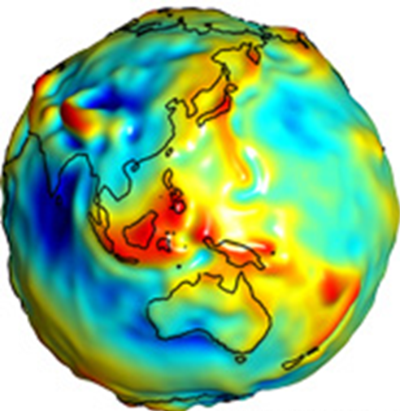
Geodesy
noun
Science of measuring the shape, orientation and gravity field of the Earth and how it changes over time.
orientation
Geospatial Reference System
noun
Collection of datums, infrastructure, models and standards required for 4D positioning.
shape
Geodesist
noun
Magical creatures who create and maintain the Geospatial Reference System.
gravity field
www.sli.do #AGRS
Notes:
Geodesy – read off screen,
GRS - explain there are geometric and physical components of a GRS

Slide 6
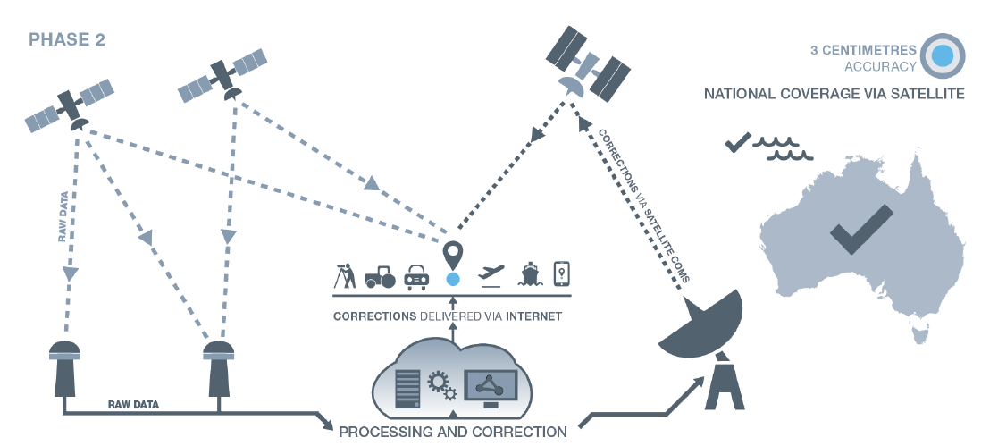
Accuracy
3-10 cm
www.sli.do #AGRS

Slide 7
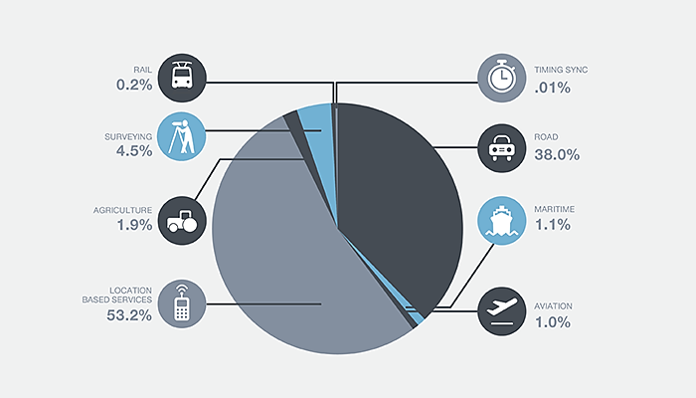
GNSS chipset sales (2013-2023)
Traditional markets make up <10% of GNSS chipset sales
Significant growth in new markets:
Location Based Services
Intelligent Transport
The cumulative distribution of global core revenue (value of GNSS chipsets) projected by the European GNSS Agency (GSA, 2015) for the period 2013 – 2023.
www.sli.do #AGRS

Slide 8

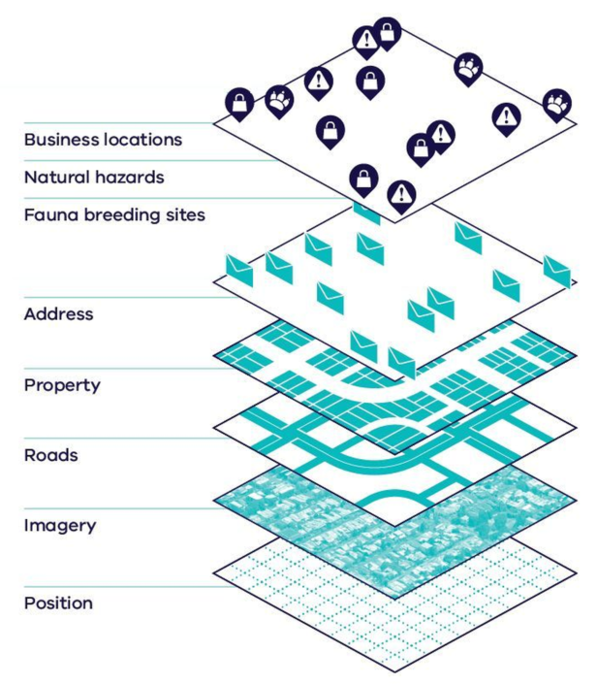
Why couldn’t GDA94 meet user requirements?
GDA2020
Positions from GNSS satellites do match data on GDA2020
Offset from GNSS: 0 m on 1/1/2020
Spatial data is aligned at 10 cm level for improved decision making
Geocentric Datum of Australia 2020
GDA94
Positions from GNSS satellites do not match data on GDA94
Offset from GNSS: ~1.8 m (~7 cm / plate tectonic motion
Spatial data can’t be aligned for good decision making
We aren’t capitalising on the benefits of precise positioning
Geocentric Datum of Australia 1994
www.sli.do #AGRS

Slide 9
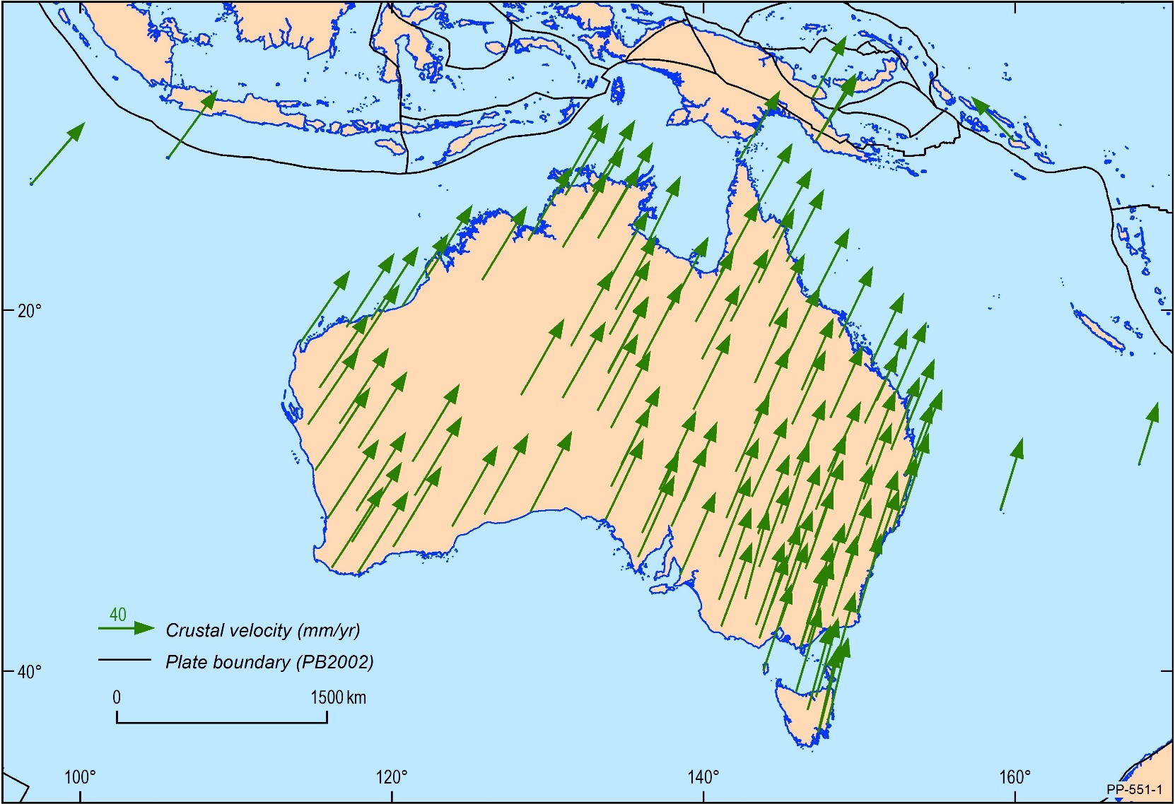
Why couldn’t GDA94 meet user requirements?
Motion of the Australian Plate
Australia is the fastest moving continental plate (~7 cm/yr NNE)
GNSS provides coordinates in ITRF (position of Australian plate now)
Users will soon see a ~1.8 m mismatch between GNSS positions and spatial datasets (if in GDA94)
Why not just transform it back to 1994? …
www.sli.do #AGRS

Slide 10
+
GDA2020 = ITRF2014@2020
ITRF2014 coordinates are different to ITRF1992 coordinates
e.g. heights are 9 cm different
Why don’t they match?
Changes in the reference frame between the ITRF1992 and today
Local distortions (e.g. subsidence, earthquakes)
Lack of rigour in the way GDA94 coordinates were computed
~7 cm / yr
Updates to ITRF; 1994, 1996, 1997, 2000, 2005, 2008, 2014.
Each is an improved realisation of the shape of the Earth
7 parameter
transformation
+
+
ITRF1992@1995.0 (~7 cm NNE of 1994)
GDA94 = ITRF1992@1994.0
www.sli.do #AGRS

Slide 11
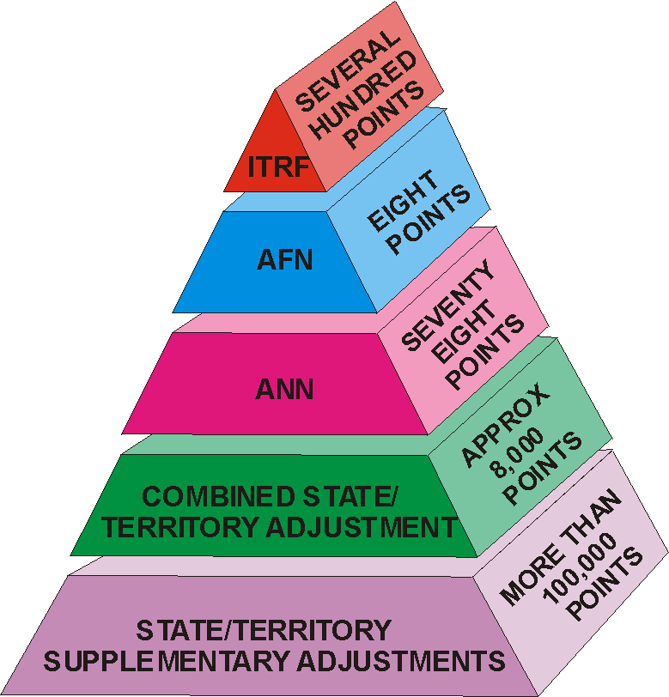
Why couldn’t GDA94 meet user requirements?
2. Distortion in GDA94
Changes in the reference frame between the ITRF1992 and today
Local distortions (e.g. subsidence, earthquakes)
Lack of rigour in the way GDA94 coordinates were computed
ITRF1992 @ 1994.0
Updated to 21 points in April 2012
GDA94
Adjustments
www.sli.do #AGRS
Notes:
These vectors show the offset between GDA94 as established in 1997 compared to ITRF coordinates observed in 2010 transformed back to 1994
Majority of errors in the order of 10 – 20 cm but extend to 30 cm.
local distortions (e.g. subsidence, surface heave)
poor uncertainty propagation down to the marks in the original adjustment (particularly around relative uncertainty)
changes in the reference frame between the ITRF 1992 and today
The implications for errors introduced for big data surveys like LiDAR start to become relevant. When assessing data, how do you know whether the uncertainty is in the survey data or in the datum?

Slide 12
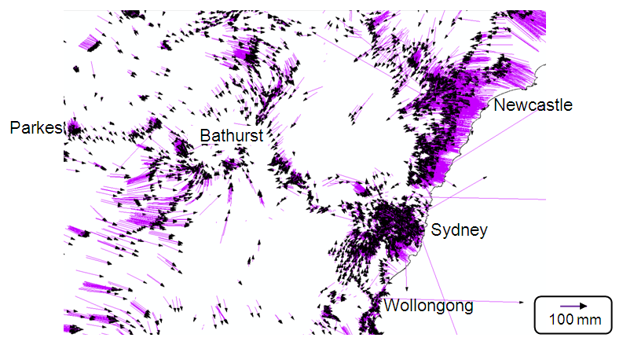
Why couldn’t GDA94 meet user requirements?
2. Distortion in GDA94
Changes in the reference frame between the ITRF1992 and today
Local distortions (e.g. subsidence, earthquakes)
Lack of rigour in the way GDA94 coordinates were computed
Source: Joel Haasdyk and Tony Watson, LPI NSW, APAS Conference 2013
www.sli.do #AGRS
Notes:
These vectors show the offset between GDA94 as established in 1997 compared to ITRF coordinates observed in 2010 transformed back to 1994
Majority of errors in the order of 10 – 20 cm but extend to 30 cm.
local distortions (e.g. subsidence, surface heave)
poor uncertainty propagation down to the marks in the original adjustment (particularly around relative uncertainty)
changes in the reference frame between the ITRF 1992 and today
The implications for errors introduced for big data surveys like LiDAR start to become relevant. When assessing data, how do you know whether the uncertainty is in the survey data or in the datum?

Slide 13
Building GDA2020
ITRF2014
1. Start global
Link to the global reference frame
20 GNSS stations in Australia
constraint
+
2017 RVS Determination
APREF
2. Increase density
Asia-Pacific Reference Frame (Regional reference frame)
454 GNSS stations
+
3. Legal Determination of ‘Datum’
109 sites in Australia
  Coordinates
  Velocities
  Uncertainties
  Equation to propagate coordinates over time
GNSS Campaign Data
4. Provide access
Rigorous national adjustment (all GNSS and terrestrial observations were used in the same adjustment)
  ~2 million observations
  ~250,000 stations
access
+
Jurisdictional archive
GDA2020
www.sli.do #AGRS

Slide 14
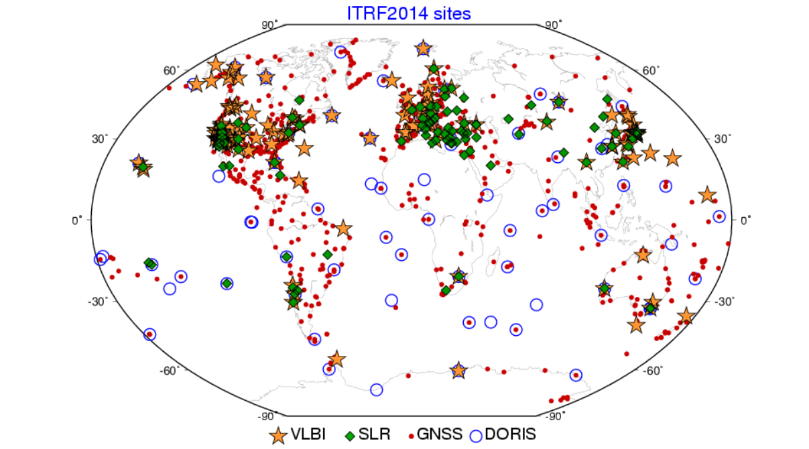
International Terrestrial Reference Frame 2014
www.sli.do #AGRS

Slide 15
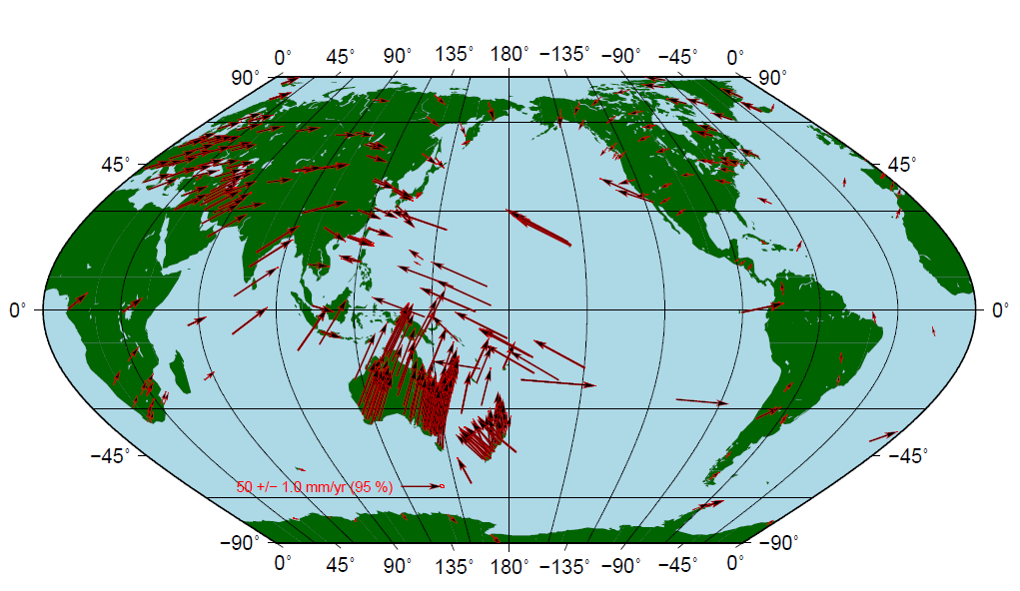
Asia Pacific Reference Frame (APREF)
Denser regional reference frame
GNSS CORS from the Asia-Pacific region
454 stations
www.sli.do #AGRS

Slide 16
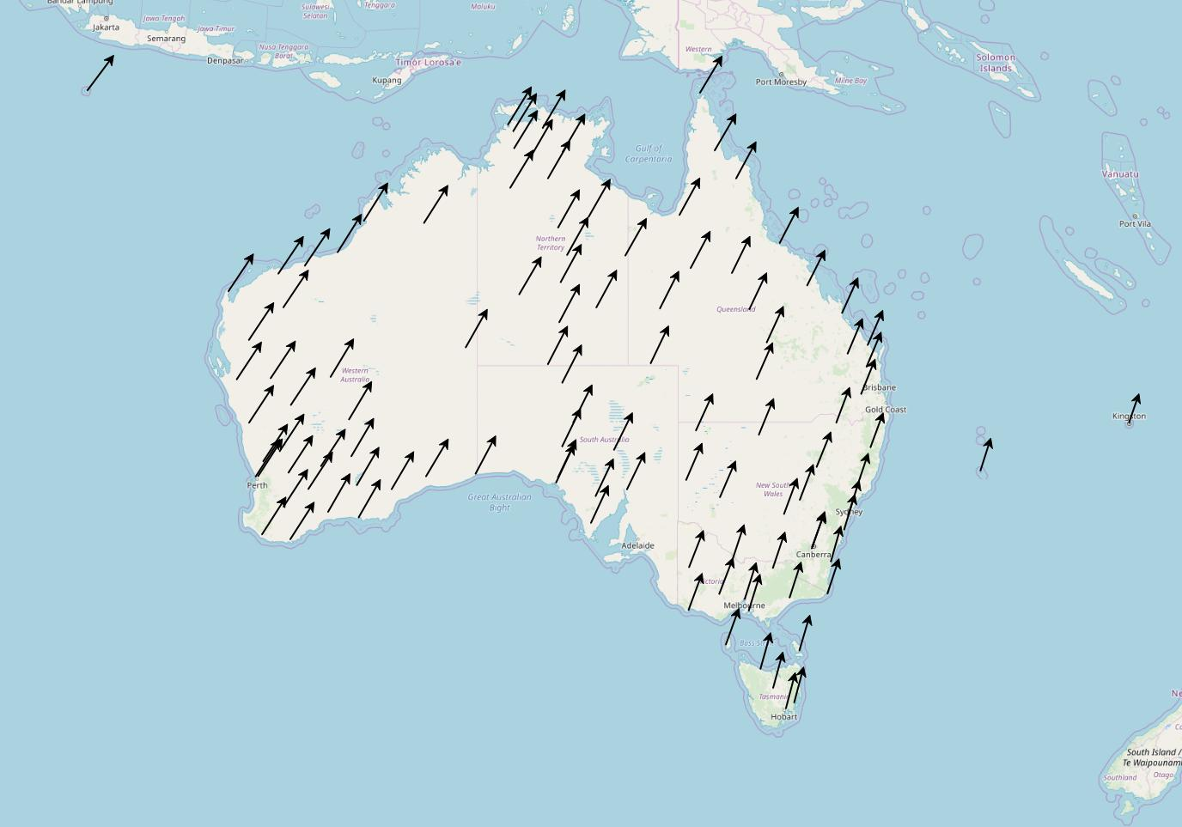
2017 RVS Determination (109 subset of APREF)
Criteria for RVS
Operated by Geoscience Australia, state, or territory;
Located on the Australian Tectonic Plate, within Australia’s jurisdiction and on a high quality survey monument; and
Have residuals less than 1 mm/yr relative to plate motion
69 mm/year
70 mm/year
60 mm/year
70 mm/year
57 mm/year
www.sli.do #AGRS

Slide 17
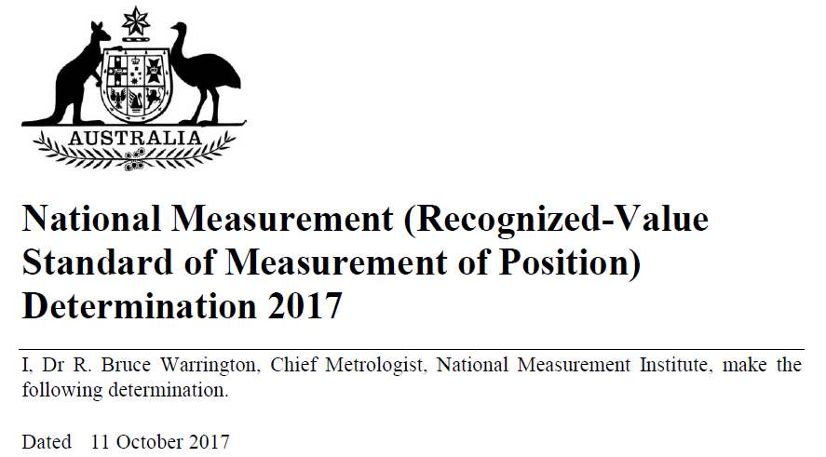
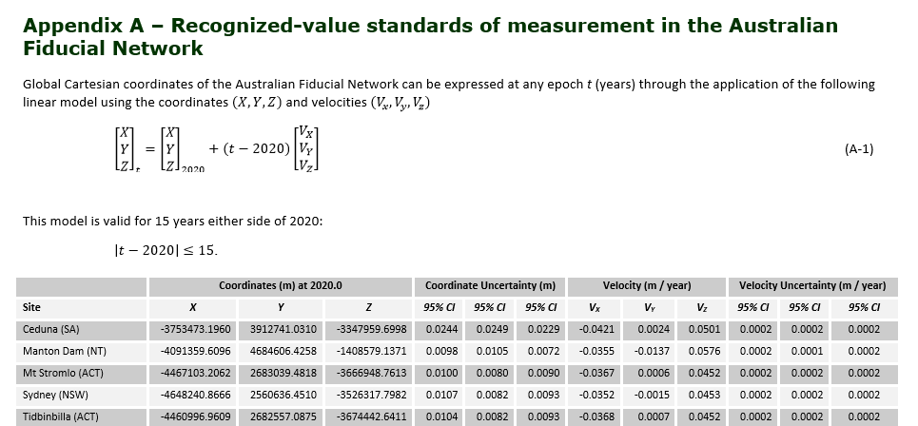
GDA2020 Determination made in October 2017
Legal Determination of coordinates, velocities and uncertainties of 109 reference sites
Equation permits propagation of coordinates over time
www.sli.do #AGRS
Notes:
PCG proposed the development of a new national datum – GDA2020

Slide 18
Building GDA2020
ITRF2014
1. Start global
Link to the global reference frame
20 GNSS stations in Australia
constraint
+
2017 RVS Determination
APREF
2. Increase density
Asia-Pacific Reference Frame (Regional reference frame)
454 GNSS stations
+
3. Legal Determination of ‘Datum’
109 sites in Australia
  Coordinates
  Velocities
  Uncertainties
  Equation to propagate coordinates over time
GNSS Campaign Data
4. Provide access
Rigorous national adjustment (all GNSS and terrestrial observations were used in the same adjustment)
  ~2 million observations
  ~250,000 stations
access
+
Jurisdictional archive
GDA2020
www.sli.do #AGRS

Slide 19
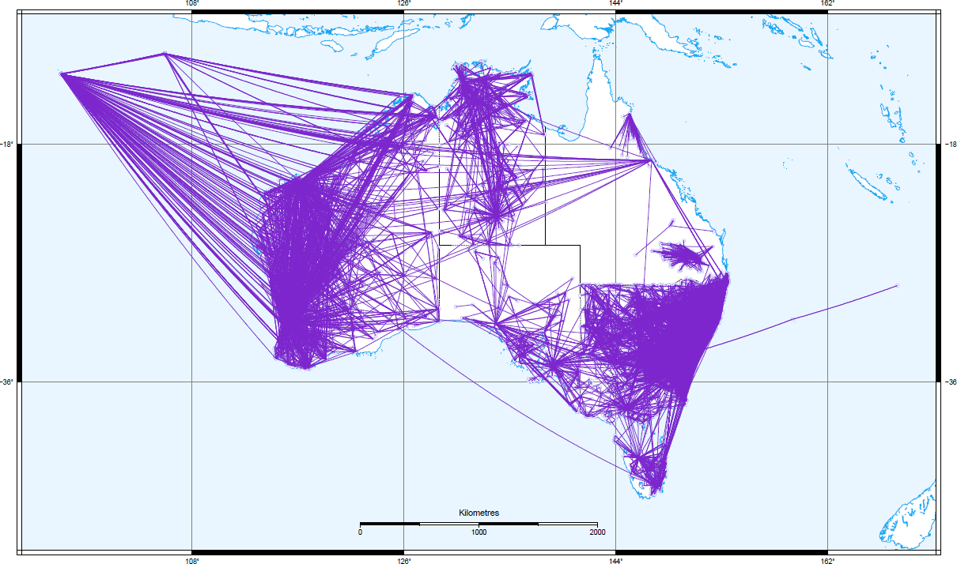
GNSS Campaign Data
Ground marks, not Continuously Operating Reference Stations
6+ hour GNSS observations
Input in the national adjustment as ‘baselines’
Not constraint in the adjustment, just measurements
www.sli.do #AGRS

Slide 20
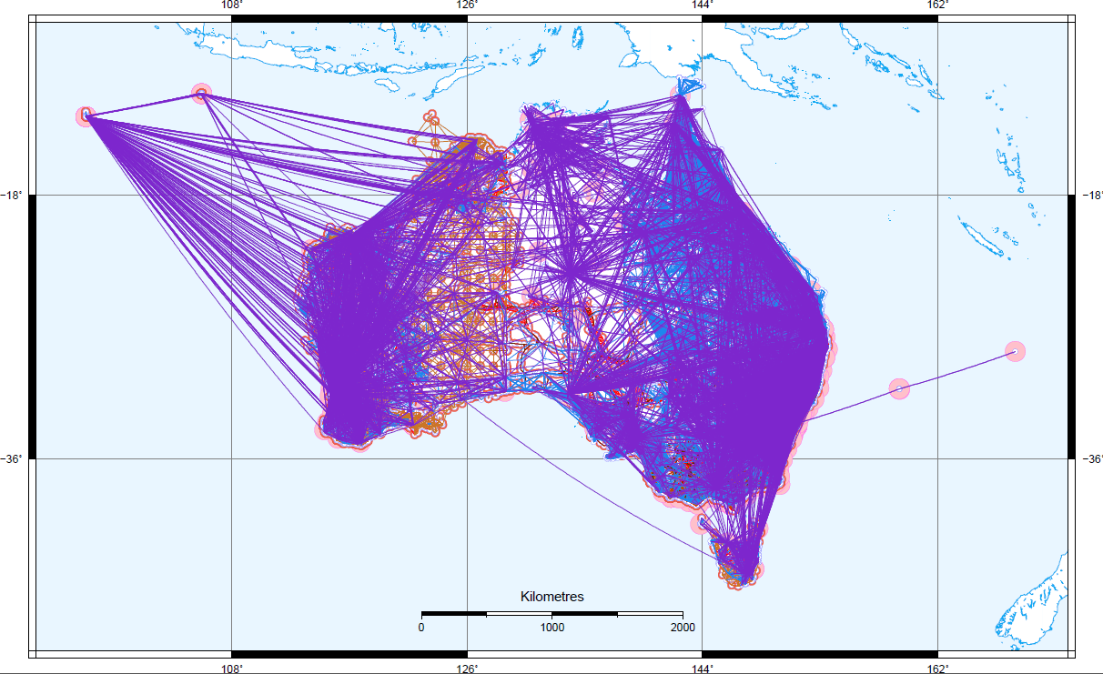
Jurisdictional Archive
Ground marks, not Continuously Operating Reference Stations
<6 hour GNSS observations
Terrestrial observations
Input in the national adjustment as ‘baselines’
Not constraint in the adjustment, just measurements
www.sli.do #AGRS

Slide 21
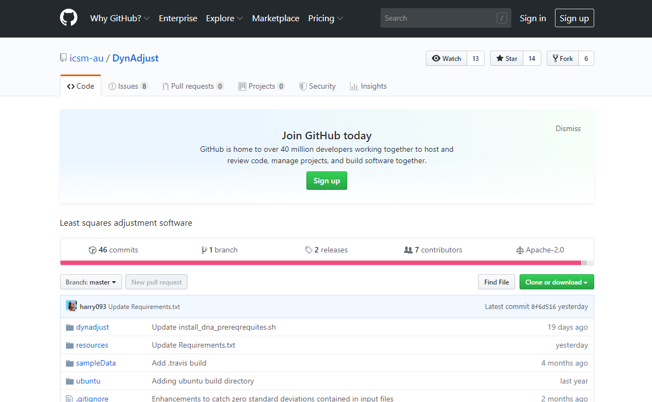
DynAdjust – Open Source – it’s FREE!
https://github.com/icsm-au/DynAdjust
www.sli.do #AGRS

Slide 22
2. Campaign
1. APREF
3. Jurisdiction
measurements
www.sli.do #AGRS

Slide 23
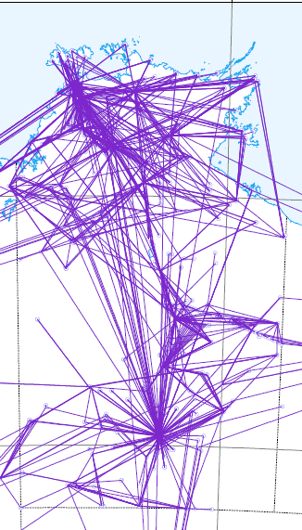
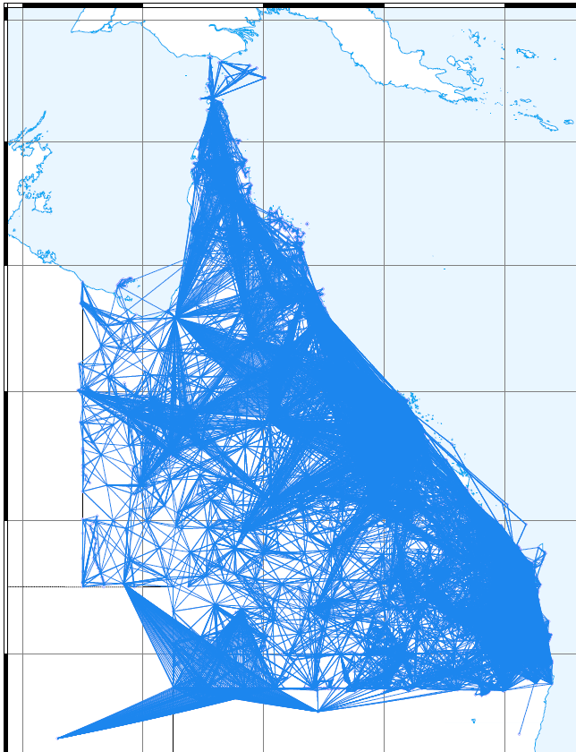
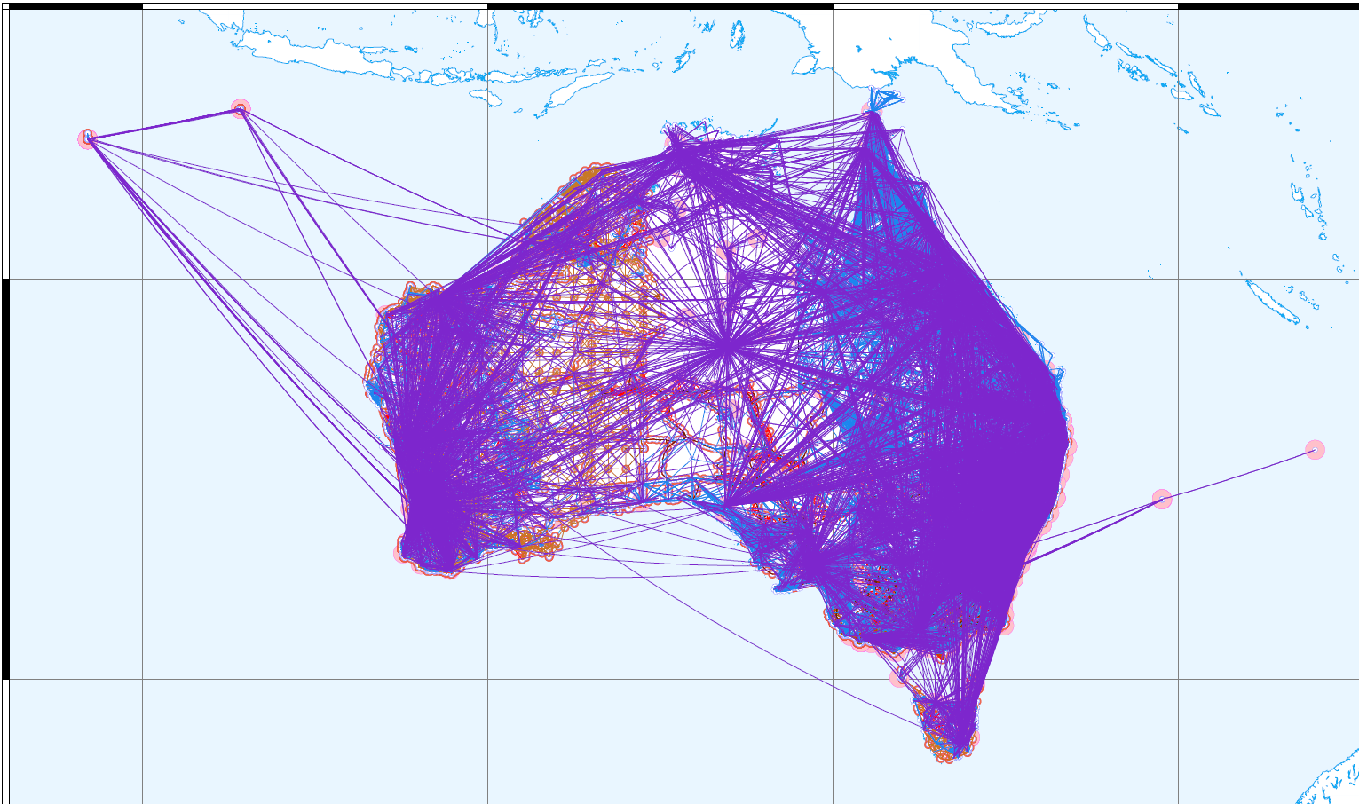
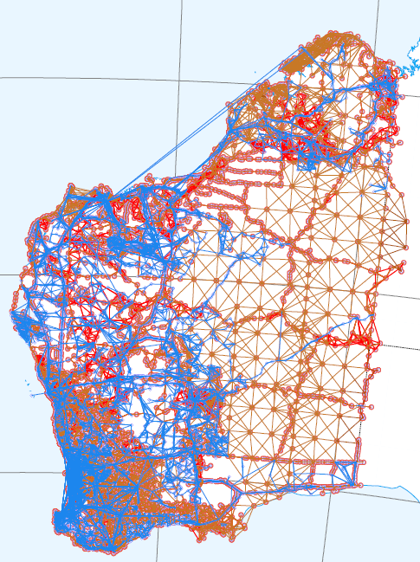
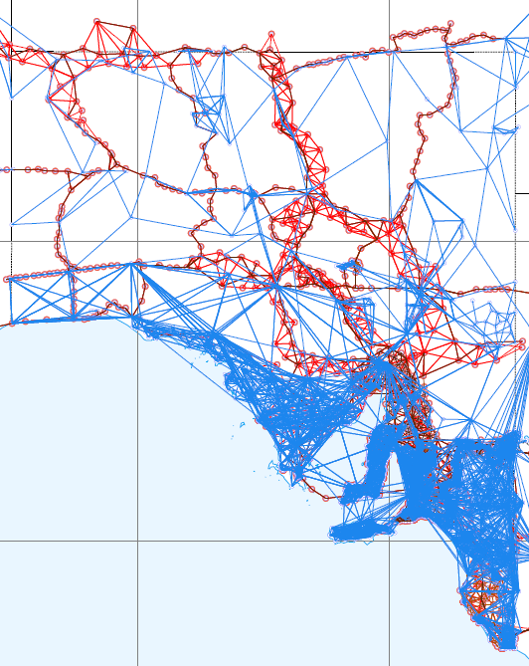
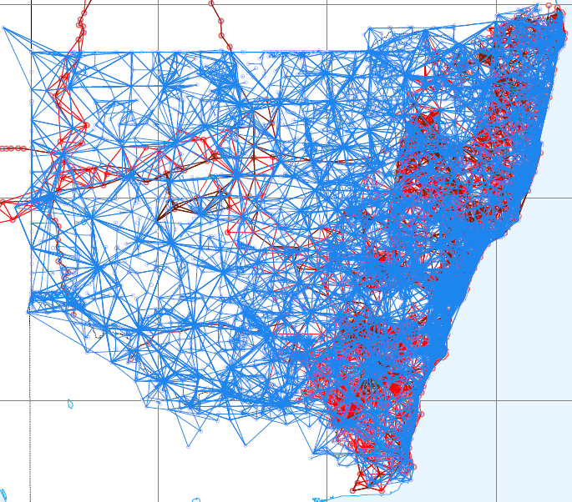
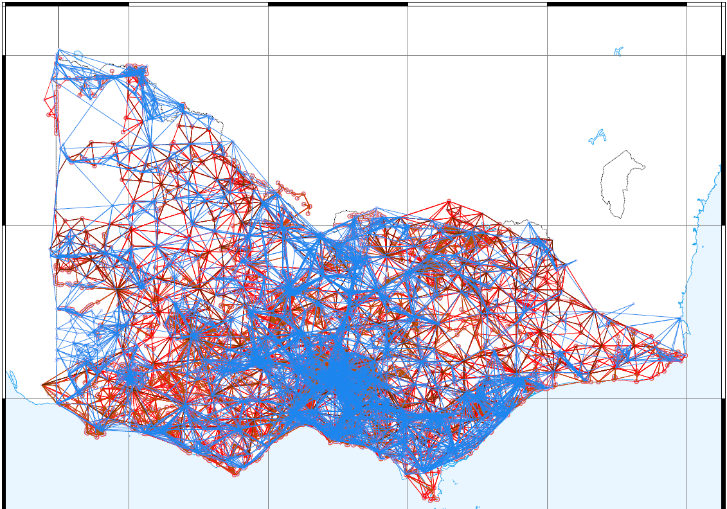
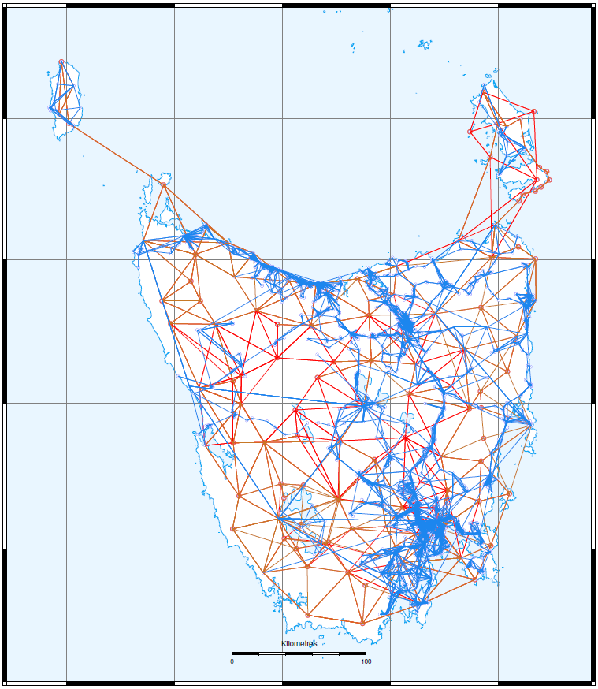
Differences | GDA94 | GDA2020
Adjustment approach | State-based, non-contiguous | National
Constraint | AFN, ANN, Marks | CORS solution
GDA94
GDA2020
Courtesy of Alex Woods, DELWP
www.sli.do #AGRS

Slide 24
GDA2020 Products and Tools
Transformations from GDA94 to GDA2020
  7 parameter transformation (3D)
  NTv2 grids (2D)
    Conformal
    Conformal + Distortion
  Spreadsheet (3D)
  Coordinate transformation web service (based on FME) (2D / 3D)
AUSGeoid2020
GDA2020 Technical Manual
Fact sheets and help guides
https://www.icsm.gov.au/datum/gda-transformation-products-and-tools
www.sli.do #AGRS

Slide 25
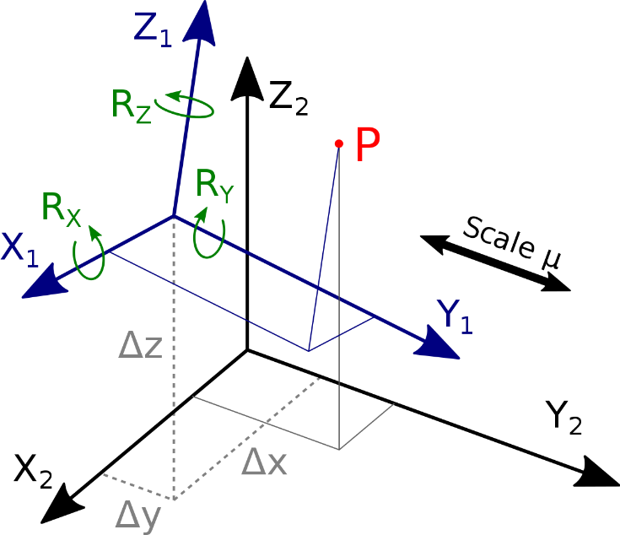
GDA94 – GDA2020 Transformation Parameters
Use common points from GDA94 Determination and GDA2020 Determination
21 reference points from GDA94 AFN minus MAC1, COCO and XMIS due to seismic displacement
Input the coordinates for 18 sites common to GDA94 and GDA2020
Solve for the 7-parameters (3 x rotation, 1 x scale and 3 x translation) using CATREF software
www.sli.do #AGRS

Slide 26
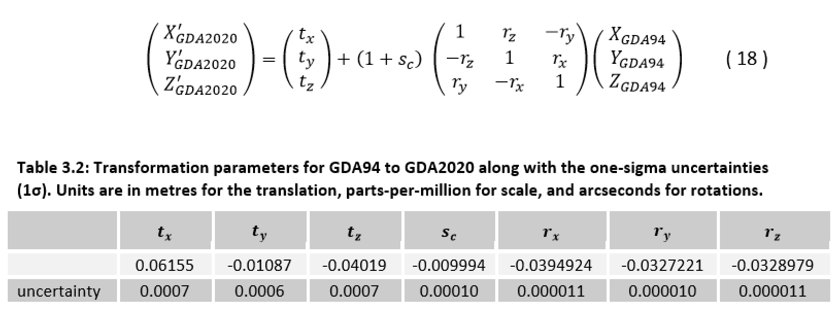
GDA94 – GDA2020 7 Parameter Transformation
GDA2020 Technical Manual
Convert coordinates from Lat, Long, Ht to X Y Z
Apply this transformation
Convert coordinates from X Y Z to Lat, Long, Ht
3D transformation – deals with 9 cm difference between ITRF1992 and ITRF2014
www.sli.do #AGRS

Slide 27
GDA94 – GDA2020 7 Parameter Transformation
www.sli.do #AGRS

Slide 28
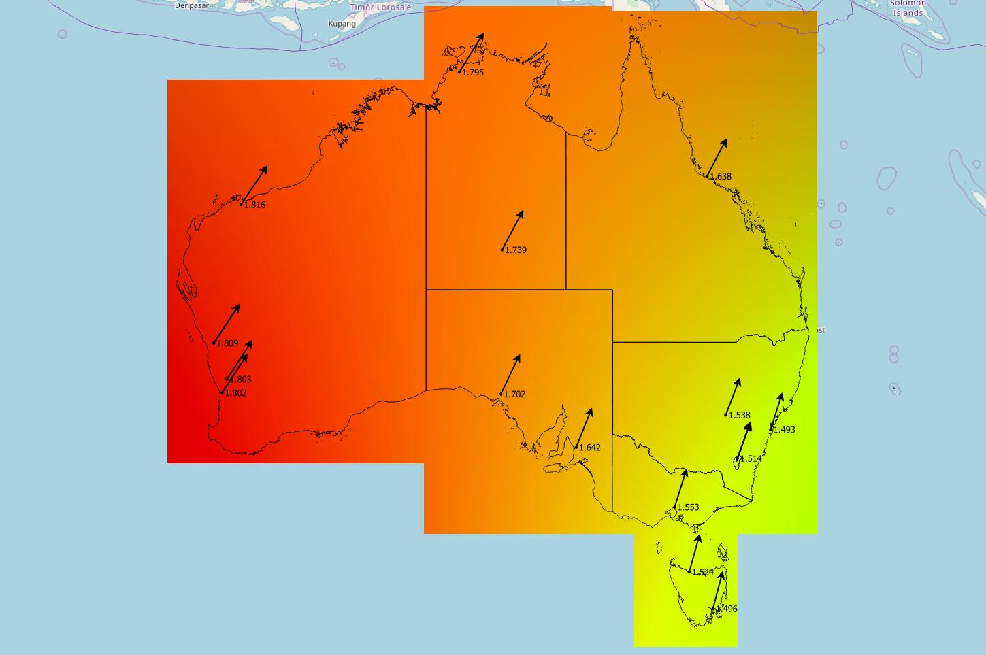
GDA94 – GDA2020 NTv2 Conformal Transformation Grid
Grid representation of 7 parameter conformal transformation
Application:
2D data
Data not influenced by the survey control mark network - GNSS only
1.638 m
1.816 m
1.739 m
1.802 m
1.702 m
1.553 m
1.496 m
Courtesy of Alex Woods, DELWP
www.sli.do #AGRS

Slide 29
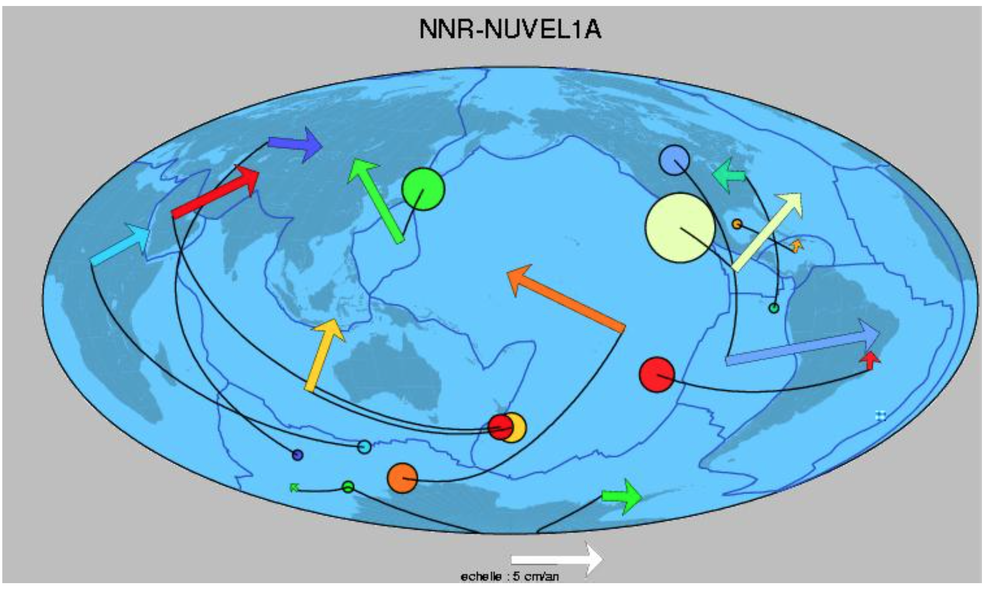
Euler Pole

Slide 30
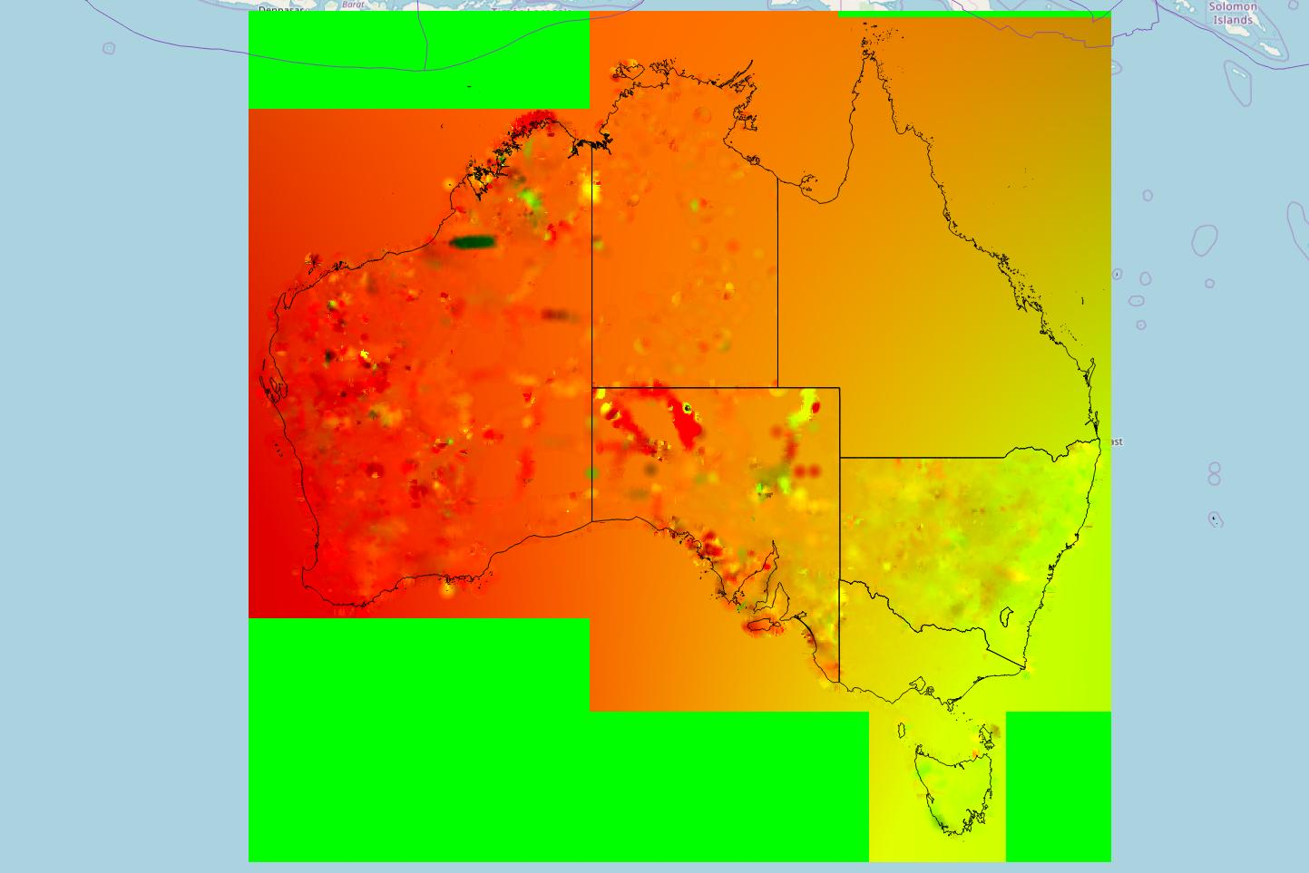
GDA94 – GDA2020 NTv2 Conformal + Distortion Transformation Grid
Input:
Conformal grid
Survey marks
  Published GDA94
  Adjusted GDA2020
Application:
2D
Data aligned with survey control mark network
Courtesy of Alex Woods, DELWP
www.sli.do #AGRS

Slide 31
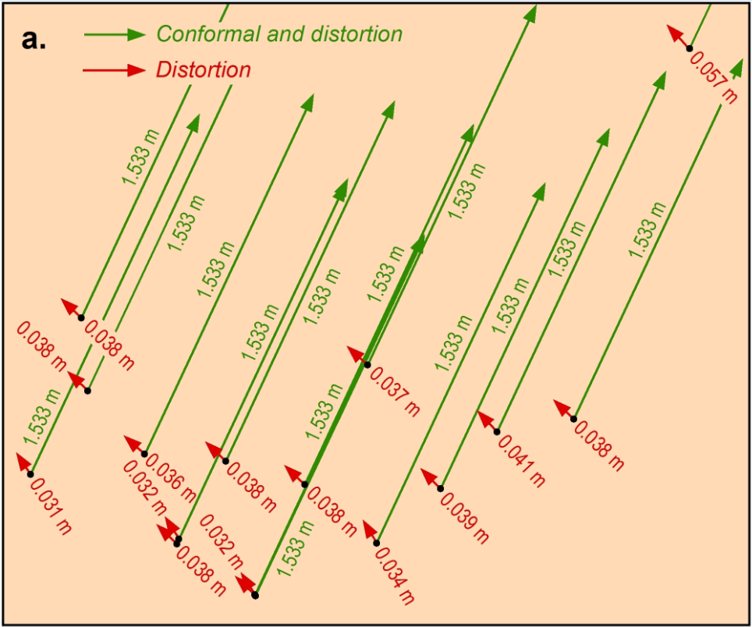
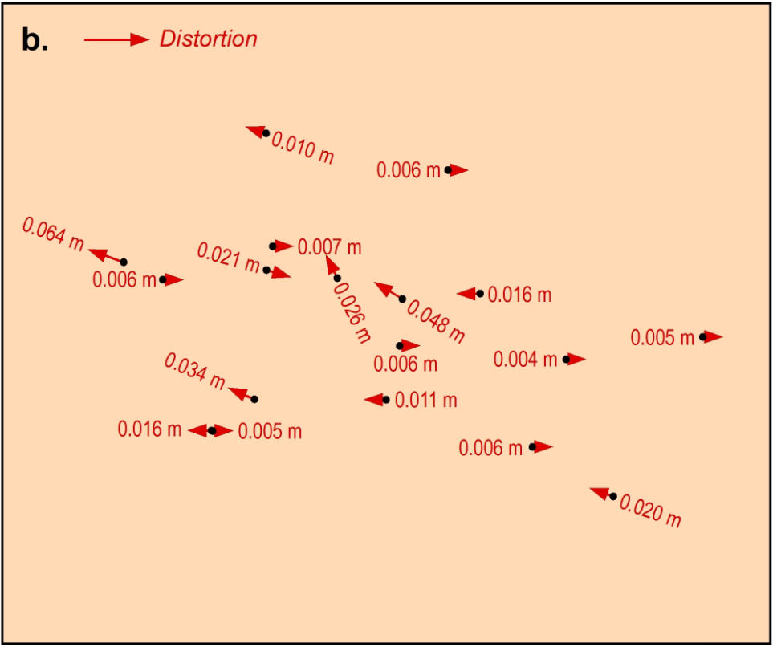
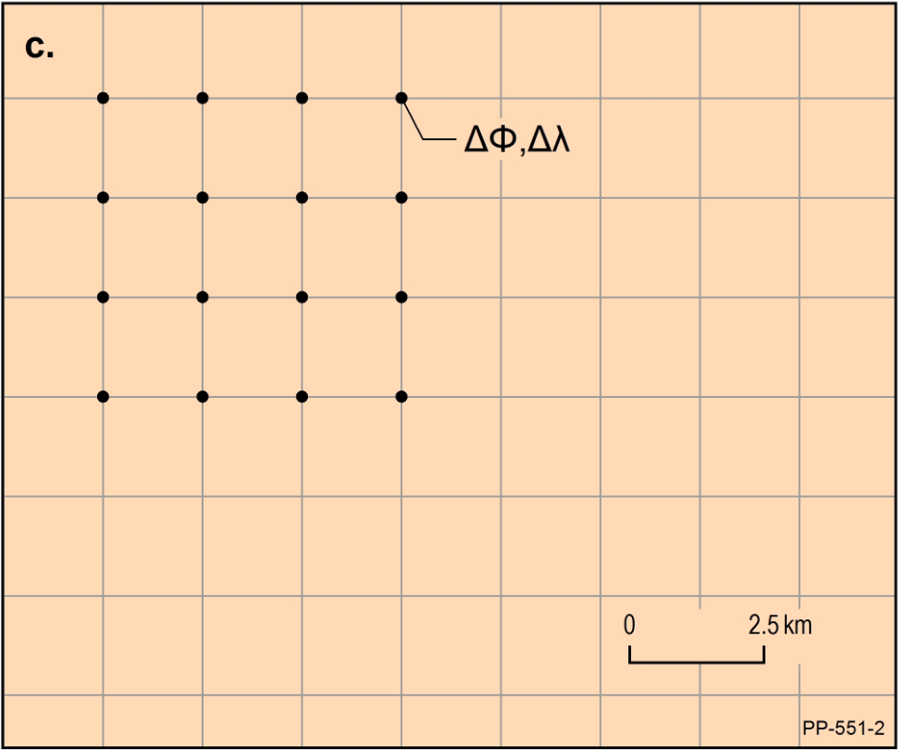
GDA94 – GDA2020 NTv2 Conformal + Distortion Transformation Grid
conformal (green) and distortion (red) components of the transformation grids;
low reliability of distortion component;
the grid has a latitude component and longitude component.
www.sli.do #AGRS

Slide 32
Choice of transformation tool
Transformation Option | Data | Coordinates
7 parameter | Recommended for users transforming from GDA94 coordinates derived from CORS | 3D
Conformal grid | Recommended for users transforming from GDA94 coordinates derived from CORS | 2D
Conformal + Distortion grid | Appropriate for users transforming GDA94 coordinates derived from survey marks (e.g. SCIMS or SCIMS-localised CORS control). | 2D
Specific jurisdictional advice supplied in GDA2020 Technical Manual
If in doubt contact your state / territory land survey authority
Courtesy of Alex Woods, DELWP
www.sli.do #AGRS

Slide 33
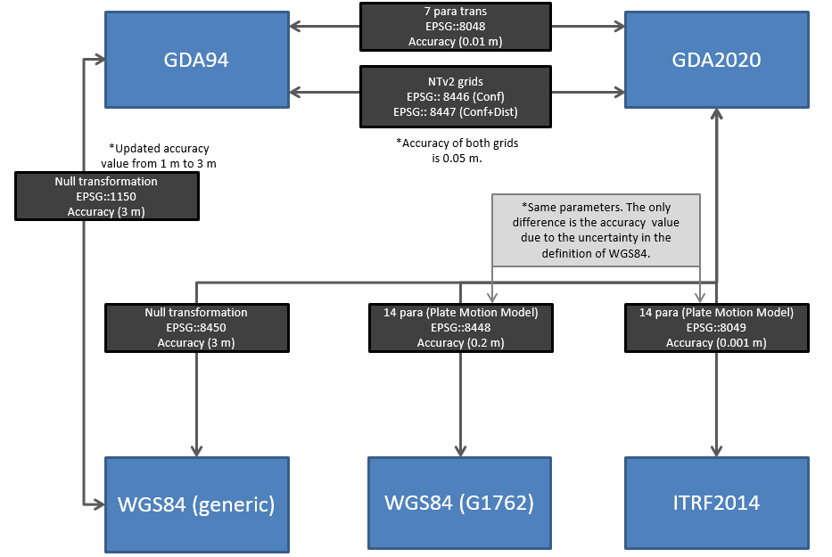
EPSG Codes
Update accuracy of GDA94-WGS84(generic) EPSG code (1150) from 1 m to 3 m
Introduction of GDA94-GDA2020 EPSG codes
Introduction of GDA2020-ITRF2014 EPSG code (8049)
www.sli.do #AGRS

Slide 34
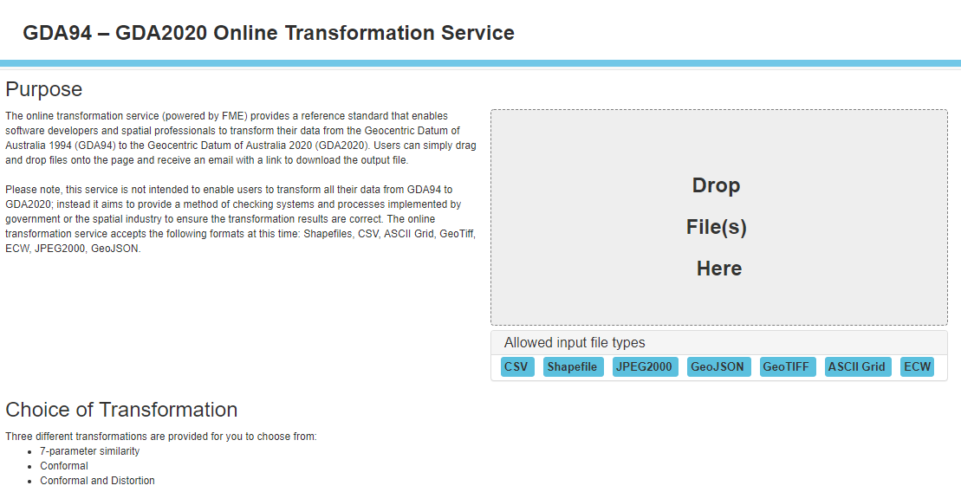
GDA94 – GDA2020 Transformation Service
http://positioning.fsdf.org.au/
www.sli.do #AGRS

Slide 35
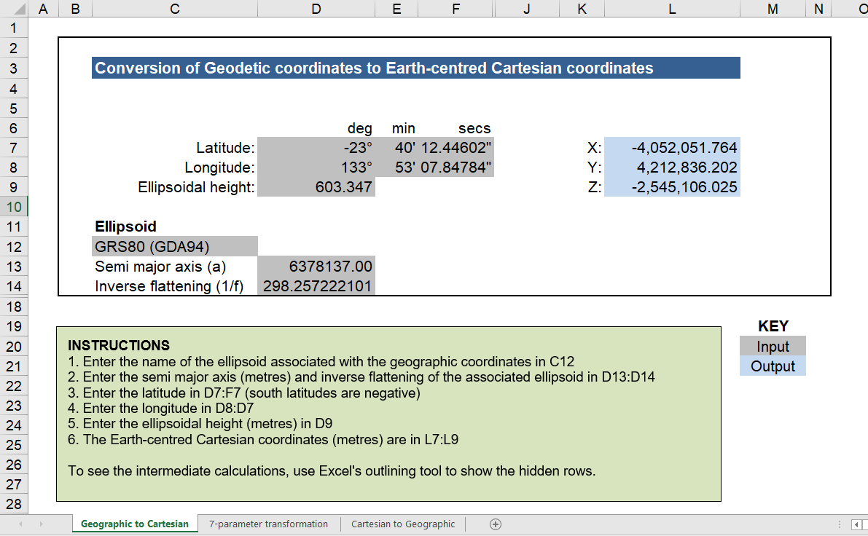
https://github.com/icsm-au/DatumSpreadsheets
www.sli.do #AGRS

Slide 36
MGA94 to MGA2020
MGA94 to GDA94 (conversion: Krueger equations)
GDA94 to GDA2020 (transformation)
GDA2020 to MGA2020 (conversion: Krueger equations)
See GDA2020 Technical Manual for details and examples to perform these conversions and transformations
www.sli.do #AGRS

Slide 37












Supporting GDA2020 since 9 February 2019
www.sli.do #AGRS

Slide 38
GNSS CORS supporting GDA2020
GNSS CORS are now operating using GDA2020 coordinates
  CORS Networks will continue to support both GDA94 and GDA2020 real-time services
  There is currently no sunset date for GDA94
  RINEX and post processing products are typically GDA2020 by default (though they can be transformed easily)
  Users should consult their hardware or software supplier for further information
Courtesy of Hayden Asmussen, DELWP
www.sli.do #AGRS

Slide 39
GDA2020 compliant vs GDA2020 compatible
GDA2020 Compliant Products
Are based on positions measured or calculated directly from coordinated positions that are traceable to the National Measurement (Recognized-Value Standard of Measurement of Position) Determination 2017.
Use algorithms that can produce the same results as the Geocentric Datum of Australia 2020 Technical Manual examples and sample data and the GDA94 – GDA2020 Online Transformation Service, within the limits of position uncertainties required by the product, and as documented by the product.
GDA2020 Compatible Products
Use a position uncertainty such that the difference between the datum used and GDA2020 is insignificant.
Contain support material consistent with the technical requirements set out in the Geocentric Datum of Australia 2020 Technical Manual and state the datum or reference frame being used or transformation algorithms used in preparing the product.

Slide 40
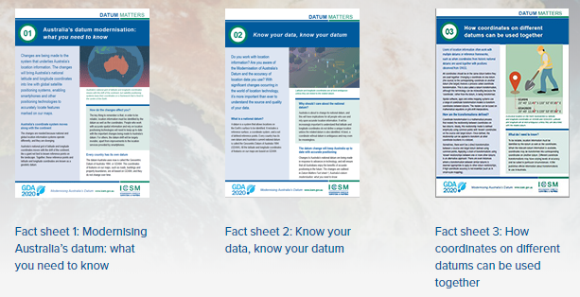
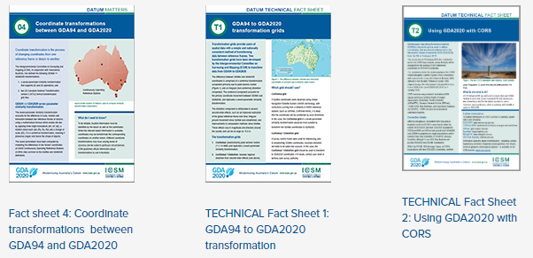
GDA2020 Fact Sheets
https://www.icsm.gov.au/datum/gda2020-fact-sheets
www.sli.do #AGRS

Slide 41
AUSGeoid09 (GDA94) vs AUSGeoid2020 (GDA2020)
p
terrain
AHD
GDA2020 ellipsoidal height (603.249 m)
AUSGeoid2020 value (15.736 m)
GDA94 ellipsoidal height (603.346 m)
AUSGeoid09 value (15.850 m)
GDA2020 (ITRF2014)
(0.097 m)
GDA94 (ITRF92)
www.sli.do #AGRS

Slide 42
Connect with us
ICSM [http://www.icsm.gov.au]
ICSM-PCG Slack [http://cutt.ly/join-pcg-slack]
GDA Modernisation Implementation Working Group
GDA2020 Forum [https://www.icsm.gov.au/datum/gda2020-forum]
GitHub – Geoscience Australia Geodesy Python software [https://github.com/GeoscienceAustralia/GeodePy]
GitHub – ICSM Australian Geospatial Reference System tools and software [https://github.com/icsm-au]
GeodesyML [http://www.geodesyml.org/]
Twitter - Nicholas Brown [@nich0lasbr0wn] - Chair of PCG
Email geodesy@ga.gov.au
www.sli.do #AGRS

Slide 43
www.sli.do
#AGRS
www.sli.do #AGRS

Slide 44
Australian Geospatial Reference System
Webinar Series
Webinar 2: Geocentric Datum of Australia 2020
Nicholas Brown
Director of National Geodesy
Geoscience Australia
Chair of ICSM Permanent Committee on Geodesy
@nich0lasbr0wn

