Slide 1


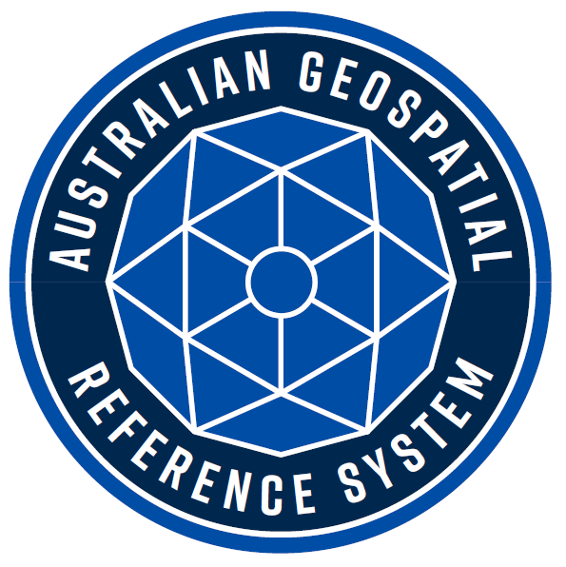


Australian Geospatial Reference System
Webinar Series
Webinar 4: Heightened Awareness
Nicholas Brown
Director of National Geodesy
Geoscience Australia
Chair of ICSM Permanent Committee on Geodesy
@nich0lasbr0wn

Slide 2


www.sli.do
#AGRS
www.sli.do #AGRS

Slide 3

Who am I?
Director of National Geodesy at Geoscience Australia
Commonwealth representative on Intergovernmental Committee on Surveying and Mapping (ICSM)
Chair of the ICSM Permanent Committee on Geodesy (PCG)
Australian representative on FIG Commission 5 – Positioning and Measurement
Favourite Movie – A Night at the Opera
www.sli.do #AGRS

Slide 4



ATRF
GDA2020
AVWS
7 cm/yr
σ = 1-8 cm
Australian Terrestrial Reference Frame
Australian Plate Motion Model
Geocentric Datum of Australia 2020
Australian Quasigeoid Model
Australian Vertical Working Surface
Webinar 3: ATRF
AHD
Δ 1.8 m
σ = 6-13 cm
Webinar 2: GDA2020
Transformation parameters / grids
AUSGeoid2020
Australian Height Datum
GDA94
Webinar 4: Height
σ = ?
Geocentric Datum of Australia 1994
AUSGeoid09
@nich0lasbr0wn
Notes:
PCG ensures Australia and New Zealand have the geospatial reference systems *including datums, reference frames, working surfaces, and standards to meet user needs.
It’s complex – yes – but as we try to measure things more accurately, we need to ensure we have the grs to enable those applications.

Slide 5
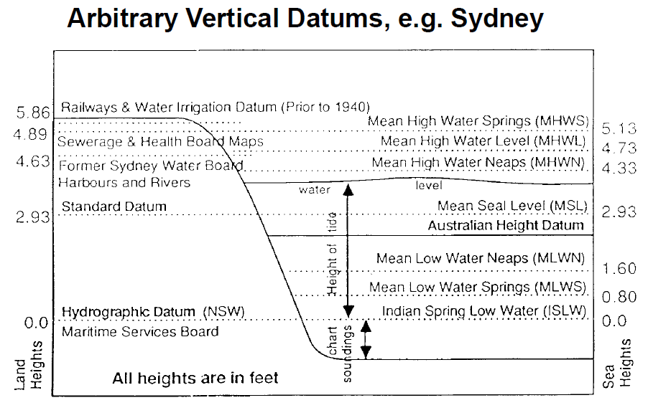
Height is hard
www.sli.do #AGRS

Slide 6
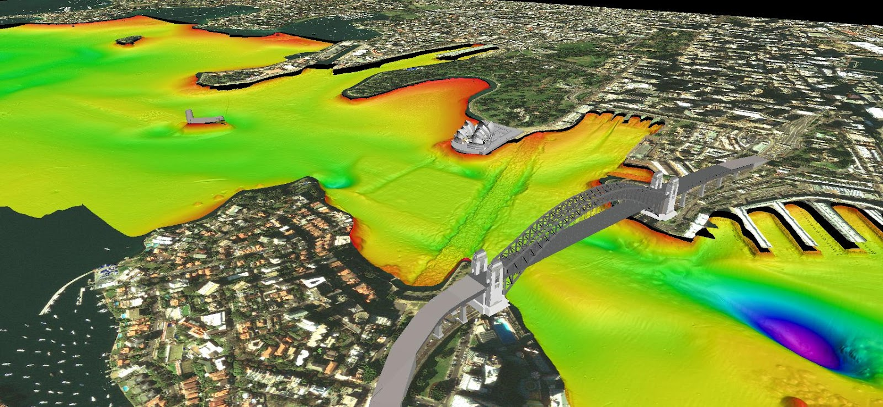
Height – Complications – Sydney example
Water
Standard
Mean Sea Level
(MSL)
Railways
Sewerage
Hydrographic
www.sli.do #AGRS

Slide 7
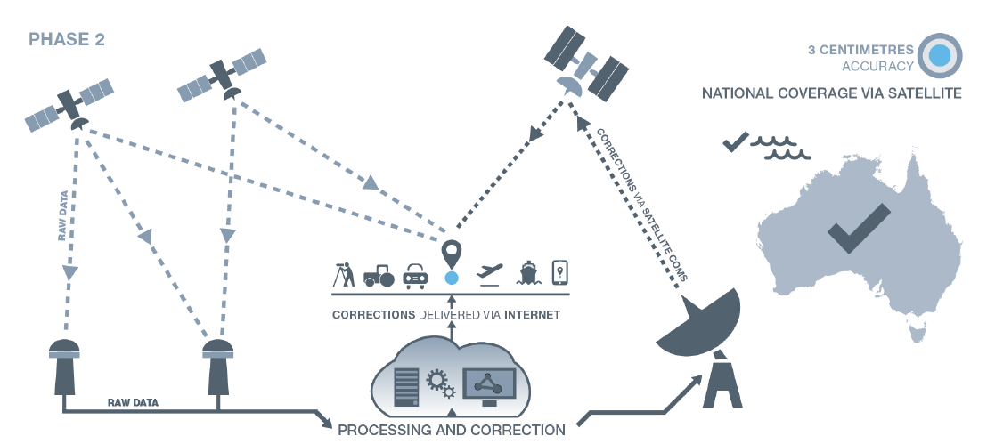
Accuracy
3-10 cm
www.sli.do #AGRS

Slide 8
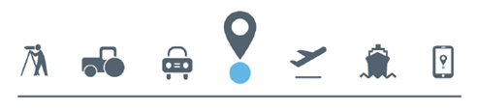
Construction and Engineering
Irrigation
Major road development
Location Based Services (e.g. advice following a tsunami / flood)
www.sli.do #AGRS
Notes:
It is anticipated that the Positioning Australia program provide efficiencies and other benefits for many applications. However, many of these potential applications are dependent on fluid flow. That is, improvements in geometric heighting is only part of the solution. We still require an accurate height datum to realise the benefits of precise positioning.

Slide 9
Introduction to height
Traditionally people prefer to know their height relative to sea level:
  Water flow for drainage systems
  Height of buildings above a flooding river
Satellite positioning systems (GNSS and remote sensing) determine heights relative to the ellipsoid
It is important to understand how these systems are different and how data from these systems can be used together
www.sli.do #AGRS

Slide 10
Height Systems
One dimensional coordinate system used to define the distance of a point from a reference surface along a well defined path
Complex description because there are a number of reference surfaces and a number of well defined paths
Two types of height systems:
  Geometric – ignore Earth’s gravity field and use straight line paths (e.g. GNSS)
  Physical – linked to Earth’s gravity field and measured along the curved plumbline (e.g. orthometric heights)
Explain the different reference surfaces and different paths
www.sli.do #AGRS

Slide 11
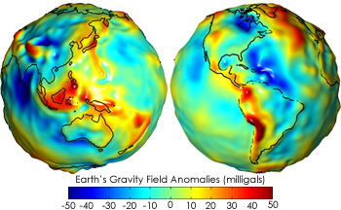
Geometric vs Gravitational Potential
Geometric
Gravity
Complex
Harder to define
Precise
Gravitational Potential
Need a model to use with GNSS
Water always flow downhill
Simple
Precise
Geometric
Useful for GNSS
Water doesn’t always flow downhill
www.sli.do #AGRS
Notes:
An update to the national frame of reference is imminent. It will be called Geocentric Datum of Australia 2020
Based on principles just described
Useful because …
But … not the only reference system we need.
Click
Earth’s gravity field isn’t a simple geometric shape
Oddly shaped potato
This is important because fluid flows
Difference up to 100 m
You remember our simplified mathematical representation of the Earth. The regular ellipsoid shape, you could consider this as the Australian datum, GDA2020.
To complicate things a little, fluid (including your sewerage system for that matter) doesn’t flow from high numbers to low numbers according to a geometric reference frame, it flows according to gravity.
And the surface of equal gravitational potential, is not coincident with the simple geometric reference frame. Instead, it looks a little more like this
// Insert gravity //
Where the difference between the geometric and gravitational potential can be up to 100 m

Slide 12
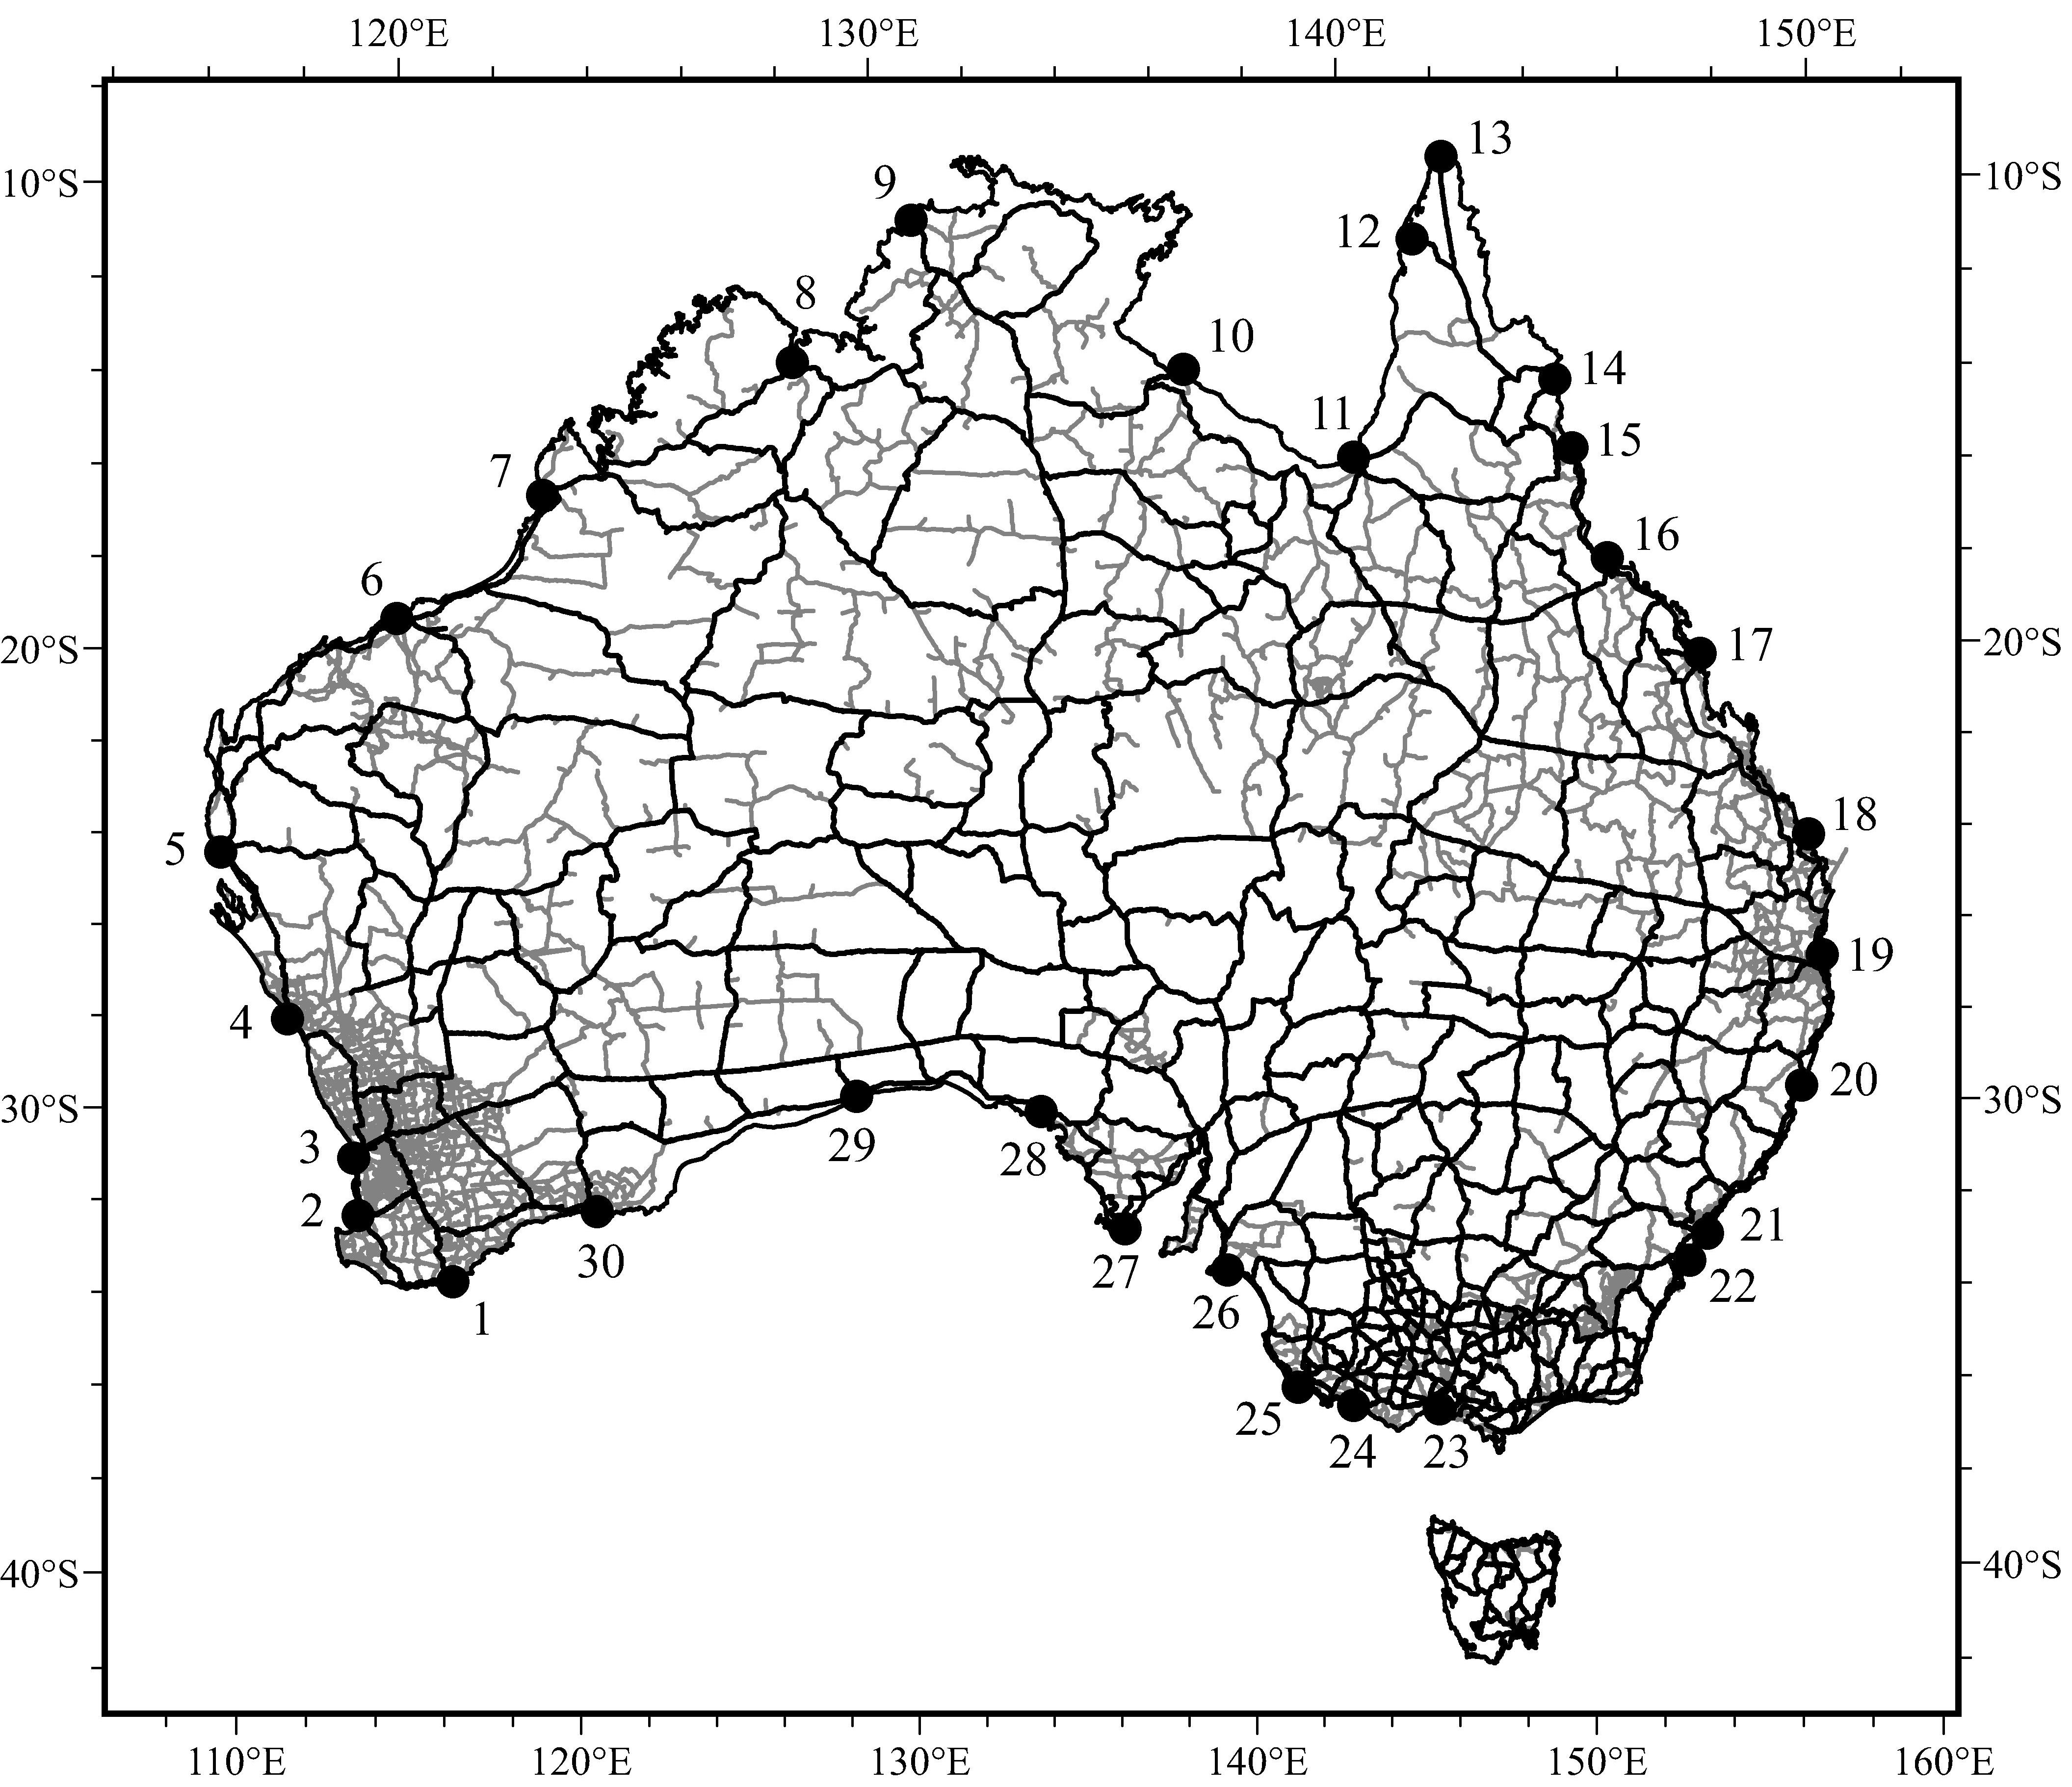
Australian Height Datum
AHD
Australian Height Datum
Mean sea level (MSL) observed at 30 tide gauges from 1966-1968
MSL = 0.000 m AHD
Over 200,000 km of levelling to transfer heights
AHD ≠ MSL
AHD ≠ geoid
www.sli.do #AGRS
Notes:
AHD isn’t MSL because it is only based on 3 years of tidal records.
AHD also isn’t geoid …

Slide 13
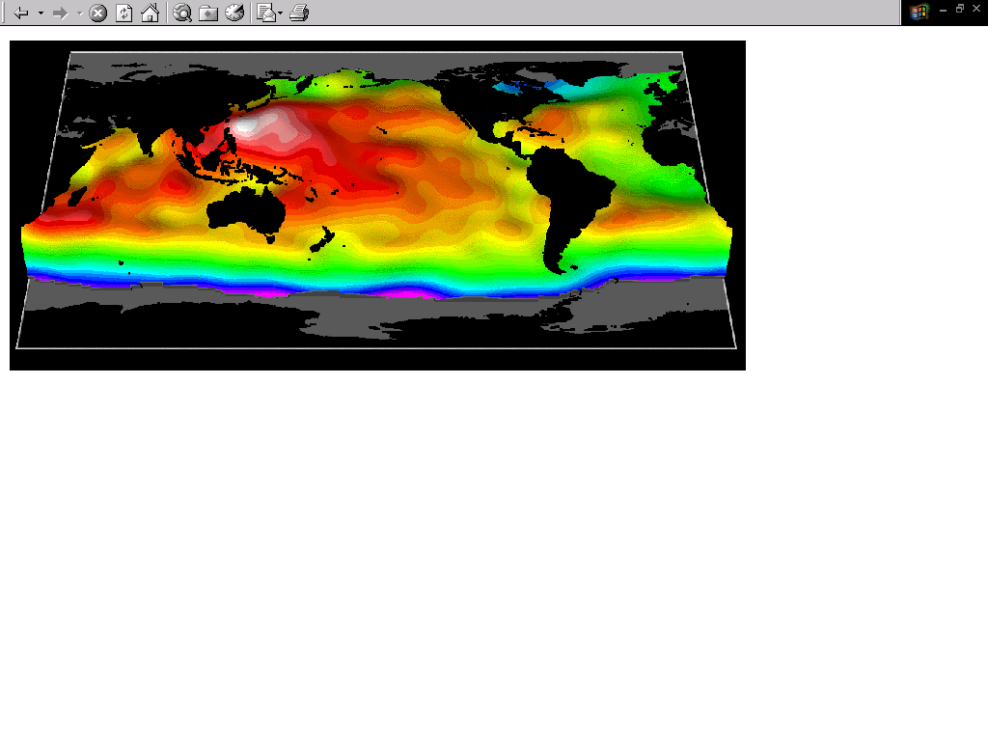
The cause of the geoid – AHD offset
The mass of water in southern and northern Australia is almost the same, however, the density is not.
The warmer / less dense water off the coast of northern Australia (red) is approximately one metre higher than the cooler/denser water off the coast of southern Australia (yellow).
Therefore, the AHD is about 0.5 m above the geoid in northern Australia and roughly 0.5 m below the geoid in southern Australia.
Source: NASA JPL
www.sli.do #AGRS

Slide 14
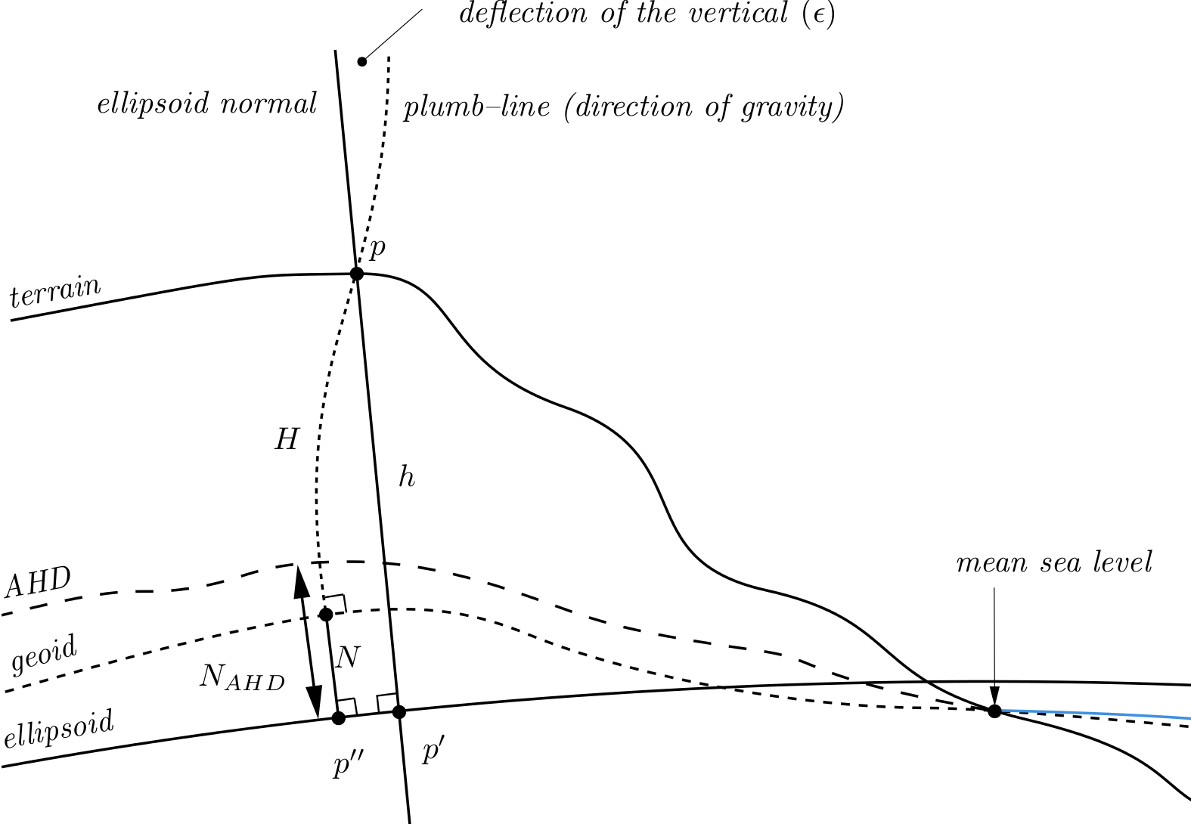
GNSS height
Geometric (-0.5 to 0.5 m)
Gravimetric (-30 to +80 m)
AUSGeoid2020
www.sli.do #AGRS
Notes:
So the offset between AHD and the geoid throughout Australian varies between -0.5 and +0.5 m across Australia. The AHD is roughly 0.5m below the geoid in southern Aus and AHD is about 0.5 m above the geoid in northern AUS.

Slide 15
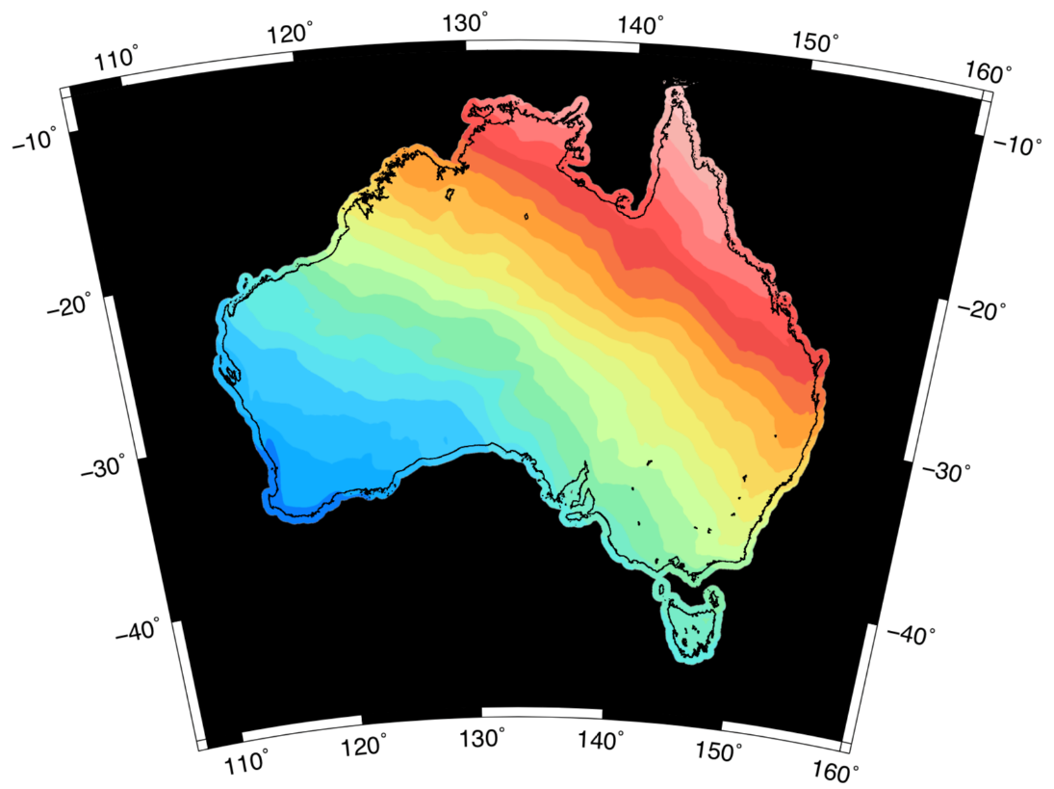
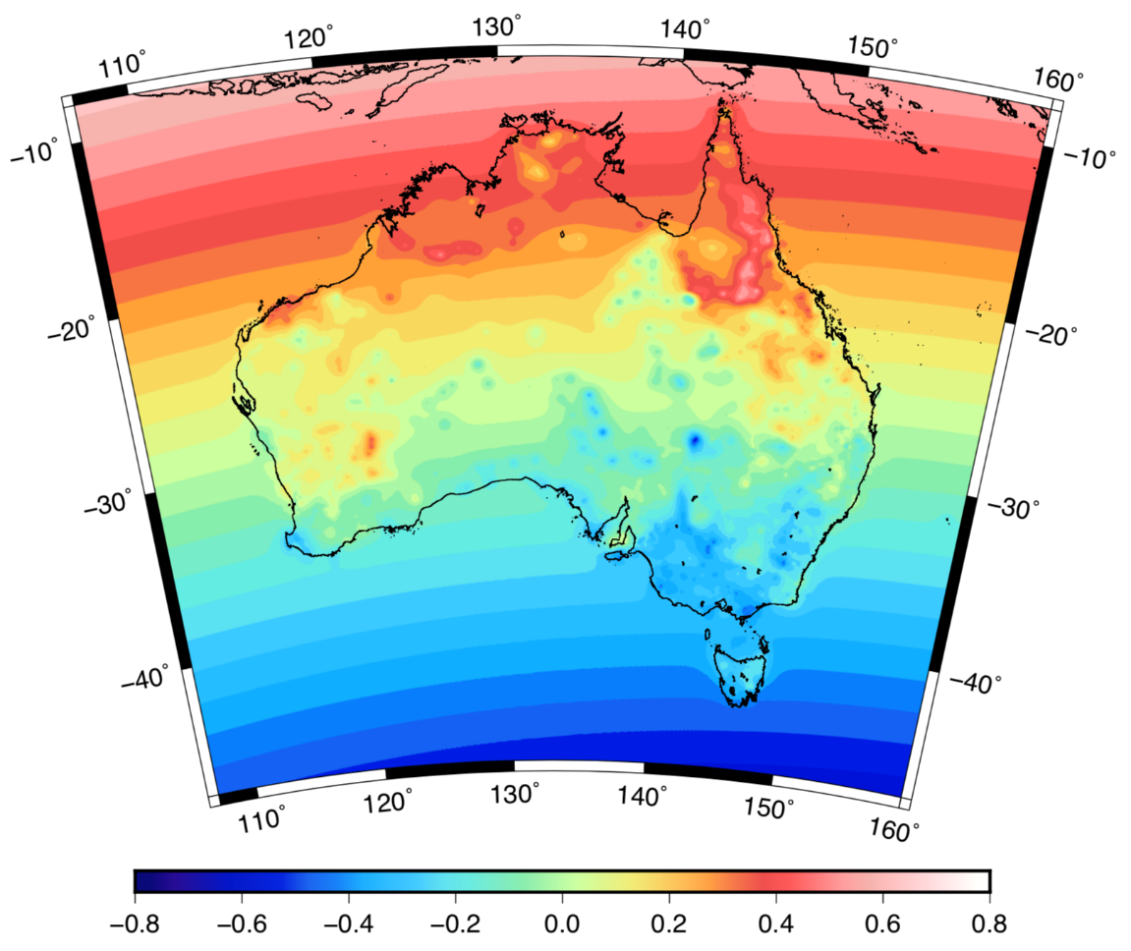

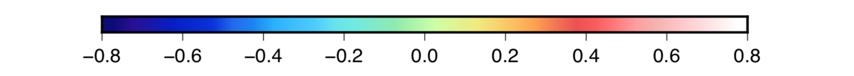
AUSGeoid2020 model
Gravimetric component
Geometric component: Bias and Error
m
m
@nich0lasbr0wn

Slide 16
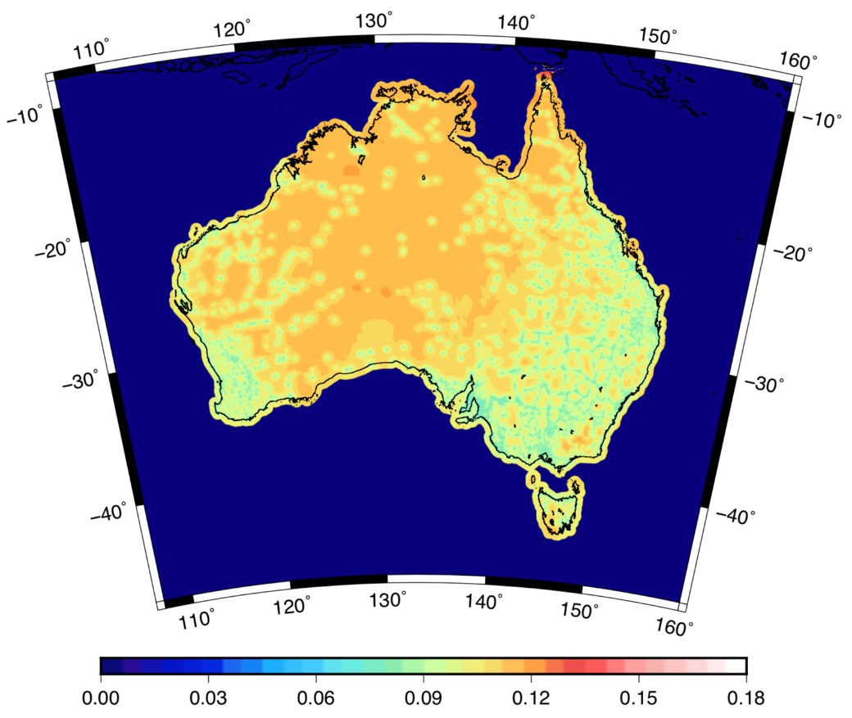
AUSGeoid2020: combined gravimetric-geometric model
AUSGeoid2020 allows for physical height transfer from GNSS to be efficient and accurate (for some applications).
More accurate in providing difference in orthometric height than levelling over distances greater than 3 km (12√k)
A rigorous combination of uncertainty from gravimetric and geometric components shows AUSGeoid2020 has 8-13 cm uncertainty (1 sigma)
Some users may need accuracy better than this
Users are asking “Is the error in the data or the datum?” (e.g. LiDAR surveys)
AUSGeoid2020 accuracy
(8 – 13 cm)
m
www.sli.do #AGRS

Slide 17
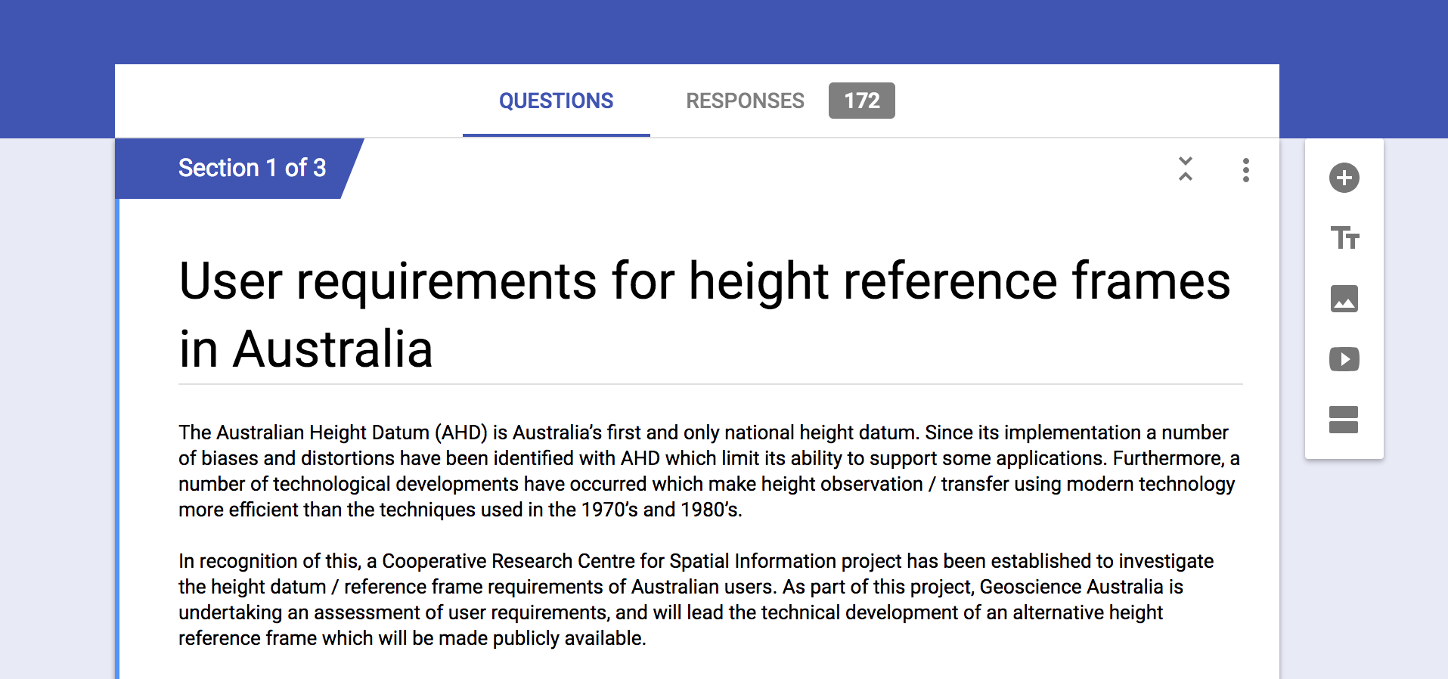
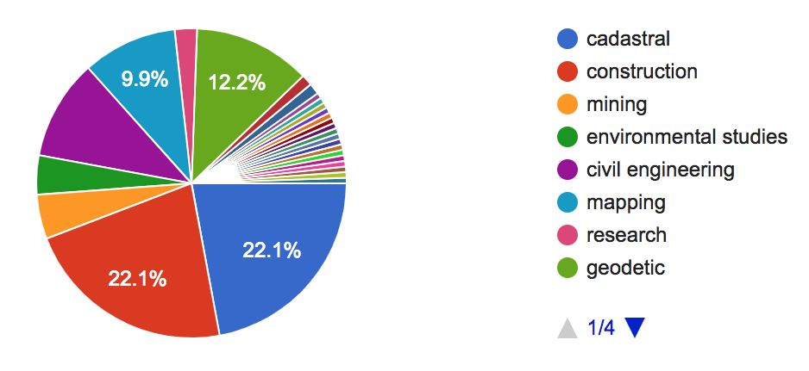
170 responses
www.sli.do #AGRS
Notes:
Many people were happy with AHD. Many people who answered the surveying were also surveyors, or cadastral engineers

Slide 18
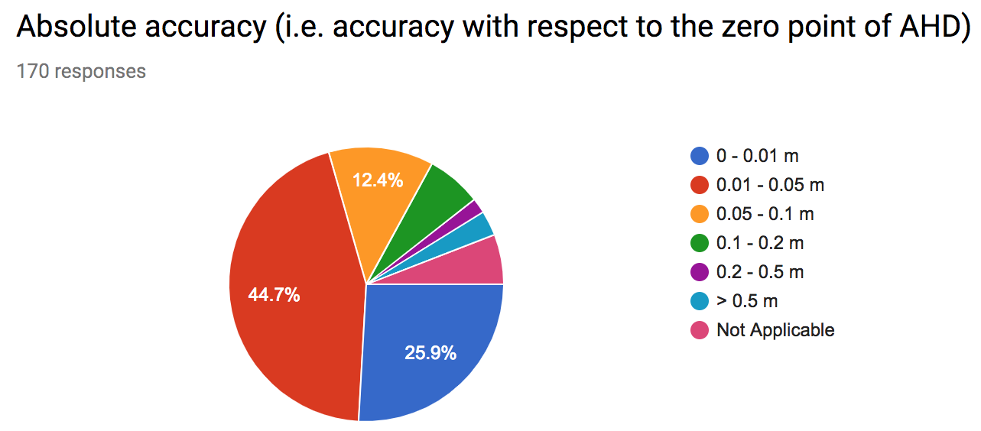
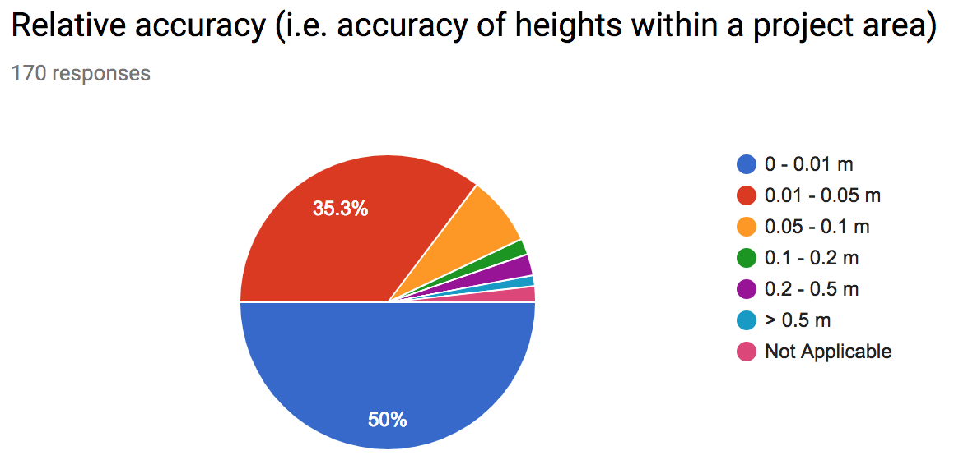
70% of users require absolute accuracy of better than 5 cm
50% of users require relative accuracy of better than 1 cm
www.sli.do #AGRS

Slide 19
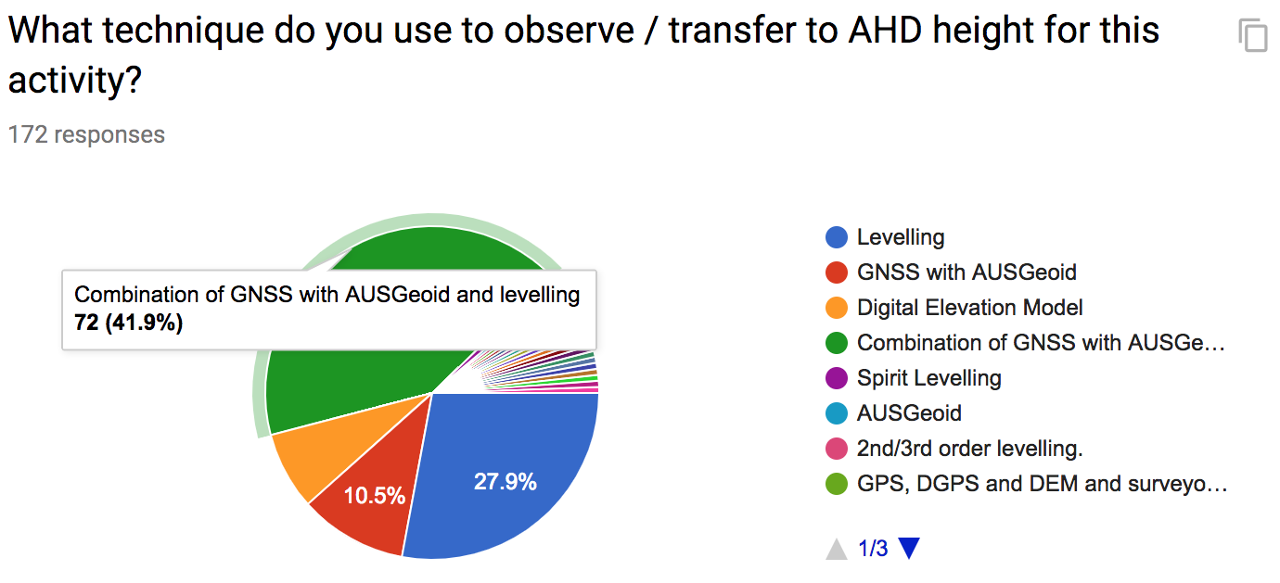
More than 50% of users require AUSGeoid to get AHD heights
www.sli.do #AGRS
Notes:
There is a clear conflict
Users are largely satisfied with AHD
But there method of accessing AHD is not accurate at the level they require.
Let’s look at the qualitative information from some of the respondents to understand this conflict.

Slide 20

Australian Vertical Working Surface
AVWS
Australian Vertical Working Surface
Updated version of the gravimetric component of AUSGeoid2020
Bias and distortion of AHD has been removed
Smoother surface for LiDAR, remote sensing, environmental modelling, major projects (e.g. road construction)
Works seamlessly on and offshore
m
www.sli.do #AGRS

Slide 21
GNSS height
Geometric (-0.5 to 0.5 m)
Gravimetric (-30 to +80 m)
AVWS
AUSGeoid2020
www.sli.do #AGRS
Notes:
So the offset between AHD and the geoid throughout Australian varies between -0.5 and +0.5 m across Australia. The AHD is roughly 0.5m below the geoid in southern Aus and AHD is about 0.5 m above the geoid in northern AUS.

Slide 22
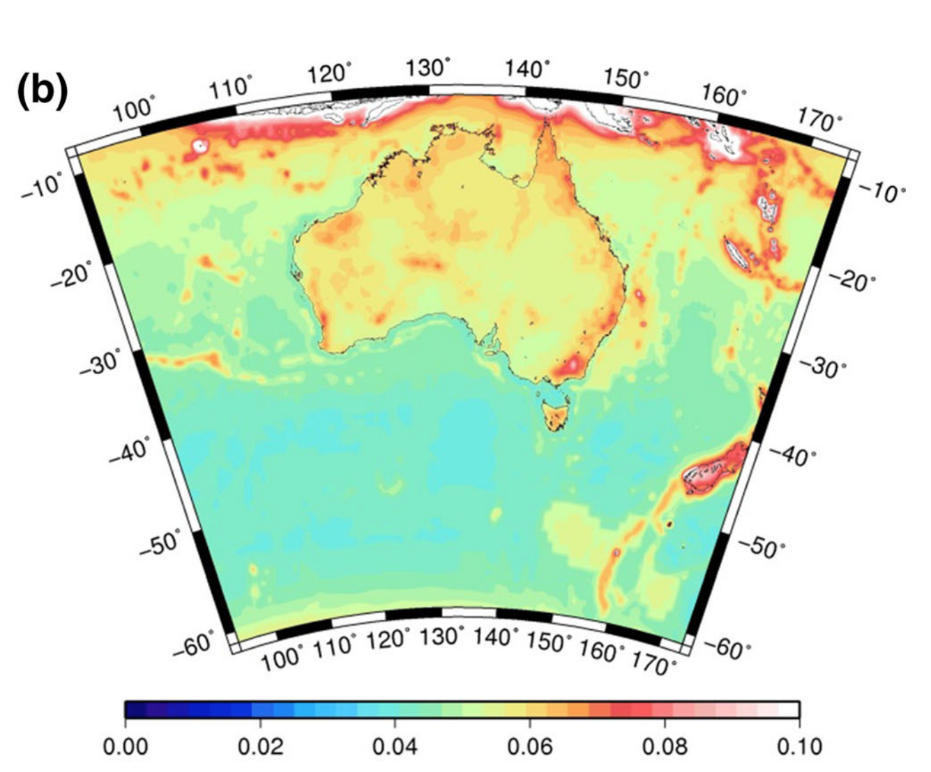

AUSGeoid2020 accuracy vs AVWS accuracy
AUSGeoid2020 accuracy
(8 – 13 cm)
AVWS accuracy
(1 – 8 cm)
m
m
Brown et al. (2018), Journal of Geodesy
Featherstone et al. (2017), Journal of Geodesy
www.sli.do #AGRS

Slide 23

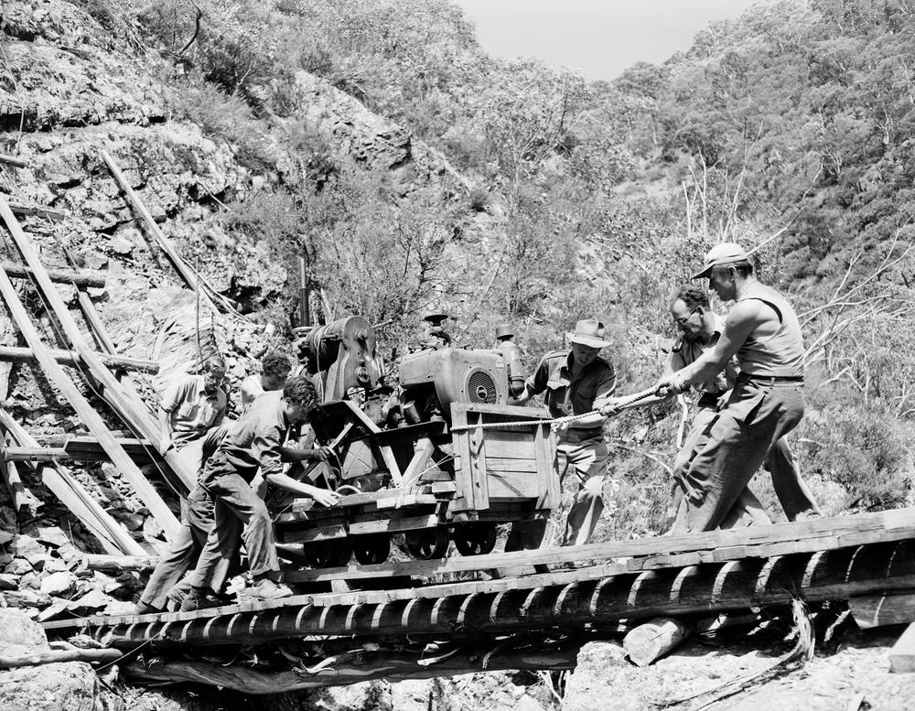
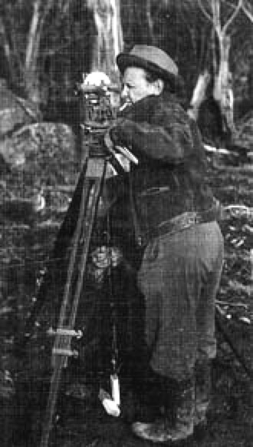
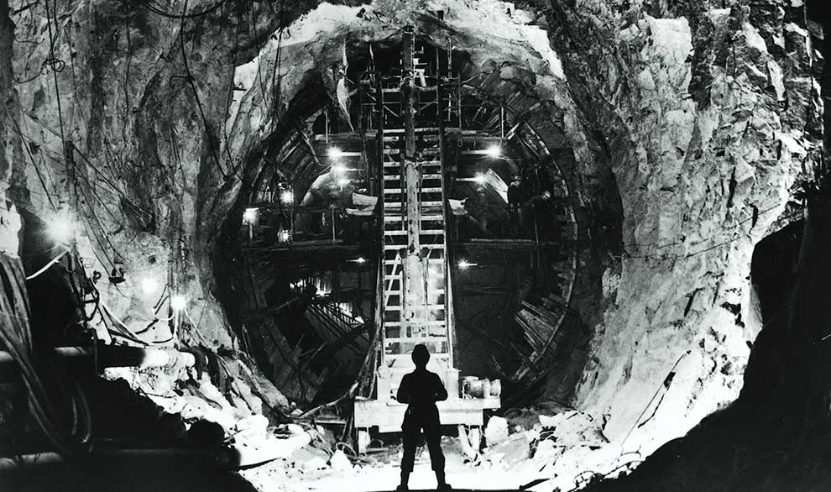
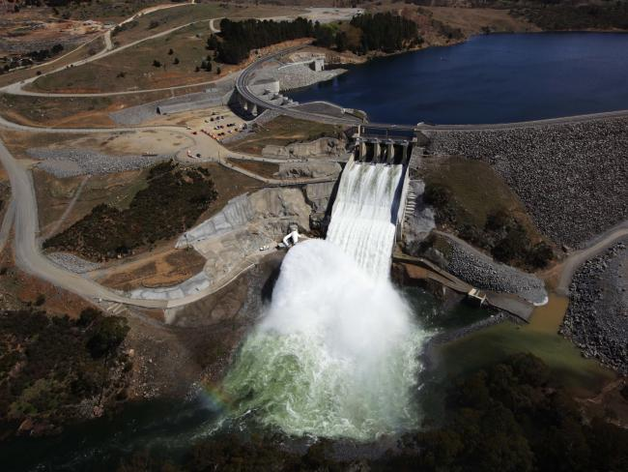
9 hydro-electric power stations
16 dams
225 km of tunnels and pipelines
Built between 1949 – 1974
Largest eng. project ever in Aus.
www.sli.do #AGRS

Slide 24
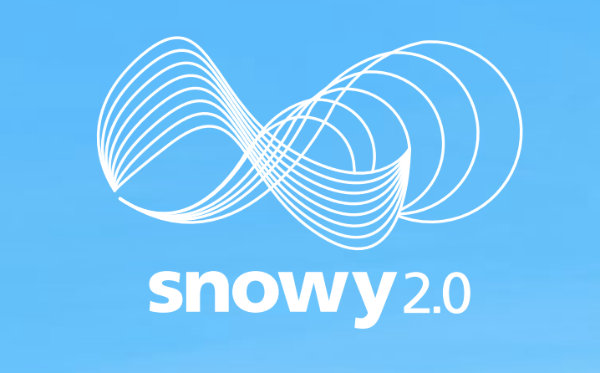
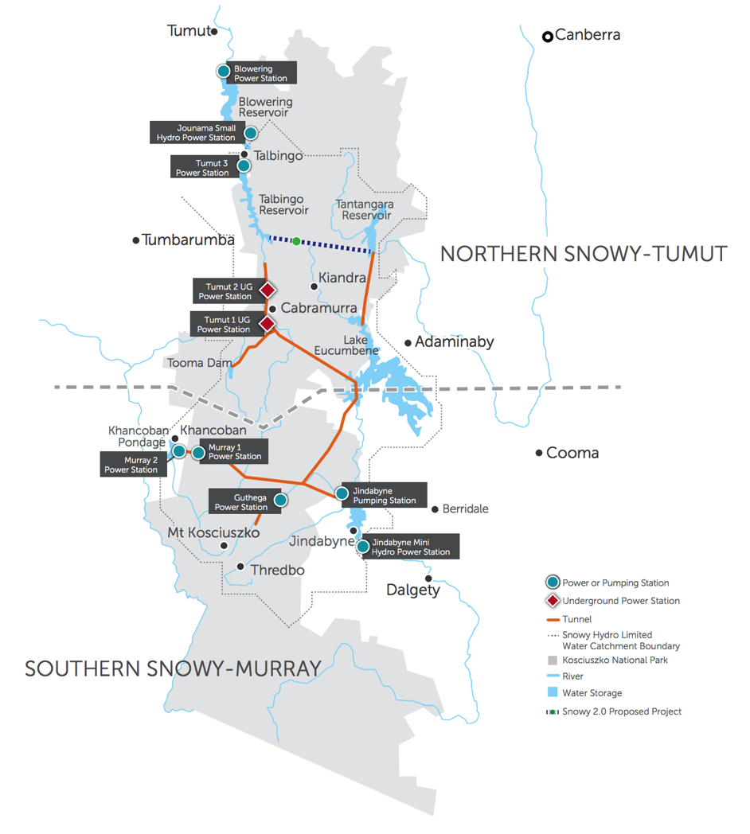
27 km of tunnels and pipelines
7 year project
$3.8 - 4.5 billion
What datum is most suitable for height?
Likely integration of GNSS, precise levelling, InSAR, LiDAR, drone, satellite imagery
This question is becoming more common
www.sli.do #AGRS

Slide 25
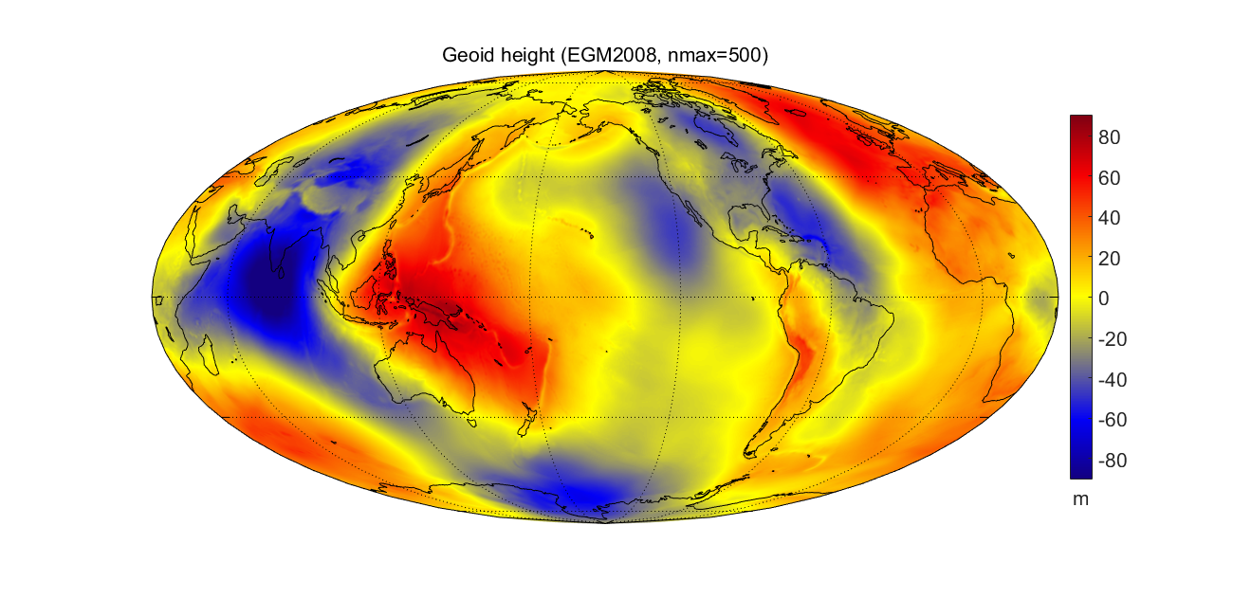
Earth Geopotential Model 2008
www.sli.do #AGRS
Notes:
Geoid – ellipsoid difference in Australia is between -35 m in south-east to +80 m in north-east
Across the Pacific Islands it ranges from +20 to +60 m

Slide 26
Uncertainty of terrestrial gravity data (mgal)
Uncertainty of airborne gravity data (mgal)
3
3
2
2
1
1
Uncertainty of geoid model (m)
0.06
Uncertainty of geoid model (m)
0.06
0.05
0.04
0.05
0.03
0.02
0.01
@nich0lasbr0wn
Notes:
Airborne gravity data have already been collected in a number of targeted regions across Australia. However, no where “useful” for geodetic purposes.

Slide 27
ellipsoidal height
NOTE:
If using GDA94, use AUSGeoid09
If using GDA2020, use AUSGeoid2020
(GDA2020 heights are ~9 cm less than GDA94 heights)
AHD height
AVWS height
AUSGeoid
AVWS
www.sli.do #AGRS

Slide 28
Advantages of Australian Vertical Working Surface
More accurate than AUSGeoid2020
Uncertainty between 4-8 cm across most of Australia
Model can be continually refined using new gravity data
No need to maintain ground infrastructure
No need for localised geoid models
Improved data integration (LiDAR is accurate to 5-10 cm)
In line with other countries (e.g. Canada, NZ and USA)
AVWS will be available for public use in early 2020
More airborne gravity will be included as it becomes available
www.sli.do #AGRS

Slide 29
Conclusions
New era of positioning requirements and new user base have expectations of height accuracy, reliability and efficiency that AHD and AUSGeoid cannot provide
Biases and distortions in the AHD make it difficult / unusable for some (is the error in data or datum?)
At this point in time, we do not see a strong push from the user community to update the AHD
However, there is a conflict between what users ‘say they want’ and what they ‘expect they are getting’
Instead develop an alternative vertical working surface for those who need / want it
www.sli.do #AGRS

Slide 30
Connect with us
ICSM [http://www.icsm.gov.au]
ICSM-PCG Slack [http://cutt.ly/join-pcg-slack]
GDA Modernisation Implementation Working Group
GDA2020 Forum [https://www.icsm.gov.au/datum/gda2020-forum]
GitHub – Geoscience Australia Geodesy Python software [https://github.com/GeoscienceAustralia/GeodePy]
GitHub – ICSM Australian Geospatial Reference System tools and software [https://github.com/icsm-au]
GeodesyML [http://www.geodesyml.org/]
Twitter - Nicholas Brown [@nich0lasbr0wn] - Chair of PCG
Email geodesy@ga.gov.au
www.sli.do #AGRS

Slide 31
www.sli.do
#AGRS
www.sli.do #AGRS

Slide 32
GNSS ellipsoidal height
www.sli.do #AGRS
Notes:
So the offset between AHD and the geoid throughout Australian varies between -0.5 and +0.5 m across Australia. The AHD is roughly 0.5m below the geoid in southern Aus and AHD is about 0.5 m above the geoid in northern AUS.

Slide 33
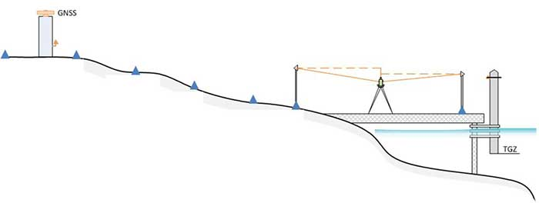
5 mm/yr
ellipsoid

Slide 34
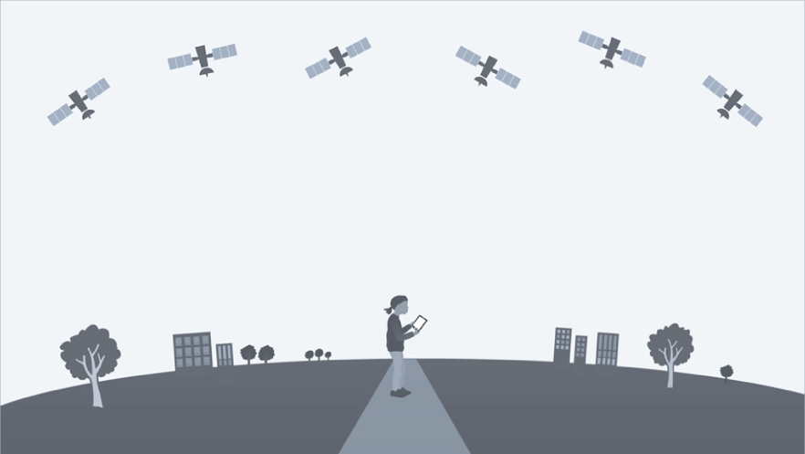
1. Satellite altimeters have a known height (h) above the centre of the Earth.
d₂₀₁₃
d₁₉₉₃
d₂₀₀₃
s₂₀₁₃
s₁₉₉₃
s₂₀₀₃
2. Satellite altimeters measure the distance (d) to the sea level over the same location about every 10 days.
h
3. The absolute sea level height (s) is the distance from the centre of the Earth to the sea level.
e.g. s₂₀₁₃ = h₂₀₁₃-d₂₀₁₃
www.sli.do #AGRS
Notes:
An update to the national frame of reference is imminent. It will be called Geocentric Datum of Australia 2020
Based on principles just described
Useful because …
But … not the only reference system we need.
Click
Earth’s gravity field isn’t a simple geometric shape
Oddly shaped potato
This is important because fluid flows
Difference up to 100 m
You remember our simplified mathematical representation of the Earth. The regular ellipsoid shape, you could consider this as the Australian datum, GDA2020.
To complicate things a little, fluid (including your sewerage system for that matter) doesn’t flow from high numbers to low numbers according to a geometric reference frame, it flows according to gravity.
And the surface of equal gravitational potential, is not coincident with the simple geometric reference frame. Instead, it looks a little more like this
// Insert gravity //
Where the difference between the geometric and gravitational potential can be up to 100 m

Slide 35
h
www.sli.do #AGRS
Notes:
An update to the national frame of reference is imminent. It will be called Geocentric Datum of Australia 2020
Based on principles just described
Useful because …
But … not the only reference system we need.
Click
Earth’s gravity field isn’t a simple geometric shape
Oddly shaped potato
This is important because fluid flows
Difference up to 100 m
You remember our simplified mathematical representation of the Earth. The regular ellipsoid shape, you could consider this as the Australian datum, GDA2020.
To complicate things a little, fluid (including your sewerage system for that matter) doesn’t flow from high numbers to low numbers according to a geometric reference frame, it flows according to gravity.
And the surface of equal gravitational potential, is not coincident with the simple geometric reference frame. Instead, it looks a little more like this
// Insert gravity //
Where the difference between the geometric and gravitational potential can be up to 100 m

