Slide 1


General metadata standards
- DCAT, Schema.org
Simon Cox
CSIRO Land and Water
Adam Shepherd
Woods Hole Oceanographic Institution

Slide 2
W3C DCAT
Scope: Datasets, Dataset Catalogues, Data services
W3C ‘evergreen standard’ - continuous update and enhancement
DCAT - Jan 2014 https://www.w3.org/TR/2014/REC-vocab-dcat-20140116/
DCAT v2 - Feb 2020 https://www.w3.org/TR/vocab-dcat-2/
DCAT v3 - in prep
Dataset versions (revisions)
Adapted from PAV, which is based on PROV-O
Current draft: https://raw.githack.com/w3c/dxwg/dcat-versioning-v2/dcat/index.html
Dataset series
Current draft: https://raw.githack.com/w3c/dxwg/dcat-dataseries-issue1272/dcat/index.html

Slide 3
Schema.org
SEO tags developed by Bing + Google + Yahoo + Yandex
Search engines read Schema.org tags in web-pages
Vocabulary is RDF (behind the scenes) in a single namespace
Community maintenance process https://github.com/schemaorg/schemaorg/issues
Google Dataset Search https://datasetsearch.research.google.com/
Subset of Google index focusing on datasets
Harvested from dataset repositories
including Research Data Australia
RDA converts RIF-CS to Schema.org (JSON), embedded in each dataset’s landing-page header
Note: Google only uses a tiny subset of Schema.org vocabulary in the index

Slide 4
Science-on-Schema.org
Conventions for using Schema.org to describe science data
Earthcube → ESIP project (NSF funded)
To contribute: https://github.com/ESIPFed/science-on-schema.org/issues

Slide 5
Preparing Science-on-Schema.org for ESIP Assembly endorsement
2021 ESIP Winter Meeting

Slide 6
Table of Contents
Brief Introduction
Discuss ESIP Endorsement
Wrap-up v1.2 Update
Discuss Dataset Variables in schema.org
Google Notes from Session

Slide 7







ESIP Schema.org Cluster
Common publishing patterns for describing research data on your web pages using schema.org
OUR FOCUS

Slide 8
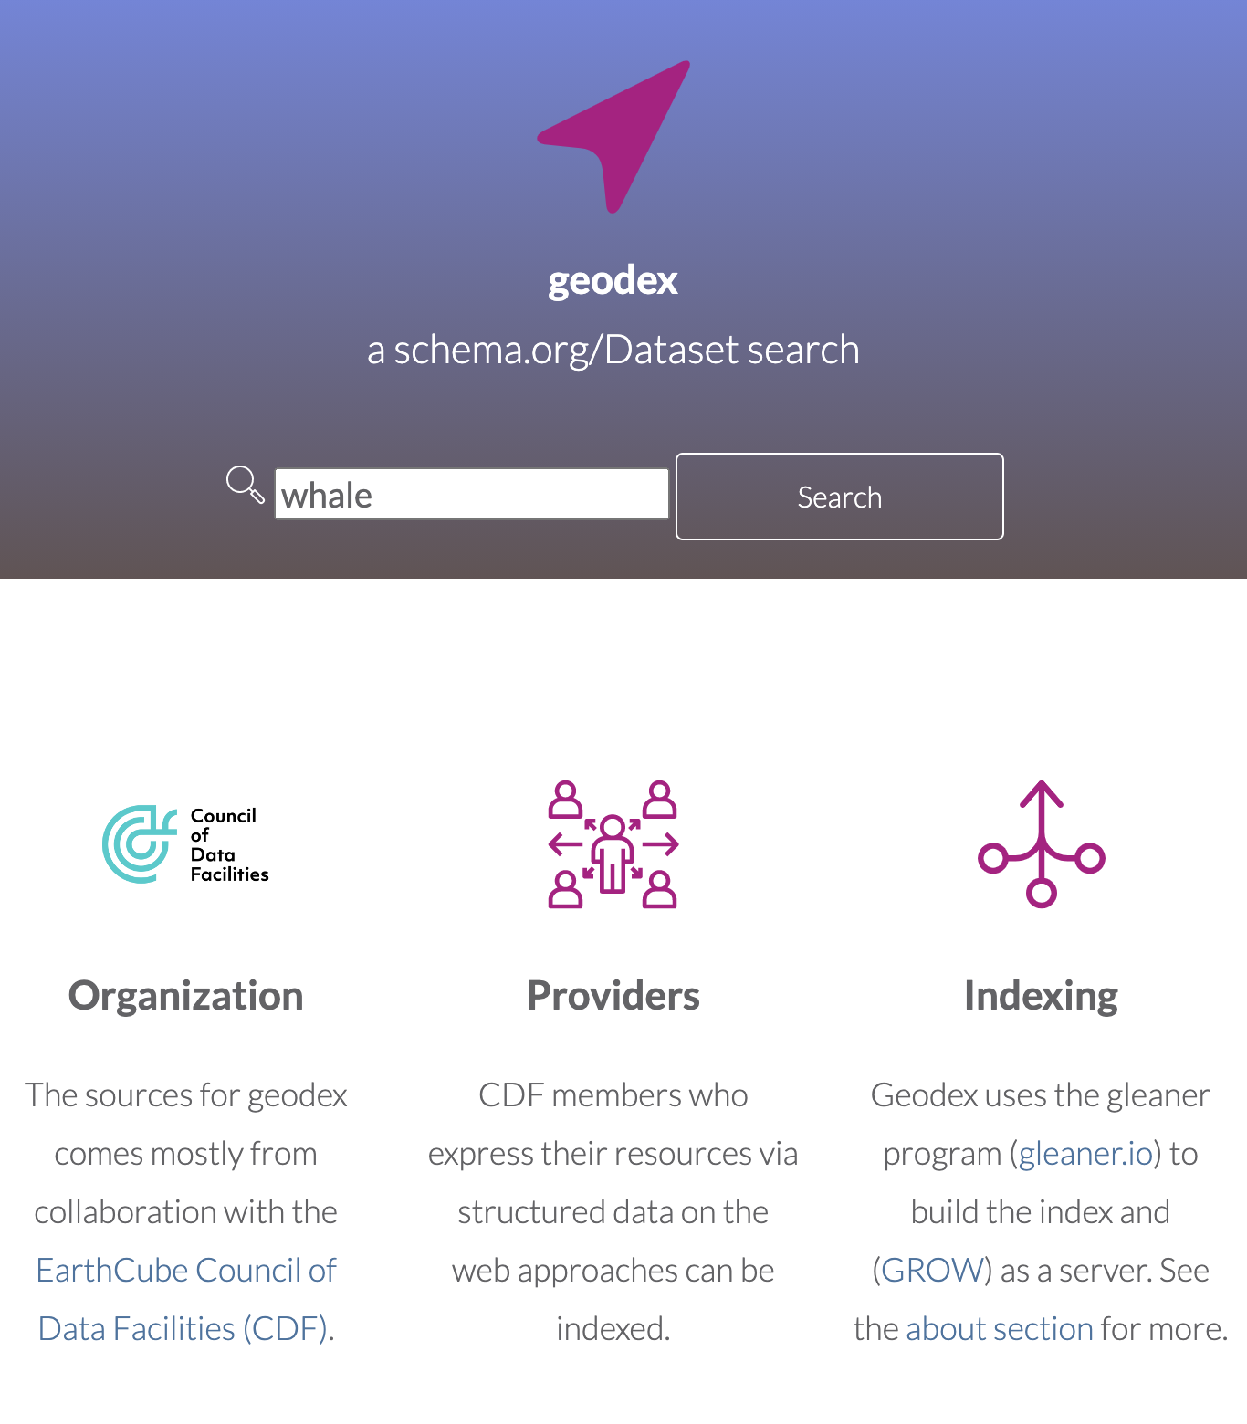
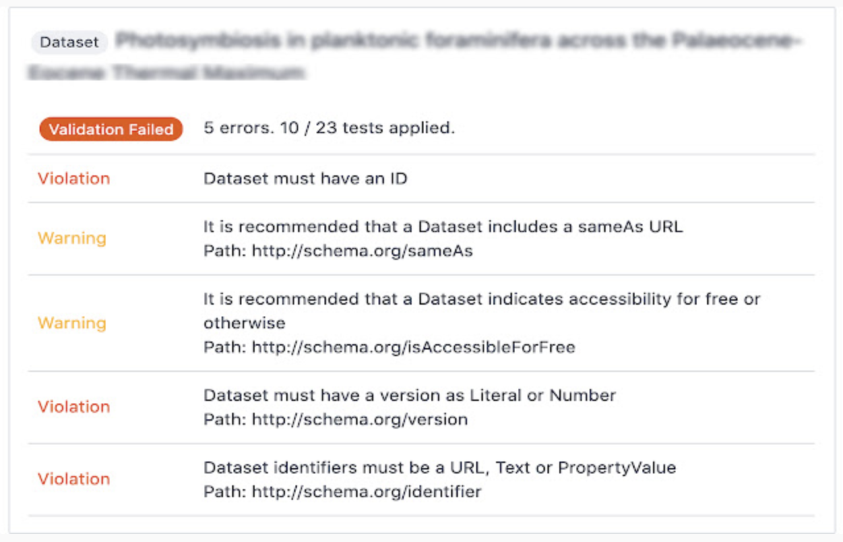
Guidelines for Shared Publishing Patterns
Reliable, consistent federation
Automate Validation

Slide 9
ESIP Schema.org Cluster
Monitor monthly to schema.org updates
Accept contributions and issues at Github
Maintain & publish updates to guidelines
Data Repository - a repository with research data
Dataset - the scientific dataset
mailing list | #sci-schemaorg (Slack) | Agendas (Google Doc)v

Slide 10
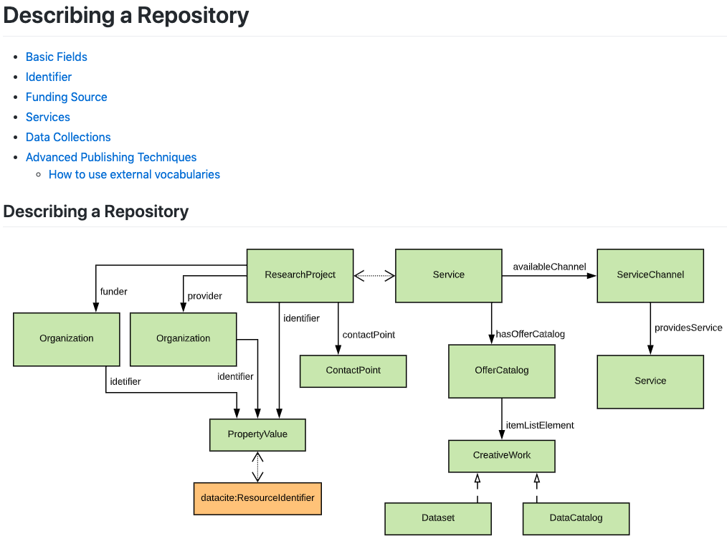
github.com/ESIPFed/science-on-schema.org/../guides/DataRepository.md
github.com/ESIPFed/science-on-schema.org/../guides/DataRepository.md

Slide 11
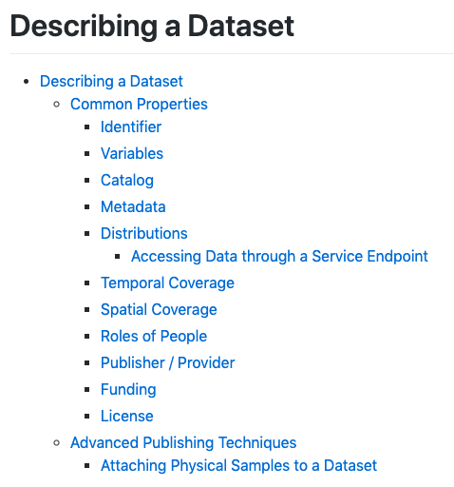
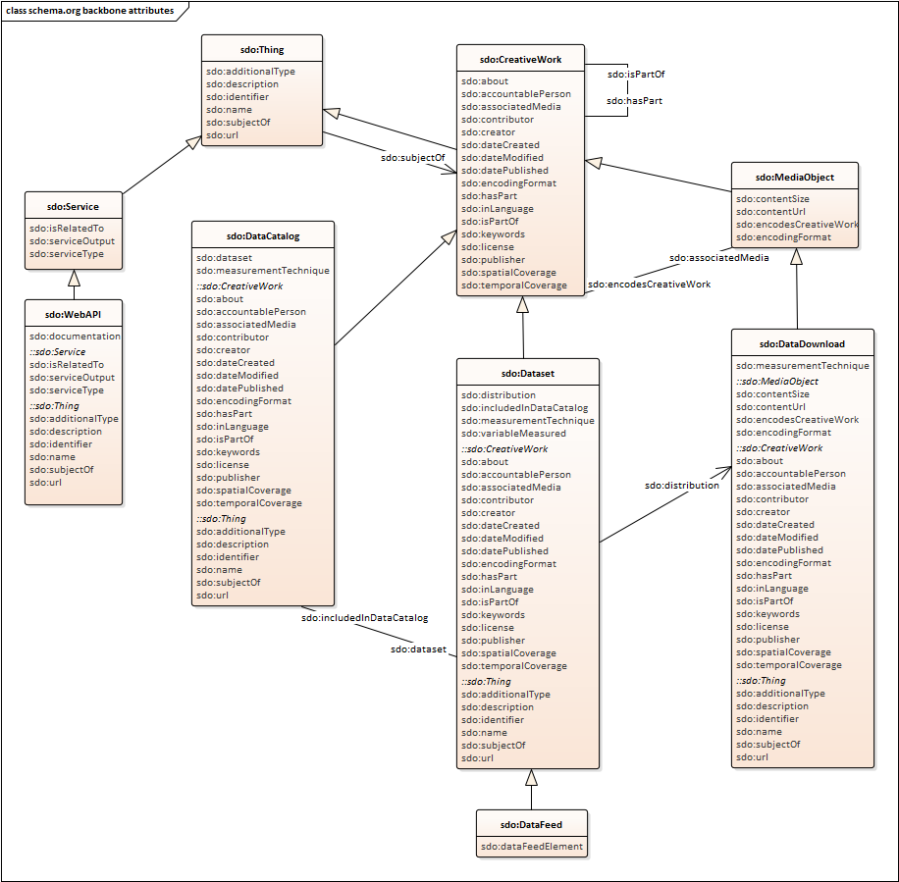
github.com/ESIPFed/science-on-schema.org/../guides/Dataset.md

Slide 12
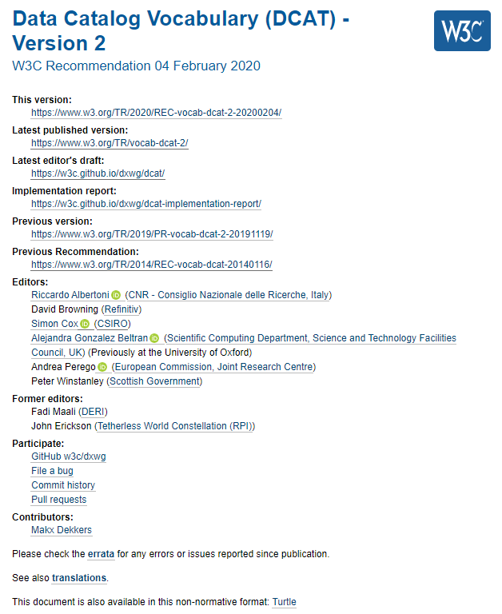
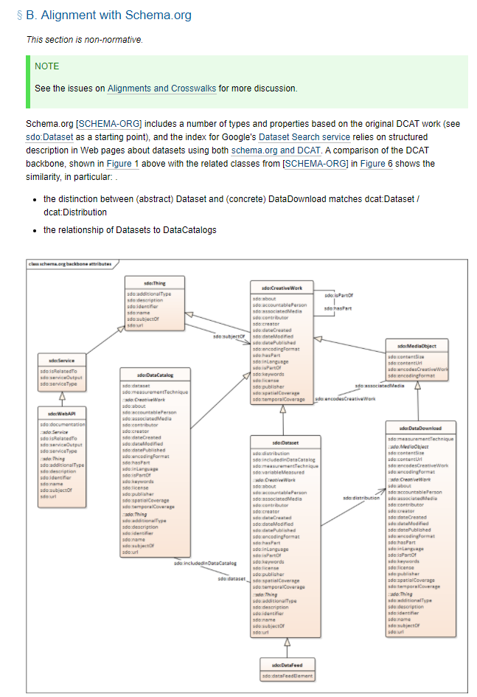
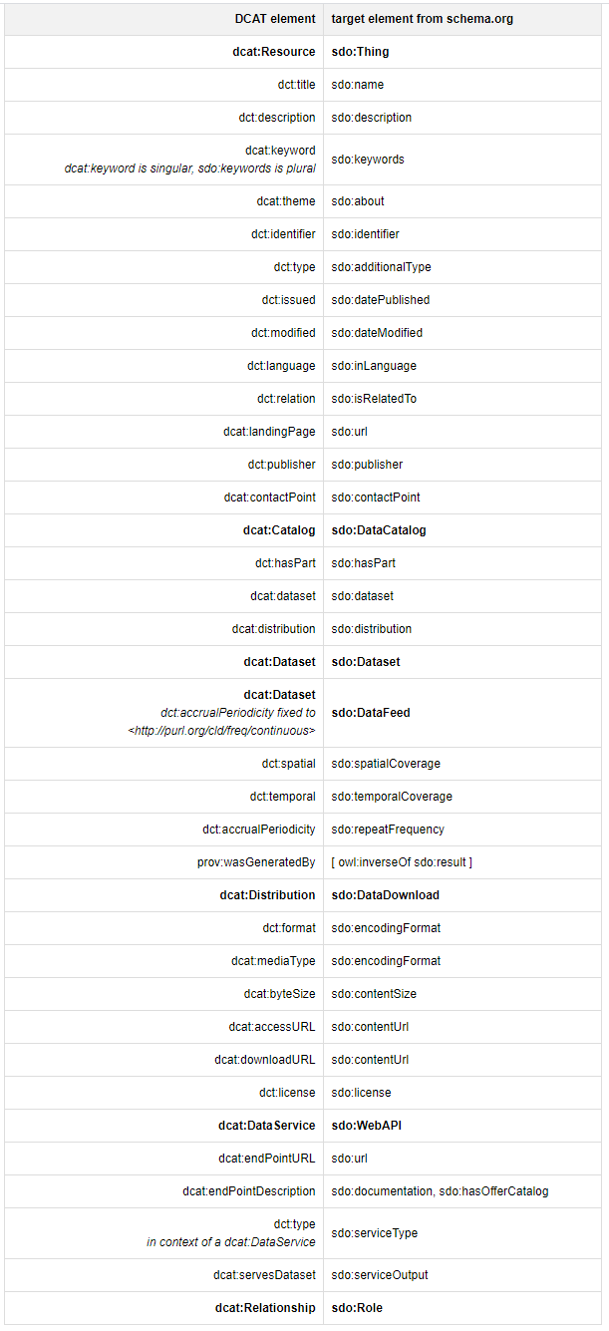
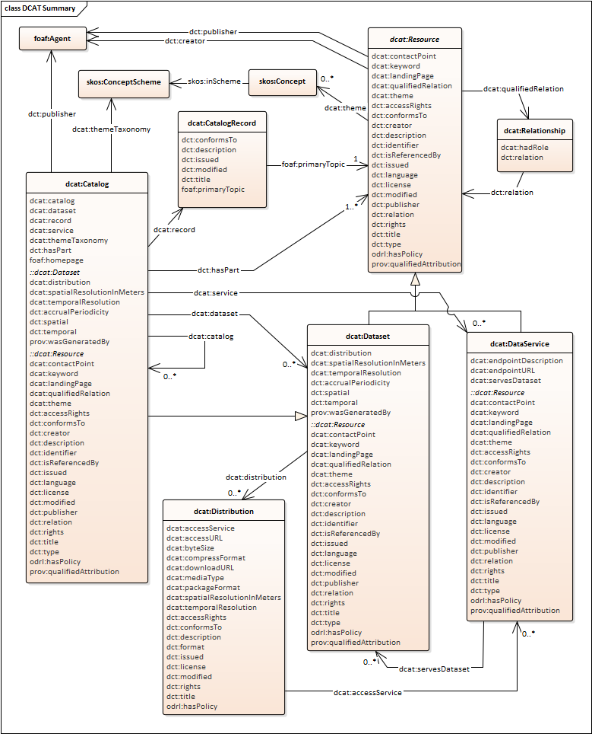

Slide 13
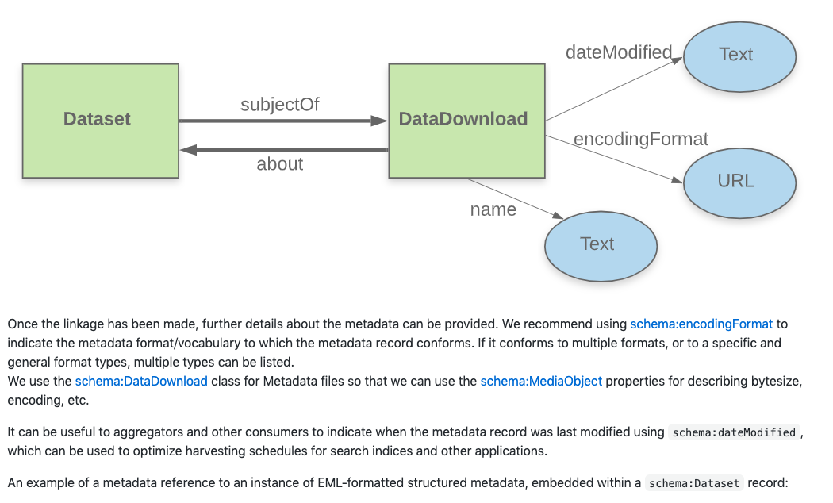
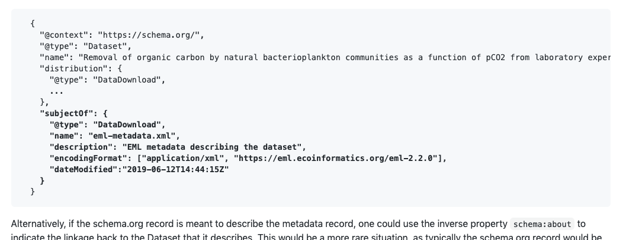
Guidelines: Drawings & Examples

Slide 14
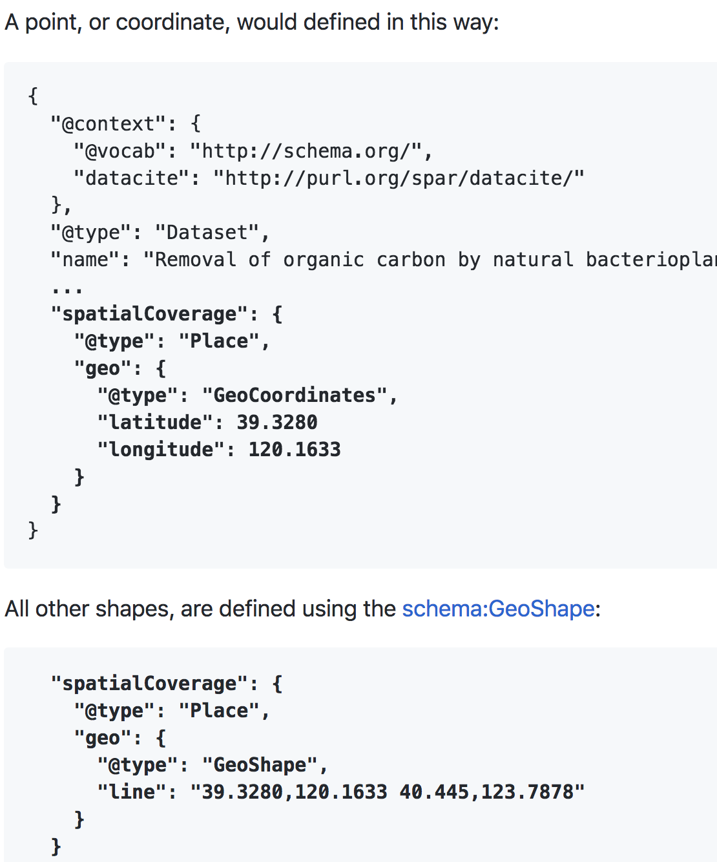
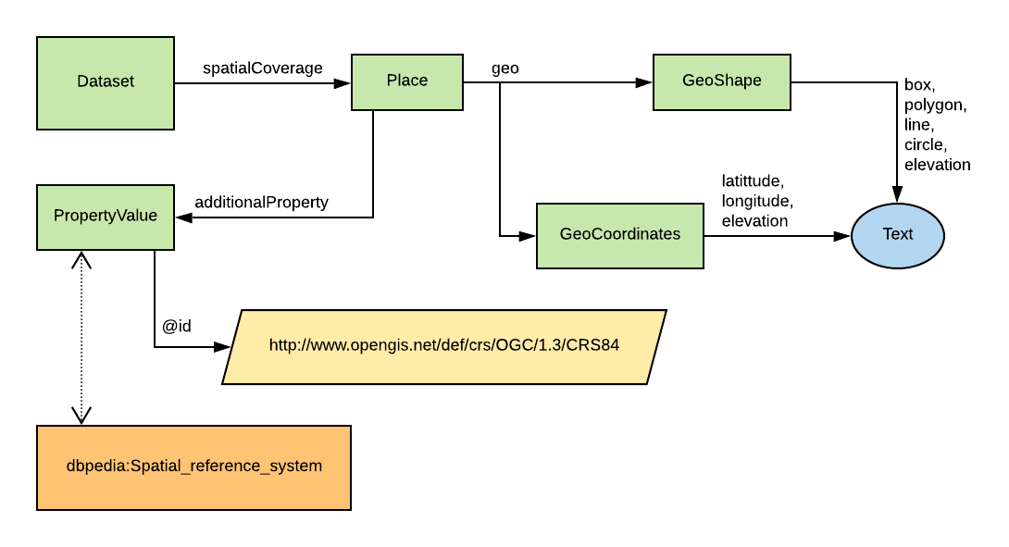
Guidelines: Drawings & Examples

Slide 15
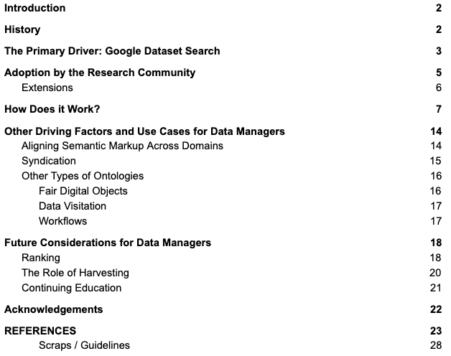

Schema.org for Research Data Managers: A Primer
by Karen Payne and Chantelle Verhey
International Science Council, World Data System International Technology Office

Slide 16
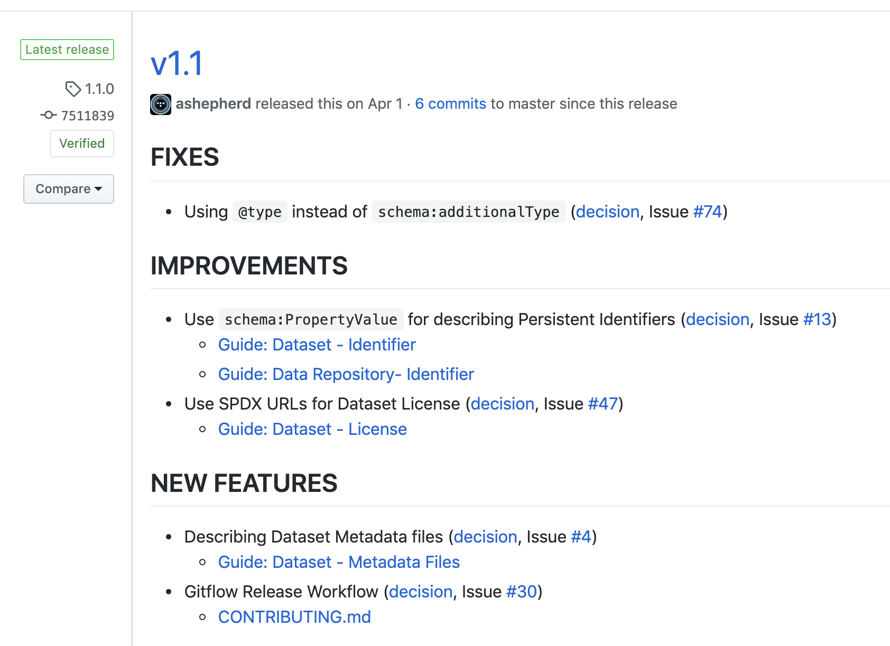

Latest Release: v1.1 on April 1 (no joke)
github.com/ESIPFed/science-on-schema.org/releases/tag/1.1.0
Persistent Identifiers
Dataset Licenses
Distinguish Dataset Metadata from Data files
7 contributors:
Matt Jones
Dave Vieglais
Stephen Richard
Ruth Duerr
Lewis John McGibbney
Charles Vardeman II
Douglas Fils
Adam Shepherd

Slide 17
Next Release: v1.2
github.com/ESIPFed/science-on-schema.org/milestone/5
DOI: 10.5281/zenodo.4477164 (pending)
FIXES
Fix various errors in Dataset full example JSON-LD (Issue #115)
  the identifier should be of type PropertyValue
  the sameAs property is missing
  the isAccessibleForFree property is missing
IMPROVEMENTS
Improvements for describing geospatial coverage (decision, Issue #101)
Dataset Provenance for processing workflows, data derivation, and dataset versioning (decision, Issue #72)
Use schema:dateModified for announcing when a Dataset resource has changed (Issue #67)
How to reference a short DOI (Issue #120)
Update GOVERNANCE & README to list ESIP Schema.org Cluster meeting times (Issue #111)
NEW FEATURES
Add SHACL shape to validate schema.org namespace (decision, Issue #59)

Slide 18
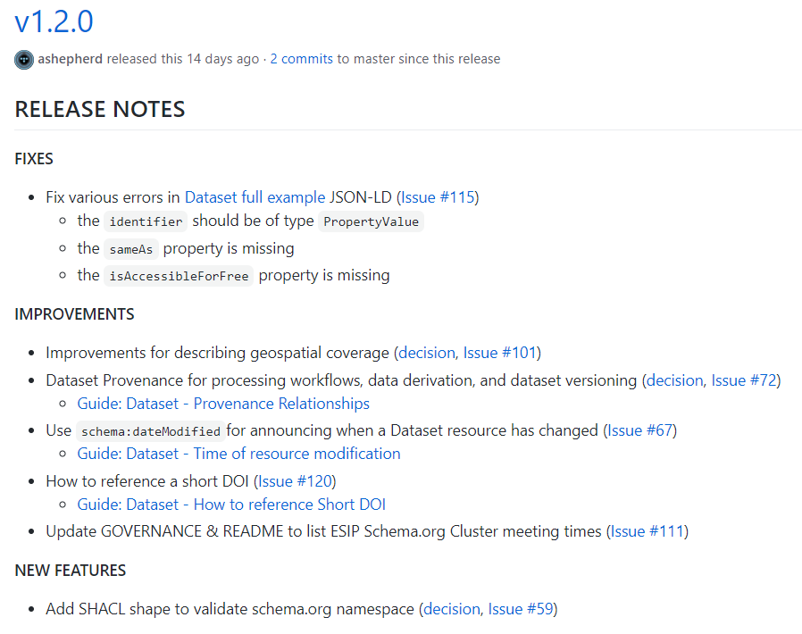
v1.2 -
release notes

Slide 19
Future Release: v1.3 (or is it 2.0)
github.com/ESIPFed/science-on-schema.org/milestone/6
Correct usage of the Dataset schema:citation property (#42)
Specifying the authoritative copy of a Dataset (#37, #128)
Enriching the description Dataset variables (#24, #27)
Using OWL-Time for temporal extent (#77)
Restructure guideline landing page README (#127)

Slide 20
ESIP Endorsement
github.com/ESIPFed/Governance/...Endorsements.md
Trigger: community consensus is built within ESIP on highly relevant and timely products, services or issues
GOAL: to bring concordance and direction for the benefit of the larger community.
Result: statements of public agreement or support that does not bind members to subsequent actions
Restrictions:
ESIP will never endorse a commercial product or a particular technology standard
arise out of an existing collaboration areas and/or closely align with the mission and strategic goals.
Process:
Submit proposal
Program Committee derives an opinion based on the history, relevance, timeliness and risk v. benefit to [ESIP].
If positive, subject to a 30 day comment period among members of the Assembly
a vote shall be held by a simple majority of the Assembly to determine final approval

Slide 21
Endorsement Proposal Contents
github.com/ESIPFed/Governance/...Endorsements.md
history of the work or issue and a statement describing why it is of benefit for ESIP to endorse the product, service or statement.
What version of the guidelines should be presented? Does this version ID matter? 1.3 vs. 2.0
How frequently should the endorsement be updated?

Slide 22
Roadmap to Endorsement
TASK | TARGET DATE | NOTES
Next Release Contents | Feb 2021
Complete Next Release | June 2021
Publish Next Release | Summer Meeting 2021 | Get everything into `develop` branch
Draft Proposal | Pre-Summer Meeting 2021 | Gather feedback at Summer Meeting
Submit to ESIP | Post-Summer Meeting 2021

Slide 23
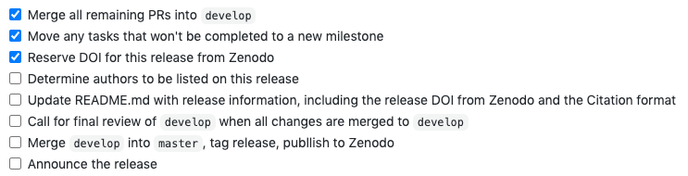
Wrap-up Release: v1.2
github.com/ESIPFed/science-on-schema.org/milestone/5
DOI: 10.5281/zenodo.4477164 (pending)
Github Issue for Publishing v1.2: https://github.com/ESIPFed/science-on-schema.org/issues/136
develop branch: https://github.com/ESIPFed/science-on-schema.org/tree/develop
RELEASE NOTES: https://github.com/ESIPFed/science-on-schema.org/issues/136#issuecomment-769818562
Finalize Author List
  Code committers: Matt Jones, Steve Richard, Dave Vieglais, Adam Shepherd
  Contributors: Ruth Duerr, Mark Schildhauer, Simon Cox, Adam Leadbetter, Alexandra Kokkinaki, Doug Fils, Lewis McGibbney, Bryce Mecum, Thomas Thelen, Dan Brickley, Richard Wallis

Slide 24
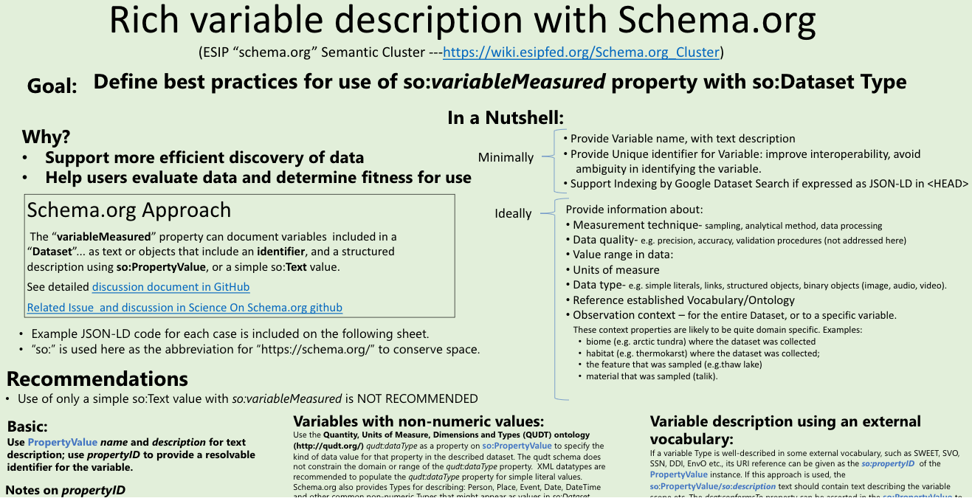
variableMeasured
Research Showcase poster

Slide 25

ESIP Schema.org Cluster
Monitor monthly updates to schema.org
Accept contributions and issues at Github
Maintain & publish updates to guidelines
@ science-on-schema.org
Telecons:
- 1st Monday at 5pm ET
- 4th Thursday at 2:30pm ET
mailing list | #sci-schemaorg (Slack) | Agendas (Google Doc)

