Slide 1
ANZ Metadata WG
Canberra
28-29 Oct 2019
Chris Body

Slide 2
International Update What’s new ISO/OGC Standards
United Nations – Sustainable Development Goals
UN-GGIM
Geospatial integration
Technology

Slide 3
International Update What’s new ISO/OGC Standards
Positioning
ISO 19116 – Positioning Services
ISO 19148 – Linear Referencing
ISO 19161-1 – Geodetic References – Part 1: International Terrestrial Reference System
ISO 6709 – Standard Representation of Geographic Point Location by Coordinates
ISO 19170-1 – Discrete global grid systems – Part 1: Core operations and equal area earth reference systems

Slide 4
International Update What’s new ISO/OGC Standards
Imagery
ISO 19123-1 – Schema for Coverage Geometry and Functions – Part 1: Fundamentals
ISO 19130-3 – Imagery Sensor Models for Geopositioning – Part 3: Implementation Schema
ISO 19159-4 Calibration and Validation of Remote Sensing Imagery Sensors – Part 4: Space-borne passive microwave radiometers
ISO 19163-2 Content components and encoding rules for imagery and gridded data – Part 2: Implementation Schema

Slide 5
International Update What’s new ISO/OGC Standards
Metadata
ISO 19115-2 – Metadata – Part 2: Extensions for acquisition and processing
Preservation of digital data and metadata – Part 2: Content specification for earth observation data and derived digital products

Slide 6
International Update What’s new ISO/OGC Standards
Other
ISO 19168-1 – Geospatial API for Features – Part 1: Core
ISO 19144 – Land Cover & Land Use
ISO 19152 – Land Administration Domain Model
ISO 19160-3 – Addressing – Part 3: Address data quality
ISO 19160-6 – Addressing – Part 6: Digital interchange models

Slide 7
International Update What’s new ISO/OGC Standards
Other
ISO 19131 – Data product specifications
ISO 19135-1 – Procedures for item registration – Part 1: Fundamentals – Amendment 1
ISO 19156 – Observations and measurements
ISO 19157 – Data Quality – Part 1: General requirements
ISO 19166 – BIM to GIS conceptual mapping
ISO 19169 – Gap analysis between Geographic Data Files (GDF) and conceptual models for geographic information

Slide 8
International Update What’s new OGC/ISO Standards
3DIM
Agriculture
Blockchain and Distributed Ledger Technologies
CityGML
IndoorGML
Marine
Smart Cities

Slide 9
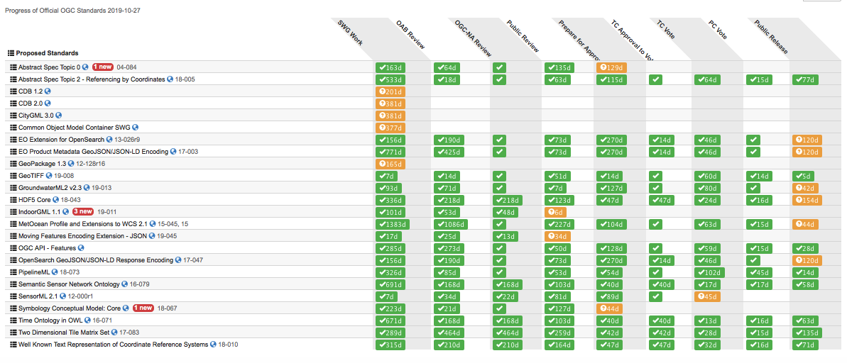

Slide 10
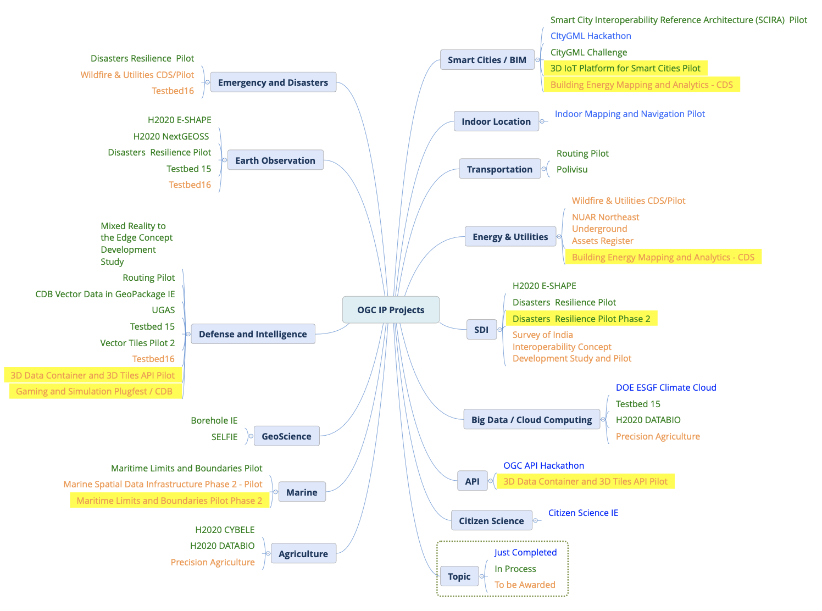

Slide 11
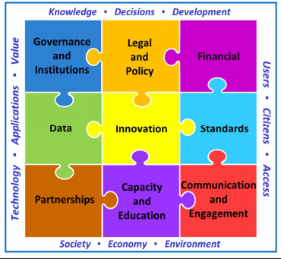
UNGGIM Integrated Geospatial Information Framework (IGIF)
For use by member nations to “develop and enhance their own geospatial information management” capabilities
Enhance government decision making
Improve services to citizens
Help the move toward digital economies
Build capacity for using geospatial technology
9 Strategic Pathway Chapters being developed
Standards Chapter now in work by ISO, OGC and IHO staff

