Slide 1
How can Semantic Web vocabularies and models improve dataset
discovery over non-SW forms
By Nicholas Car, Kurrawong AI
https://kurrawong.net

Slide 2
Agenda
What makes a vocabulary a Semantic Web one?
How are SW vocabs different to/better than non-SW ones?
SW vocab range
How do SW vocabs improve dataset discovery?
Do we have evidence it’s working?

Slide 3
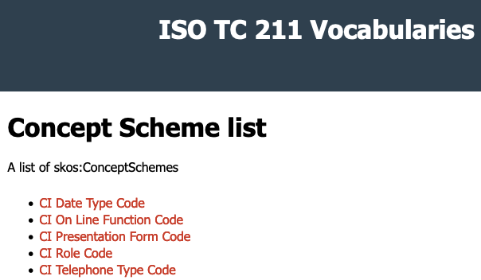
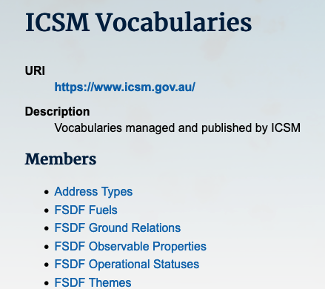
What makes a vocabulary a Semantic Web one?
Use of particular SW models
SKOS
OWL
++
Delivery as Linked Data
Human-
machine-readable
…

Slide 4
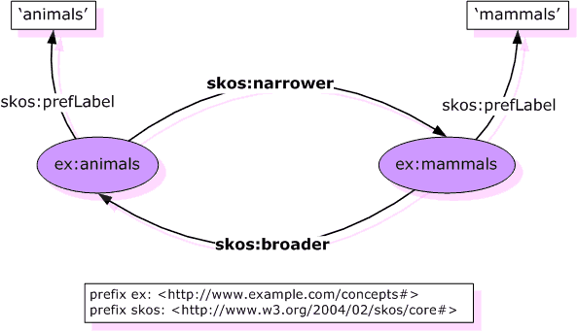
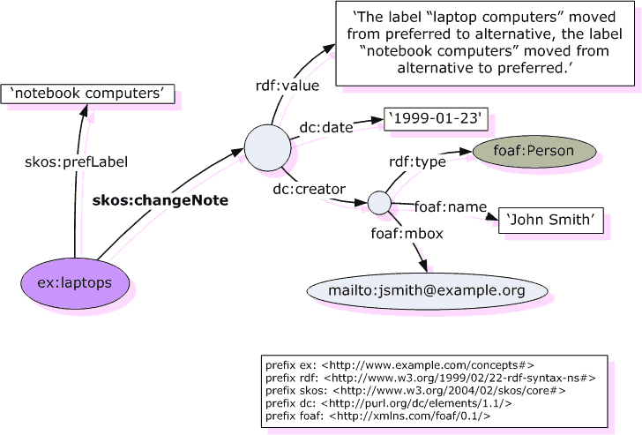
How are SW vocabs different to/better than non-SW ones?
SKOS “skill”
Not unique among vocab models but powerful
Labelling, relations, mappings
Canonical form of extensibility
SKOS+
OWL
Is unique
IRI resolution
For human use
For machine use
Multiple formats, multiple partial representations
http://linked.data.gov.au/def/depth-reference http://linked.data.gov.au/def/depth-reference/australian-height-datum

Slide 5
SW vocab range
cs: a skos:ConceptScheme ;
skos:definition "The point or level from ..." ;
skos:hasTopConcept
:australian-height-datum,
:drill-collar,
:ground-level,
...
:well-head ;
skos:prefLabel "Depth Reference" .
:australian-height-datum
a skos:Concept ;
skos:prefLabel “Australian Height Datum” ;
skos:definition “The Australian Height Datum is a vertical datum...” ;
skos:notation “AHD” ;
... .
Pure SKOS
SKOS+
Non-SKOS
Large v. Small

Slide 6
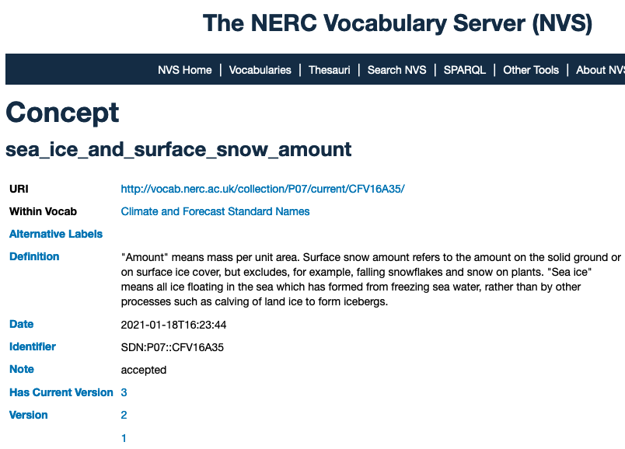
SW vocab range
Pure SKOS
SKOS+
Non-SKOS
Large v. Small

Slide 7
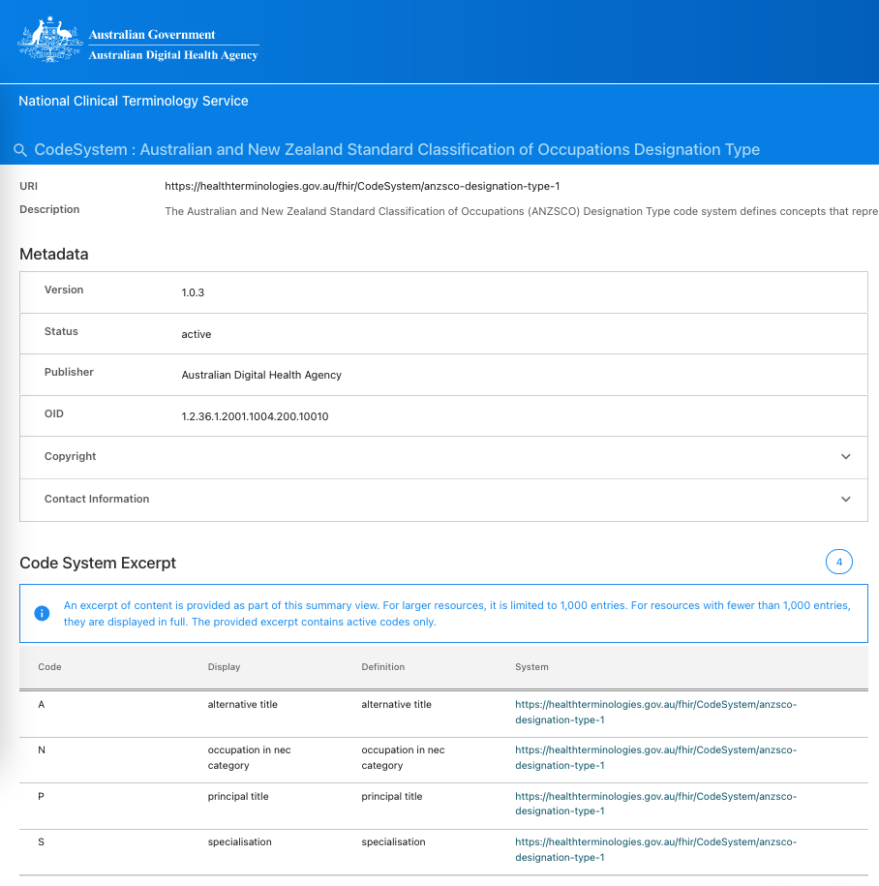
SW vocab range
Pure SKOS
SKOS+
Non-SKOS
Large v. Small

Slide 8
SW vocab range
Pure SKOS
SKOS+
Non-SKOS
Large v. Small
Small: http://linked.data.gov.au/def/depth-reference
Large(r): http://linked.data.gov.au/def/minerals
Very large: Genebank

Slide 9
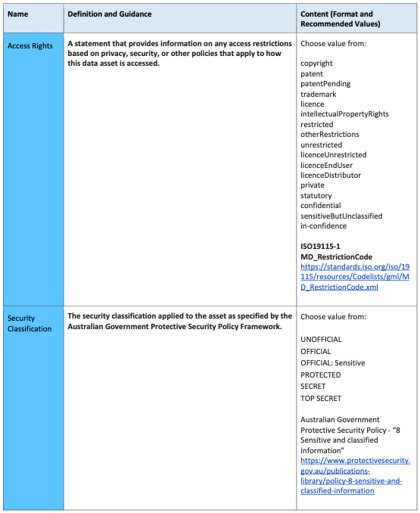
How do SW vocabs improve dataset discovery?
Standardised mechanics across multiple vocabs
Certainty about how to use vocabs
The AGDAMP anti-pattern…
Resolution
What is “AHD”? Go to australian-height-datum
Machine-access
Via resolution
In multiple formats/forms

Slide 10
How do SW vocabs improve dataset discovery?
Standardised mechanics across multiple vocabs
Certainty about how to use vocabs
The AGDAMP anti-pattern…
Resolution
What is “AHD”? Go to australian-height-datum
Machine-access
Via resolution
In multiple formats/forms

Slide 11
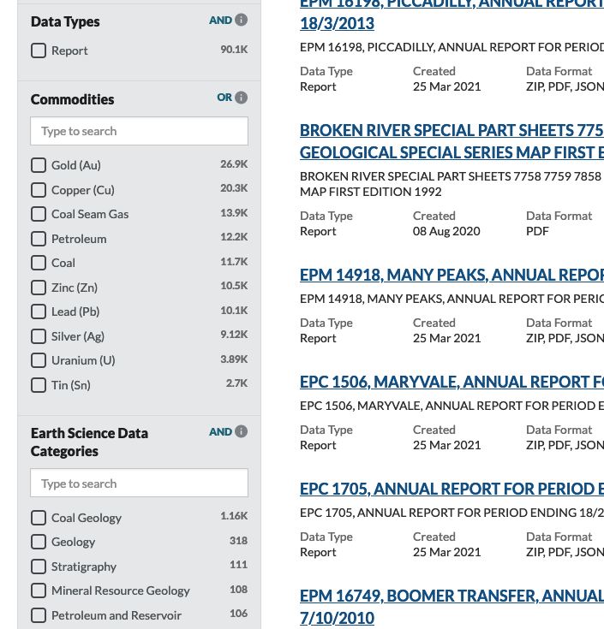
How do SW vocabs improve dataset discovery?
Standardised mechanics across multiple vocabs
Certainty about how to use vocabs
The AGDAMP anti-pattern…
Resolution
What is “AHD”? Go to australian-height-datum
Machine-access
Via resolution
In multiple formats/forms
Faceted search in clients

Slide 12
How do SW vocabs improve dataset discovery?
Standardised mechanics across multiple vocabs
Certainty about how to use vocabs
The AGDAMP anti-pattern…
Resolution
What is “AHD”? Go to australian-height-datum
Machine-access
Via resolution
In multiple formats/forms
Faceted search in clients
Growing skill into Reference Datasets

Slide 13
How do SW vocabs improve dataset discovery?
Growing skill into Reference Datasets
Datasets are associated with rich objects that have more information linked to them
Domain knowledge can be stored in vocabs - labelling & def but also structure - and reused
We have an extensible graph over the web
Combining with original metadata allows for specialised traversal
rich object

Slide 14
How do SW vocabs improve dataset discovery?
Growing skill into Reference Datasets
Datasets are associated with rich objects that have more information linked to them
Domain knowledge can be stored in vocabs - labelling & def but also structure - and reused
We have an extensible graph over the web
Inter-vocab linking
Combining with original metadata allows for specialised traversal
Current Voc Search Strategies:
SKOS Weighted Search
SKOS Structured Search
Future:
Online resolution
Custom properties (e.g. NSL)

Slide 15
Do we have evidence it’s working?
Resolvable vocabs promoting term understanding
E.g. https://cgi.vocabs.ga.gov.au/vocab/
Concept reuse across orgs
Shared categorisation, e.g. ANZSRC (https://linked.data.gov.au/def/anzsrc-for)
Geological Surveys are starting to reuse the same vocab terms in data
Cross-systems demonstrations
Catalogues starting to share codelists with other tools
Use in graphs
NAA BRII challenge used vocabs for Records classification/discovery
ICSM: not yet
benefitting from vocab presentation & review so far

