Slide 1
Update on ANZ MDWG Activities:
November 2021 – May 2022
1-2 June 2022
ANZ MDWG Meeting # 10

Slide 2
ISO Metadata Standards – What’s new and what’s different
ISO 19115:2003
Metadata
ISO 19115-1:2014 & Amd 1:2018 / Amd 2:2020
Metadata Fundamentals & Services
ISO 19139:2007 (withdrawn)
XML Encoding
ISO 19115-2:2019
Imagery Metadata
ISO 19115-2:2009
Imagery Metadata
ISO 19115-3:2016
XML Encoding (F&S)
ISO 19157:2013
Data Quality Metadata
ISO 19139-2:2012
XML Encoding (Imagery)
ISO 19119:2016
Services Metadata
ISO 19119:2005
Services Metadata
OGC API
OGC Web Services
ISO 19139-1:2019
Encoding Rules
ISO 19165-1:2018
Preservation of Digital Data & Metadata - Fundamentals
ISO 19165-2:2020
Preservation of Digital Data & Metadata – Earth Observations & derived products

Slide 3
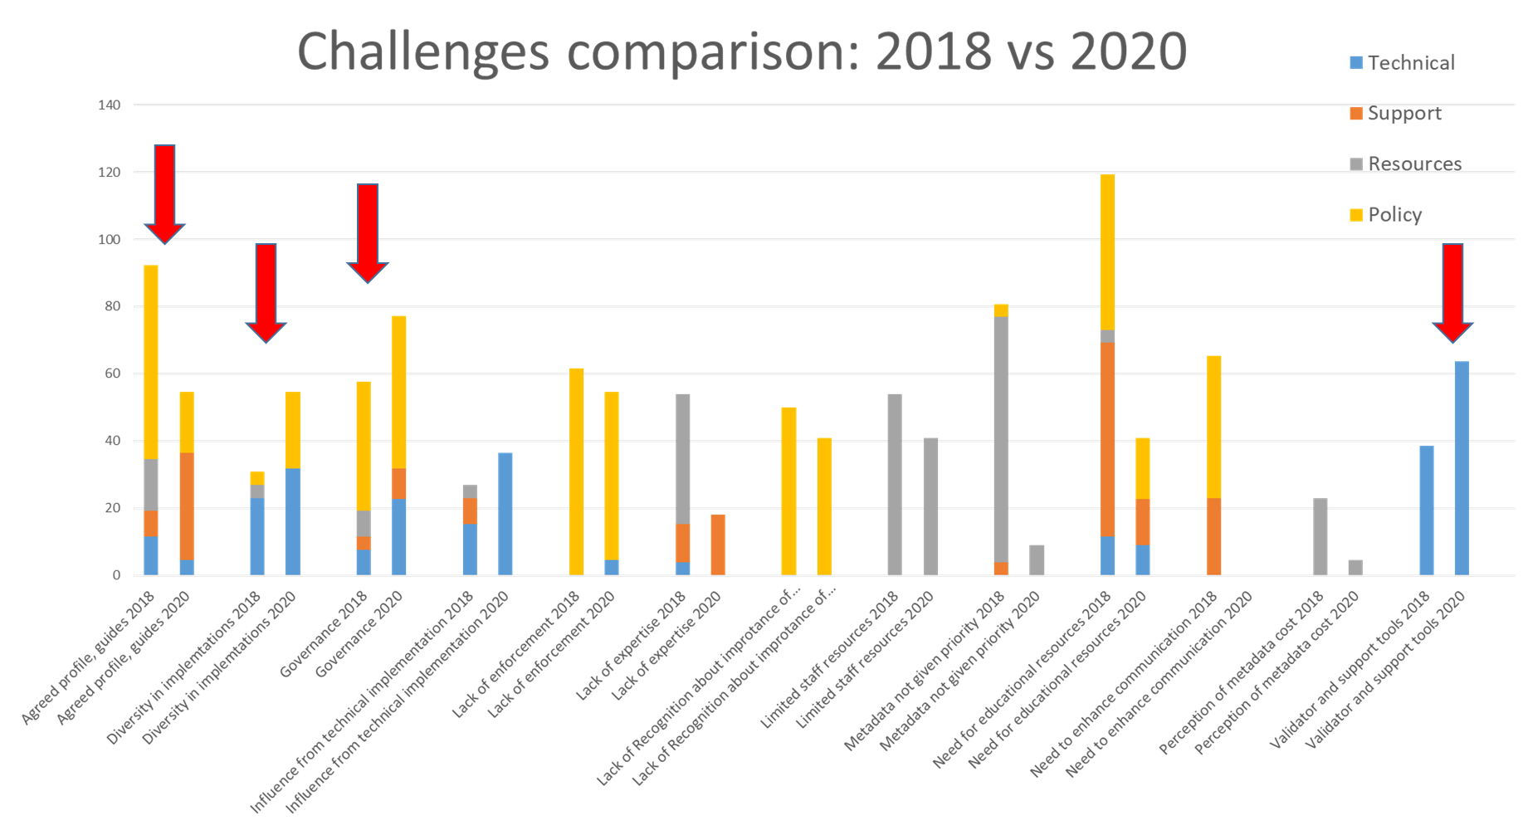
Roadmap 2: Priorities
Four major priority areas:
Support for transformation pathways - access to expertise
Development data specific profiles and implementation examples
Metadata creation, editing and validation tools
Improving technical governance

Slide 4
Requirements for ESRI supported metadata tool
Current situation
  Developed by ESRI Australia to support creation of the ISO 19115 metadata
  Maintained by GA
  The tool based on a superseded version of the standard, which s not supported by ANZLIC
  GA/ANZ MDWG received many questions about plans to upgrade it to the ISO 19115-1 standard
  Digital Atlas of Australia and Australian Climate Service require interoperable ISO 19115-1/ANZLIC complaint metadata to ensure quick discovery of fit for purpose resources
Issues
  Metadata statements generated by the ESRI tool:
      are not compliant with new version of metadata
      have limited interoperability
      cannot be easily integrated in central catalogues
      additional steps are required to convers to the new standard
  Metadata for services is not supported

Slide 5
Requirements for ESRI supported metadata tool
Does your organisation use ESRI software for managing spatial data and products?
Has your organisation used the ESRI ANZLIC Metadata Tool before?
Will your organisation use upgraded ESRI ANZLIC Metadata Tool?

Slide 6
1. Support for transformation pathways
Identify potential collaboration areas and pilot project to improve consistency and access to metadata
Investigate metadata standards used across geospatial community in AUS and NZ:
  Conduct survey – completed in April/May 2022
  Develop crosswalks – to do
Provide advise/feedback on the ISO 19115-1 (-3) related matters - continuous
Development of metadata community profiles: EM (completed), advice and agreed way forward for geodesy metadata profile (on the way)
Work with Esri Inc on enhancement of current workflow to create the ISO 19115-3 compliant xml (link to Esri documentation) - commenced
Provision of advice on implementation and use of the metadata - continuous
Feedback on the ISO 19115-1 (-3) and ISO 19157 - provided

Slide 7
2. Development data specific profiles & implementation examples
Development of metadata community profiles:
  EM – V1 completed
  GNSS metadata profile – commenced, advice provided
  Australian Climate Services – commenced
How to record data dictionary information in the ISO 19115-1 - commenced

Slide 8
3. Metadata creation, editing and validation tools
Creation of ANZMet Lite V2, including EM metadata templates – completed
Creation of new templates: Australian Climate Services, Data Dictionary - commenced
Work with Esri to contribute to influence Esri’s work on compliance with the ISO 19115-1 - commenced
Assist with access/testing of the ANZMet Lite V2 and EM metadata tools - continuous
Assist/provide advice on implementation metadata catalogues - continuous
ANZMet Lite V2 (link) and ‘How to’ access and use ANZMet Lite V2 – published (link)

Slide 9
4. Improving technical governance
ANZLIC pages – updated (link)
Best Practice document – updated (link)
Participation in:
  UN-GGIM 3rd edition of Guide on the Role of Standards – published in February 2022 (link)
  Development of International Community Guidelines for Sharing and Reusing Quality Information of Individual Earth Science Datasets – published in March 2022 (link)
  APS Metadata Management and Data Interoperability Project – metadata recommendation for Federal Government Agencies – published (link)
Advice on geospatial (provided, continuous):
  Data.gov.au – indirect influence for all data.gov.* across Australia
  Office of National Data Commissioner
  Aristotle (proprietary metadata software)
Publish advice on (to do)
  Development guidelines for recording metadata on Data Quality and Uncertainty
  Transformation between the ISO 19115 and ISO 19115-1
  How to validate the metadata and where to find the validation tools

Slide 10
Next Steps
Progress/complete commenced activities
Assist EM sector with their metadata project
Development guidelines for recording metadata on Data Quality and Uncertainty
Other priorities and new challenges? – Survey to identify challenges and priorities in November 2022

Slide 11

Questions and comments???

