Slide 1
Standards Update
(Standards Australia, ISO, OGC & UNGGIM)
Chris Body (Independent Chair - IT-004 Geographic Information/Geomatics – Standards Australia and
OGC – Australia/New Zealand)
ISO/TC 211

Slide 2
Standards Australia
Standards Australia has submitted to publish ISO/TC 211 Standards as AS/NZS
  AS/NZS ISO 6709 Standard Representation of Geographic Point Location by Coordinates
  AS/NZS TS ISO 19159-4 Geographic Information – Calibration and Validation of Remote Sensing Imagery Sensors – Part 4: Space-borne Passive Microwave radiometers
  AS/NZS TS ISO 19166 Geographic Information – BIM to GIS Conceptual Mapping (B2GM)
  AS/NZS ISO 19168-2 Geographic Information – Geospatial API for Features – Part 2: Coordinate Reference Systems by Reference by Reference
  AS/NZS TR ISO 19169 Geographic Information – Gap Analysis: mapping and describing the differences between the current GDF and ISO/TC 211 conceptual models to suggest ways to harmonise and resolve conflicting issues

Slide 3
Standards Australia
Increase coordination of committees requiring spatial & positioning knowledge and information
  Building Information Modeling
  Intelligent Transport System
  Smart Cities/Digital Twin
  Uninhabited aerial vehicles
Review AS/NZS 4819:2011 Rural and Urban Addressing
Next IT-004 meeting 22nd October

Slide 4
ISO/TC 211
Over the last 6 months there has been a number of announcements:
  Next Meeting Nov/Dec 2021 (Zoom)
  No face-to-face meeting until May 2022 (Vienna, Austria)
  A number of new Advisory Groups & convenors:
    AG 13 Land Cover & Land Use
    AHG on Representing Time
    Jan Hjelmager (Denmark) – AHG 6 e-Government Co-convenor
    Tobias Spears (Canada) – AG 10 XML Maintenance Group Co-convenor
  Established a liaison with the UGGGIM Subcommittee on Geodesy and UNGGIM Africa
  Liaison Review
  Long-term sustainability of the ISO Geodetic Register

Slide 5
ISO/TC 211
Published
  ISO 19116:2019/Amd1:2021 Geographic information —Positioning services —Amendment 1
  ISO 19126:2021 Geographic information —Feature concept dictionaries and registers
  ISO 19135-1:2015/Amd1:2021 Geographic information —Procedures for item registration —Part 1: Fundamentals —Amendment 1
  ISO 19148:2021 Geographic information —Linear referencing
  ISO/TS 19166:2021 Geographic information —BIM to GIS conceptual mapping (B2GM)
  ISO 19170-1:2021 Geographic information —Discrete Global Grid Systems Specifications —Part 1: Core Reference System and Operations, and Equal Area Earth Reference System
  ISO/TR 23262:2021 GIS (geospatial) / BIM interoperability

Slide 6
ISO/TC 211
Systematic Review (Results)
  ISO 19134:2007 Geographic Information – Location-based Services – Multimodal Routing and Navigation (Confirmed)
    PMG to look at this at the next meeting
  ISO 19137:2007 Geographic Information – Core Profile of Spatial Schema (Confirmed)
    PMG to look at this at the next meeting
  ISO/TS 19159-3:2018 Geographic Information – Calibration and Validation of Remote Sensing Imagery Sensors and Data – Part 3: SAR/InSAR (Confirmed)

Slide 7
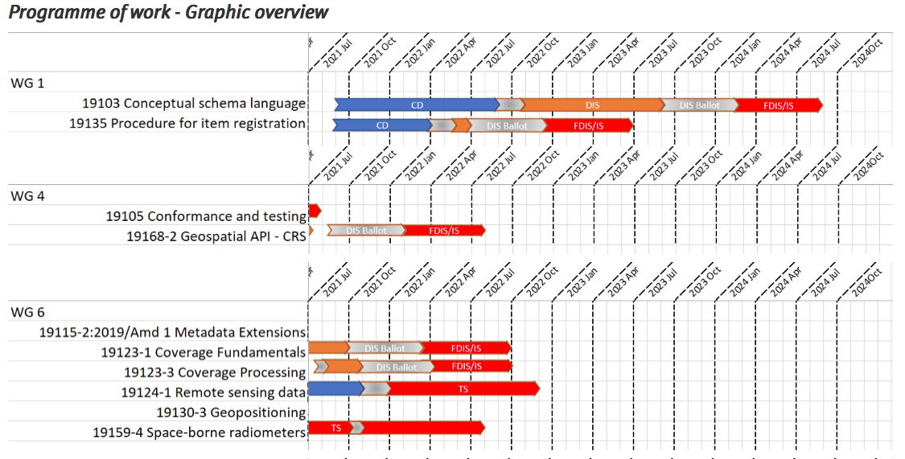

Slide 8
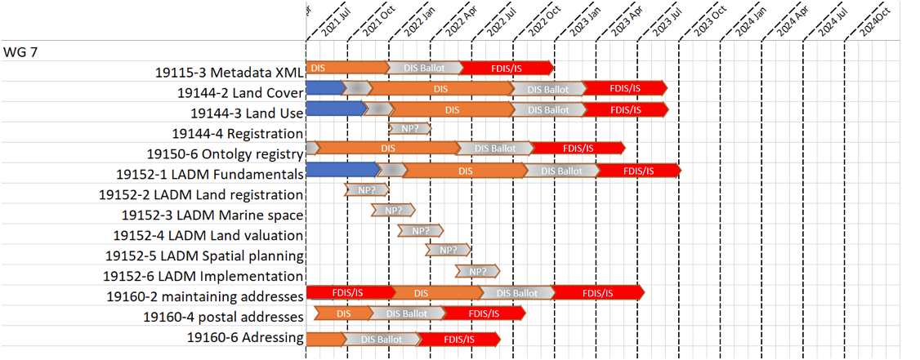

Slide 9
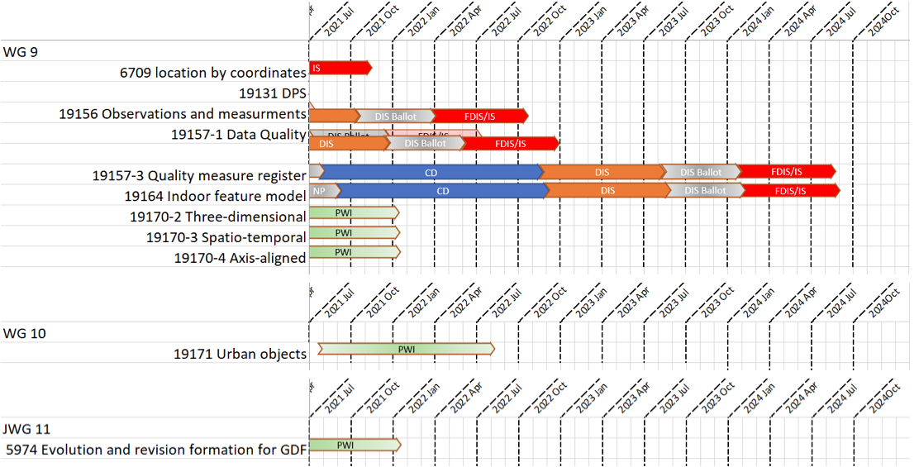

Slide 10
ISO/TC 211
Closer collaboration with other ISO committees, UNGGIM, OGC and IHO
Standards being linked to SDGs
Next meeting virtual – Nov/Dec 2021

Slide 11
ISO/TC 211
Australian/New Zealand Member Contribution
  Evert Bleys
  Mike Judd
  Byron Cochrane
  Robert Gibb
  Margie Smith
  Nick Car
  Ivana Ivanova
  Nick Brown
  Irina Bastrakova
  Simon Cox
  Mark Alcock
  Matt Purss
  Norman Mueller
  Kate Roberts
  Sisi Zlatanova
  Glenn Newnham
  Richard Murcott
  Chris Body

Slide 12
OGC
OGC 120th Meeting was held again virtually 13-20 September
  Held in conjunction with Singapore Geospatial Festival
  Over 750 attended
  Special sessions during the meetings covered: Beyond Spatial Data Infrastructure (SDI); Start Ups; Metadata, Catalogues and Records; Developer Workshop; New Space Summit; Mobility Summit Preview; Indoor Mapping and Marine
  Integration of BIM and GIS and the upcoming Integrated Digital Built Environment Pilot
  Testbed 17 nearing completion with Engineering Reports to be reviewed by WG.
    Advance Sensor Integration
    Security, Clouds and Model-Driven Architecture
    Interoperability through APIs
  Marine Spatial Data Infrastructure

Slide 13
OGC
Innovation Program
  Disaster Pilot
  OGC-IHO Federated Marine SDI Demonstration Pilot
  Interoperable Simulation & Gaming Sprint (Year 2)
  CYBELE – HPC, Big Data, Cloud Computing and IoT for Smart Farming
  E-shape – Develop Operational Earth Observation Services
  Climate Change Services 2022 Pilot
  Testbed 18 – potential technologies could be Web API enhancements; Machine Learning and Artificial Intelligence; 3D data; Linked Data & Semantics
  https://www.ogc.org/projects/initiatives/active

Slide 14
OGC
Published
  OGC TimeSeriesML 1.3
  Indoor Mapping Data Format (IMDF)
  Abstract Specification – Discrete Global Grid Systems – Part 1: Core
  OGC API – Environmental Data Retrieval
  CityJSON 1.0 Community Standard
  CityGML v3.0 Conceptual Model
Best Practice
  Defence Geospatial Information Working Group (DGIWG) GeoTIFF/TIFF Profile for Imagery Gridded Data 2.3.1
  DGIWG GMLJP2/JP2 Profile for Imagery & Gridded Data 2.1.2
https://www.ogc.org/roadmap

Slide 15
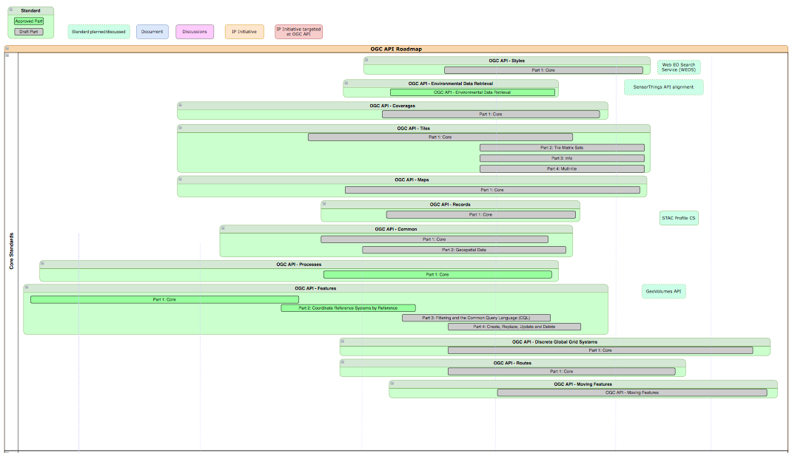
OGC development of APIs is to make it easy for anyone to provide geospatial data to the web
https://ogcapi.ogc.org

Slide 16
UNGGIM
OGC, ISO/TC 211, IHO and Member States
  Contributed to the Integrated Geospatial Information Framework (IGIF)
  Participated in the review of the Framework for Effective Land Administration (FELA)
  Development of the Guide to the Role of Standards in Geospatial Information Management
  Supporting UNGGIM work program in the areas of:
    Land Administration and Management
    Global Geodetic Reference Frame
    Statistical and Geospatial Information Integration
    Marine and International Boundaries
    Geographic Names
    Fundamental Geospatial Data Themes
    Addressing
    Land Cover & Land Use

Slide 17
Summary
Smart Cities/Digital Twins
BIM & Geospatial Integration
Uninhabited aerial vehicles
Earth Observation/Space
Coordinate Referencing and Geospatial Data for ITS
Data Quality & Authoritative Data
3D & 4D Geospatial Data
Lotus Charter – ethical use of location data
Question
Where does ICSM see geospatial metadata specification/standard being developed in the future?
  Is it with ISO, OGC, or with non-spatial consortiums (W3C, Open Source, STAC) or a combination

