Slide 1
ANZLIC/ICSM Metadata Working Group presentation
Marco Wallenius, Policy & Strategy

Slide 2
Policy release
Building trust in the public record: managing information and data for government and community
Endorsed by the Attorney-General and Minister for Industrial Relations 20 November 2020

Slide 3
Policy purpose and statement
Policy statement
Agencies will:
1. manage information assets strategically with appropriate governance and reporting - to meet current and future needs of government and community
2. implement fit-for-purpose information management processes, practices and systems - that meet identified needs for information asset creation, use and re-use
3. reduce areas of information management inefficiency and risk - to ensure public resources are managed effectively
Policy purpose
The purpose of this policy is to improve how Australian Government agencies create, collect, manage and use information assets. Effective information management facilitates delivery on government objectives to better support, protect and serve the Australian community - now and in the future. This increases trust in government.

Slide 4
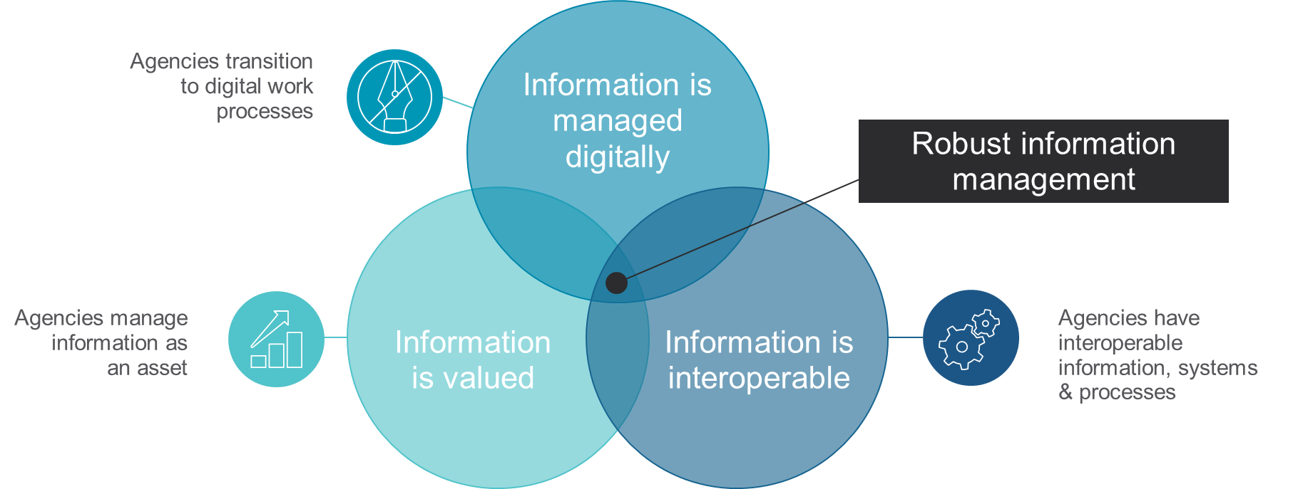
Previous policies

Slide 5
Metadata reflected in policy actions
Action 5: Register your information assets where there is business value in doing so
Action 10: Ensure business systems, including whole-of-government systems, meet functional and minimum metadata requirements for information management

Slide 6
Implementation support for agencies
Current focus of National Archives’ work following policy release
Includes continued engagement with agencies both at senior and operational levels
The National Archives will support delivery by developing or endorsing products and advice – advised through annual public release schedules published to our website
Engaging with communities of practitioners will be an important touchpoint to inform products and implementation advice
Continued engagement also important for effective monitoring, evaluation and reporting of the policy in achieving its intended outcomes

Slide 7
Questions
new policy from 2021

