Slide 1
UN-GGIM Role of Standards in Geospatial Information Management Guide – 3rd Revision
ANZ Metadata Working Group Meeting No 9
Irina Bastrakova
8 October 2021
Positioning geospatial information to address global challenges
Notes:
1

Slide 2
United Nations Global Geospatial Information Management (UN GGIM) Committee of Experts
Established by UN Economic and Social Council (ECOSOC) in July 2016
Global Intergovernmental mechanism for making decisions and setting directions about production, availability and use of geospatial information within national, regional and global policy frameworks.
Aims:
Leader in development of global geospatial information
Promoter of use of geospatial information to address key global challenges
Global policymaking of geospatial information management

Slide 3
UN GGIM Regional Committees
Five Regional Committees:
Role:
Liaise with the UN-GGIM Secretariat on topics of interest and major developments
Facilitate regional development and discussion
Provide formal feedback
Alison Rose (GA) – President of Asia-Pacific Regional Committee

Slide 4
Integrated Geospatial Information Framework (IGIF)
Provides a basis and guide for developing, integrating, strengthening and maximising geospatial information management and related resources in all countries
Assist countries in bridging the geospatial digital divide, secure socio-economic prosperity, and to leave no one behind
Focuses on location information that is integrated with any other meaningful data to solve societal and environmental problems, acts as a catalyst for economic growth and opportunity, and to understand and take benefit from a nation's development priorities and the Sustainable Development Goals
IGIF’s three parts:
Part 1 is an Overarching Strategic Framework
Sets the context of 'why' geospatial information management is a critical element of national social, economic and environmental development
Part 2 is an Implementation Guide
Communicates ‘what’ is needed to establish, implement, strengthen, improve and maintain a national geospatial information management system and capability
Part 3 is a Country-level Action Plan (CAP)
Country specific details on 'how' the guiding principles, options, and actions specified in the Implementation Guide will be carried out, when and by whom

Slide 5
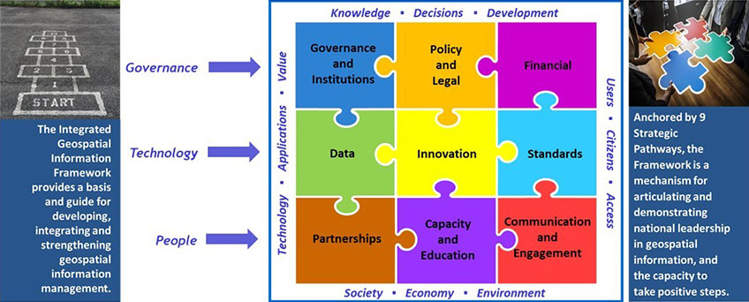
IGIF - Nine Strategic Pathways
Part 2: Implementation Guide
https://ggim.un.org/IGIF/part2.cshtml

Slide 6
UN GGIM Guide to the Role of Standards - History
OGC, ISO/TC 211 and IHO participate as a joint SDO team to support the UN-GGIM
Major Work Product:
UN-GGIM Guide to the Role of Standards in Geospatial Information Management, and Companion Document
Developed in collaboration with:
OGC, ISO TC211, IHO
ESRI, Oracle, the SI Organization, USGS, OS (UK), etc.
GA, Standards Australia, Dept of Communication, CSIRO, Vic Government
Publications
Initial publication 2015
Second Edition 2018

Slide 7
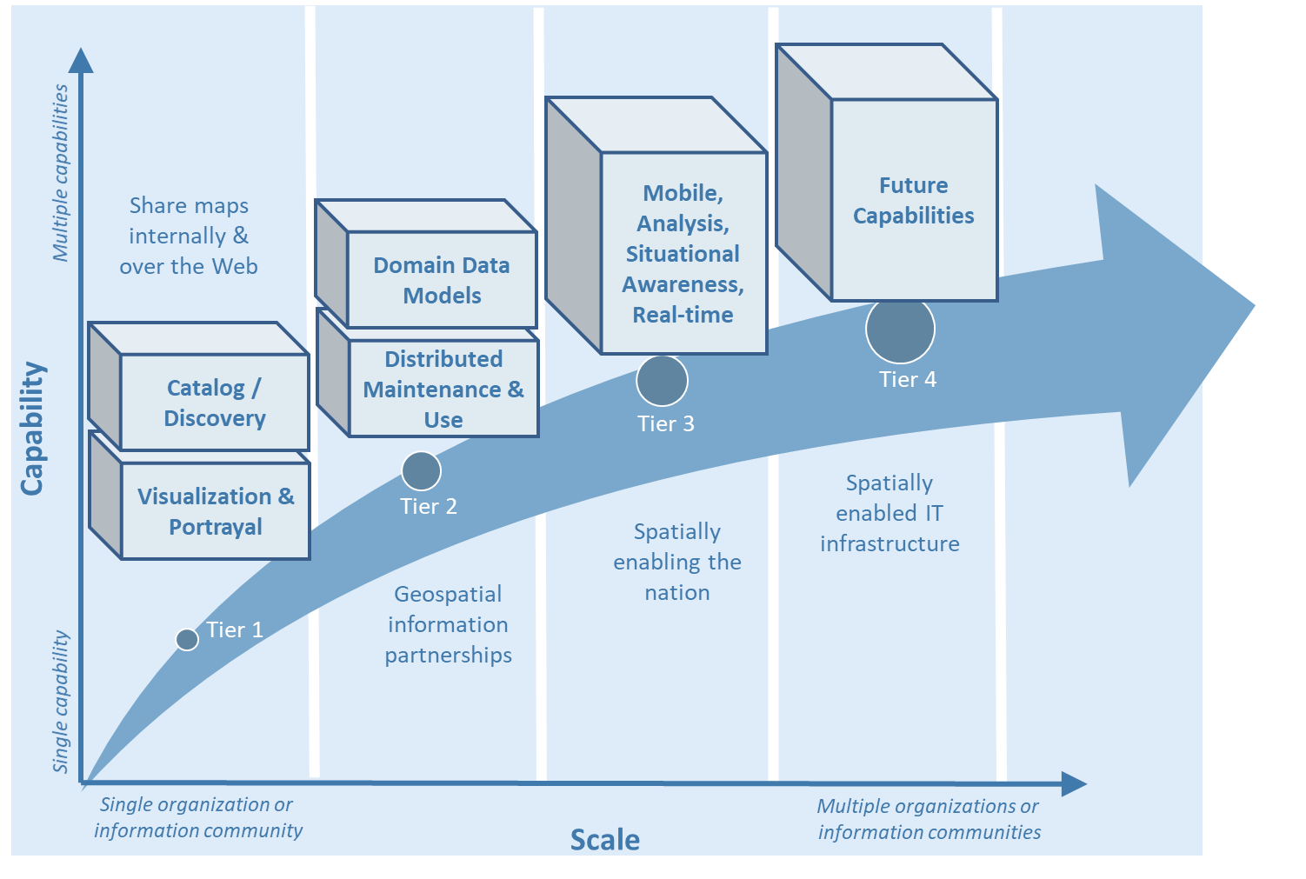
UN GGIM Guide to the Role of Standards - overview
Definitions
Value and Benefits of Geospatial Standards
Tiers of capability
Use Cases / Examples
Resources

Slide 8
Revision – 3rd Edition, 2021
Significant Review
Assure alignment across IGIF, IGIF annexes, Standards Guide, and Companion Document
Include relevant advancements in standards and associated best practices since publication of Edition 2 in 2018
Address specific feedback received from community and SDOs
Limited timeframe and SDO resources (Jan - Dec 2021)

Slide 9
Revision – 3rd Edition, 2021
Feedback / Areas of opportuinty
Elevated discussion on Sustainable Development Goals
Geospatial integration with other meaningful data
Include more detail on data content standards and how these are used with the W*S standards
Stronger emphasis on the application of semantic concepts, ontologies, spatial data on the web
Better identfy the specific steps for implementers to follow
3D/4D (e.g. city models), 3D streaming, other technologies transitioning from emerging status
Citation of benefits and use cases, openly available training and other user resources for learning about and implementing standards
Improve illustrations / graphics (lesson learned from IGIF Chapter 6 work)

Slide 10
Work Approach / Governance
Activity Schedule
Kick-off meeting – Jan 2021
Identify small Core Team to oversee and guide revision effort – Feb 2021
Review and update Guide structure based on feedback – Feb-Mar 2021
Form task teams to focus on particular sections – Mar – Apr 2021
Core Team to monitor progress and address issues – Feb – Jul 2021
Develop a final draft by Core Team – Jun 2021
Transmit to UN GGIM Secretariat on behalf of SDO Standards Guide team – Jul 2021
Community consultations – Aug – Oct 2021
Publication – Dec 2021

Slide 11
Activity deliverables
The Guide has been updated to:
Represent the latest adopted geospatial and complementary standards, good practices, use cases and other resources,
Consolidate material presented the 2nd Ed of Guide and Companion document
Align with the IGIF Strategic Pathway, and
Support transition of content to an on-line presence in late 2021
Australian Core Team members:
Irina Bastrakova and Shane Crossman
Acknowledgment:
Joel Haasdyk, Evert Bleys, Chris Body

Slide 12
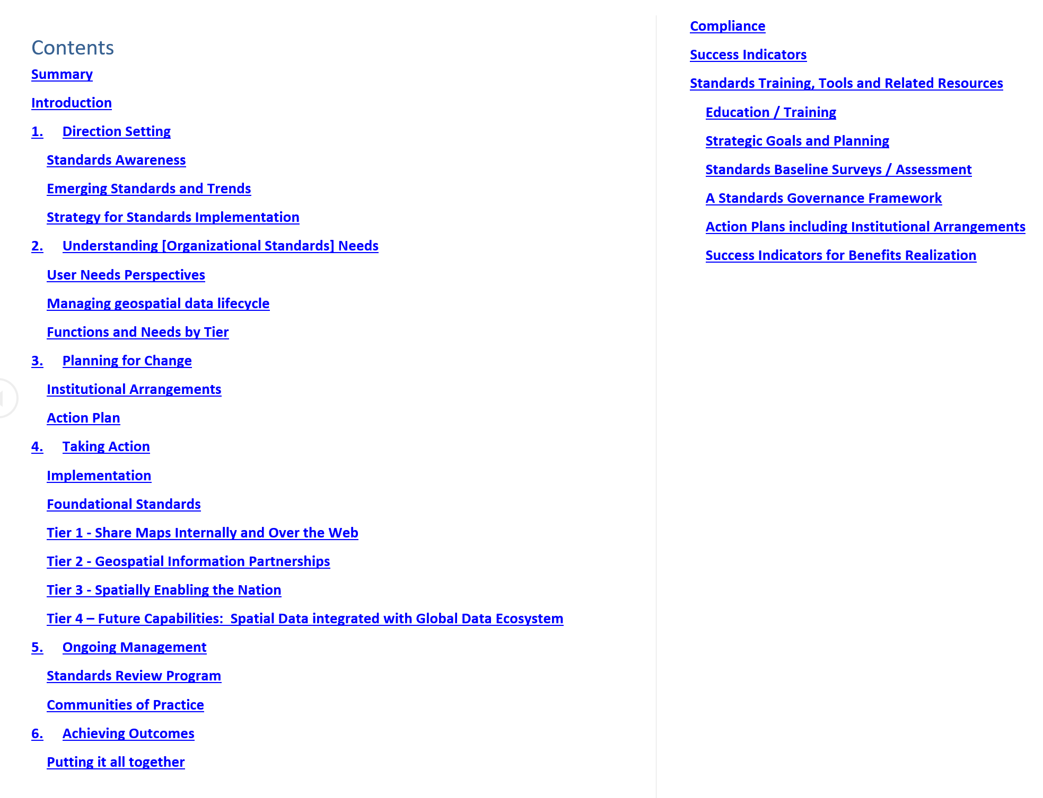
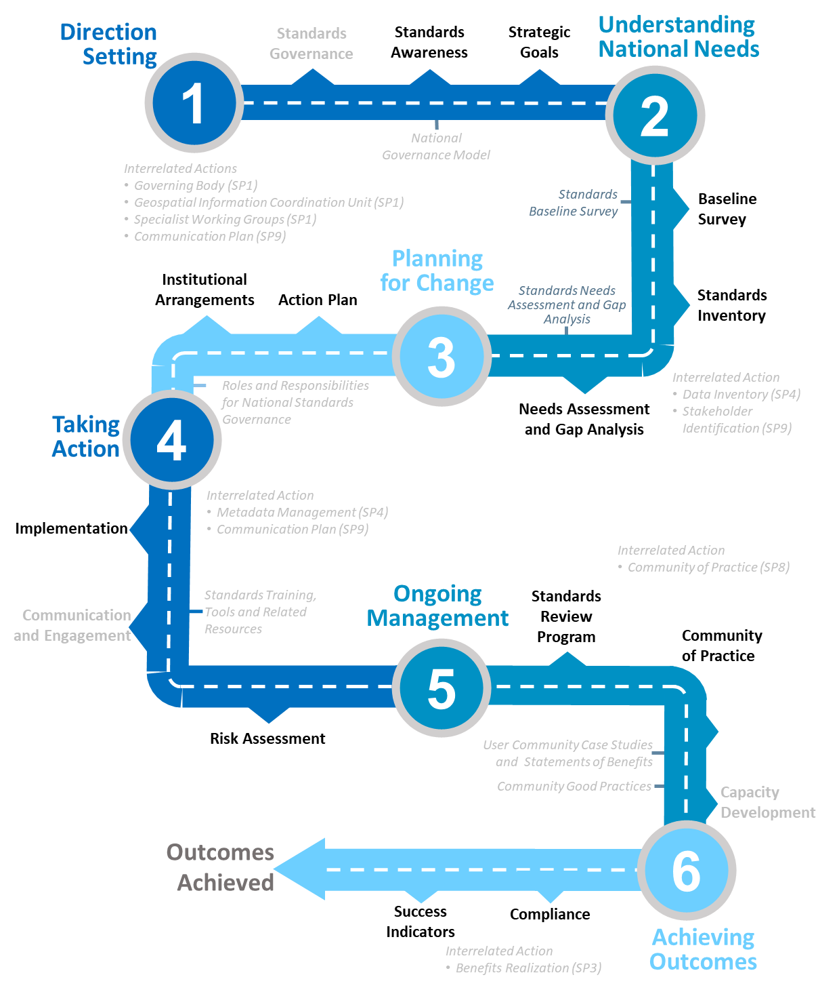
Content and Attachments
Attachments for Catalogues of:
Current standards
Emerging Standards
Registries of vocabularies and code lists
Standard bodies and standards’ registries
Communities of Practice
Resources, References and Tools

Slide 13
Content: Chapters
Direction Setting
Benefits of standards; importance of setting strategic goals to achieve geospatial maturity
Identify types of standards required for increasing levels of capability & collaboration
Role of SDOs and how to participate in standards development
How standards contribute to interoperability; examples of benefits
Understanding National Needs
Standards to assess and address an org. needs based on geospatial maturity level or tier
Standards evolving along with changing needs and technologies
Three perspectives: User, Data, Organization/Institution
Planning for Change
Implementation & use of standards to meet national or organisational needs
Types of business needs that may be supported through the implementation of standards
Implementing standards as part of the systems development lifecycle
Standardisation in domain contexts, engaging with CoP to facilitate alignment & interoperability at various levels

Slide 14
Content: Chapters
Taking Action
Level of maturity, level of complexity & the work to be done during the implementation
Matching the standards required to fulfil their needs to a given maturity level
Details about standards in different cases, how to access & implement them
Standards & providing feedback into the ongoing development of standards
Ongoing Management
Establishing a standards review / maintenance process
Remain up-to-date through periodic review with standards bodies and CoP
Leveraging standards bodies to talk & submit requirements for standards; to address interoperability issues
Value of sharing experiences and standards success stories with others
Achieving Outcomes
How standards improves sharing & use of geospatial information and its management
Use cases to apply rapid mobilisation of new sources of data/technologies; avoid lock-in to specific technology providers
How to improve uptake of geospatial information, creating efficiencies in geospatial data production & management, saving effort, time, cost in reusing & repurposing data
Benefit realisation, indicators to monitor & evaluate as part of an internal/external audit

Slide 15
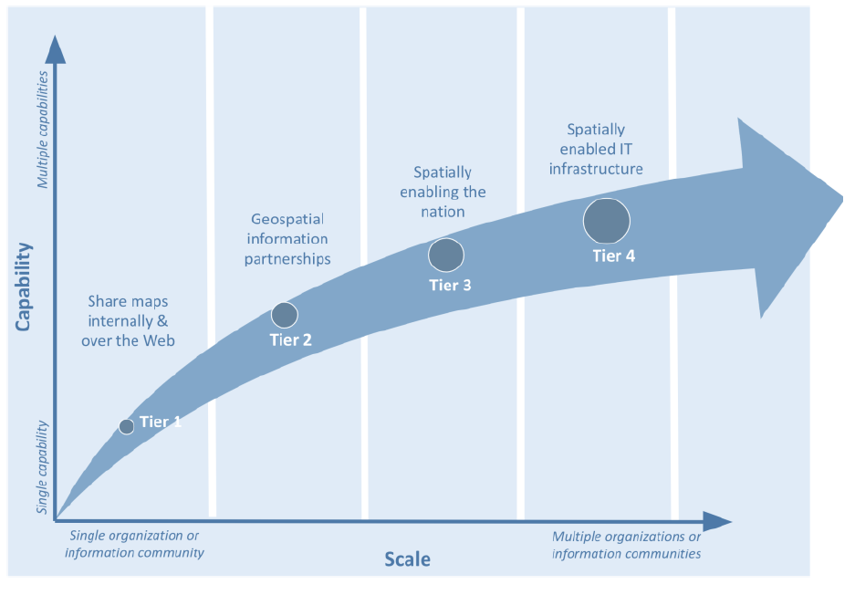
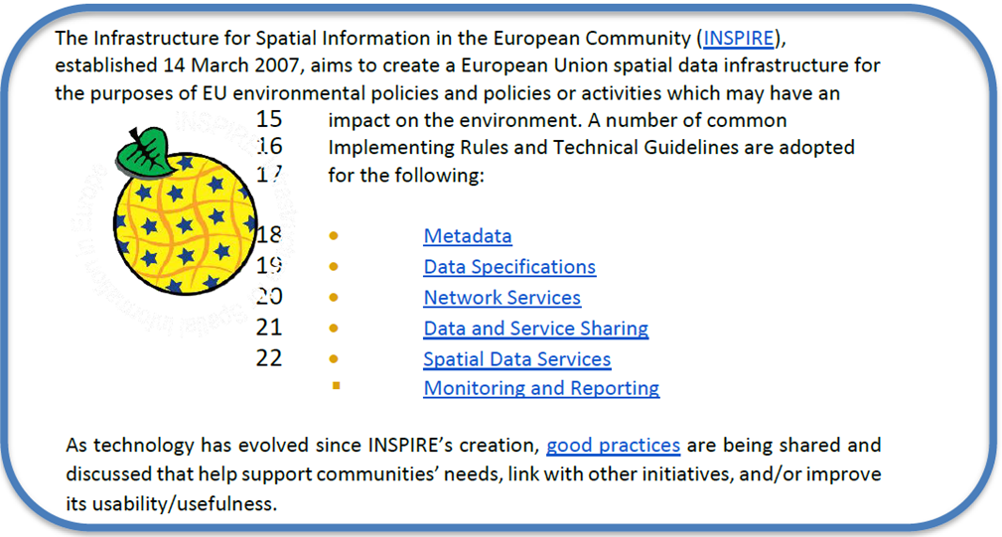
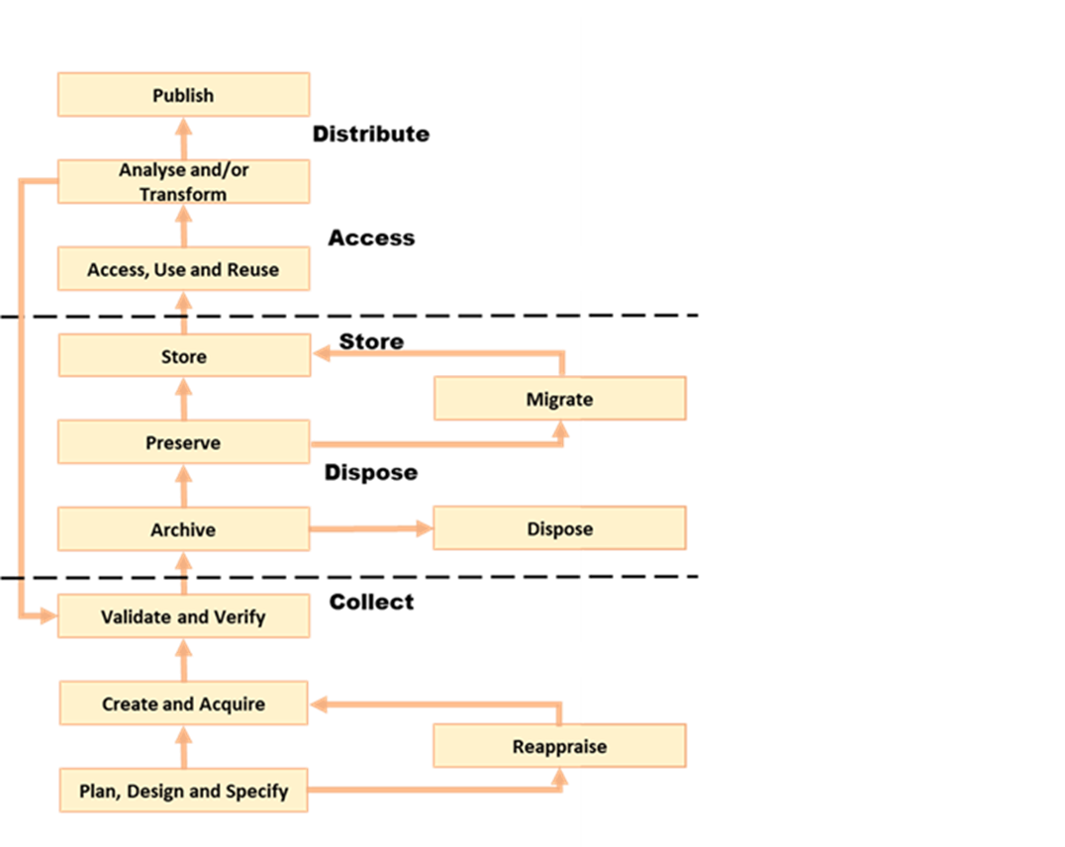
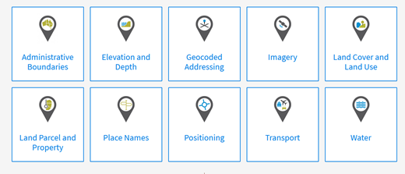
Graphics
Applicable Standards (examples):
ISO 19115-1 (data and services metadata), W3C DCATv2 for semantic web metadata capturing, ISO 19110 (methodology for feature cataloguing), OGC Geopackage (format for transferring Geospatial Information)
ISO 19157-2 (data quality), PROV to record history of data changers
OGC O&M / ISO 19156 (data observations and measurements)
ISO 19165-1 and ISO 19165-2 (digital data preservation), and PROV to record history of data changers
ISO 19157-2 (data quality), OGC O&M / ISO 19156 (data observations and measurements)
ISO 19109 (rules for application schema), ISO 19131 (Data product specifications), ISO 19115-1 (data and services metadata), W3C DCATv2 for semantic web metadata capturing
Geospatial data life cycle and examples of applicable standards (Amended from Source: Geospatial Frameworks)
Figure 4.4: Example: Foundation geospatial information layers (Source: ANZLIC)

Slide 16
Summary
UN-GGIM Guide to the Role of Standards in Geospatial Information Management, 3rd Ed:
Significantly updated to align with modern technological standards
Life/web and PDF formats
Bi-annual review and update by chapter leaders
Better alignment with other IGIF Strategic Paths
Covers data and technology
Useful reference materials

