Slide 1
Vocabularies: Development and Publication
Irina Bastrakova
ANZLIC/ICSM Metadata Working Group Meeting No 5, Canberra
28-29 October 2019

Slide 2
What is a vocabulary and why we need them
What?
Vocabularies define the concepts and relationships (also referred to as “terms”) used to describe and represent an area of concern.
Used to classify the terms that can be used in a particular application, characterise possible relationships, and define possible constraints on using those terms.
Can be very complex (thousands of terms) or very simple (one or two concepts )
Why?
Help with data integration by removing ambiguities that may exist on the terms used in the different data sets
Help to organize knowledge (e.g. library catalogues)
Used as tags to improve search (e.g. Google)
Improve communication
Improve machine-to-machine exchange
Provide extra knowledge that may lead to the discovery of new relationships

Slide 3
Vocabularies: development and governance
Types of vocabularies:
Defined in the ISO standards – e.g. ISO 19115-1
Defined by communities
Extension of ISO standards (e.g. extending code list of roles)
Subject specific (e.g. code lists of rock types, street types)
Governance:
For ISO vocabularies – strict protocols through standard revisions and amendments.
For community vocabularies – protocols defined by a community, official organisation or group (e.g. PCPN, Geological Union), CoP, etc.

Slide 4
Vocabularies: Publication
Published through Research Vocabularies Australia Portal (https://vocabs.ands.org.au/)
Available to all users (nationally and globally)
Consistent publication process and central point of truth
RDF Format – machine readability, semantic web
Ability to collaborate
Currently Published:
ISO 19115-1 vocabularies (https://vocabs.ands.org.au/search/#!/?pp=15&q=ISO)
ISO 19115-1 vocabulary extensions (Service Type, Protocol Type, Association Type)
GNAF vocabularies
Place names vocabularies
Many other community vocabularies

Slide 5
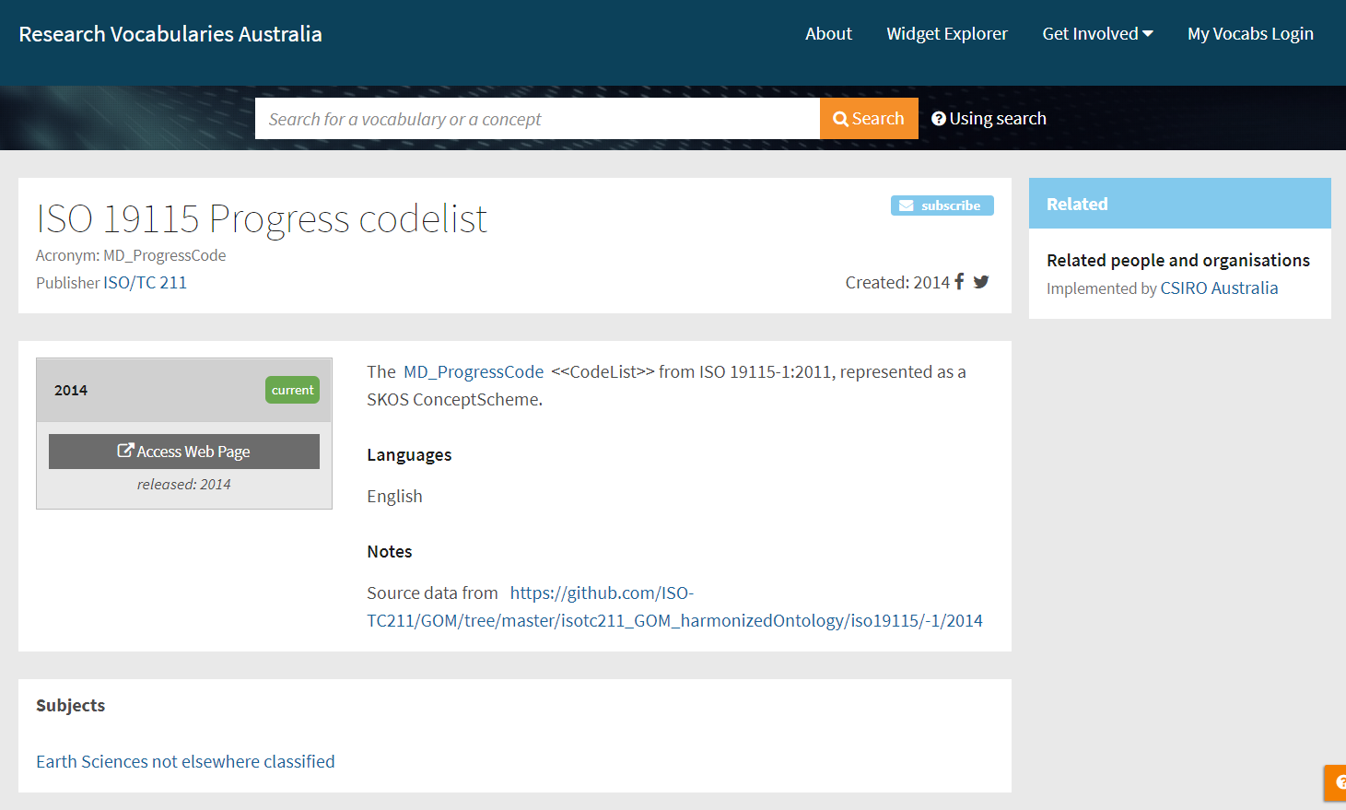
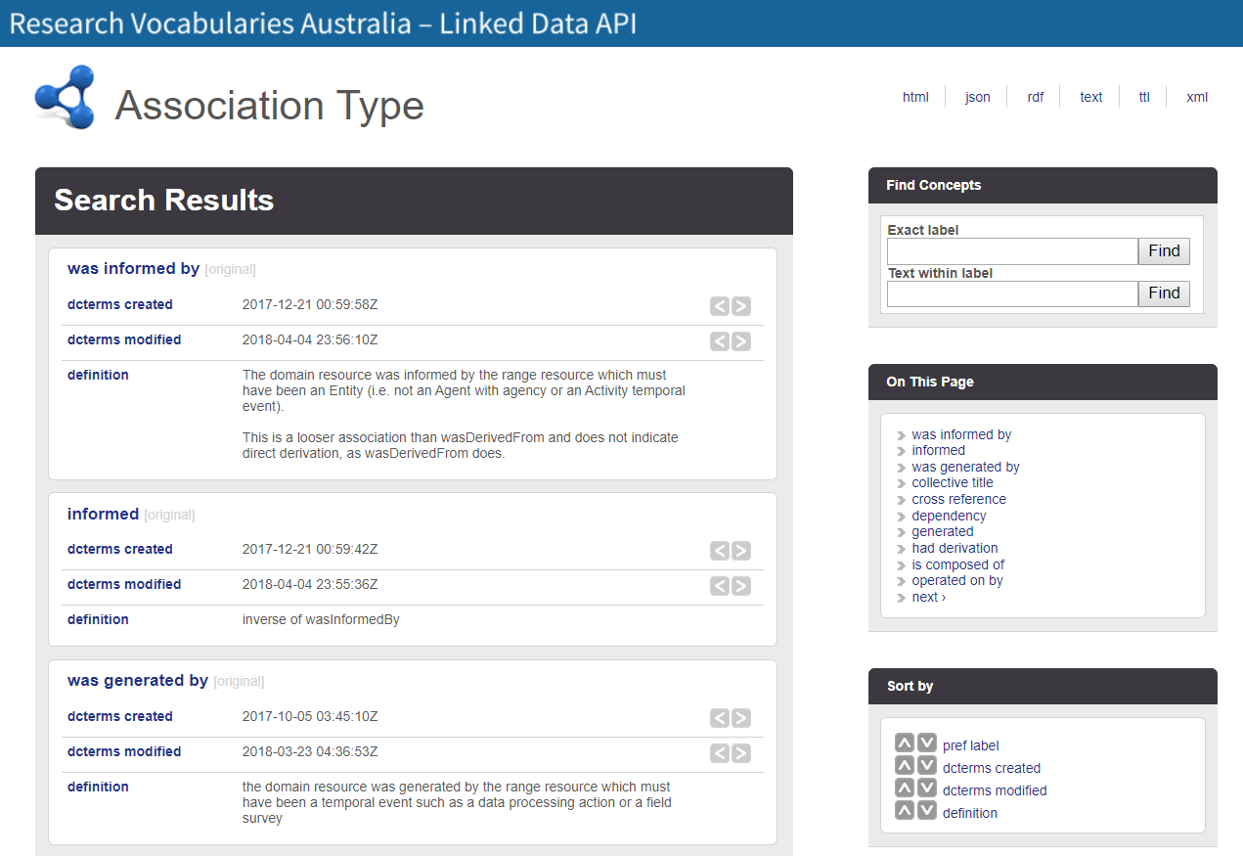
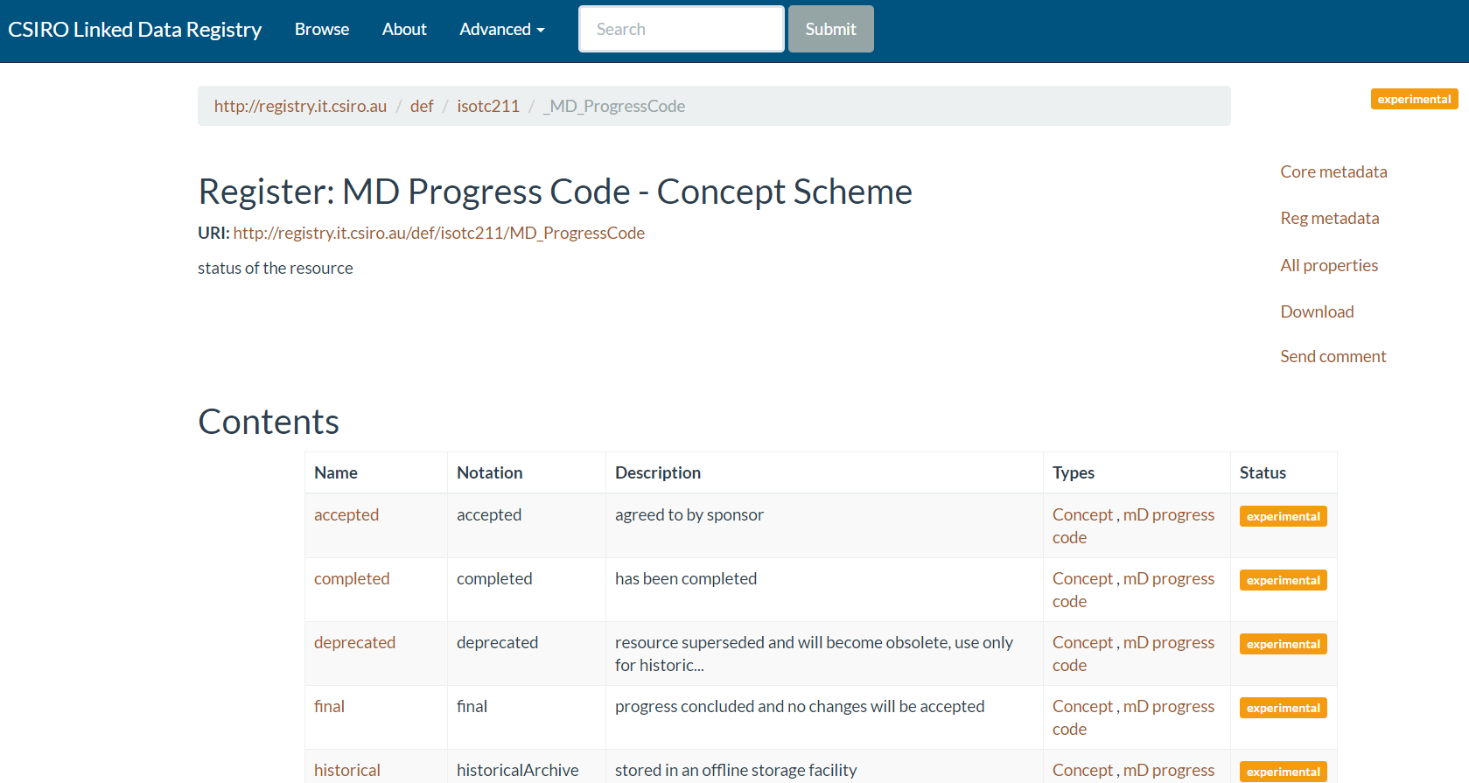
Example 1: RVA only
Vocabulary and terms are published at RVA
Example 2: Hybrid
Vocabulary is published at RVA, terms are published at CSIRO

