Slide 1
ANZ MDWG Roadmap 2:
Development Metadata Community Profiles
25 February 2021
ANZ MDWG Meeting No 8

Slide 2
Roadmap 2 Priorities
Support for transformation pathways
Development data specific profiles and implementation examples
Metadata creation/editing and validator tools
Improving governance

Slide 3
Current focus
EM metadata profile
Elevation metadata profile

Slide 4
Methodology
Steps:
  Identify relevant participants
  Identify existing documentation and/or conduct a workshop
  Develop analysis of specification requirements
  Develop the profile draft: Map requirements to a Standard (s) elements
  Evaluate and improve the profile draft
  Develop the final draft and implementation guideline, including xml template
  If required, develop an implementation template

Slide 5
EM Metadata profile: Summary of progress
Steps | Progress | Comments
1 | Done | Work with the Emergency Management Spatial Information Network Australia (EMSINA) group to develop requirements and evaluate implementation. Kane Orr help to facilitate.
2 | Done | Initial requirements were identified through workshop and other consultations
3 | Done | Analysis of requirements was complete
4 | In progress | Initial metadata profile for services is being developed
5 | In progress | Under review by the EMSINA
6 | In progress
7 | In progress | Contract was initiated to create a metadata template

Slide 6
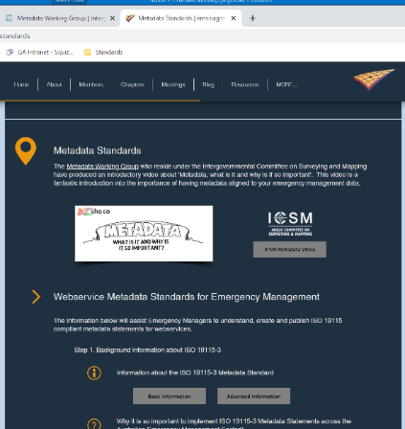
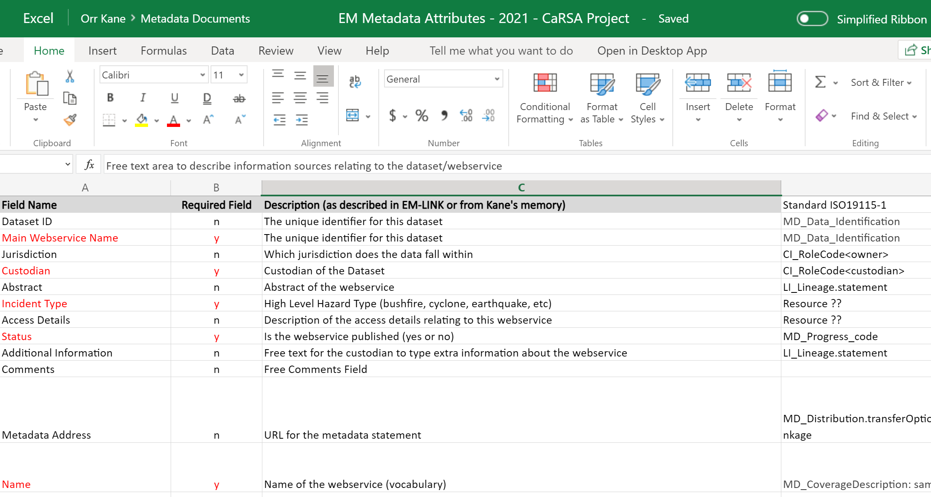
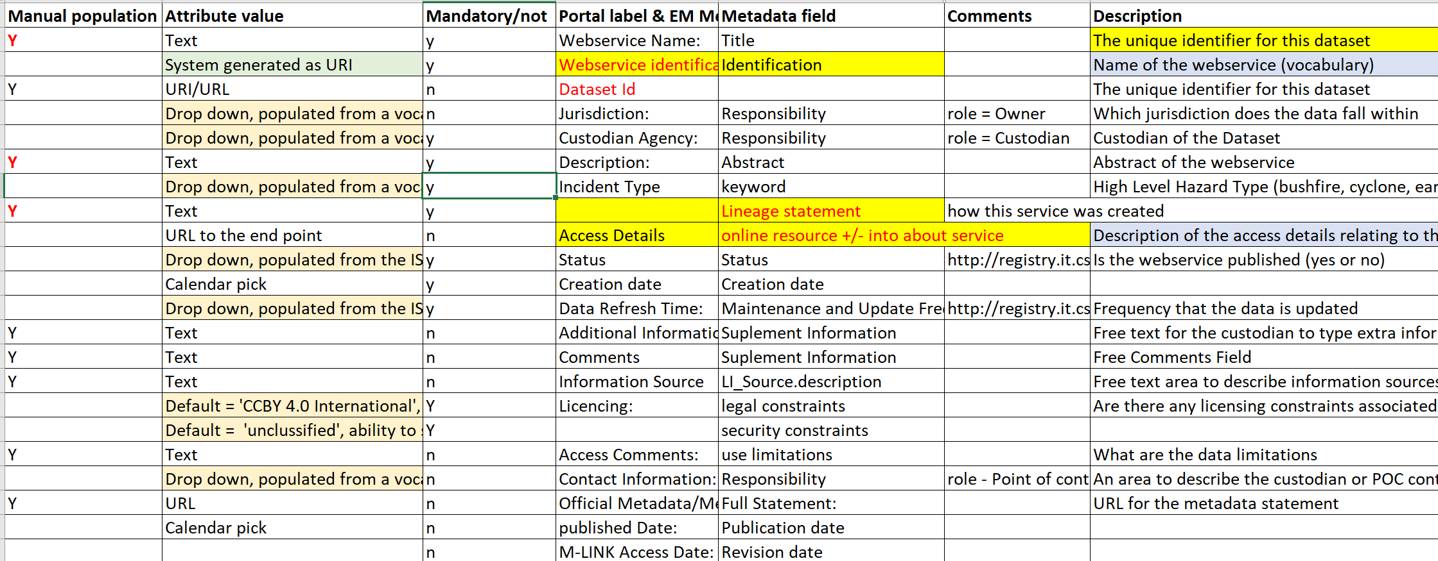
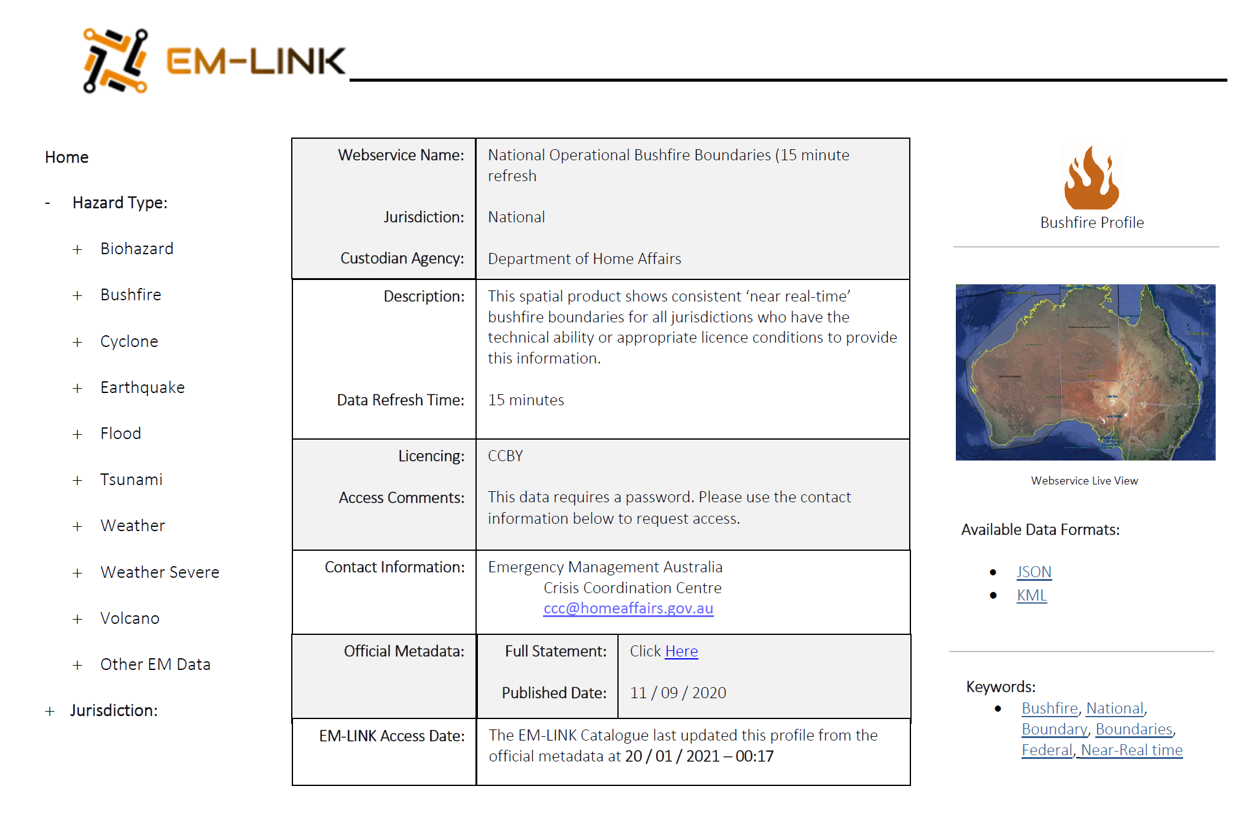
Development of EM Metadata Profile
Initial consultation and collection of requirements Initial Profile Draft
FEEDBACK

Slide 7
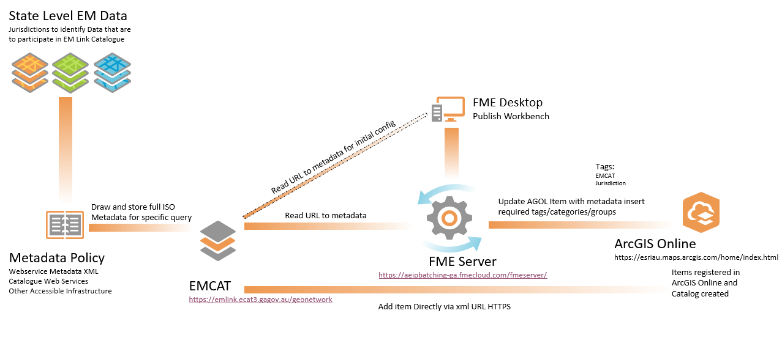

Slide 8
Elevation Metadata profile: Summary of progress
Steps | Progress | Comments
1 | Done | Work with the ICSM Elevation/Imagery WG to develop requirements and evaluate implementation. Kane Orr help to facilitate.
2 | Done | Initial requirements were identified through workshop and other consultations
3 | Done | Analysis of requirements was complete
4 | Done | Initial metadata profile for services was developed
5 | In progress
6 | In progress
7 | In progress

Slide 9
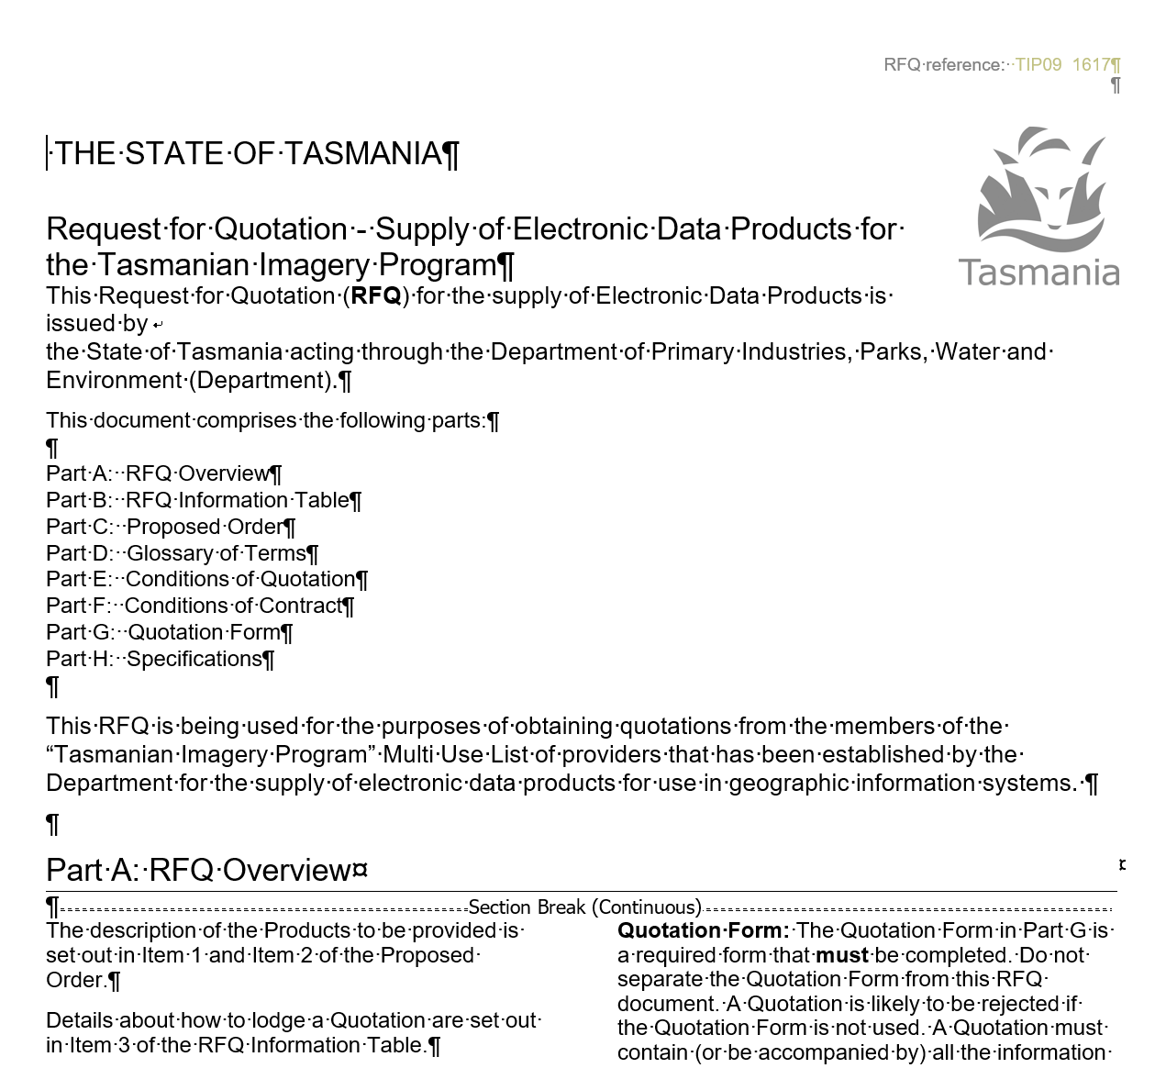
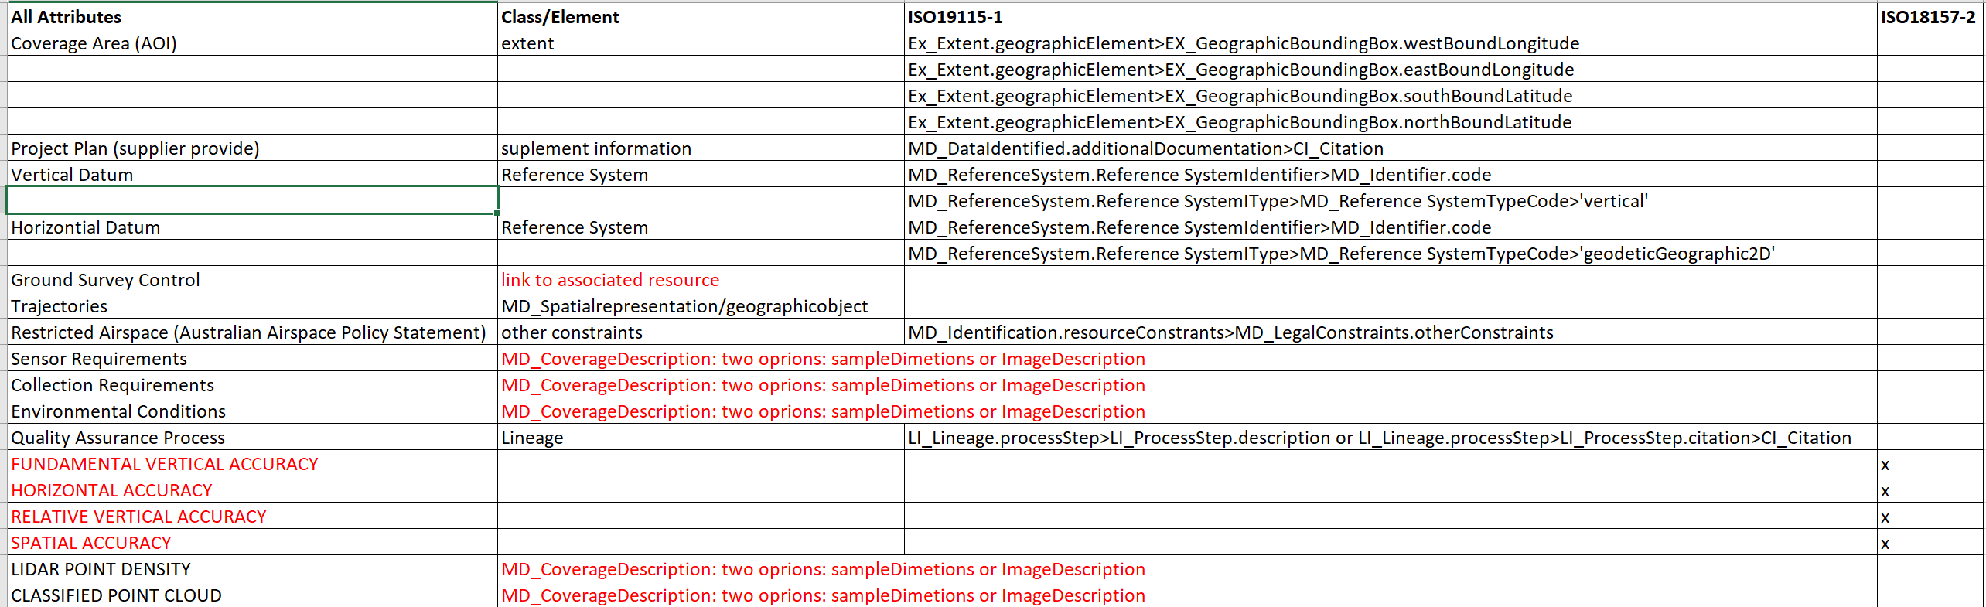
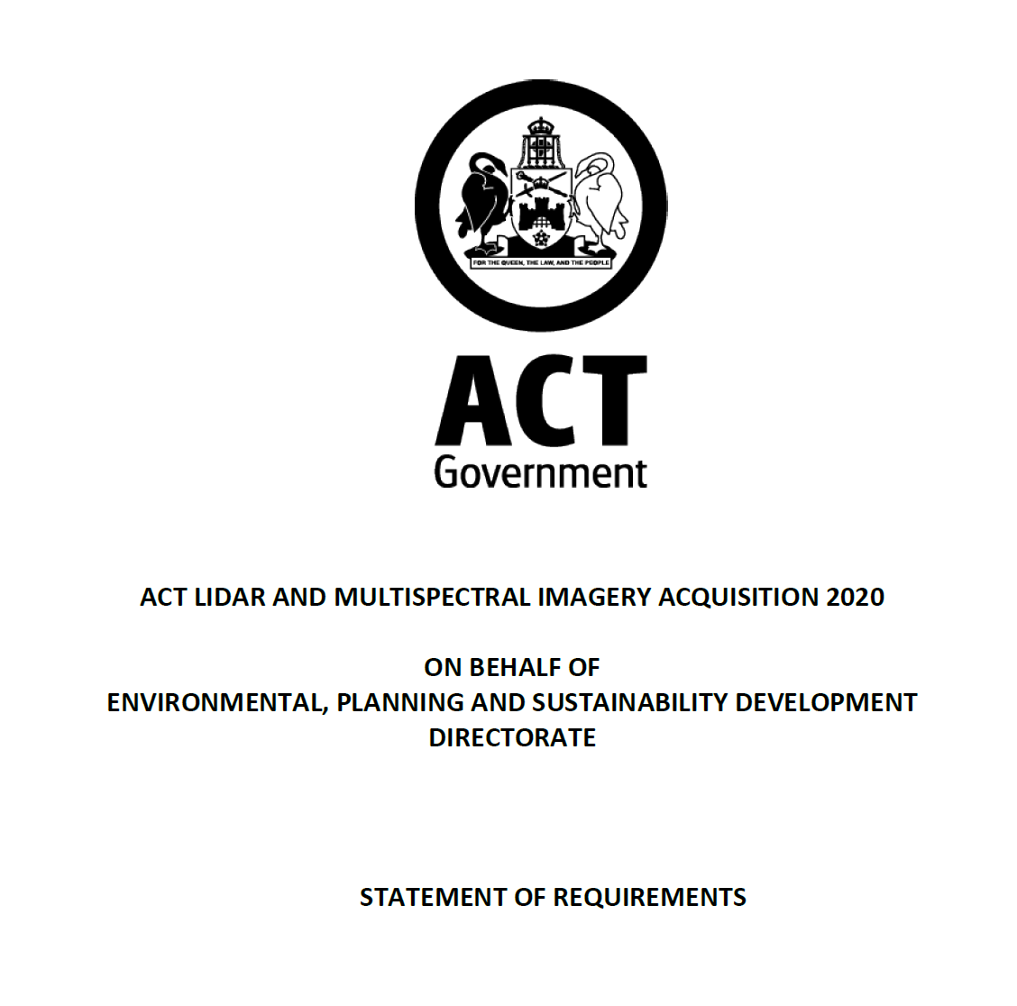
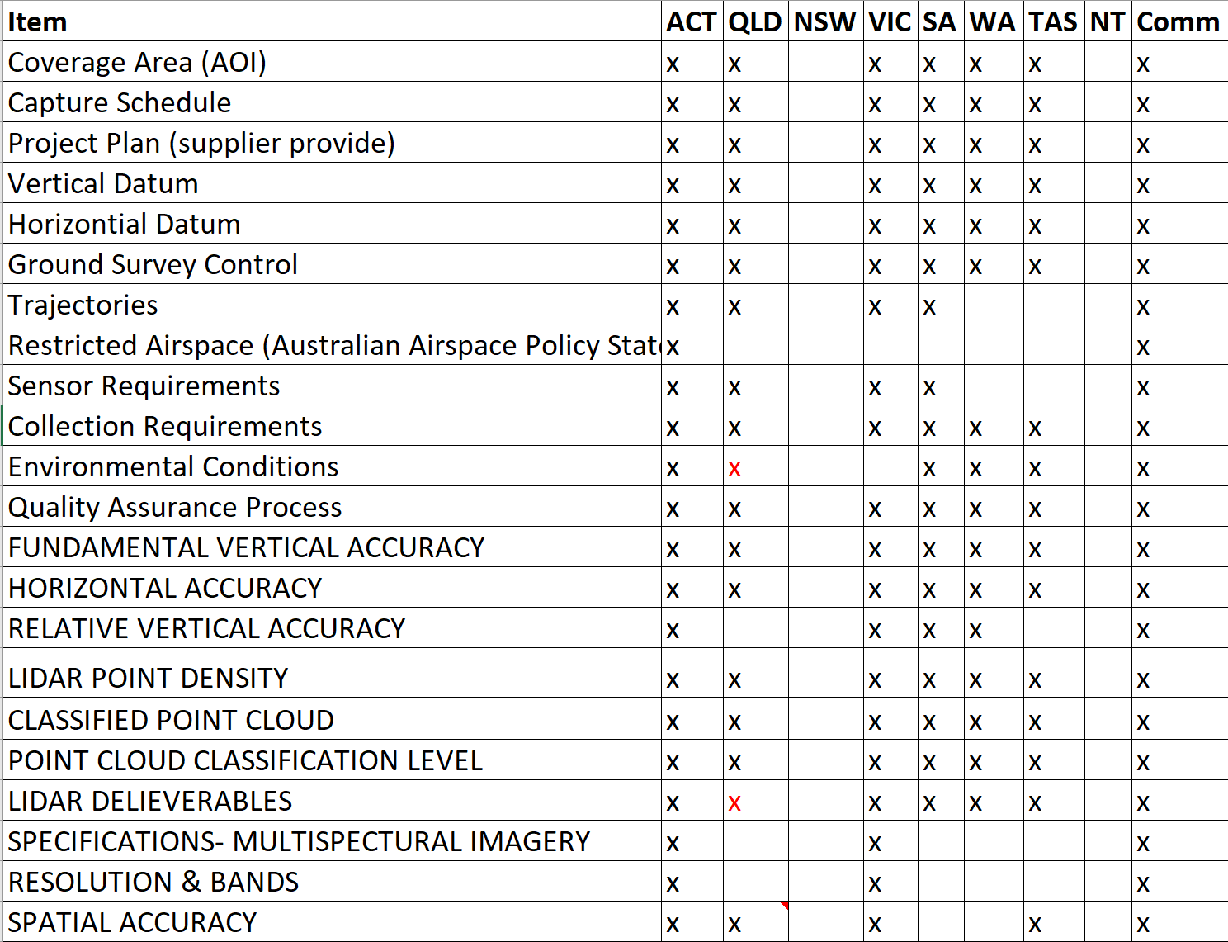
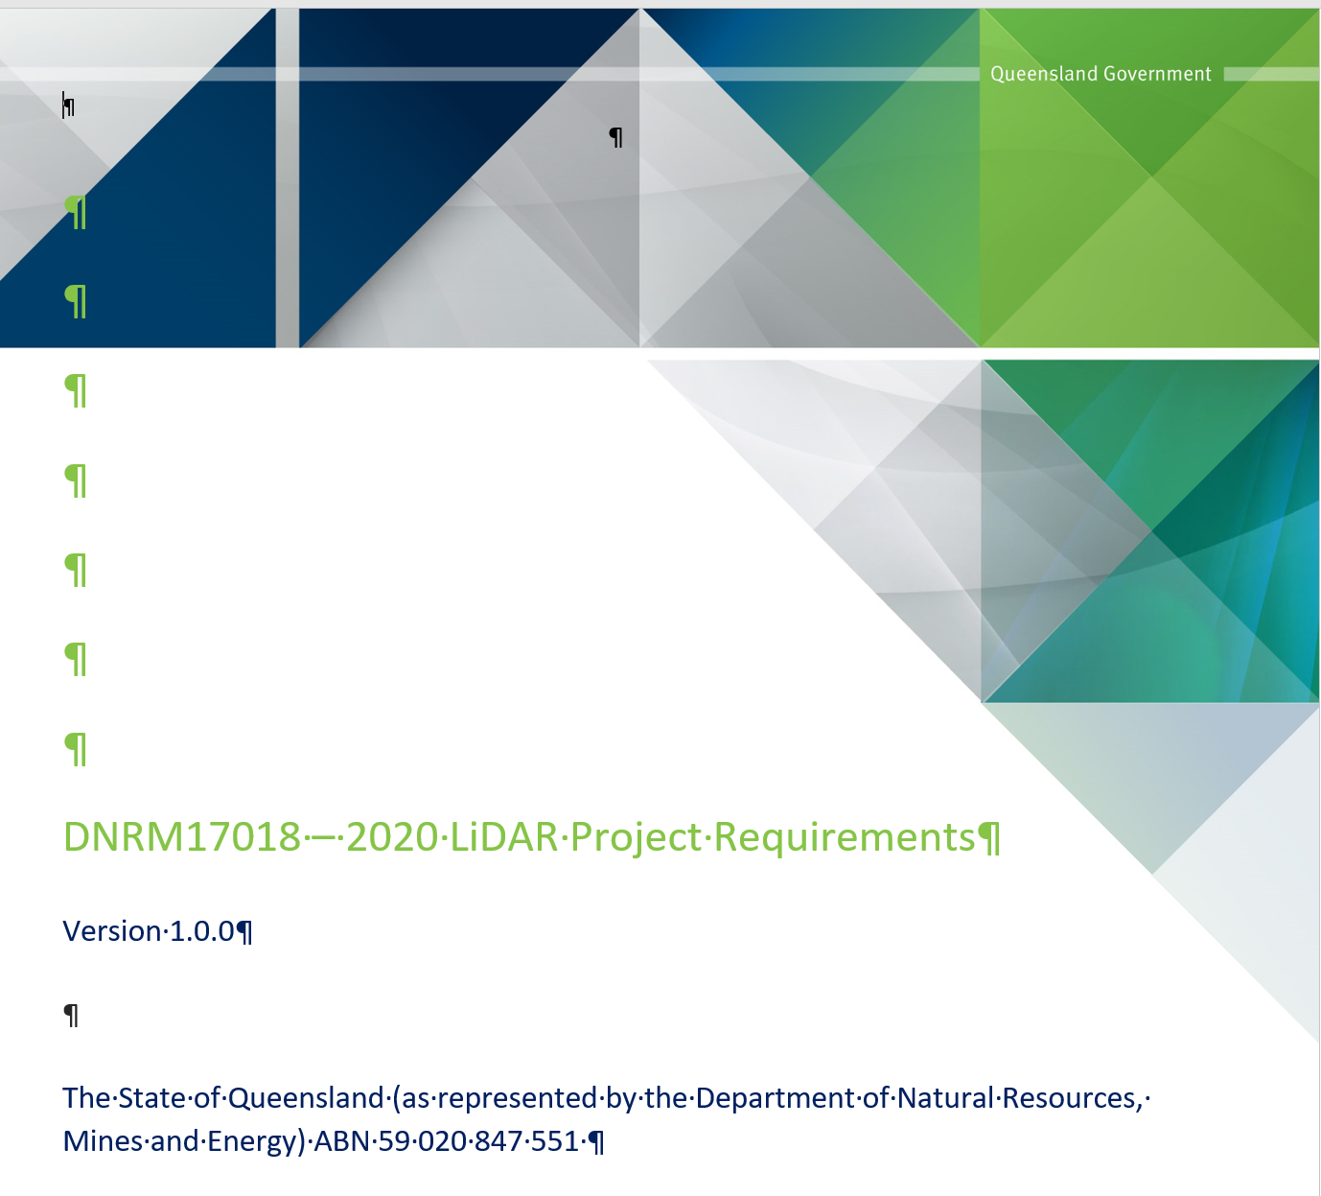
Development of Elevation Metadata Profile
Initial consultation and collection of requirements Initial Profile Draft
FEEDBACK

Slide 10
Next Steps
For current activities:
Improvement based of feedback
Agreement on implementation and adoption
Agreement on tools, documentation and future support
Future activities:
Assist with development of Geodesy metadata profile
Requirements for other profiles - TBA

Slide 11

Questions and comments???

