Slide 1
What’s new in -3
19115-3
ICSM
Oct
2021
Working towards Modularising TC211 schemas

Slide 2
But first – what’s happened – 2020 & 2021
19115-3
ICSM
Oct
2021
Standard number | Standard name
ISO 19111:2019/AMD 1:2021 | Geographic information — Referencing by coordinates — Amendment 1
ISO 19115-1:2014/AMD 2:2020 | Geographic information — Metadata — Part 1: Fundamentals — Amendment 2
ISO 19116:2019/AMD 1:2021 | Geographic information — Positioning services — Amendment 1
ISO 19126:2021 | Geographic information — Feature concept dictionaries and registers
ISO 19135-1:2015/AMD 1:2021 | Geographic information — Procedures for item registration — Part 1: Fundamentals — Amendment 1
ISO 19136-1:2020 | Geographic information — Geography Markup Language (GML) — Part 1: Fundamentals
ISO 19148:2021 | Geographic information — Linear referencing
ISO 19160-3:2020 | Addressing — Part 3: Address data quality
ISO 19161-1:2020 | Geographic information — Geodetic references — Part 1: International terrestrial reference system (ITRS)
ISO 19165-2:2020 | Geographic information — Preservation of digital data and metadata — Part 2: Content specifications for Earth observation data and derived digital products
ISO 19168-1:2020 | Geographic information — Geospatial API for features — Part 1: Core
ISO 19170-1:2021 | Geographic information — Discrete Global Grid Systems Specifications — Part 1: Core Reference System and Operations, and Equal Area Earth Reference System
ISO/TR 19169:2021 | Geographic Information — Gap-analysis: mapping and describing the differences between the current GDF and ISO/TC 211 conceptual models to suggest ways to harmonize and resolve conflicting issues
ISO/TS 19163-2:2020 | Geographic information — Content components and encoding rules for imagery and gridded data — Part 2: Implementation schema
ISO/TS 19166:2021 | Geographic information — BIM to GIS conceptual mapping (B2GM)

Slide 3
And – what’s happening 2021, 2022, & 2023
19115-3
ICSM
Oct
2021
Oversight group | Standard number | Standard name | Project lead | DIS/DTS/DTR expected
WG 4 | ISO 19168-2 | Geographic information – Geospatial API for features — Part 2: Coordinate Reference Systems by Reference | Mr Panagiotis Vretanos | 2021/08/31
WG 6 | ISO 19123-1 | Geographic information -- Schema for coverage geometry and functions -- Part 1: Fundamentals | Mr Liping Di | 2021/09/30
WG 6 | ISO/TS 19124-1 | Geographic information -- Calibration and validation of remote sensing data and derived products — Part 1: Fundamentals | Mr Liping Di | 2021/09/01
WG 7 | ISO 19160-6 | Addressing -- Part 6: Digital interchange models | Mr Ronald Tse | 2021/09/30
WG 9 | ISO 19156 | Geographic information -- Observations and measurements | Mr Ilkka Rinne | 2021/10/30
WG 7 | ISO 19160-4 | Addressing — Part 4: International postal address components and template language | Mr Piotr Piotrowski | 30/11/2021
WG 9 | ISO 19115-3 | Geographic information — Metadata — Part 3: XML schema implementation for fundamental concepts | Mr Ronald Tse Mr Evert Bleys | 2021/12/19
WG 9 | ISO 19157-1 | Geographic information -- Data quality -- Part 1: General requirements | Dr Ivana Ivanova Mr Torsten Svärd | 2021/12/30
WG 7 | ISO 19150-6 | Geographic information -- Ontology -- Part 6: Service ontology registry | Prof. Bi Jiantao | 2022/06/05
WG 7 | ISO 19160-2 | Addressing — Part 2: Assigning and maintaining addresses for objects in the physical world | Dr Serena Coetzee | 2022/07/15
WG 7 | ISO 19144-2 | Geographic information — Classification systems — Part 2: Land Cover Meta Language (LCML) | Mr John Latham | 2022/09/04
WG 7 | ISO 19144-3 | Geographic information — Classification systems — Part 3: Land Use Meta Language (LUML) | Mr John Latham | 2022/09/01
WG 7 | ISO 19152-1 | Geographic information -- Land Administration Domain Model (LADM) — Part 1: Fundamentals | Mr Chris Body | 2022/10/01
WG 1 | ISO 19103 | Geographic information — Conceptual schema language | Ms Heidi Vanparys | 2023/07/15
WG 1 | ISO 19135-1 | Geographic information — Procedures for item registration — Part 1: Fundamentals | Mr Ronald Tse | 2023/07/15
WG 9 | ISO 19157-3 | Geographic information -- Data quality -- Part 3: Data quality measures register | Dr Ivana Ivanova Mr Torsten Svärd | Estimated DIS 2023-08
WG 6 | 19159-4 | Geographic information – Calibration and validation of remote sensing imagery sensors and data– Part 4: Space-borne Microwave Radiometers

Slide 4
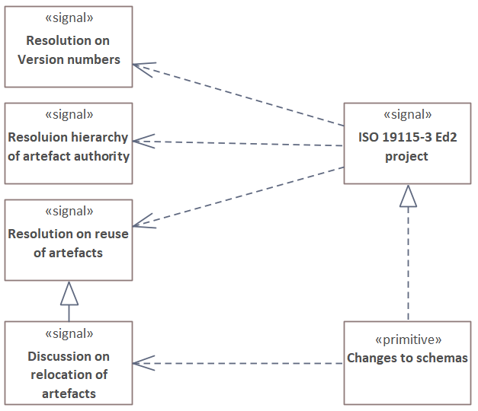
Que? Porque? Donde?
19115-3
ICSM
Oct
2021
Start: 2020-03
CD: 2020-12-19
Submission to DIS: 2021-04
Resubmit: 2021-10-05
DIS expected: 2021-12-19
FDIS – hope not to need?
IS expected: 2022-12-19

Slide 5
What have they done to my ...
19115-3
ICSM
Oct
2021
19115-3 XSDs → 19115-1, 19115-2, 19103, 19136
Weird version numbering
Reorder elements
Relocated schemas

Slide 6
Changes to ISO 19115-3 implementation (and versions)
19115-3
ICSM
Oct
2021
19115-3:2016 Ed 1 - XML schemas V1.0
  ISO 19115-1:2014 Ed 1
  ISO 19115-2:2009 Ed 1
19115-3:2016 Ed 1 - XML schemas V2.0
  ISO 19115-1:2014 Ed 1 + Amd 1:2018
  ISO 19115-2:2019 Ed 2
19115-3:2022 Ed 2 - XML schemas V1.3 & V2.2
  ISO 19115-1:2014 Ed 1 + Amd 1:2018 + Amd 2:2020
  ISO 19115-2:2019 Ed 2
  Reordering of elements
  Relocating

Slide 7
Attribute authority & order in TC211 standards
19115-3
ICSM
Oct
2021
Resolution within TC211 has established that the UML is deemed to be correct
  BUT UML is not order specific
Data Dictionary (DD) provides an order for the attributes defined in the UML
  If there is a discrepancy between the UML definition and the DD then UML wins
The XML schemas SHOULD use the UML definitions and the DD order
  This has not always been observed (especially order of elements)
  XSD order not matching DD makes it difficult for developers to work
New version of ISO 19115-3 has reordered elements to match the DD

Slide 8
ISO 19115-1 V1.3 adjustments in element order
19115-3
ICSM
Oct
2021
  mdb:MD_Metadata:
    resourceLineage from before portrayalCatalogue now 3rd last;
    metadataScope from after parentMetadata (4th) now 2nd last;
    acquisitionInformation still last (not in UML or data dictionary)
  srv:SV_CoupledResource: swap 3rd & 4th (resource/operation)
  gex:EX_VerticalExytent: swap 3rd & 4th (verticalCRS/verticalCRSId)
  Amd 2: mrs:MD_ReferenceSystem
    insert crs & coordinateEpoch (2nd & 3rd) before referenceSystemType

Slide 9
ISO 19115-2 V2.2 adjustments in element order (pt 1)
19115-3
ICSM
Oct
2021
Metadata for Acquisition (mac)
  mac:MI_Metadata: added
  mac: MI_AcquisitionInformation: scope [10..1]; Reorder most other elements
  mac: MI_Instrument:
    Remove content. Reorder: otherProperty; otherPropertyType; mountedOn
  mac: MI_Objective:
    Reorder: sensingInstrument (3rd last to last) objectiveOccurence (last to 3rd last)
  mac: MI_Operation:
    Reorder: parentOperation; otherProperty; otherPropertyType; platform
  mac: MI_Plan:
    Retain only: citation.
    New elements: type; status; citation; operation, satisfiedRequirements
  mac: MI_Event:
    Reorder: expectedObjective from last to 3rd to last
    Rename: relatedSensor to relatedInstrument

Slide 10
ISO 19115-2 V2.2 adjustments in element order (pt 2)
19115-3
ICSM
Oct
2021
Metadata Resource Lineage for imagery (mrl)
  mrl:LE_Processing:
    Reorder: otherProperty; otherPropertyType
Metadata for Spatial Representation for imagery (msr)
  msr:MI_GCPCollection:
    Reorder: gcp from 1st to last

Slide 11
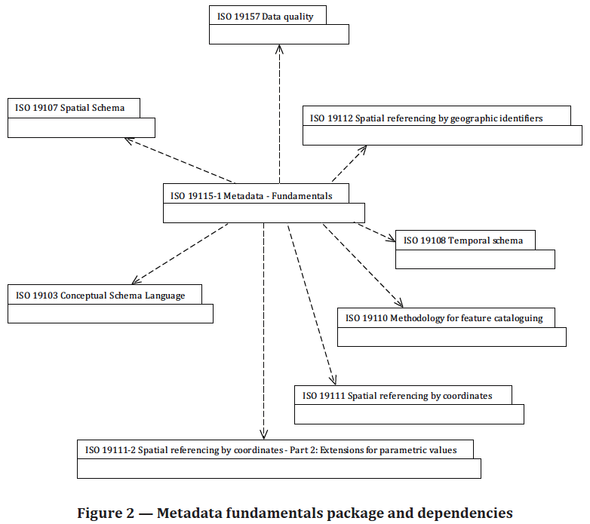
CONTEXT: ISO 19115-1 dependencies
19115-3
ICSM
Oct
2021
Most obvious are
ISO 19103 Conceptual Schema Language
GML 3.2.1 Geographic Markup Language
ISO 19110 Methodology for feature cataloguing
ISO 19139:2007 XML schema implementation
ISO 19157 Data Quality
ISO 19111 Spatial referencing by coordinates
Worth referencing these in XML namespace declarations
ISO 19115-2: Metadata Pt2 Ext for acquisition …
GML
ISO 19139:2007 XML schema implementation

Slide 12
Who is responsible for schemas - modularisation?
19115-3
ICSM
Oct
2021
ISO standards, update frequency is variable
Reusability of components is dependent on their stability AND progress
Responsibility for a component must lie with the group that defined it
Implementation
  is the responsibility of the group that defined the component
  should be associated with definition of the components
  should not be hosted in conjunction with other components
In the case of ISO 19115-3 – no components where added
  Components implemented belong to:
    ISO 19115-1; ISO 19115-2; ISO 19103; ISO 19136
    Note: ISO 19110 call components that belong to ISO 19139:2007 (cat:) - withdrawn
    ISO 19115-1 Amd 2 references ISO 19111 (no XSDs)
    ISO 19111 references ISO 19107 (no XSDs)

Slide 13
Where have all the … gone?
19115-3
ICSM
Oct
2021
ISO 19115-1 Ed 1 (location .../19115/-1/…/1.3.0/…) is responsible for:
  All of: cit; gex; lan; mas; mcc; mco; mda; mdb; mex; mmi; mpc; mrd; mri; mrs; srv
  Most of: mrc; mrl; msr
ISO 19115-2 Ed 2 (location .../19115/-2/…/2.2.0/…) is responsible for:
  All of: mac
  Some of: mrc; mrl; msr
ISO 19103 Ed 1 (location .../19103/-/…/1.2.0/…) is responsible for:
  Sort of: gco; gcx
ISO 19136 Ed 1 (location .../19136/-/gmw/1.1.0/…)
is associated with GML and held responsible for:
  The little bit that is: gmw (wrapper for GML)
ISO 19139 ED 1 (withdrawn) (location .../19139/-/cat/1.1.0/…) is responsible for:
  All of: cat
Note: mrc; mrl; msr occur as both -1 (…/1.3.0/…) & -2 (…/2.2.0/…) schemas

Slide 14
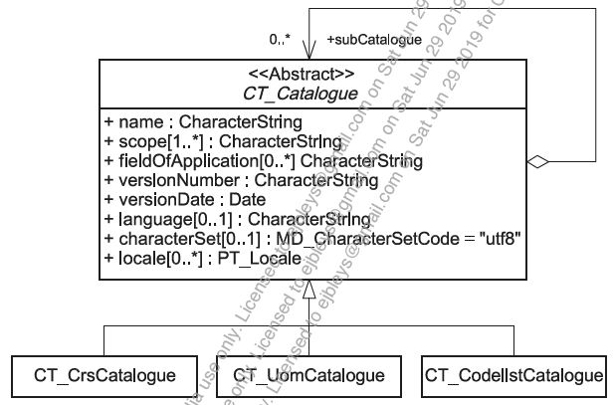
Code lists?
19115-3
ICSM
Oct
2021
ISO 19139:2007 (withdrawn) defined catalogues, included CT_CodelistCatalogue
  There should now be a single code-lists file
  https://schemas.isotc211.org/Resources/codelists.xml
  Stubs for all TC211 standards
  All ISO 19115-# namespaces/codelists/codes
  URLs for all listed namespaces/codelists/codes
  URIs for all listed namespaces/codelists/codes

Slide 15
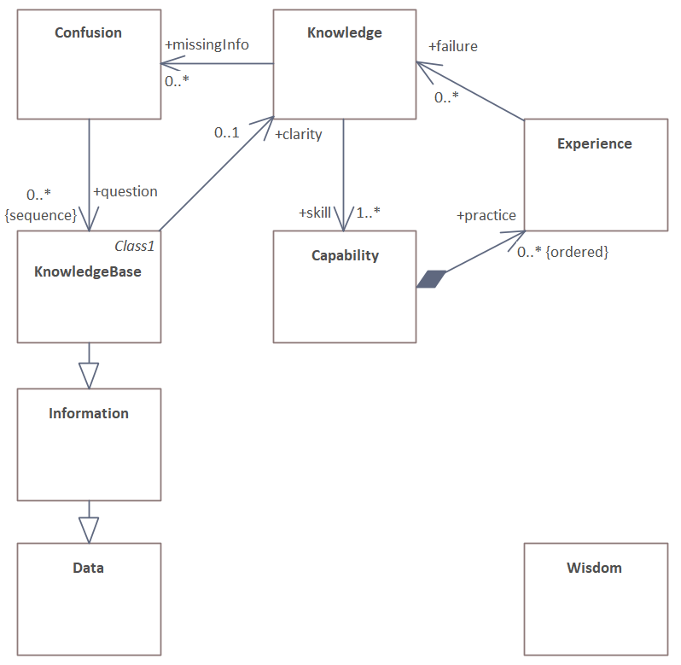
Questions?
19115-3
ICSM
Oct
2021

