Slide 1
ISO19115-1 amd 2 - Update
Spatial reference system description to support dynamic datum
Byron Cochrane - Director
OPEN SOURCE | OPEN STANDARDS | OPEN DATA
- Geospatial - Linked Data - Catalogues -
byron@openwork.com 243 Trafalgar Street Nelson http://openwork.nz

Slide 2
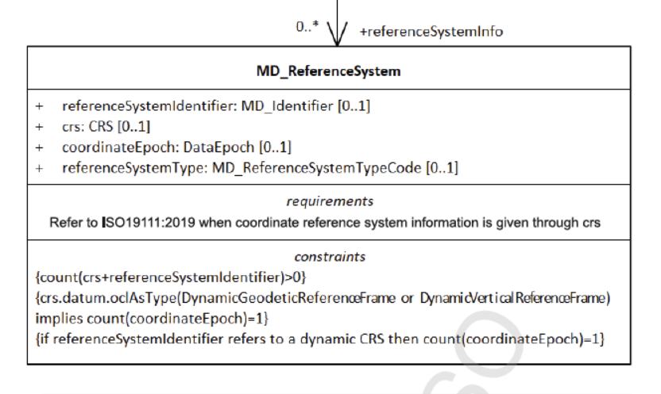
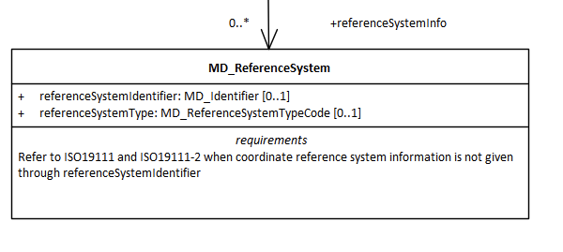
What has Changed in Amd. 2?
New CRS and DataEpoch elements
ISO 19115-1 amd 1
ISO 19115-1 amd 2

Slide 3
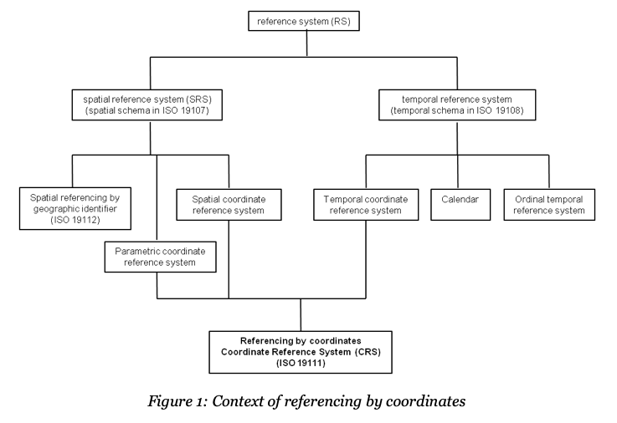
ISO10111-2019
UML

Slide 4
ICSM ISO19115-1 Metadata Best Practice Guide
Updated - Spatial Reference Systems

Slide 5
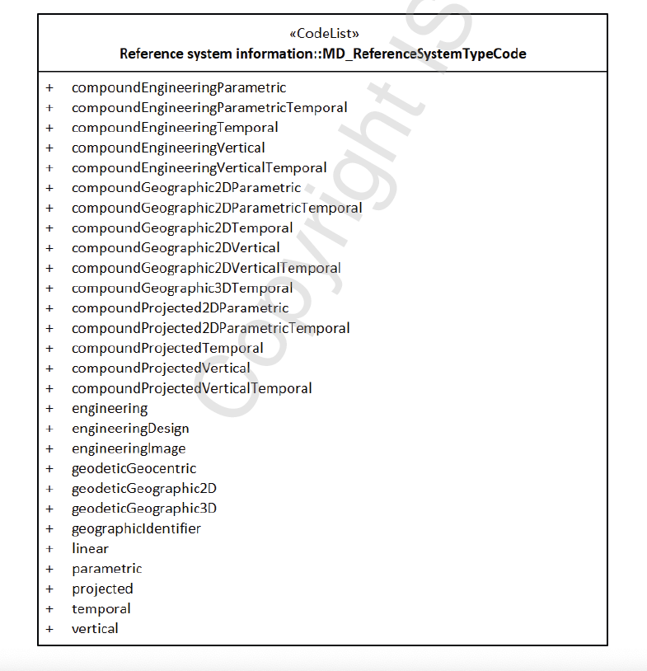
Reference System Type
Dynamic?
Constraints:
{if referenceSystemIdentifier refers to a dynamic CRS then count(coordinateEpoch) = 1
{crs.datum.oclAsType(DynamicGeodeticReferenceFrame or DynamicVerticalReferenceFrame) implies count(coordinateEpoch)=1}
3.1.7 coordinate epoch
epoch to which coordinates in a dynamic coordinate reference system are referenced (commonly expressed in the Gregorian calendar as a decimal year. EXAMPLE 2017-03-25 in the Gregorian calendar is epoch 2017.23)
How do we know a reference system is Dynamic?

Slide 6
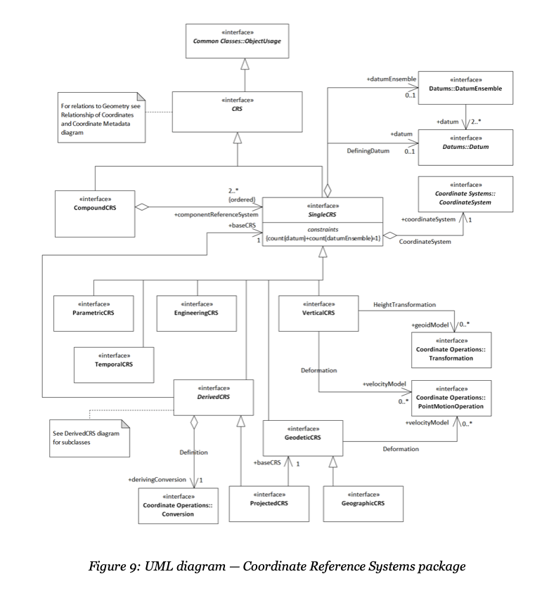
ISO19111-2019
UML

Slide 7
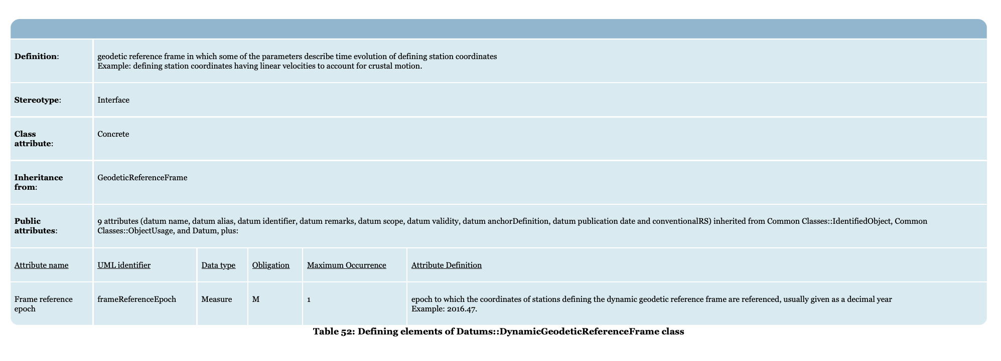
Constraint
{crs.datum.oclAsType(DynamicGeodeticReferenceFrame or DynamicVerticalReferenceFrame) implies count(coordinateEpoch)=1}

Slide 8
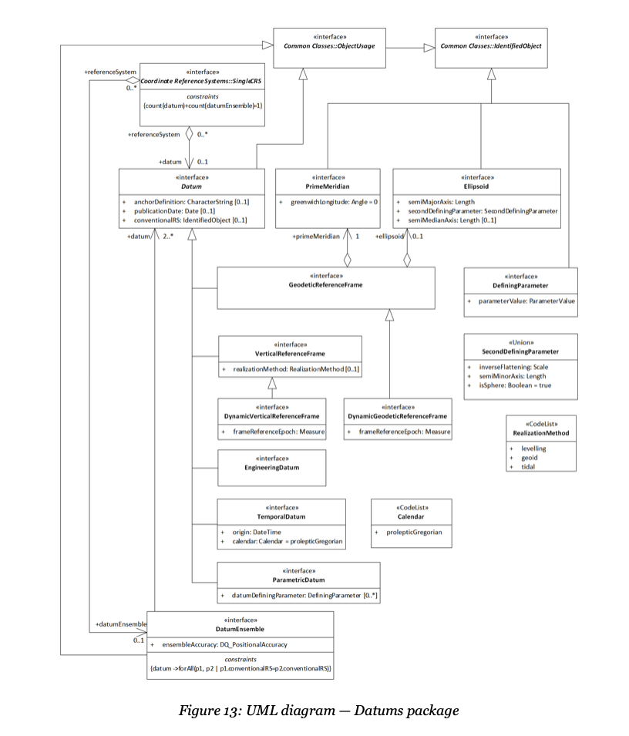
ISO19111-2019
Datums package
Dynamic Datum?

Slide 9
Future Work to Support ISO19115-1 amd.2
Schema and Tools
Create Schema (XML) for ISO19115-1 amd.2
Include ISO19111 2019 elements
coordinateEpoch - decimal year
crs - logical model and XML implementation
Tool support - GeoNetwork
Plugin Schema
ISO19111 editing interface
Support to help to tell “if dynamicCRS = true”
Questions? Suggestions?

