Slide 1

Legal and Security Constraints
Shanti Rowlison
Notes:
Image by Darwin Laganzon from Pixabay

Slide 2
Why Use them?
Access Control management Tool
It provides a mechanism to allow machine-machine automation based on the various access controls
Provides a means of capturing information for users and data managers
Notes:
Protective Security Policy Framework
Information security:
There are four core information security requirements that entities apply to achieve the information security outcome. The
Core1: Sensitive and classified information
Each entity must:
identify information asset holdings
assess the sensitivity and security classification of information asset holdings
implement operational controls for these assets proportional to their value, importance and sensitivity.
Core 2: Access to information
Each entity must enable appropriate access to official information. This includes:
sharing information within the entity, as well as with other relevant stakeholders
ensuring that those who access sensitive or security classified information have an appropriate security clearance and need to know that information
controlling access to supporting ICT systems, networks (including remote access), infrastructure and applications.
Source: https://www.protectivesecurity.gov.au/information/Pages/default.aspx

Slide 3
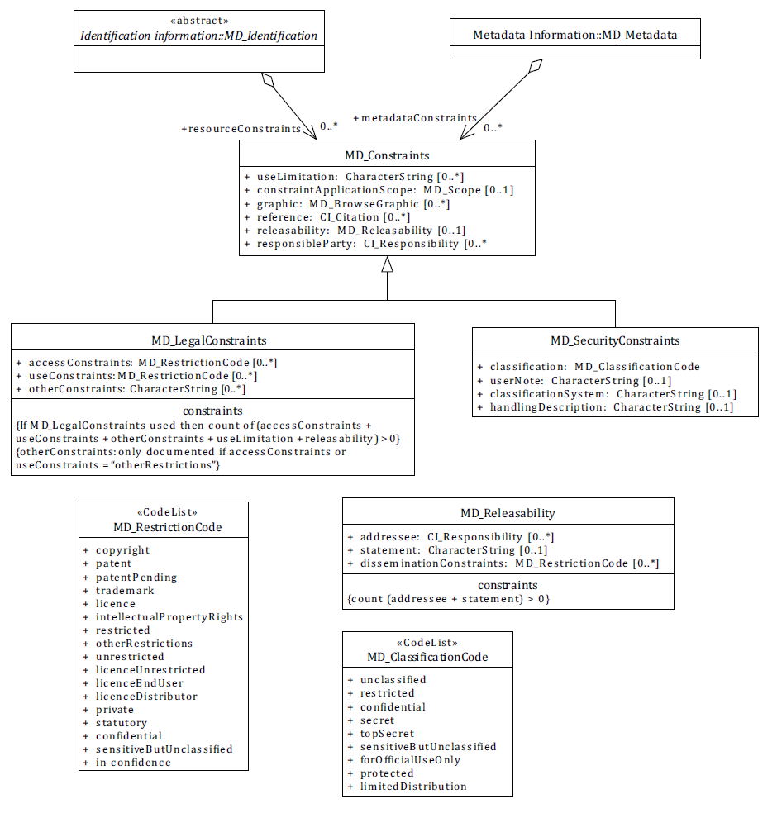
Constraint Information Classes
Notes:
Image is Figure 8 from ISO 19115-1
Constraints apply to both the Metadata Record and the Dataset. Constraints information is required to comply with the Archives Act and Australian Government Protective Security Policy Framework (https://www.protectivesecurity.gov.au/Pages/default.aspx) or for New Zealand the Public Records Act 2005 and National Security Policy (https://dpmc.govt.nz/our-business-units/national-security-group/national-security-policy).

Slide 4
useLimitation
This element provides an opportunity for resource custodians to identify that there are specific limitations on the resource for a given use.

Slide 5
releasability
This element should be used to provide information about the release of the resource (DLMs). In particular, it should provide users with information on:
  1. who the resource should not be released to, or
  2. the release statement, or
  3. if there is a restriction on dissemination.
  For example: For Official Use Only (FOUO)
Notes:
This element should be used to provide information on the limitations on the use of the resource. In particular, it should inform users how the resource should not be used.

Slide 6
Legal Constraints
The metadata and resource constraints are used to describe restriction on the access and use of the resource being described by the metadata record.
Examples: Copyright to protect Intellectual Property, Legal Privilege (Lawyers/Doctors), Legislative secrecy (Defence/Intel Community), personal privacy (Privacy Act)

Slide 7
accessConstraints
This element should be used to provide information on the access limitations for the resource.
For example,
the resource may have access restrictions applied such as licenses
Or require a login to access (e.g. WA SLIP)
Notes:
Or the requirement for using a login

Slide 8
useConstraints
This element should be used to provide information on the limitations of the use of the resource. In particular, it should inform users how the resource should not be used.
For example,
the resource may have use restrictions applied such as patents, copyrights or trademarks.
Not suitable for measurements e.g. web mercator
Notes:
Copyright is a big one in the commercial world

Slide 9
otherConstraints
This element provides an opportunity for resource custodians to identify that there are specific limitations on the resource not covered by access or use constraints.

Slide 10
Security Constraints
The metadata and resource constraints are used to describe restriction on the security classification of the resource being described by the metadata record. For example, the resource may have a security classification constraint, such as protected or secret.
Guidance:
The sub-components of this element are presented in more detail

Slide 11
Classification
This element provides the classification placed on the resource or metadata indicating its handling restrictions. Values for this element are selected from a code list.

Slide 12
ClassificationSystem
Identify which classification system is being used.
By default this should be the Australian Government Information Security Manual (ISM) or NZ Policy https://dpmc.govt.nz/our-business-units/national-security-group/national-security-policy

Slide 13
handlingDescription
This element provides an opportunity for resource custodians to identify any special handling instructions for the resource.
This element provides space to identify additional information handling restrictions on the resource or metadata. This information is commonly referred to as “Security caveats”. For more information, refer to “Information security management guidelines: Protectively marking and handling sensitive and security classified information” on the Attorney-General’s Department’s Protective Security Policy Framework website

Slide 14
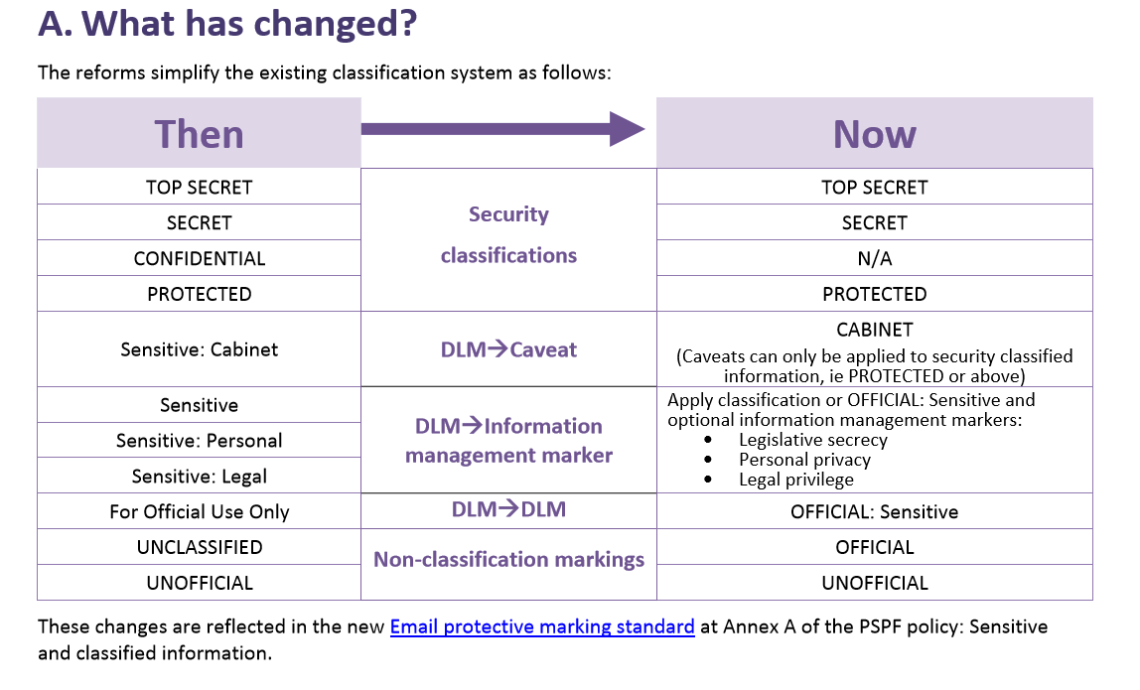
Australia’s Recent Changes
Notes:
Image source: https://www.protectivesecurity.gov.au/resources/Documents/PSPF-fact-sheet-classification-reforms.pdf

Slide 15
Notes:
https://www.protectivesecurity.gov.au/resources/Pages/default.aspx
https://www.protectivesecurity.gov.au/sites/default/files/pspf-infosec-08-sensitive-classified-information.pdf
https://www.protectivesecurity.gov.au/sites/default/files/pspf-infosec-09-access-information.pdf
https://www.protectivesecurity.gov.au/resources/Pages/PSPF-fact-sheets-and-publications.aspx
https://www.cyber.gov.au/sites/default/files/2019-10/Australian%20Government%20Information%20Security%20Manual%20%28October%202019%29.pdf
https://www.protectivesecurity.gov.au/sites/default/files/PSPF-fact-sheet-summary-of-key-changes.pdf
https://www.protectivesecurity.gov.au/sites/default/files/PSPF-on-page-a3.PDF

