Slide 1
CRS + Coordinate Epoch Sample Use Cases
ANZ Metadata Working Group
Meeting 5, 28 October 2019
Canberra
Joel Haasdyk

Slide 2
Coordinate Epoch – Example Use Cases
Use Case | CRS | Coordinate Epoch¹ | Observation Epoch² [or Range] [vs Temporal Extent = approx?]
Observe Data in ATRF (GPS at 3-10cm accuracy in Australia | ATRF2014 ‘2014’ ³ nominal from ITRF2014 Defined as coordinates at epoch 2020.0 ⁴, plus velocities | @today Equal to Observation epoch Precision driven by user need 2019.83 or 2019.82543 or 2019/10/28 14:05:18 Single epoch only; [average?] Data-set level metadata only? | @today , for example: 2019/10/28 2019/10/28 14:05:18 2019/10/28 14:05:18 – 15:06:30 Time range, rarely an instance Can only be extent in metadata and/or timestamp on each point.
Propagate to a project epoch e.g. for storage(?), analysis | ATRF2014 | @projectEpoch (e.g. 2015.0) via velocities / models | @today (unchanged)
Transform to CRS2 | GDA2020 | [@2020.0; implicitly] | @today (unchanged)
Transform to CRS3 | ITRF2014 Defined as coordinates at epoch 2010.0 , plus velocities | @anyEpoch (e.g. 2023.54) | @today (unchanged)
Velocity Model + Accuracy
Transform + accuracy
Parameters are time-dependent! ⁵
Transform + accuracy:
Parameters are time-dependent! ⁵
1 “Coordinate Epoch” Epoch at which the data is described in the nominated CRS. Explicitly required for a dynamic CRS> Best described by ISO8601? ISO19108? Decimal year? Extensible to enable user defined precision? Single epoch… average(?) of recorded Observation epoch(s) if a range.
2 “Observation Epoch” Epoch at which the data is physically observed.
3 “Realisation [Epoch]” Date nominated to distinguish one CRS realisation from another. E.g. ITRF2008 vs ITRF2014; Nominally last data employed in creating the realisation.
4 “Frame Reference Epoch” Epoch of Coordinate that define a dynamic reference system [ISO 19111:2019]
5 “Parameter Reference Epoch” and /or “Transformation Reference Epoch”: Transformations between dynamic CRSs are time-dependent [ISO 19111:2019]

Slide 3
Coordinate Epoch – Example Use Cases
Use Case | CRS: | Coordinate Epoch¹ | Observation Epoch² [or Range] [vs Temporal Extent = approx]
Observe from GPS (without local differential ystem) | WGS84 [which? – WGS84 is an ensemble at metre-level] | @today Equal to Observation epoch(s), | @today
Observe GPS (via CORS network) | CORS-defined CRS | CORS-defined Epoch | @today
Coordinates obtained from website / web-service | WGS84? [if so, which?] Per metadata from service? Unknown? | Per metadata from service ? Unknown? | Per metadata from service? Date of new capture? Unknown?
Coordinate from Imagery | Per metadata from service? Unknown? | Per date of image capture? Per date of image CRS? Unknown? | Per date of image capture? Date of new capture? Unknown?

Slide 4
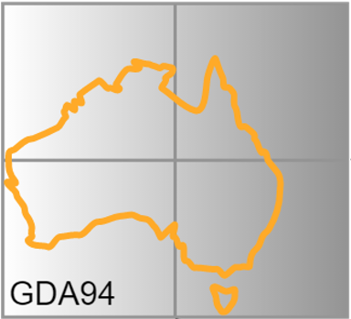
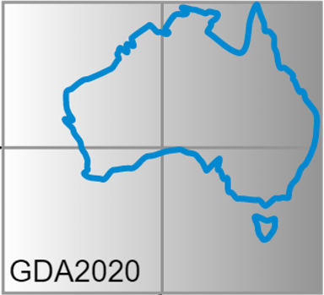
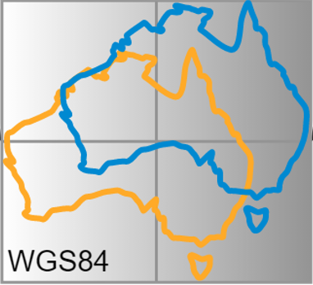
Misaligned maps (a symptom, not the problem)
1994
2020
1.8 m
WGS 84
As used in Web-mapping
Notes:
I

Slide 5
