Slide 1





Australian Geospatial Reference System
Webinar Series
Webinar 3: Australian Terrestrial Reference Frame
Nicholas Brown
Director of National Geodesy
Geoscience Australia
Chair of ICSM Permanent Committee on Geodesy
@nich0lasbr0wn

Slide 2


www.sli.do
#AGRS
www.sli.do #AGRS

Slide 3

Who am I?
Director of National Geodesy at Geoscience Australia
Commonwealth representative on Intergovernmental Committee on Surveying and Mapping (ICSM)
Chair of the ICSM Permanent Committee on Geodesy (PCG)
Australian representative on FIG Commission 5 – Positioning and Measurement
Favourite EPL Team - Liverpool
www.sli.do #AGRS

Slide 4



ATRF
GDA2020
AVWS
7 cm/yr
σ = 1-8 cm
Australian Terrestrial Reference Frame
Australian Plate Motion Model
Geocentric Datum of Australia 2020
Australian Quasigeoid Model
Australian Vertical Working Surface
Webinar 3: ATRF
AHD
Δ 1.8 m
σ = 6-13 cm
Webinar 2: GDA2020
Transformation parameters / grids
AUSGeoid2020
Australian Height Datum
GDA94
Webinar 4: Height
σ = ?
Geocentric Datum of Australia 1994
AUSGeoid09
@nich0lasbr0wn
Notes:
PCG ensures Australia and New Zealand have the geospatial reference systems *including datums, reference frames, working surfaces, and standards to meet user needs.
It’s complex – yes – but as we try to measure things more accurately, we need to ensure we have the grs to enable those applications.

Slide 5
Australian Datums – you choose …
ATRF
GDA2020
7 cm/yr
Australian Terrestrial Reference Frame
Australian Plate Motion Model
Geocentric Datum of Australia 2020
Available from 1 January 2020
Time dependent reference frame (like WGS84, ITRF2014)
Positions of features (e.g. property boundaries) change with movement of the Australian Plate (7 cm/yr NNE)
Useful for Intelligent Transport Sector (e.g. autonomous vehicles) and Location Based Services (e.g. mobile apps)
Available since October 2017
Static Datum (like GDA94)
Positions of features (e.g. property boundaries) aligned with the Australian Plate at 1 Jan 2020
Convenient for many applications, storing data, and data alignment
www.sli.do #AGRS

Slide 6
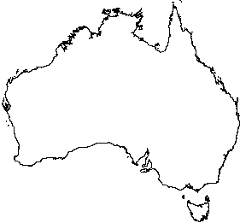
GNSS operate in a time dependent reference frame
Z
GNSS satellites orbit ~20,000 km above the surface of the Earth.
Coordinates provided by GNSS satellites are with respect to the centre of mass of the Earth.
These are called Earth centred Cartesian coordinates.
Can be converted to latitude, longitude and ellipsoidal height to make them easier to understand and use.
Earth centred GNSS coordinates describe where you are right now.
Features (e.g. property boundary) on the Australian plate will have different coordinates when re-observed over time.
GNSS satellites orbit
Y
X
www.sli.do #AGRS

Slide 7
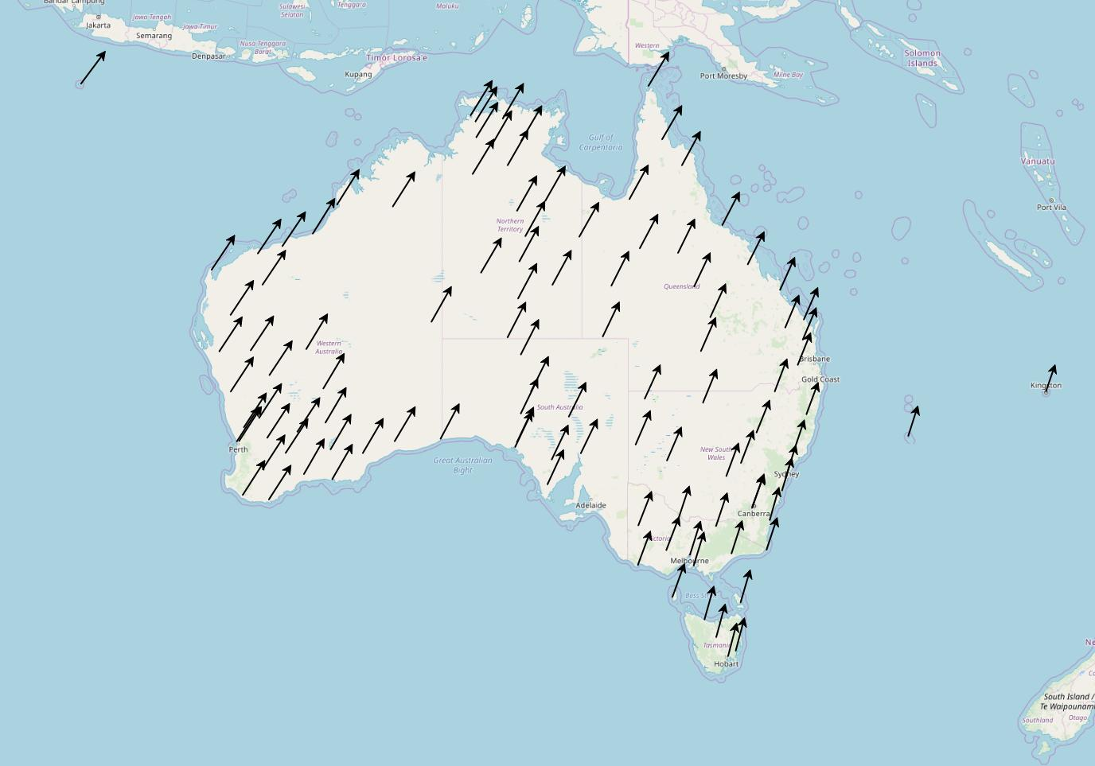
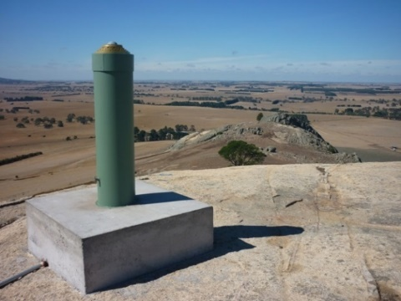
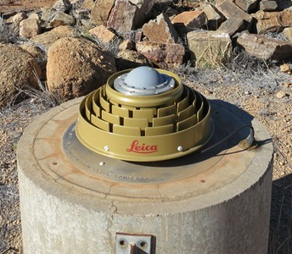
Australian plate motion
Courtesy of Alex Woods, DELWP
www.sli.do #AGRS

Slide 8
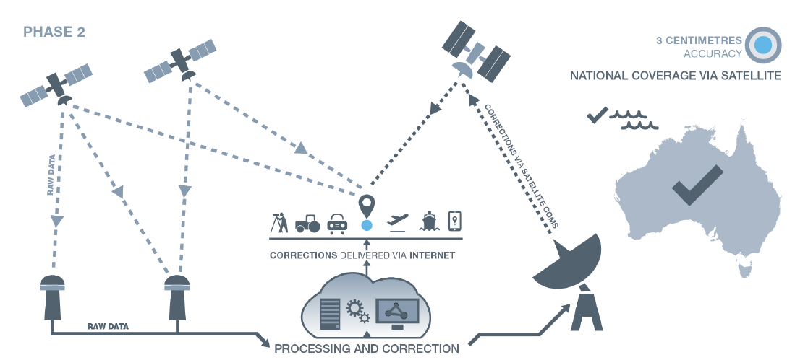

3 – 10 cm positioning
Position from GNSS will be in ATRF (ITRF).
This is the native format GNSS data is supplied.
Location Based Services users will be expecting other data supplied to them in ATRF.
This is THEIR datum.
Accuracy
3-10 cm
www.sli.do #AGRS

Slide 9
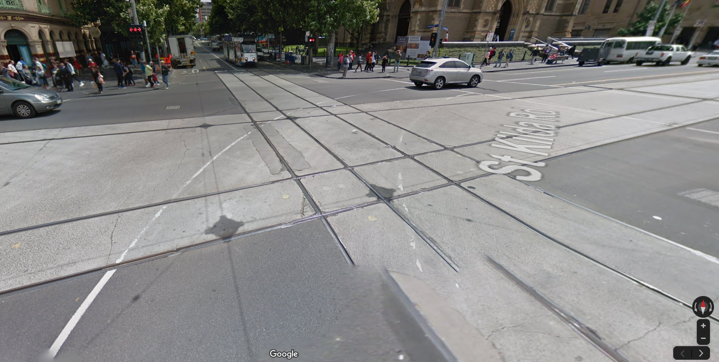

www.sli.do #AGRS
Notes:
Maybe it doesn’t matter too much for Strava, but differences between these datums is going to matter for people looking for underground infrastructure services
Let’s assume, you and I know nothing about datums. The boss has said, go to the Young and Jackson in Melbourne, I mean the corner of Flinders and Swanston, find the underground power line, dig it up and fix it.
We pull out the iPad and use augmented reality. Up on the screen appears the underground power line with an uncertainty buffer. Perfect. Easy.
But what happened in the background? The iPad had to know its position from GNSS. This was done natively in ITRF. Then, you made a request to a database for the location of the power line, which was stored in GDA2020 and propagated to ATRF using the APMM and projected onto your screen. All done in the background, using clever software which abstracts the user from the complexities. It leaves the spatial decisions to the spatial experts who store the data in the database, choose the appropriate model to propagate the coordinates and use of standards to encode the data and ensure it is FAIR for users like this on the street. Literally.

Slide 10
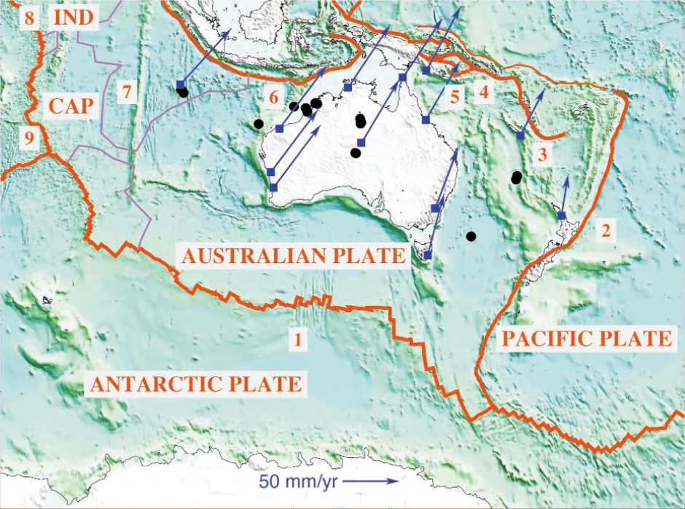
Fastest moving continent
Karratha: 70 mm/yr
Alice Springs: 67 mm/yr
Canberra: 58 mm/yr
www.sli.do #AGRS

Slide 11
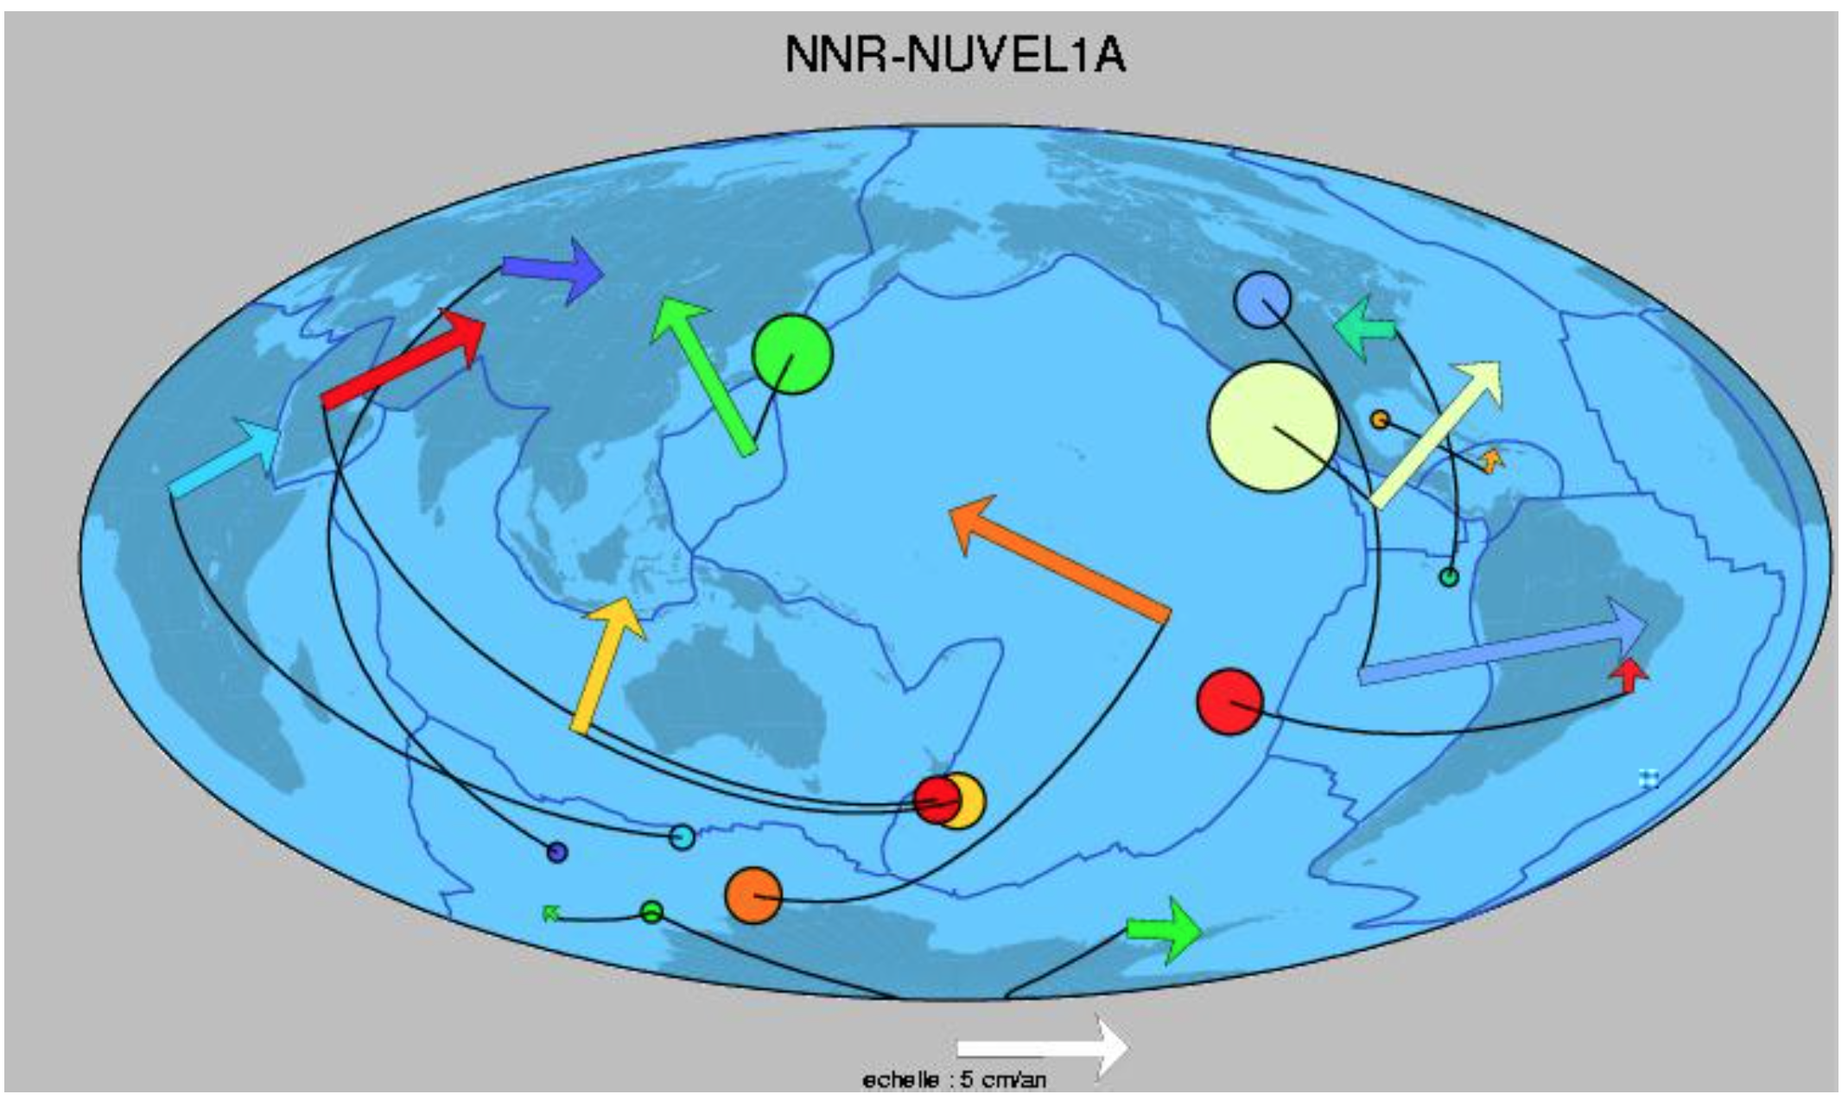
Euler Pole
www.sli.do #AGRS

Slide 12
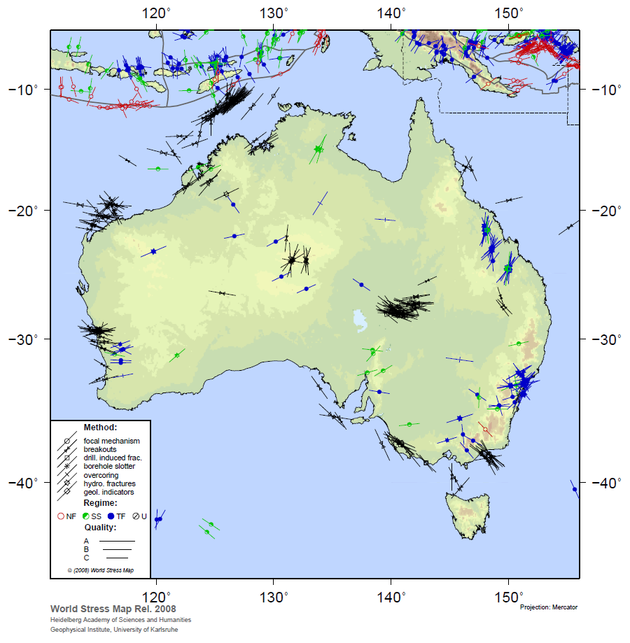
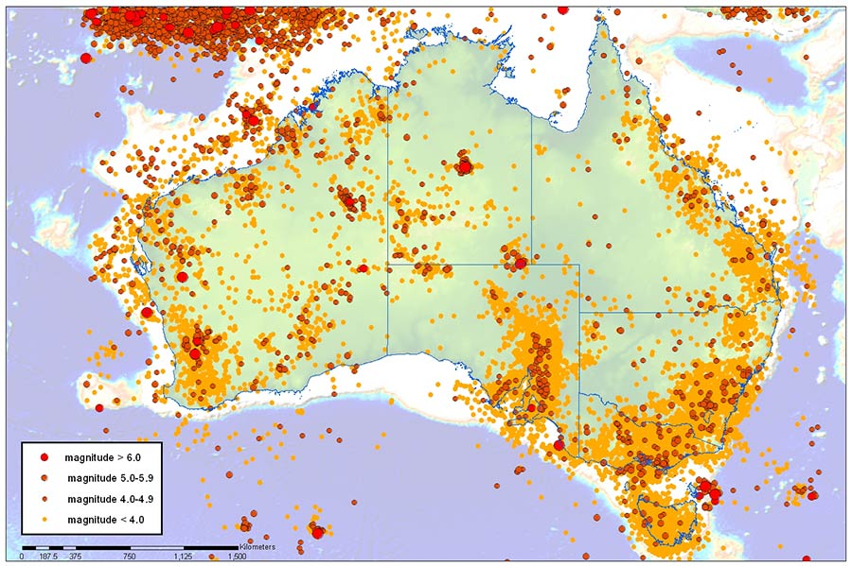
How can we model plate motion?
Estimates of the regional seismic moments (e.g., Kostrov, 1974) lead to predictions of the deformation of the Australian plate of 0.65 ± 2 mm/yr (95% confidence level) (Leonard, 2008)
www.sli.do #AGRS

Slide 13
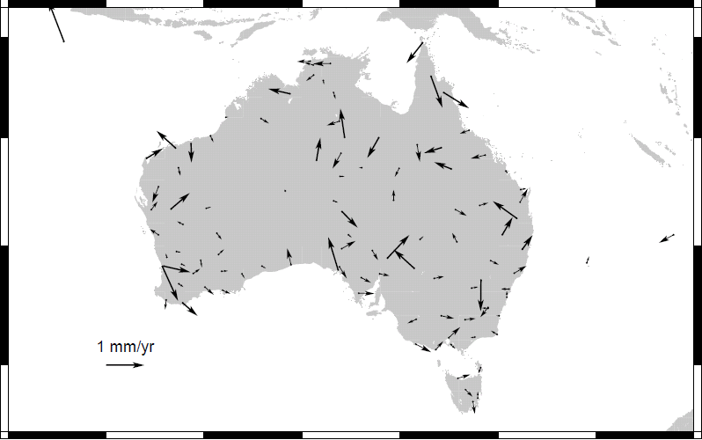
Residual Crustal Deformation
www.sli.do #AGRS

Slide 14
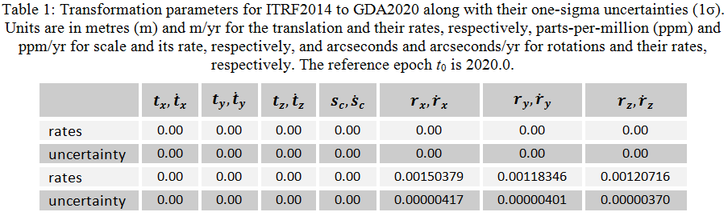
Australian Plate Motion Model
GDA2020 coordinates can be converted to ATRF using the Australian Plate Motion Model (APMM)
Computed from 109 reference sites which define GDA2020
Only rotation velocities of the 14-parameter transformation
Describes 2D motion only
www.sli.do #AGRS

Slide 15
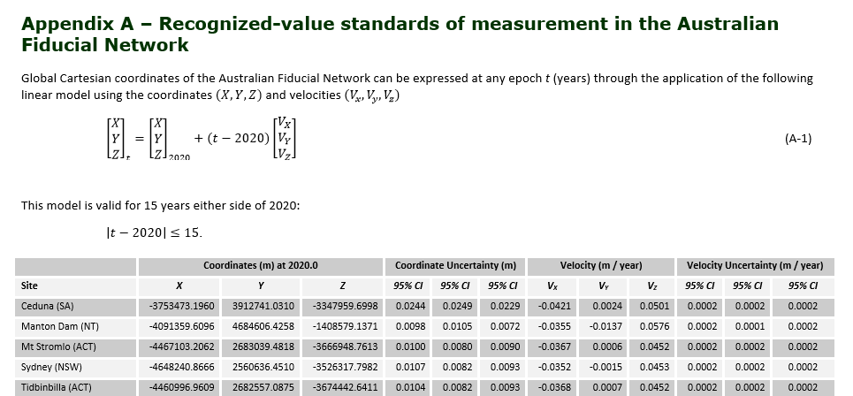
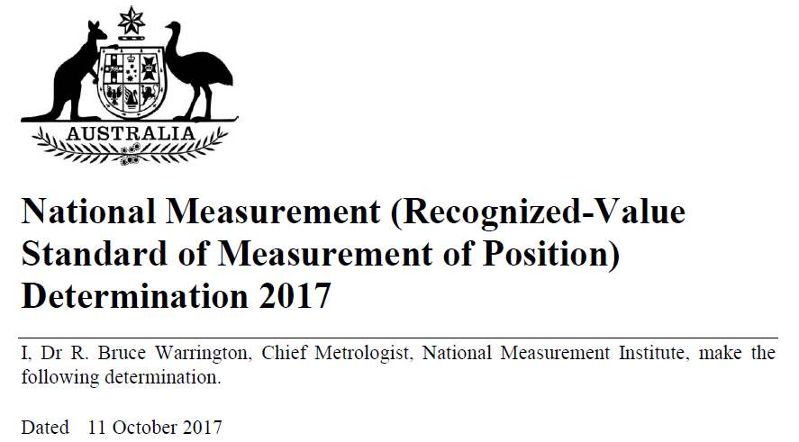
GDA2020 Determination made in October 2017
Legal Determination of coordinates, velocities and uncertainties of 109 reference sites
Equation permits propagation of coordinates over time
www.sli.do #AGRS
Notes:
PCG proposed the development of a new national datum – GDA2020

Slide 16
Building GDA2020 and ATRF
ITRF2014
1. Start global
Link to the global reference frame
20 GNSS stations in Australia
constraint
+
2017 RVS Determination
APREF
2. Increase density
Asia-Pacific Reference Frame (Regional reference frame)
454 GNSS stations
+
3. Legal Determination of ‘Datum’
109 sites in Australia
  Coordinates
  Velocities
  Uncertainties
  Equation to propagate coordinates over time
GNSS Campaign Data
4. Provide access
Rigorous national adjustment (all GNSS and terrestrial observations were used in the same adjustment)
  ~2 million observations
  ~250,000 stations
access
+
Jurisdictional archive
GDA2020
ATRF
7 cm/yr
www.sli.do #AGRS

Slide 17
GDA2020 vs ATRF
ATRF
ATRF
Change in position
ATRF@epoch
ATRF
ATRF
ATRF
Propagation via Australian Plate Motion Model
GDA2020
2021
2025
2022
2024
2023
www.sli.do #AGRS

Slide 18
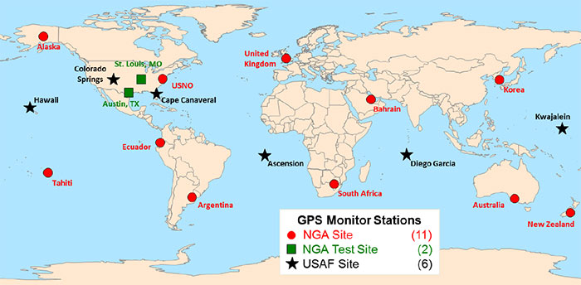
WGS84
World Geodetic System 1984 (WGS84) is the reference frame used by the Global Positioning System (GPS) and developed by the USA Department of Defense (DoD).
It is now maintained by the U.S. National Geospatial-Intelligence Agency (NGA).
WGS84 has been revised five times since its original realisation in 1987. The most recent version is WGS84 (G1762) implemented on 16 October 2013 (aligned to ITRF2008).
WGS84 is realised using coordinates of 17 DoD monitoring stations distributed across the world.
WGS84 is a time dependent reference frame.
www.sli.do #AGRS

Slide 19
WGS84 realisations
  WGS84 – original realisation completed in 1987
  WGS84 (G730) – aligned with ITRF 1991 @ 1991.0
  WGS84 (G873) – aligned with ITRF 1994 @ 1994.0
  WGS84 (G1150) – aligned with ITRF 2000 @ 2001.0
  WGS84 (G1674) – aligned with ITRF 2008 @ 2005.0
  WGS84 (G1762) – aligned with ITRF 2008 @ 2005.0
    Adopted in Oct 2013
~GDA94

Slide 20
GDA2020 vs ATRF vs WGS84
ATRF
ATRF
WGS84@2024.5
Change in position
ATRF@epoch
ATRF
WGS84@2023.5
ATRF
WGS84@2022.5
WGS84@2021.5
ATRF
Propagation via Australian Plate Motion Model
WGS84@2020.5
GDA2020
2021
2025
2022
2024
2023
www.sli.do #AGRS
Notes:
At the beginning of each year, the NGA update station coordinates of the 17 sites. The coordinates are adjusted to an epoch at the half year mark to account for plate tectonic motion.
For example, in Jan each year, the US Air Force began using coordinates for the DoD GPS reference sites with an epoch of the middle of the year. This results in an annual step-wise update to the WGS84 frame used to generate the GPS broadcast message.

Slide 21

Need to know the epoch of data
Coordinates observed in WGS84@2010.0 vs WGS84@2020.0
10 years x 0.07 m = 0.70 m
It is important to:
  Record the epoch data is collected
  Know the epoch of base maps
This is the same for ITRF realisations and ATRF
Use the convention WGS84(1762)@2019.9
Craig Allinson
IOGP Geodesy Subcommittee
www.sli.do #AGRS

Slide 22
WGS84
There are some limitations of using WGS84 in Australia that users should be aware of:
  There are no official tools for transforming to or from current or legacy Australian geodetic datums to WGS84.
  Unlike the Geocentric Datum of Australia 2020 (GDA2020), WGS84 does not have a Recognized-value standard for measurement of position under the National Measurement Act 1960 in Australia.
  WGS84 (G1762) is ‘aligned’ to ITRF2014 at the 1-2 cm level.
  Since Australia is moving up to 7 cm per year, WGS84 coordinates collected 20 years ago will have experienced ~1.4 m of apparent horizontal motion.
www.sli.do #AGRS

Slide 23
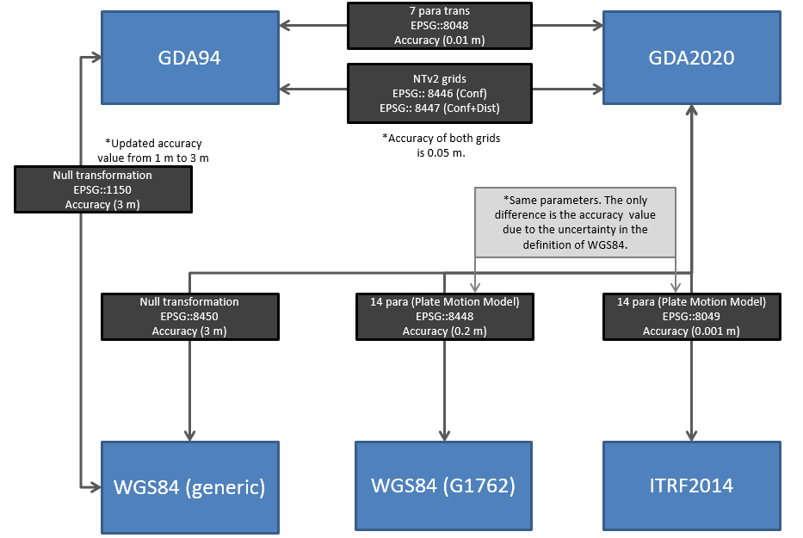
EPSG Codes
Current status
Update accuracy of GDA94-WGS84(generic) EPSG code (1150) from 1 m to 3 m
Introduction of GDA94-GDA2020 EPSG codes
Introduction of GDA2020-ITRF2014 EPSG code (8049)
Future
Discussions with OGC+EPSG to recognise WGS84 as time-dependent
www.sli.do #AGRS

Slide 24
Connect with us
ICSM [http://www.icsm.gov.au]
ICSM-PCG Slack [http://cutt.ly/join-pcg-slack]
GDA Modernisation Implementation Working Group
GDA2020 Forum [https://www.icsm.gov.au/datum/gda2020-forum]
GitHub – Geoscience Australia Geodesy Python software [https://github.com/GeoscienceAustralia/GeodePy]
GitHub – ICSM Australian Geospatial Reference System tools and software [https://github.com/icsm-au]
GeodesyML [http://www.geodesyml.org/]
Twitter - Nicholas Brown [@nich0lasbr0wn] - Chair of PCG
Email geodesy@ga.gov.au
www.sli.do #AGRS

Slide 25
www.sli.do
#AGRS
www.sli.do #AGRS

