Slide 1
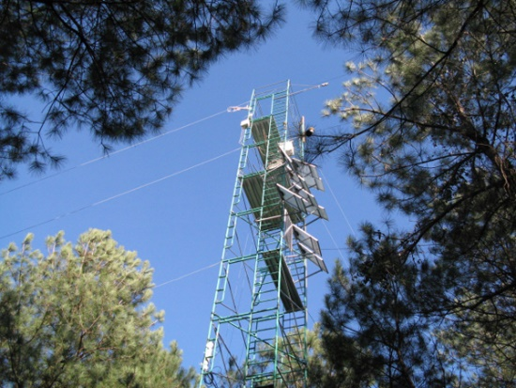
General dataset metadata standards – current developments
Simon J D Cox
21 February 2019
Land and Water

Slide 2
Overview
DCAT
schema.org

Slide 3
DCAT 2014

Slide 4
Scope
Records in data catalogues

Slide 5
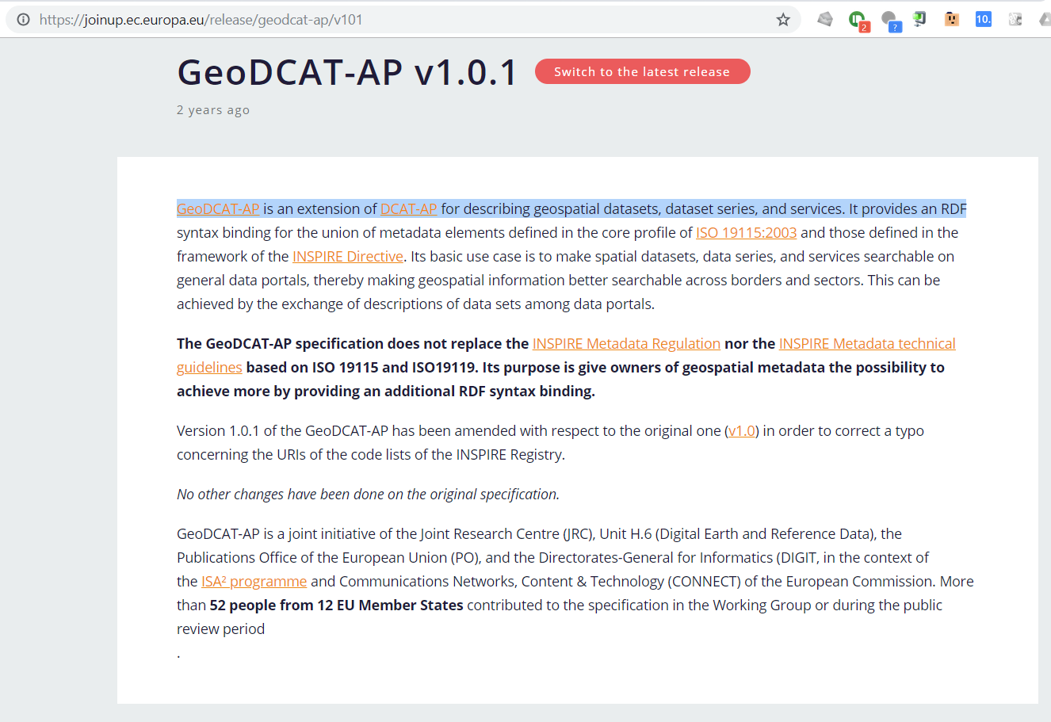

Slide 6
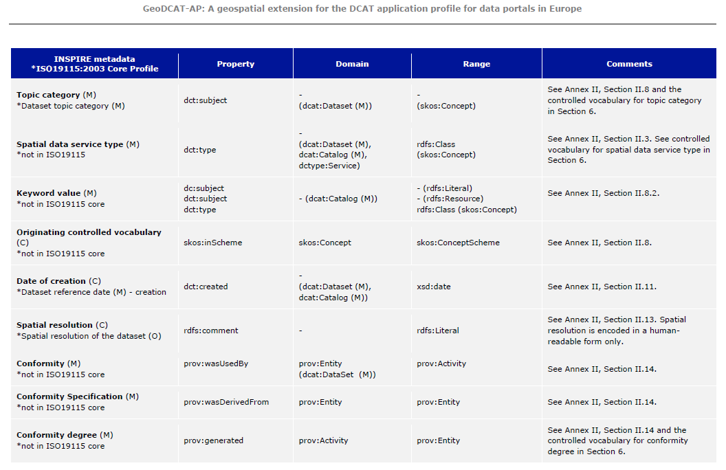
Mapping ISO 19115 properties to DCAT

Slide 7
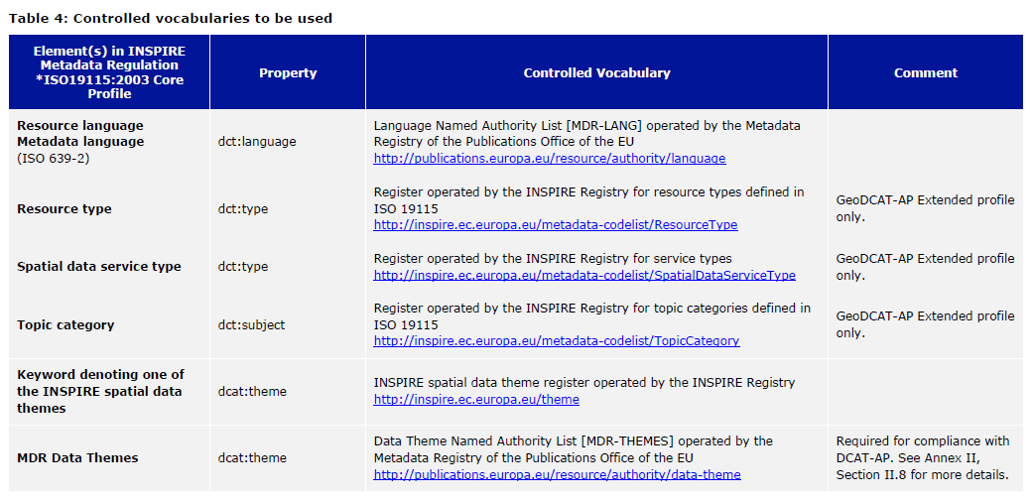
Controlled vocabularies recommendations

Slide 8
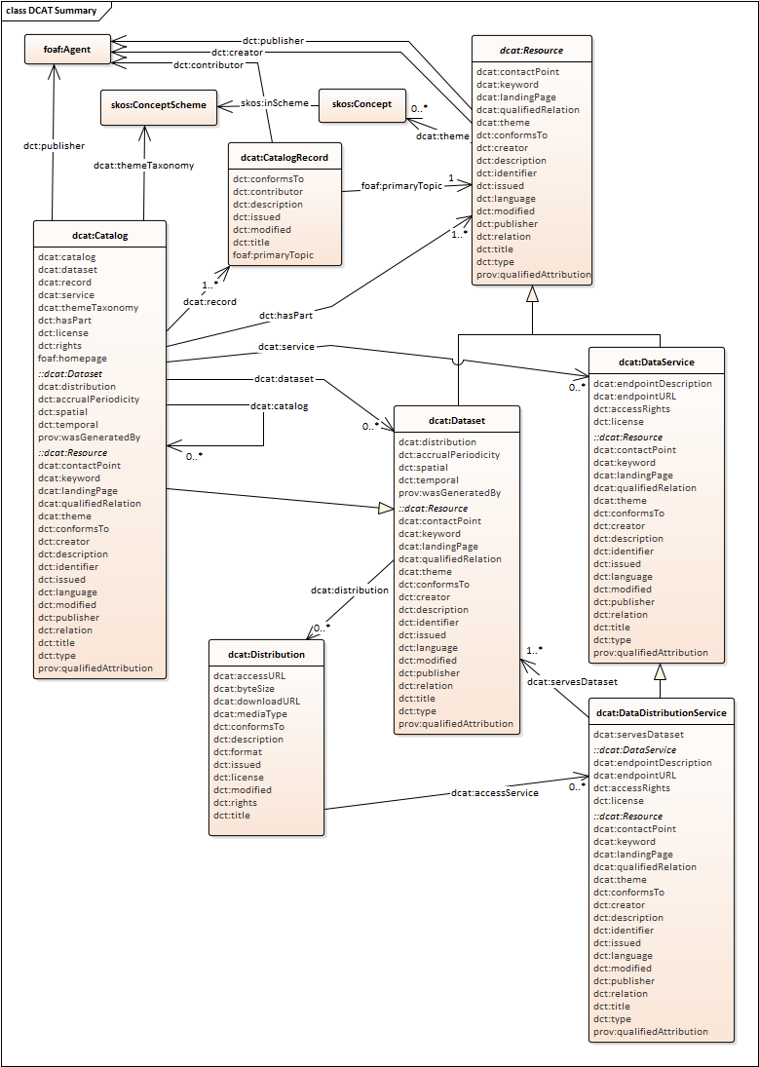
DCAT-rev
from the Editors Draft https://w3c.github.io/dxwg/dcat/

Slide 9
DCAT-rev scope

Slide 10
DCAT-rev scope

Slide 11
Data services

Slide 12
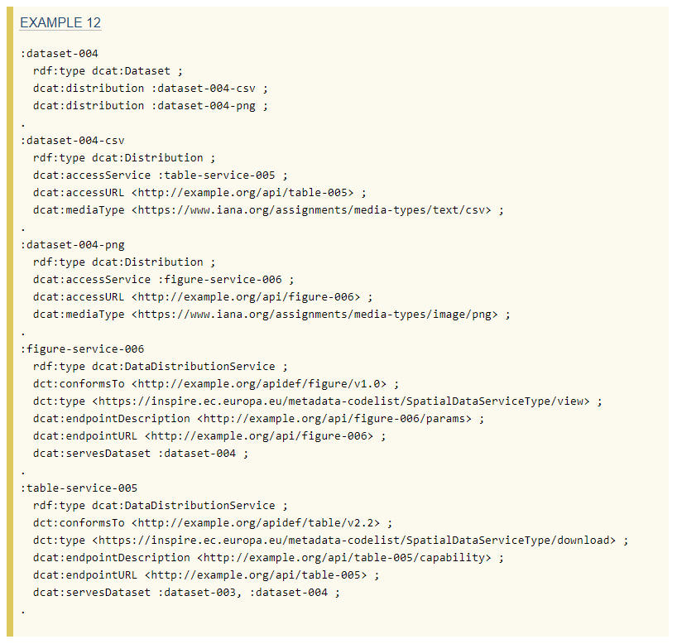

Slide 13
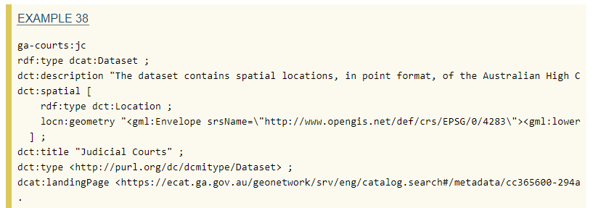
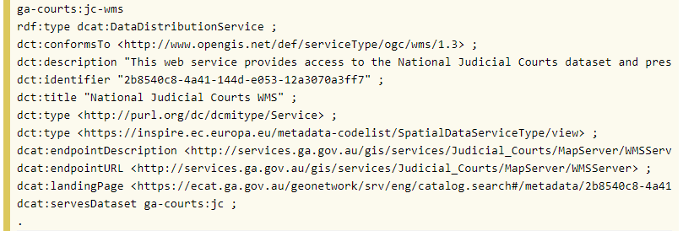
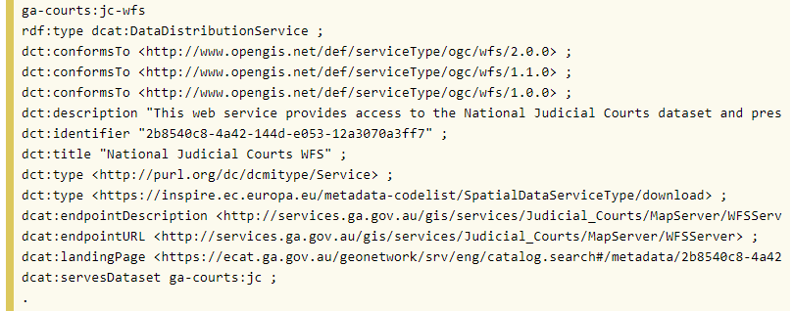
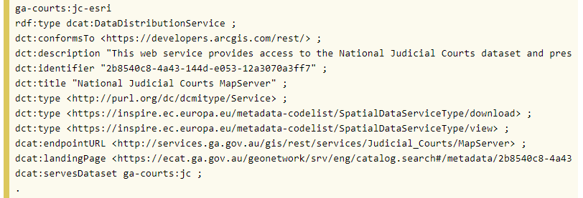

Slide 14
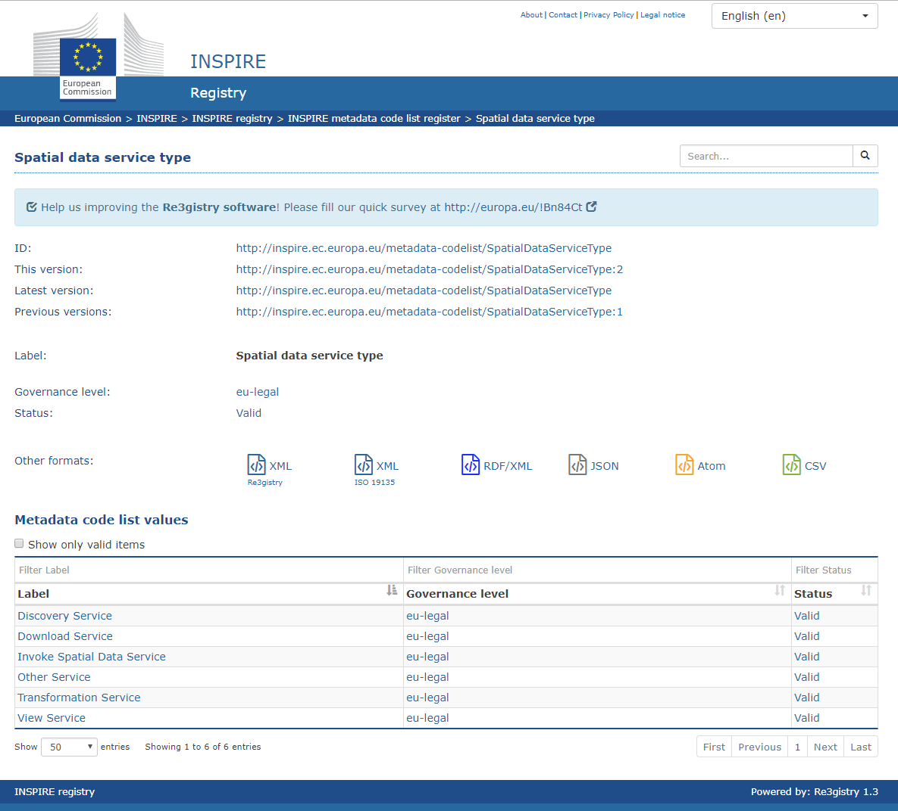

Slide 15
Meanwhile – schema.org

Slide 16
Scope
Descriptions embedded in web-pages
including dataset landing-pages

Slide 17
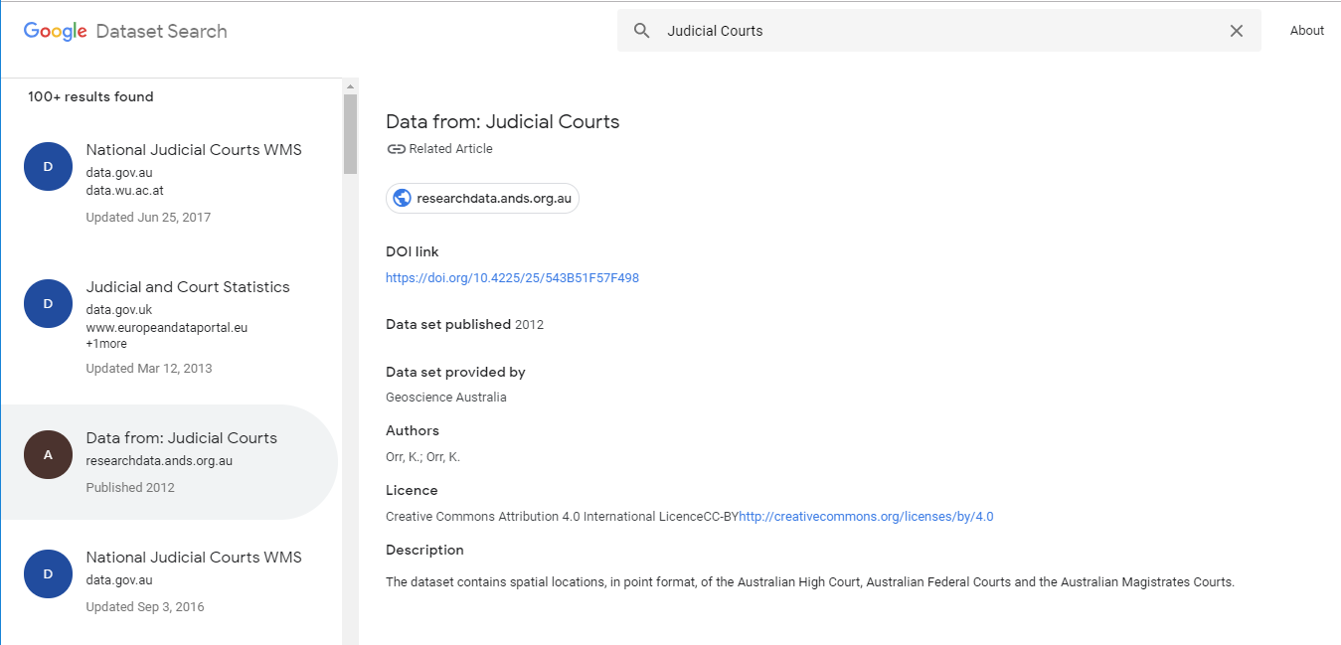
Dataset search

Slide 18
schema.org
Observation
resultTime
madeBySensor
usedProcedure
hasFeatureOfInterest
hasResult
phenomenonTime
observedProperty

Slide 19
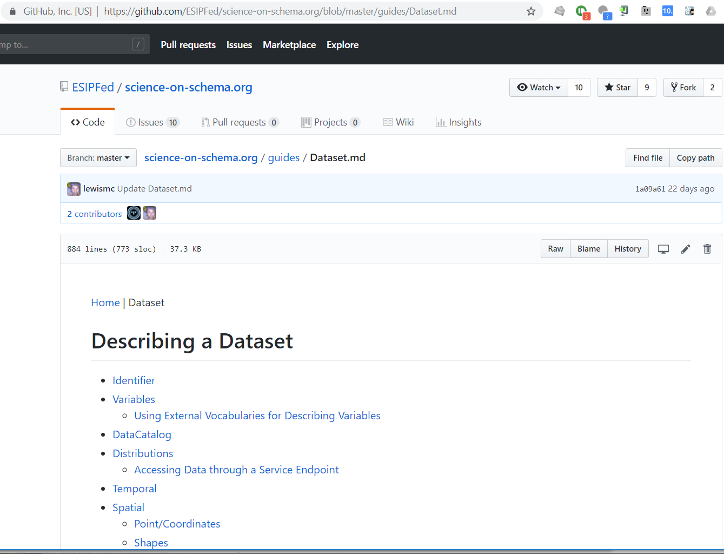

Slide 20
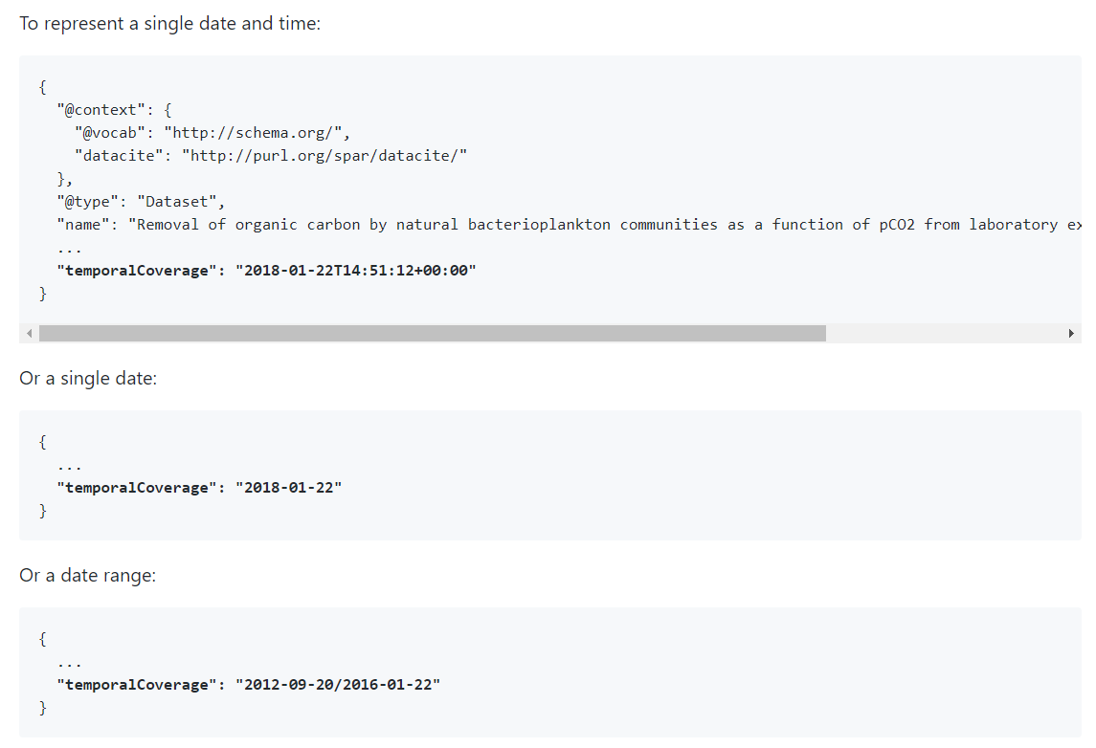

Slide 21
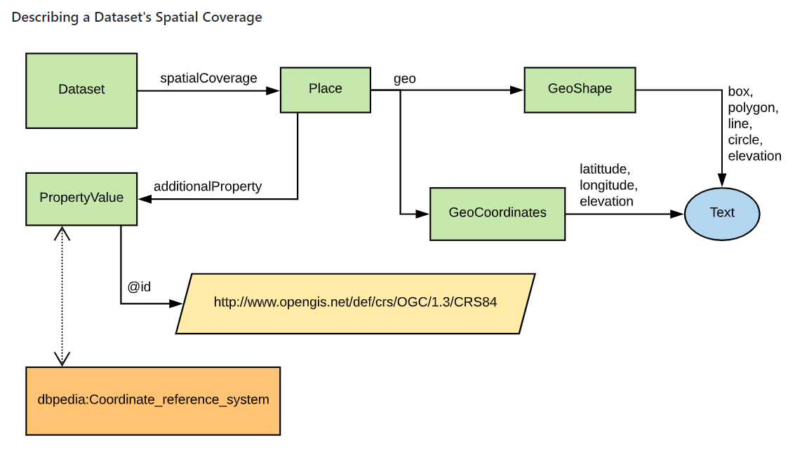

Slide 22
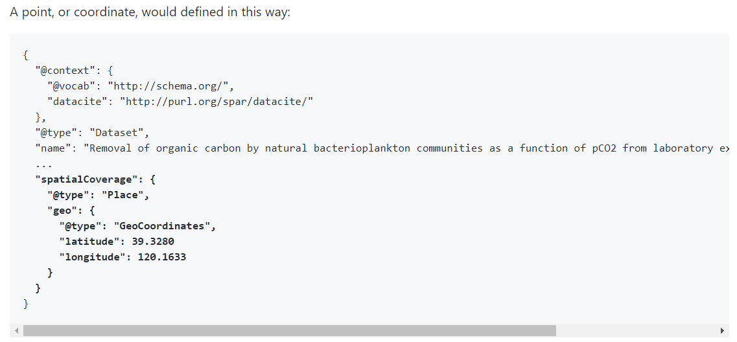
Spatial properties

Slide 23
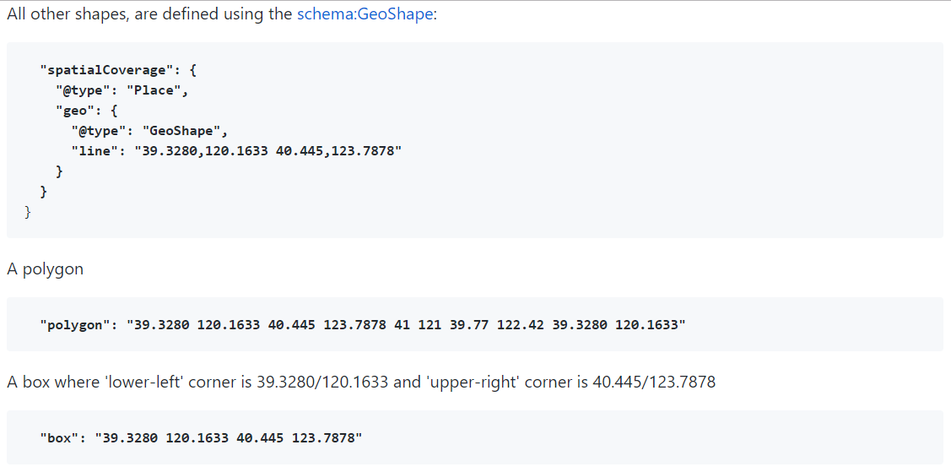
coordinates in a space-separated array
c.f. GeoJSON ☹ which uses nested arrays

Slide 24
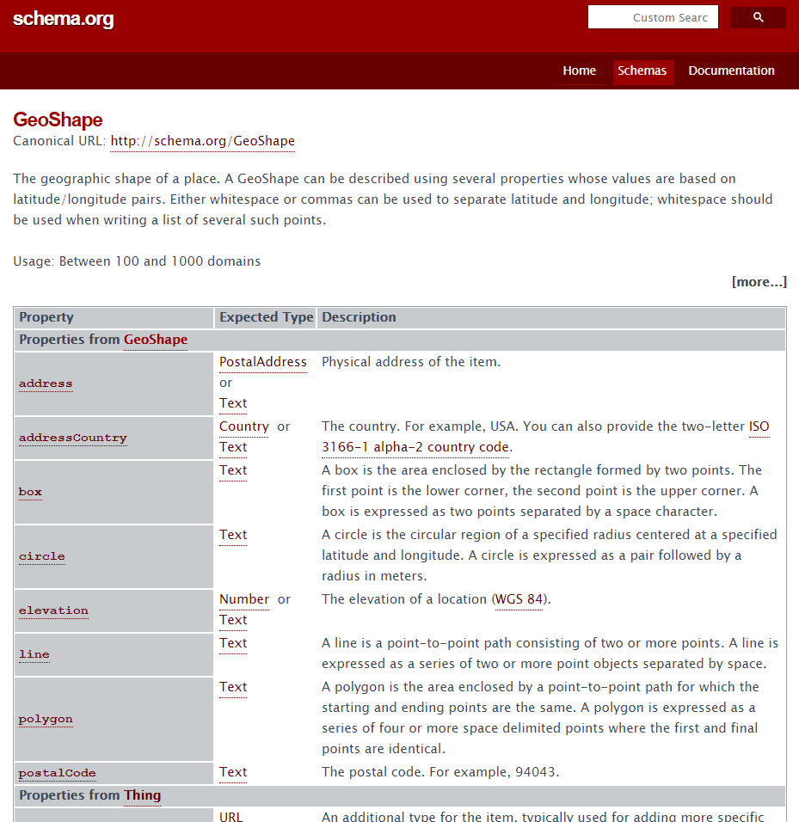

Slide 25
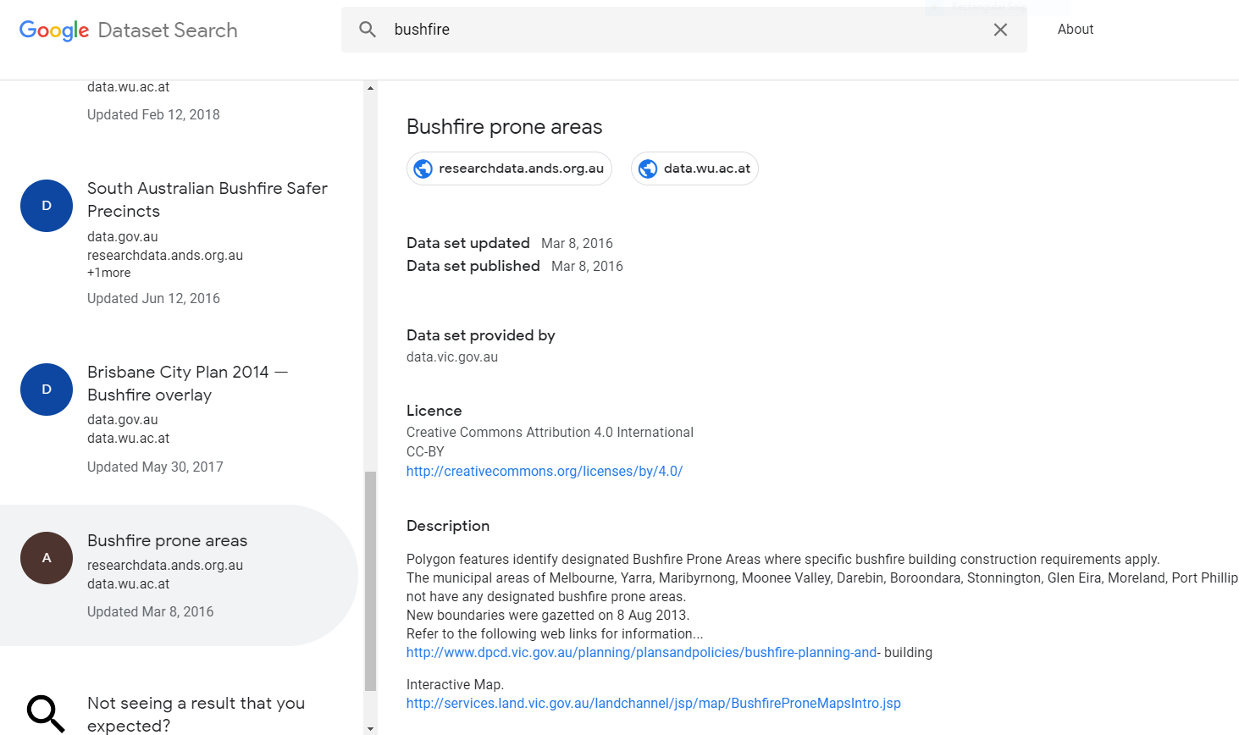
Google dataset search

Slide 26
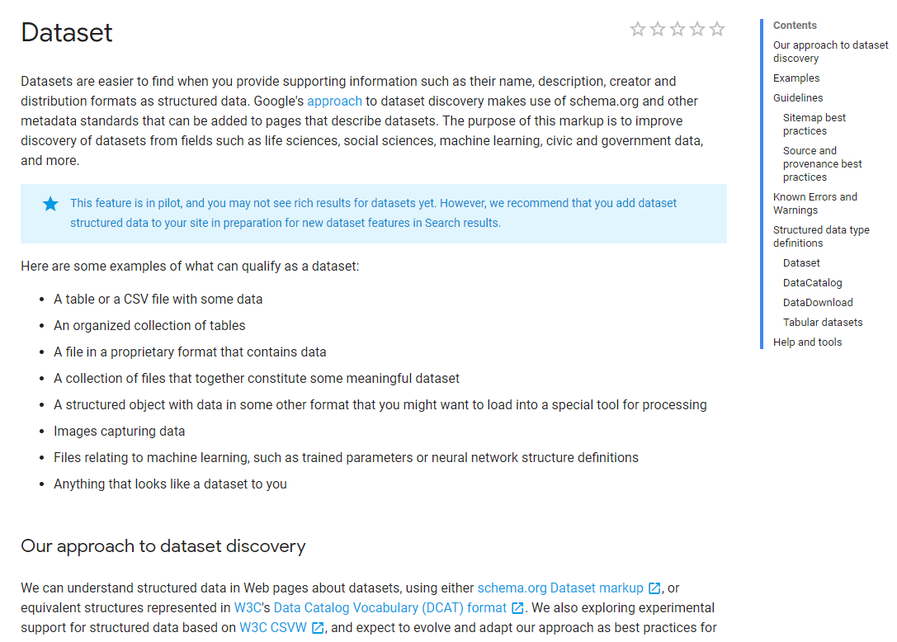

Slide 27
Thank you
Land and Water
Simon Cox Research Scientist
t +61 3 9545 2365
e simon.cox@csiro.au w www.csiro.au
Land and water

Slide 28
Darwin Core - biodiversity

Slide 29
OBO - Open Biological and Biomedical Ontologies

Slide 30
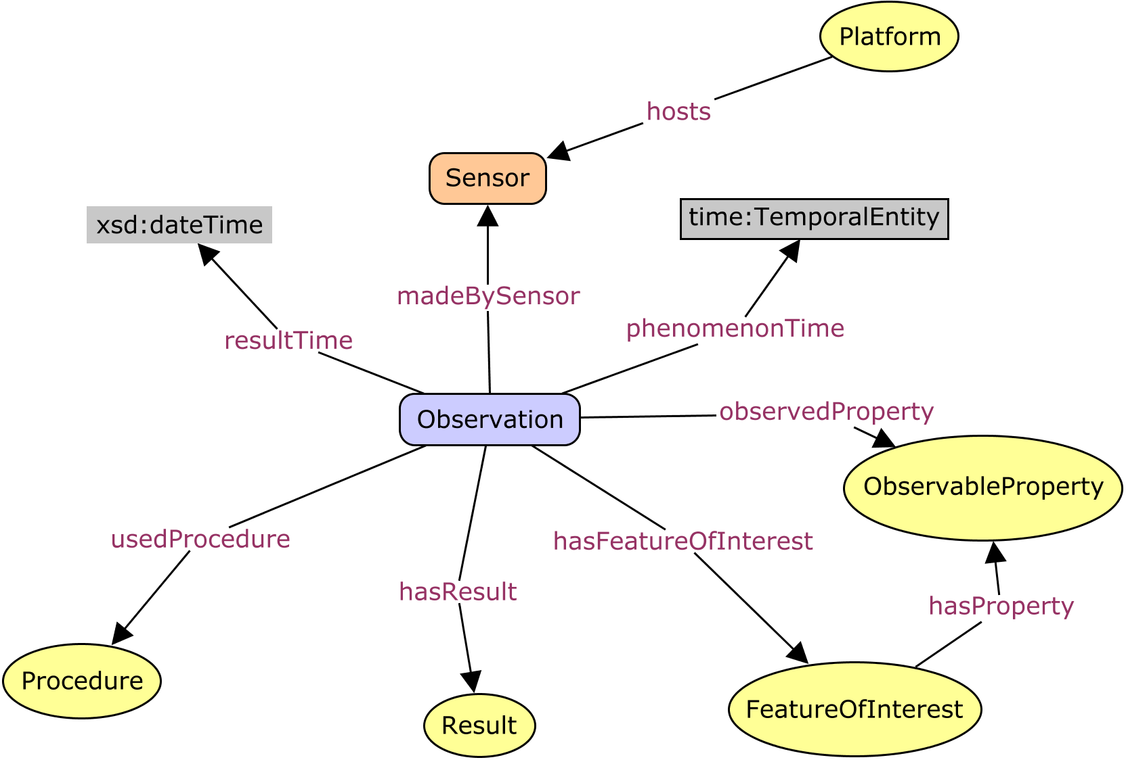
O&M / SSN – geospatial/general purpose
instruments and sensors
observable-properties
the application-domain
protocols and procedures
object types (features)
Notes:
The general model can be specialised for use in a specific domain, by defining domain specific feature types and lists

Slide 31
Datasets - collections of observations

Slide 32
SDMX / QB – Official Statistics

Slide 33
DDI / DISCO – Social sciences

Slide 34
SSN extension - Observation collection

Slide 35
Cataloging datasets

Slide 36
W3C Dataset catalog vocabulary - DCAT

Slide 37
Dataset catalog – schema.org

Slide 38
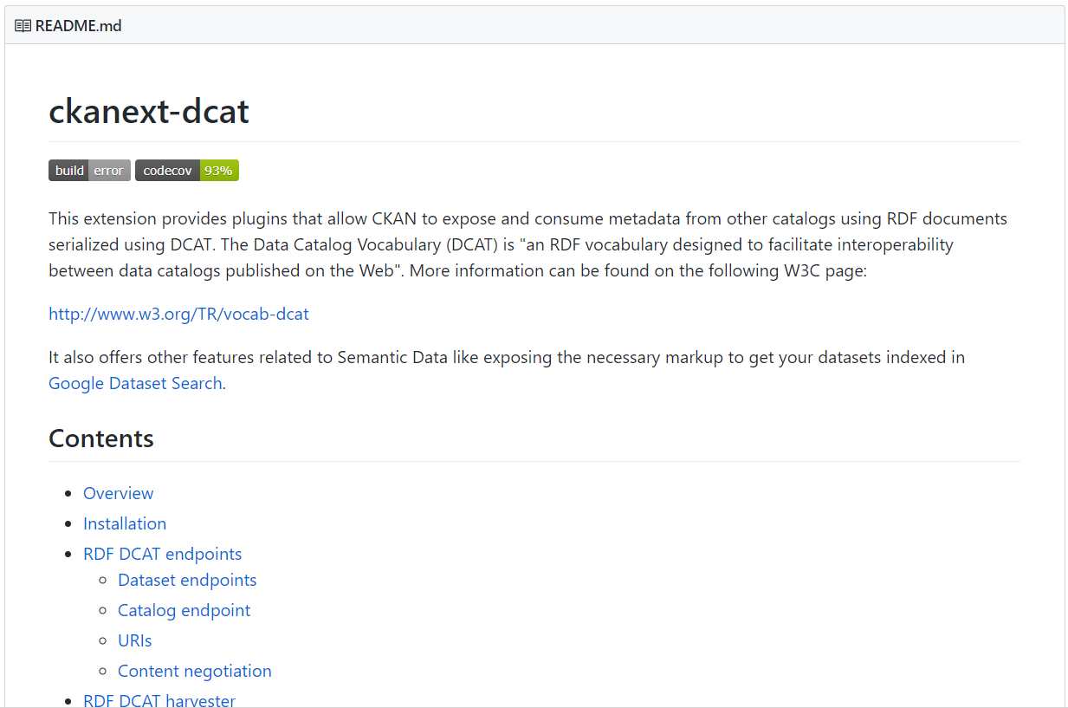
CKAN ♥ DCAT

Slide 39
Profile for research data discovery & assessment

Slide 40
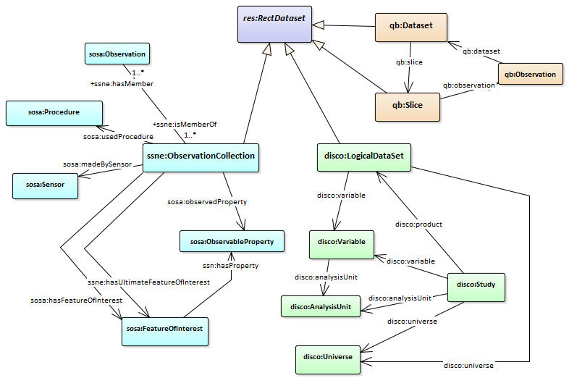
Rectangular data …

Slide 41
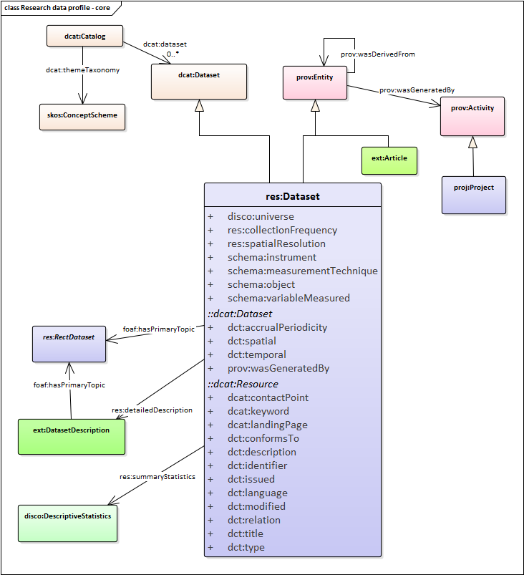
Metadata mashup:
Controlled vocabularies
Provenance/context
Observation properties
Dataset statistics

Slide 42
Schema.org – web index

Slide 43
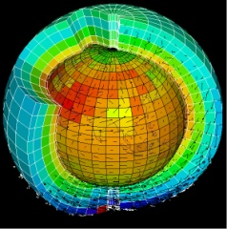
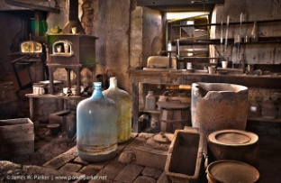
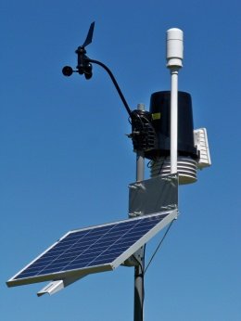
A common vocabulary for observations?
Remote sensing
Sensor
Value
Parameter
Scene
For data integration, mapping between vocabularies is a significant challenge
An Observation is an action whose result is an estimate of the value of some property of the feature-of-interest that applied at the stated phenomenon-time, obtained using a specified procedure, completed at the recorded result-time
Earth science
Algorithm, code, simulator
Model, field
Variable
Volume, grid
Metrology
Instrument
Value
Measurand
Sample
Chemistry
Instrument, analytical process
Analysis
Analyte
Sample
Environmental monitoring
Gauge, sensor
Value, time-series
Parameter
Station
Observations & Measurements
procedure
result
observed property
feature of interest
Notes:
This slide was originally developed for the 2013 Leptoukh Lecture.
Might need to kill the animation and just make the main points over it.
Different disciplines use different words for the same things
O&M provides a standard, domain-neutral terminology
Reduces ambiguity
Increases interoperability

Slide 44
“Observation” = Act of observation
Phenomenon-time = time result applies to feature
Result-time = time result became available
Sensor observations: result-time ≥ phenomenon-time
Forecasts: result-time < phenomenon-time
Archeology, Geology, Cosmology: result-time >> phenomenon-time
https://www.w3.org/TR/vocab-ssn/
Notes:
Observation model – as O&M except Procedure (plan, protocol) and Sensor (implementation) are separated
Phenomenon-time != result-time – allows use of model for forecasting, estimation of geological properties in deep past

Slide 45
Many types of result
1.76m Scaled number
(-37.908, 145.029) epsg:4326 Vector, Tuple
Array, Image, Field
“Silurian” ISC 2017 Word or concept, classifier
“poor” {reference} Assessment
“false” Boolean
Value of result is tied to a reference system

Slide 46
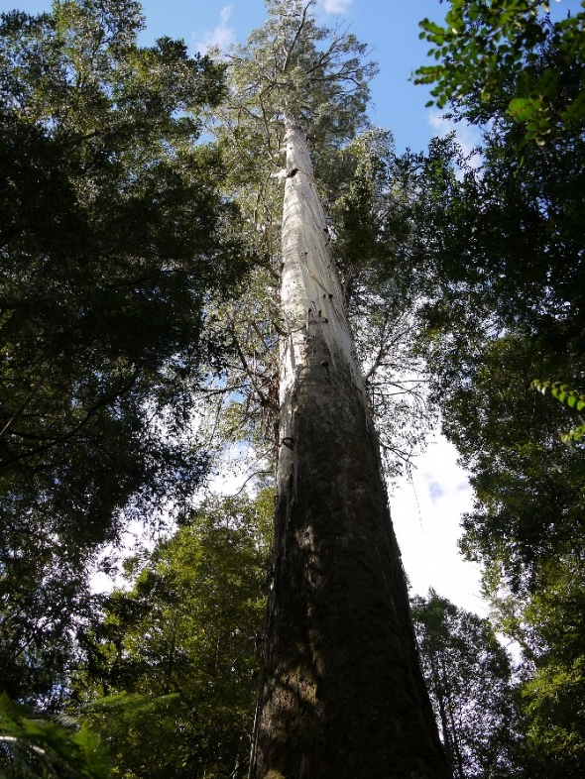
Domain model
Feature type
VascularPlantOccurrence
Characteristic properties
height
dbh
taxon
location
Property values
= 91 m
= 1.5 m
= Eucalyptus regnans
= -42.72, 146.81
A feature type is defined by a set of characteristic properties
A feature instance is defined by the values of its properties
Notes:
Skip if short of time

Slide 47
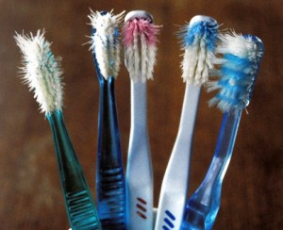
One vocabulary to rule them all?
No way
Separate disciplines have their specific requirements, community, prerogative
Each community focuses on specific elements of empirical science

Slide 48
One vocabulary to rule them all?
No way
Separate disciplines have their specific requirements, traditions, prerogative, community
Each focuses on specific elements of empirical science
This model labels the boxes where specialists focus their work
Common high-level vocabulary makes mapping between disciplines easier, not frictionless

Slide 49
DCAT
W3C Dataset catalog
https://w3c.github.io/dxwg/dcat/

Slide 50
DCAT Science profile
Collections of Observations

Slide 51
DCAT research profile?
Ontology mashup:
Controlled vocabularies
Observation properties
Project context

Slide 52
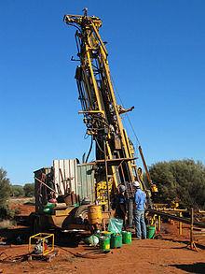
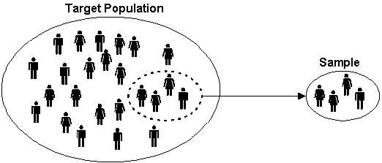
Sampling

Slide 53
Sample = result of Act-of-sampling
A ‘sample’ is a thing or subset which is intended to be representative of a larger thing or set …
… created or selected for the purpose of making observations to determine the value of one or more properties, traits or qualities of the larger thing
The essential property of a sample is the 'is-sample-of' relationship with the larger thing.
https://goo.gl/KBvkgW
Notes:
Sampling is core part of scientific observations
Definition supports all kinds of sampling, including statistical sampling of a population
Essential property captures sampling intention – to be representative of a bigger thing

Slide 54
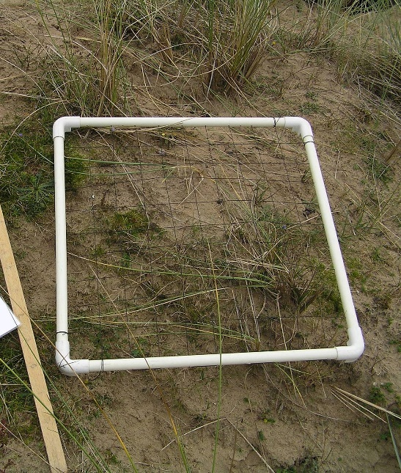
Types of sample
A material sample or specimen is typically selected to allow ex-situ observations
A statistical sample or subset is a specified number of individuals from a population
A spatio-temporal sample may have the same dimension but a smaller extent than the thing which it represents,
or a lower topologic dimension than the thing which it represents

Slide 55
Sampling chains
Similar patterns apply to samples
https://w3c.github.io/sdw/proposals/ssn-extensions/

Slide 56
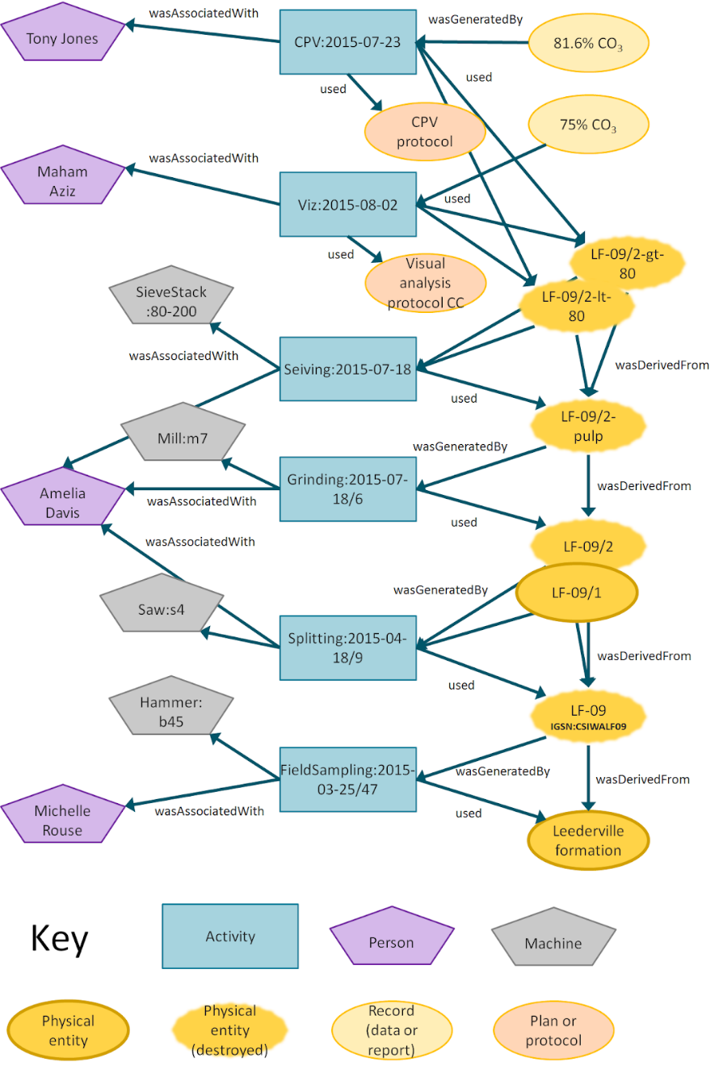
Sample preparation
Details of sample preparation chains can be recorded using PROV-O
https://www.w3.org/TR/prov-o/
Provenance-of-things - https://goo.gl/HeVkXp

Slide 57
Thank you
Land and Water
Simon Cox Research Scientist
t +61 3 9545 2365
e simon.cox@csiro.au w www.csiro.au
Land and water

Slide 58
OWL-Time
https://www.w3.org/TR/owl-time/

Slide 59
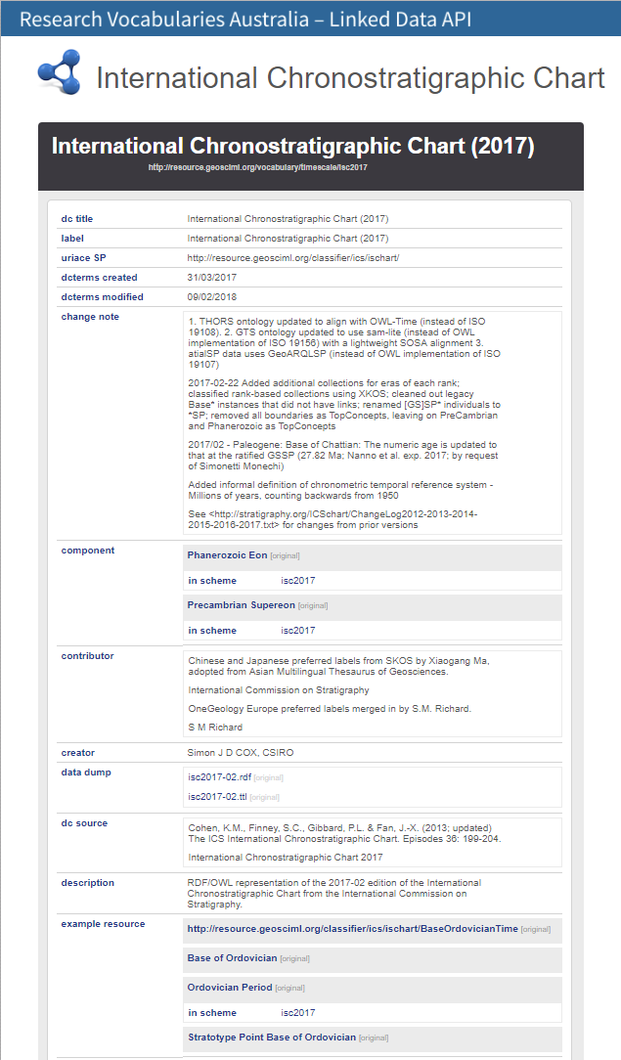
Geologic timescale
https://doi.org/10.25919/5b4d2b83cbf2d
http://resource.geosciml.org/vocabulary/timescale/isc2017

Slide 60
PDF image - also not machine-processable!

Slide 61
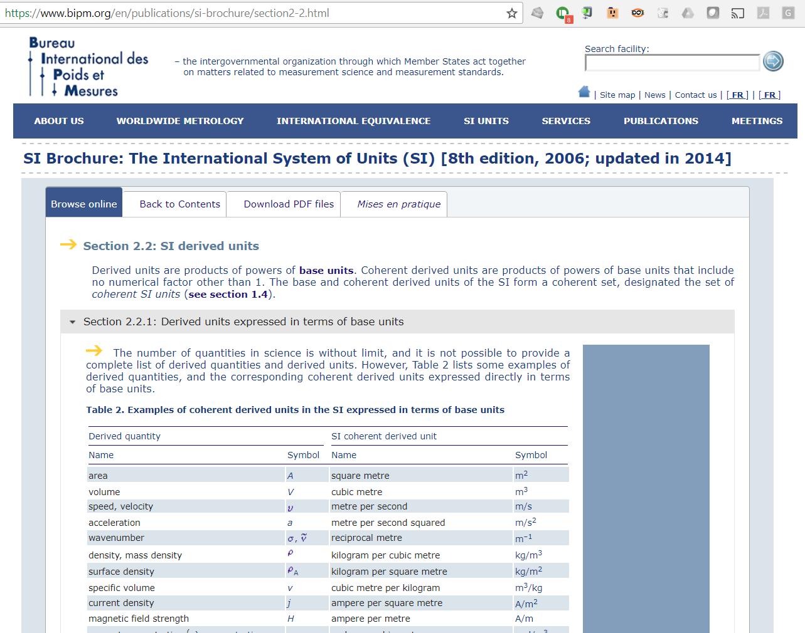
A web page – not directly interpretable ☹

Slide 62
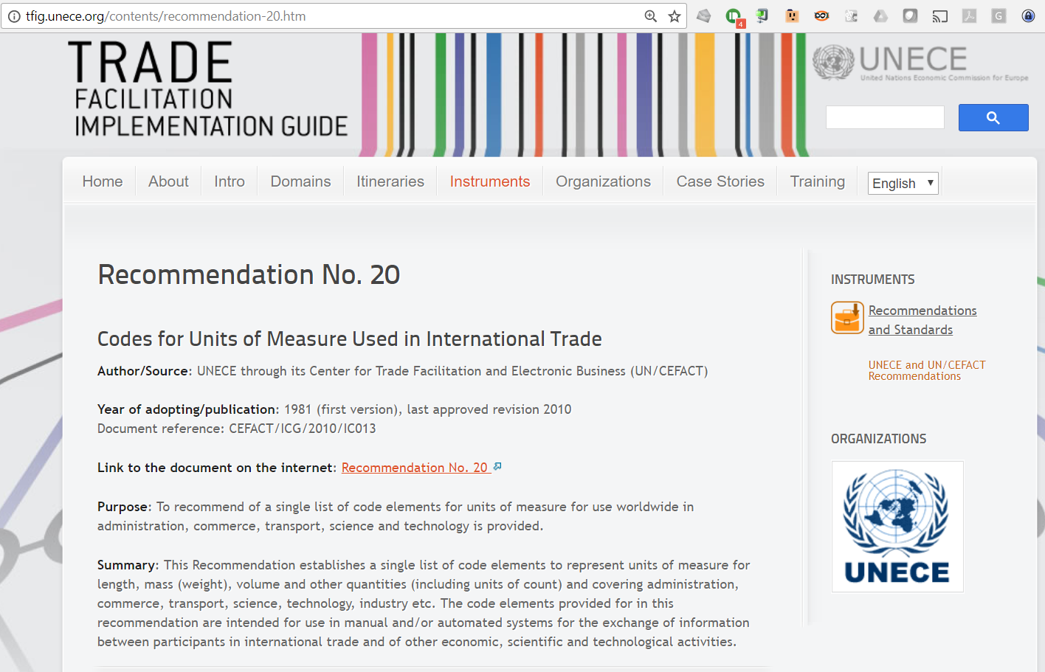
PDF + Excel table (better, but still not Linked Data)

Slide 63
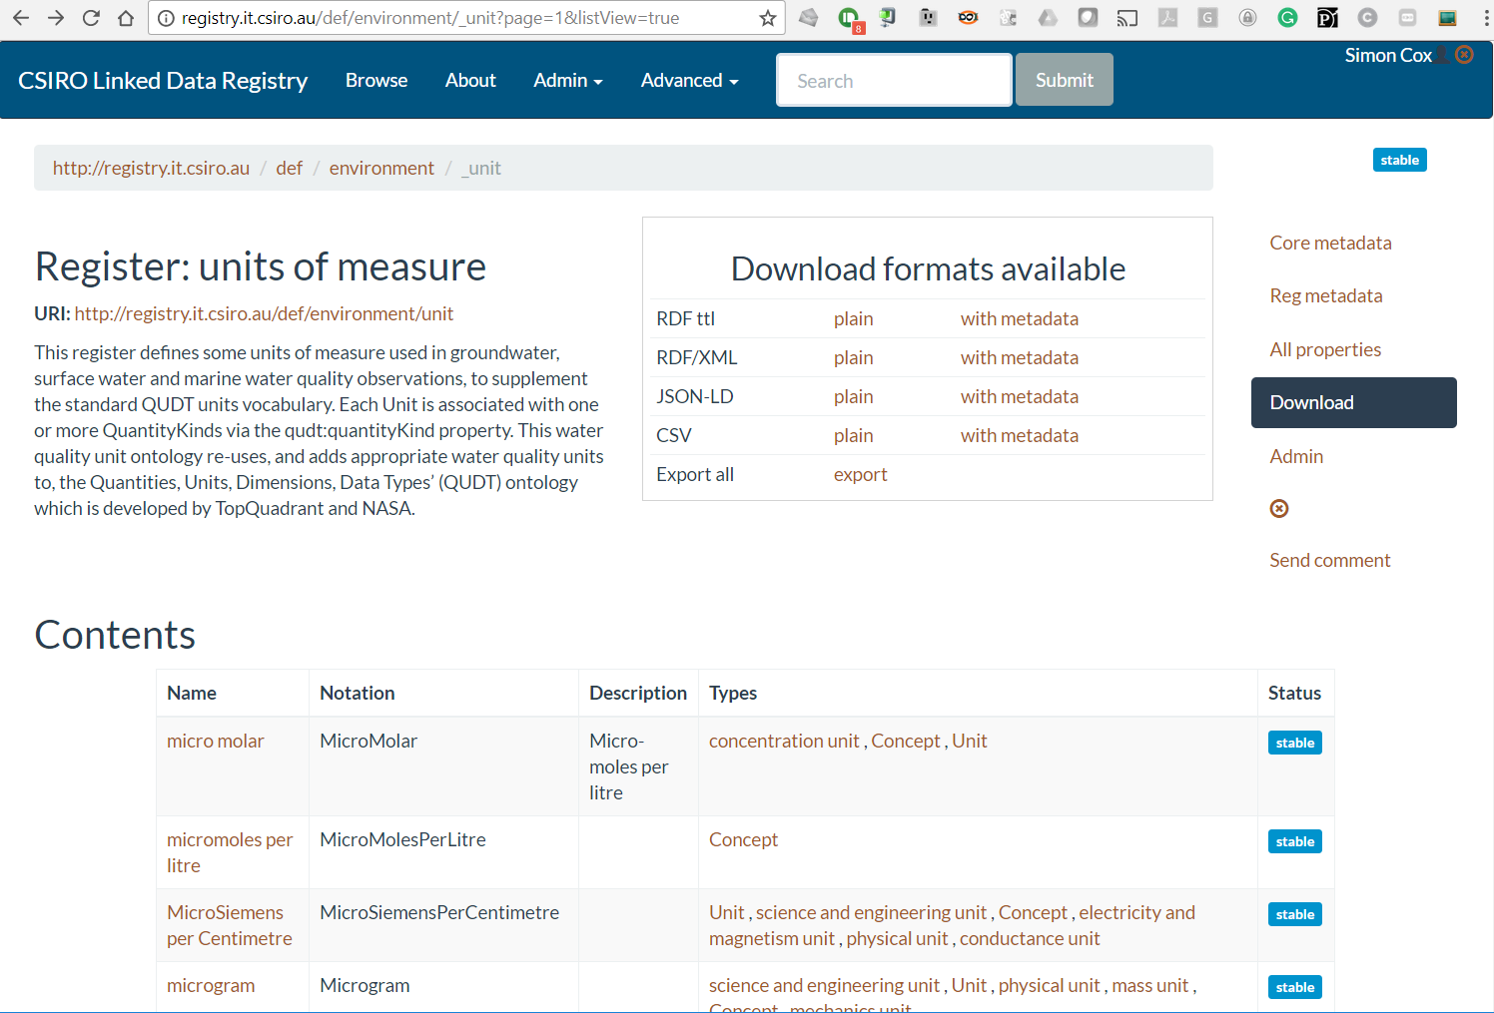

Slide 64
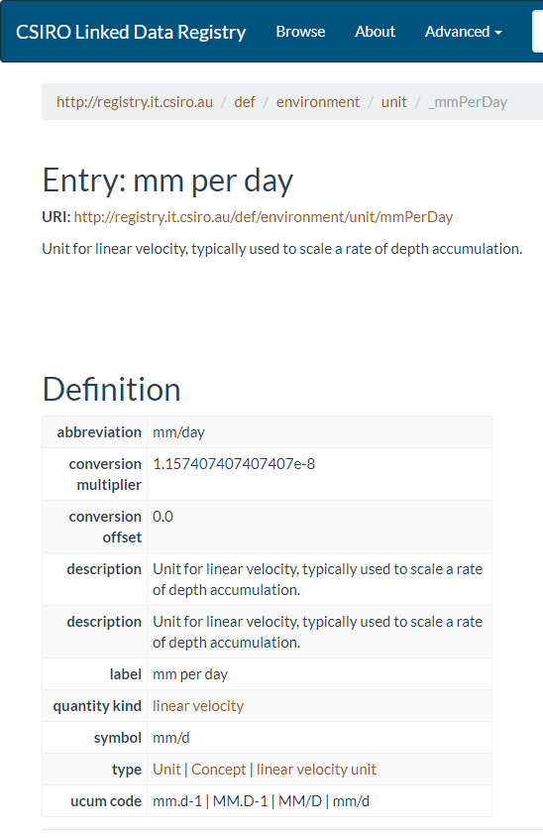
What does ‘machine readable’ look like?
A URI for each term
Structured values, references to other vocabularies

Slide 65
Example/Opportunity?
Geodetic reference systems
British National Grid
WGS84
GDA94, 2016, 2020
Various state datums …
Critical business requirement
European Petroleum Survey Group – EPSG (now OGP)
→ EPSG database
De-facto standard
Recognised by ISO TC/211
Access database for download
OGC Registry
… CODATA?

Slide 66
Summary
W3C ontologies - discipline-neutral, but science-friendly
Potential bridging vocabularies between disciplinary vocabularies
Term definitions can be machine-readable, in linked data

Slide 67
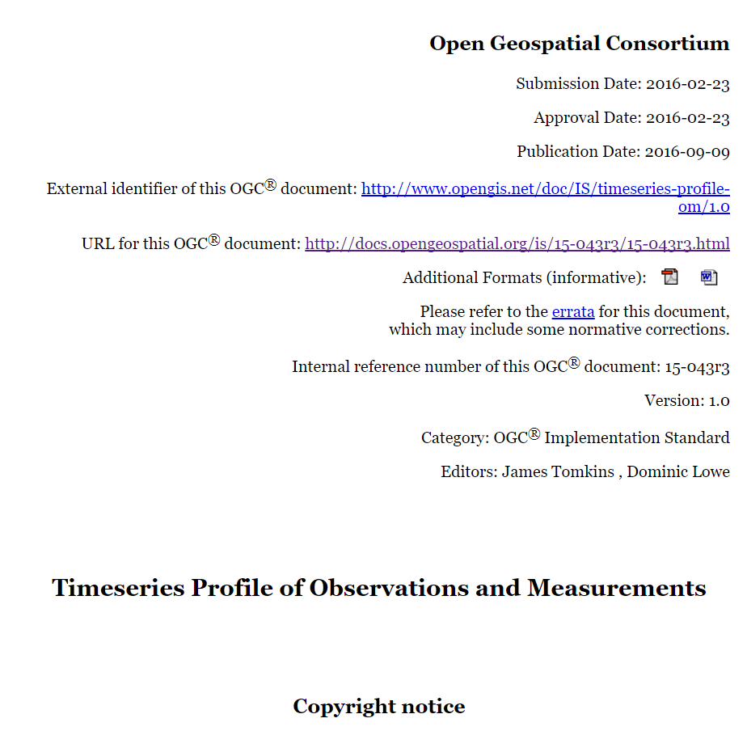
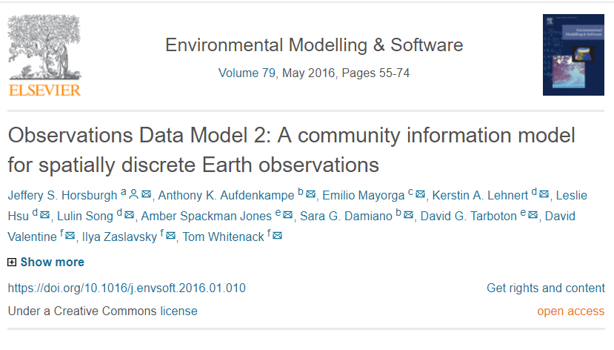
Implementation work

Slide 68
Indirect observation
While sometimes the proximate feature of interest is also the ultimate feature of interest
most observations are on samples
and some samples are several steps removed from the ultimate feature of interest
https://w3c.github.io/sdw/proposals/ssn-extensions/

Slide 69
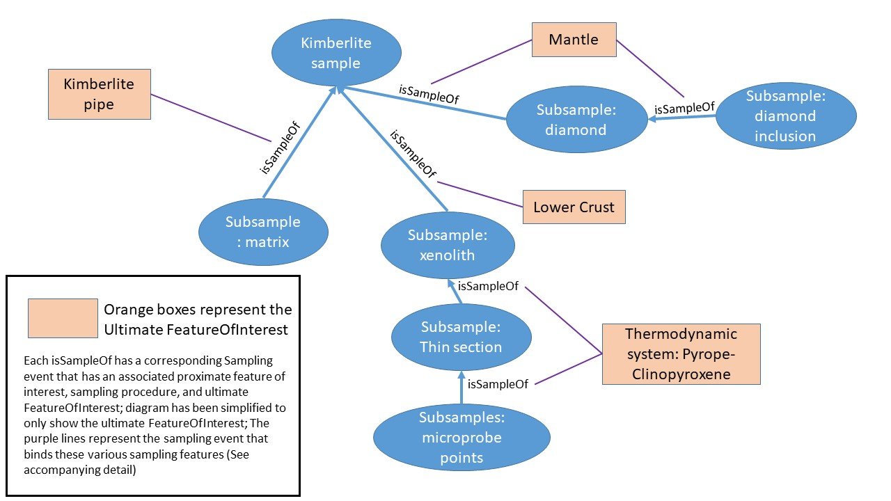
Same samples may relate to different UFoI

Slide 70
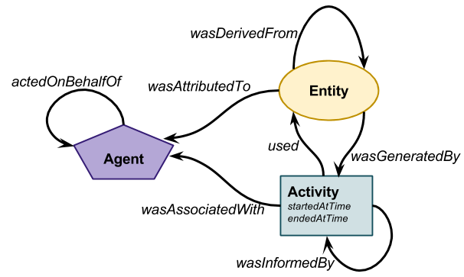
Core PROV
Process-flow model
Developed primarily for datasets, data products, reports
T. Lebo, S. Sahoo, D.L. McGuinness, PROV-O: The PROV Ontology, (2013). http://www.w3.org/TR/prov-o/ (accessed February 13, 2014).

Slide 72
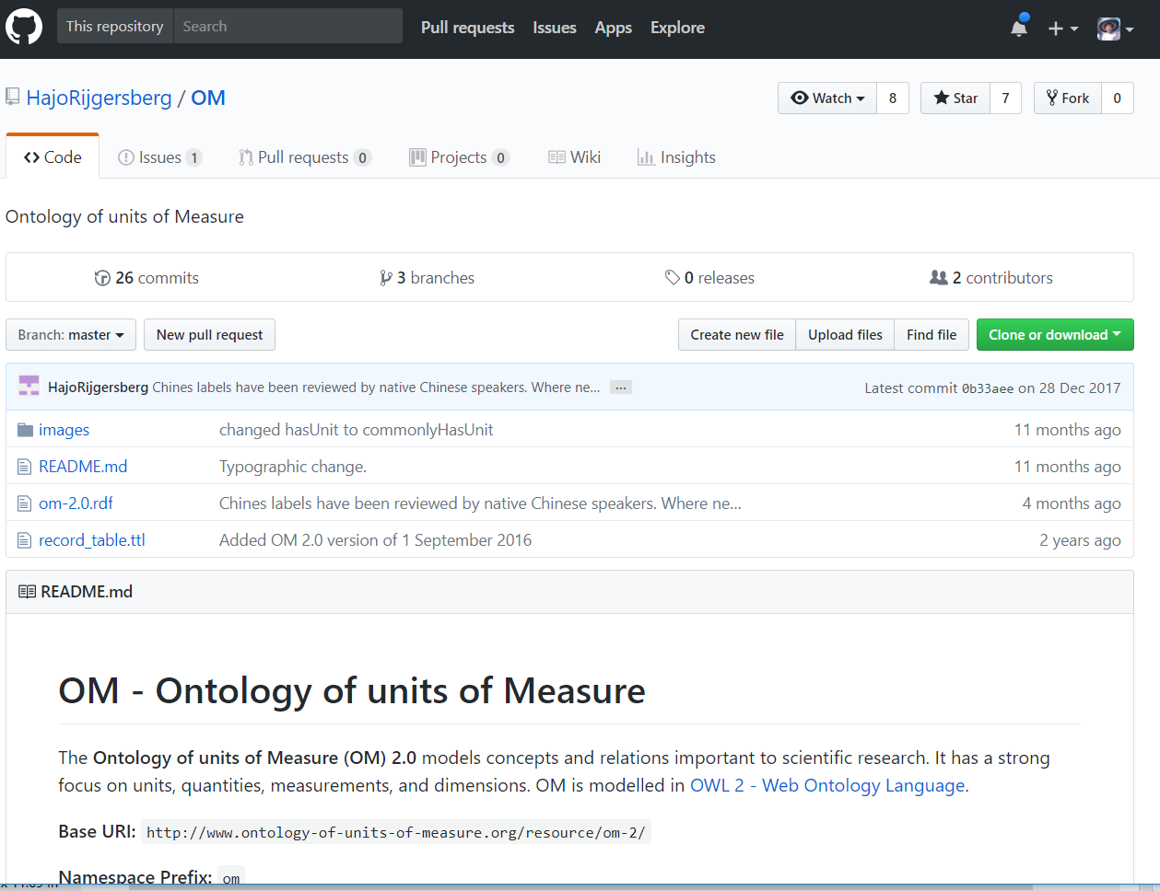
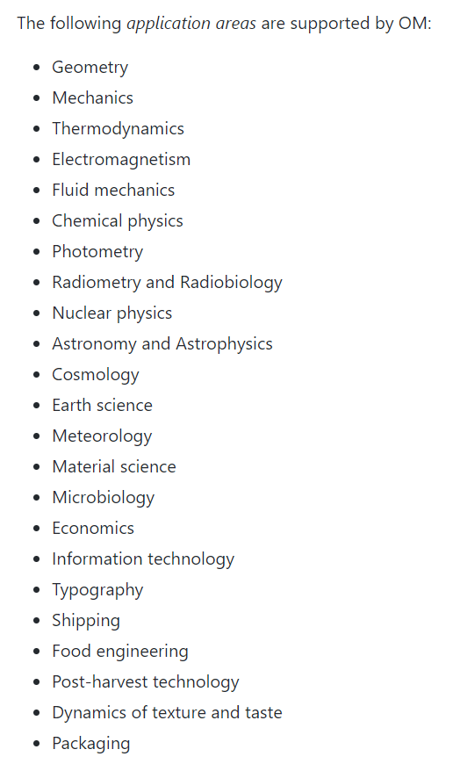
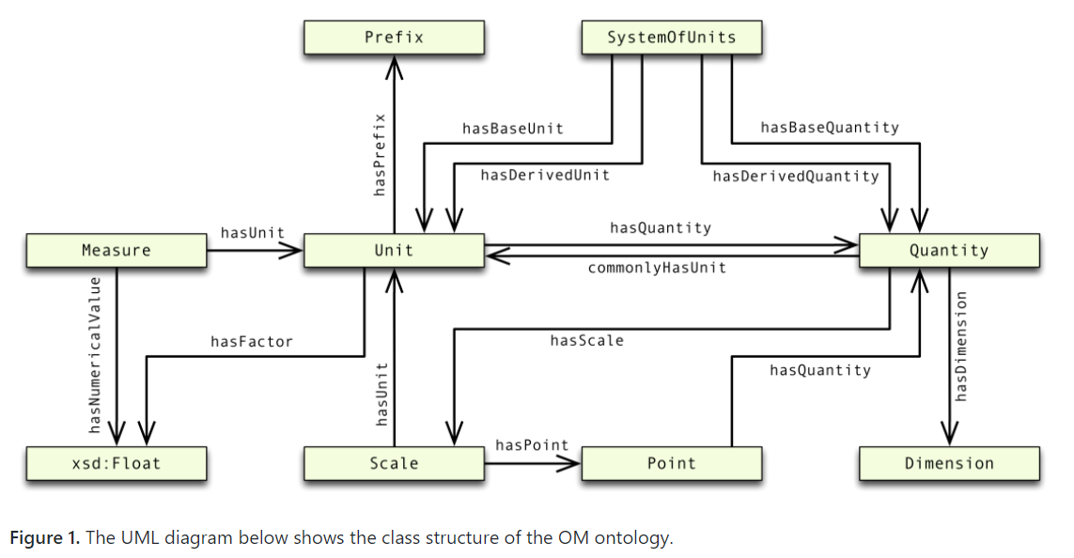

Slide 73
Discipline standards
Clinical data – HL7 – FHIR; DATS
Life sciences – OBO – OBI, ENVO; EML
Biodiversity - IUBS/TDWG – Darwin Core
Geology – IUGS/CGI – GeoSciML
Social Sciences / Official Statistics – SDMX, QB, DDI/DISCO
…
Task Group on “Coordinating data standards amongst data unions”

Slide 74
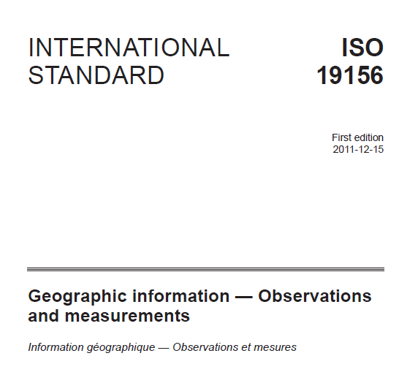
Notes:
Now it has been formalized as an OWL ontology and published as a W3C Recommendation – October 2017

