Slide 1
Data and related Services
Metadata
Melanie Barlow
2020

Slide 2
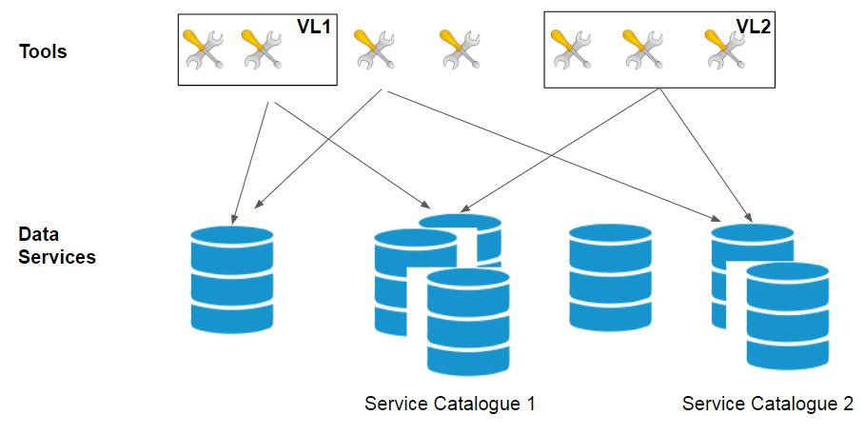
Interaction between Tools and Data Services

Slide 3
Interaction between Tools and Data Services
Data and Service metadata
Dataset Metadata
Service
Metadata
Service
Metadata
Service
Metadata
Service
Metadata

Slide 4
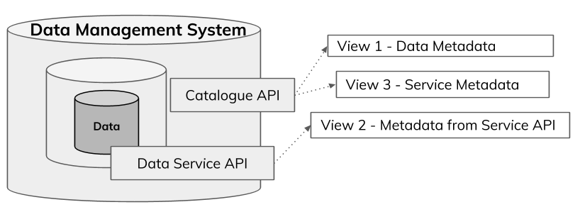
Interaction between Tools and Data Services
Data and Service metadata, in Views
Data and related Service, Metadata Views - Sourced and Generated (google slides)
Data and related Services - Metadata Views (google doc)

Slide 5


Data and related Services, Views
Concepts - for data-services and related data | View 1 Data metadata record | View 2 Service description available from service API | View 3 Service metadata record
Service URL
Service Type (function, protocol, version)
Service Title
Data Subject
Data and Data-Service Metadata Concepts and Schemas (google sheet)
Data and related Services - Metadata Views (google doc)

Slide 6

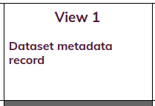
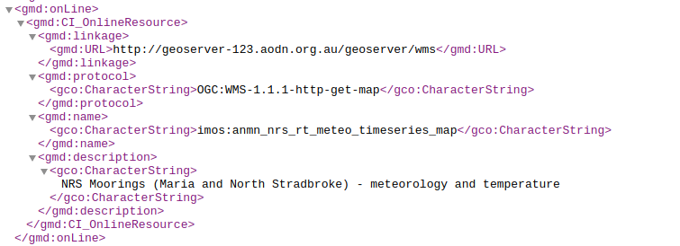
Example DataSet Metadata in IMOS Catalogue
service URL
service type
{
domain name, layer name
data
description

Slide 7
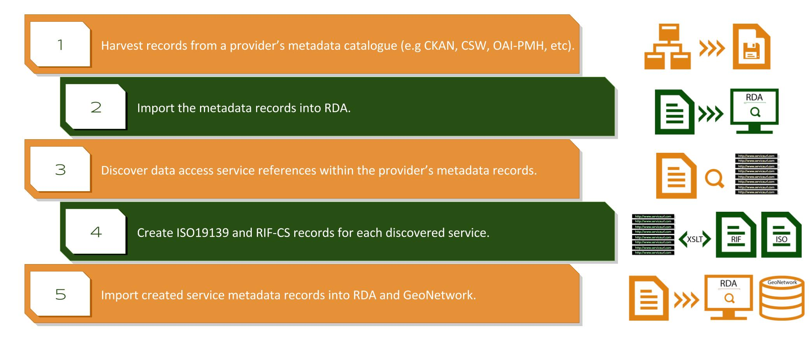
The Solution: Discovering Services
Notes:
~ 40 service records generated from the example data sources

Slide 8
melanie.barlow@ardc.edu.au
Notes:
Harmonising Data Service Description - Current Practice

