Slide 1
Geoscience Australia Service Metadata
ANZ Metadata Working Group Meeting February 2019
Aaron Sedgmen

Slide 2
What services are in the GA Catalogue?
ISO 19119 defines a geographic service as an entity with functionality that is provided through interfaces
This can include machine-to-machine and human interaction interfaces
Services in the GA Catalogue are currently limited to web APIs (web services) that provide access to spatial data
Web service types being catalogued by GA include:
OGC W*S
Esri ArcGIS web services
Possible service types to be catalogued in the future:
OpenDAP
Custom APIs (Oracle XML APIs, ad-hoc “RESTful” APIs)
SPARQL endpoints

Slide 3
Why have metadata records for services?
Dedicated service metadata records may be overkill for some organisations
The web service URLs in the Distribution Information of dataset metadata records may be sufficient
Reasons for having dedicated service metadata records:
Allows users to discover web services independently of datasets
Web services that aren’t associated with a dataset (e.g. geoprocessing services) would otherwise have no record of its existence in the catalogue
Provides more detailed service information, enhancing ability for users and machines to bind to services
A valuable mechanism for in-house administration and management of web services and the web service life-cycle

Slide 4
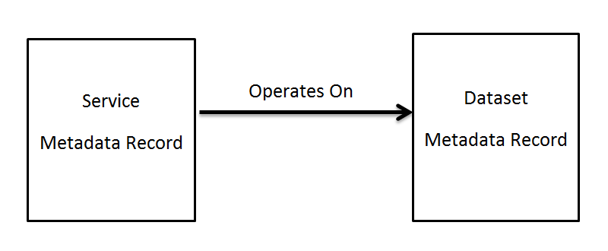
Linking datasets and web services
Service metadata records are linked to metadata records for the datasets on which they operate
Dataset records operated on by a web service will contain links to the service endpoint URL in the Distribution Information

Slide 5
Linking datasets and web services (Cont.)
Base ISO 19115-1 standard does not facilitate dataset record to service record associations
GA Profile of ISO 19115-1 allows links from dataset records to service records as an Associated Resource.
The GA Profile extends the Associated Resource Codelist to include the “operatedOnBy” relationship

Slide 6
Service Record Granularity
It’s not uncommon for the same dataset to be delivered via multiple web service types, e.g:
OGC Web Map Service
OGC Web Feature Service
Esri MapServer web service
The collective set of service endpoints can be regarded as a single logical web service (a common concept among Esri users)
Multiple endpoints can be accommodated in a single ISO 19115 record, although combining endpoints into one record can impact on interoperability
complicates search and discovery operations
not a common convention - most implementers of ISO 19115 service metadata have one record per service endpoint
GA implements one service record per service endpoint

Slide 7
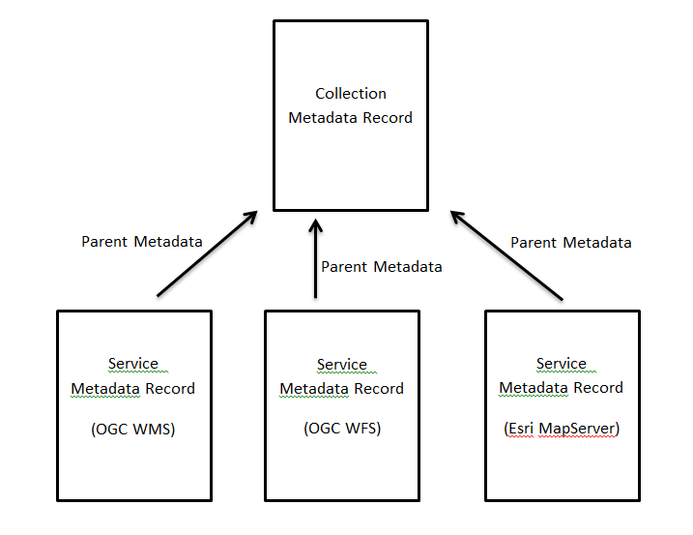
Service Record Granularity (cont.)
An option for capturing the endpoint associations is to create a collection level record

Slide 8
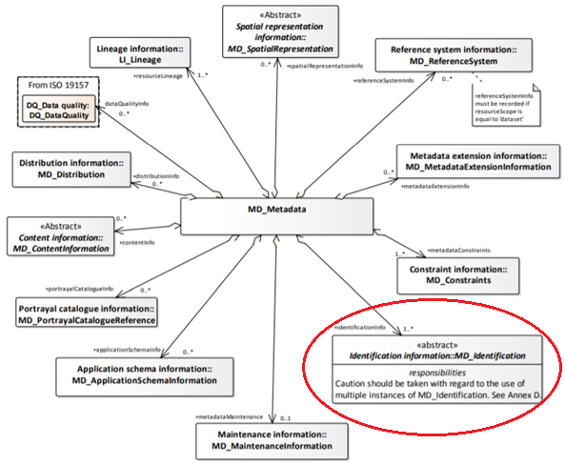
Service metadata ISO 19115-1 elements
Service metadata records consist of elements from the MD_Metadata package and associated classes

Slide 9
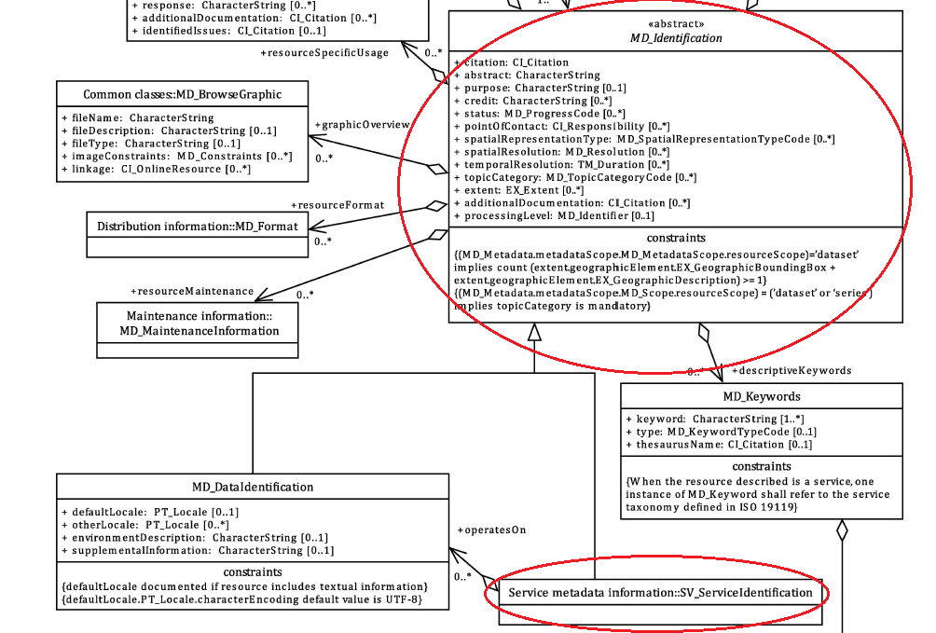
Service metadata ISO 19115-1 elements (cont.)
The abstract MD_Indentification class is specialised by the SV_Serviceldentiflcation class to provide service specific elements

Slide 10
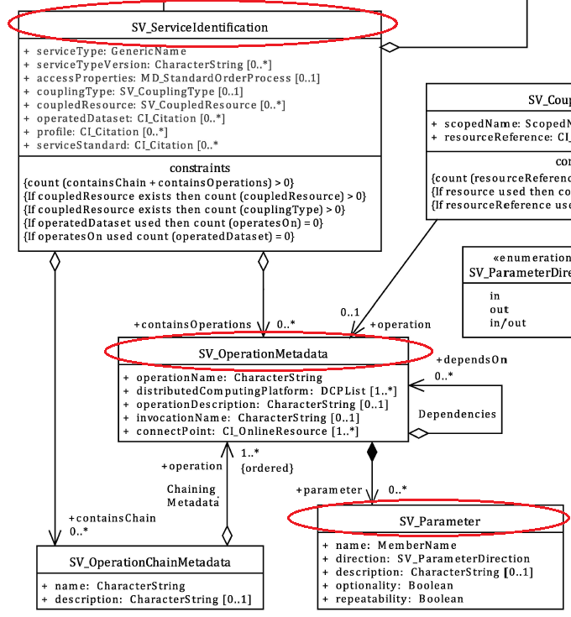
Service metadata ISO 19115-1 elements (cont.)
The key “SV Metadata for services” package classes used in service metadata

Slide 11
Service metadata ISO 19115-1 elements (cont.)
Class | Element | Obligation | Description
SV_ServiceIdentification | serviceType | M | A service type name. EXAMPLE ‘discovery’, ‘view’, ‘download’, ‘transformation’, or ‘invoke’ (GA Profile constrains service type to a codelist)
 | serviceTypeVersion | M | The version of the service, supports searching based on the version of serviceType. EXAMPLE We might only be interested in OGC Catalogue V1.1 services. If version is maintained as a separate attribute, users can easily search for all services of a type regardless of the version.
 | couplingType | C | Type of coupling between service and associated data (if exists)
 | operatesOn | M | Provides information on the resources that the service operates on. NOTE Either operatedDataset or operatesOn may be used (not both for the same resource).
SV_OperationMetadata | operationName | M | A unique identifier for this interface
 | distributedComputingPlatform | C | Distributed computing platforms on which the operation has been implemented
 | operationDescription | O | Description of the intent of the operation and the results of the operation
 | connectPoint | C | Handle for accessing the service interface
SV_Parameter | name | M | The name, as used by the service for this parameter
 | direction | M | Indication if the parameter is an input to the service, an output or both
 | description | M | A narrative explanation of the role of the parameter
 | optionality | M | Indication if the parameter is required
 | repeatability | M | Indication if more than one value of the parameter may be provided

Slide 12
Service metadata ISO 19115-1 elements (cont.)
An example ISO 19115-3 service metadata record in the GA catalogue:
https://ecat.ga.gov.au/geonetwork/srv/api/records/29b9b918-c5ae-fb1d-e053-10a3070a1a72/formatters/xml

Slide 13
Additional notes on GA service metadata content
Only the capability operations are described, no need to repeat service operation information contained in capability statements
Service metadata records include Distribution Information to enhance interoperability
GA’s service metadata in action:
https://ecat.ga.gov.au/geonetwork

Slide 14
Questions?

