Slide 1
ANZ MetLite v2 Update
To GeoNetwork 4.2.5

Slide 2
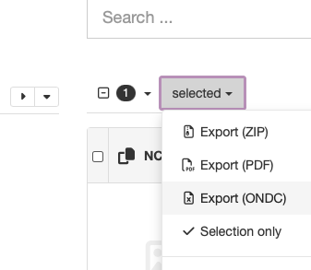
What is New?
Very little changed visibly from the previous version
ONDC export
GNSS Profile of ISO19115-3:2018 Support

Slide 3
What’s Different?
Migrated to GeoNetwork 4.2.5
Elasticsearch indexing - faster and more capable
Docker deployment
Clean templates - pass all validation

Slide 4
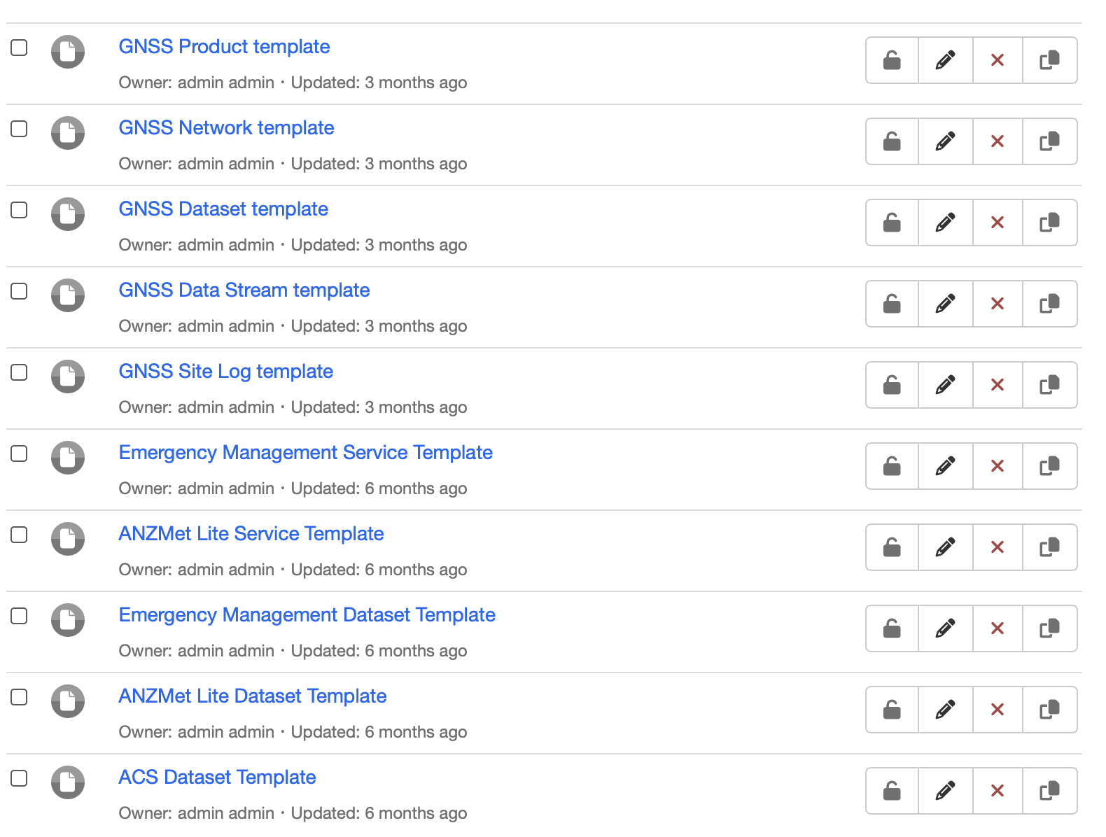
Templates

Slide 5
GNSS Metadata Schema Plugin
For cataloguing GNSS Base station metadata
Plugin Geonetwork schema - separable from GeoNetwork install
Based on GNSS Profile of ISO19115-3:2018 by Ivana Ivanova and Team at Curtin University
Backported from ISO19115-3:2023 and ISO19115-1:2014/Amd-2:2020
Support for latest ISO19157 Data Quality elements
Full dynamic datum / coordinate epoch support

Slide 6
Issues - Next Steps
Deploy ANZMetLite v2 as a Metadata 101 Schema Plugin
To install in existing GeoNetwork alongside default ISO 19115-3:2018
GeoNetwork 4.4.x - remove Java 8 requirement (ANZ GN Implementors Group)
Depricated version of Java, presents challenges
Java 11 (required) can be used by Elasticsearch (required)
Update Schema to ISO19115-3:2023
Dynamic Datum / Coordinate Epoch support
Support for latest ISO 19157 Data Quality schemas

Slide 7
ANZMetLite v2
Plugin Schema Proposal

Slide 8
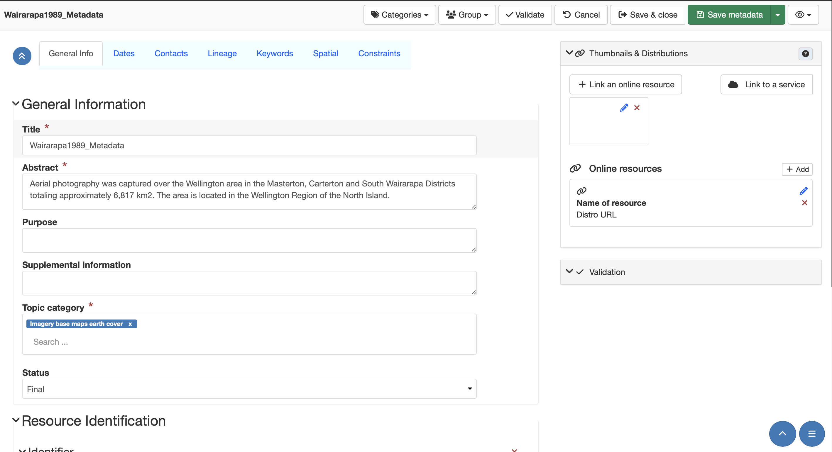

Slide 9
ANZMetLite v2 Architecture
ANZMetLite V2 was developed as a modified version (fork) of GeoNetwork.
Exists as a website hosted by GeoScience Australia. Could be made more widely available
To deploy ANZMetLite v2, one must install the entire ANZMetLte v2 fork of GeoNetwork;
This approach would be especially problematic if their current deployment includes modifications or customisations.

Slide 10
A better way- Schema Plugins
Schema plugins reside in a central repository, Metadata101
Can then be downloaded and incorporated into local GeoNetwork installs.
ANZMetLite v2 editor could be refactored into a schema plugin and made available in Metadata101.
Organisations could then deploy this plugin inside their existing GeoNetwork instance.
GNSS Profile of ISO19115-3:2018 already done this way

Slide 11
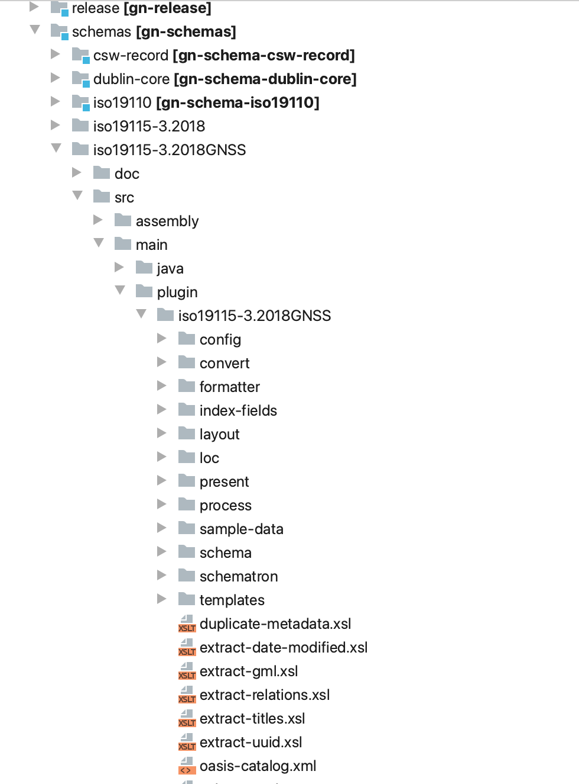
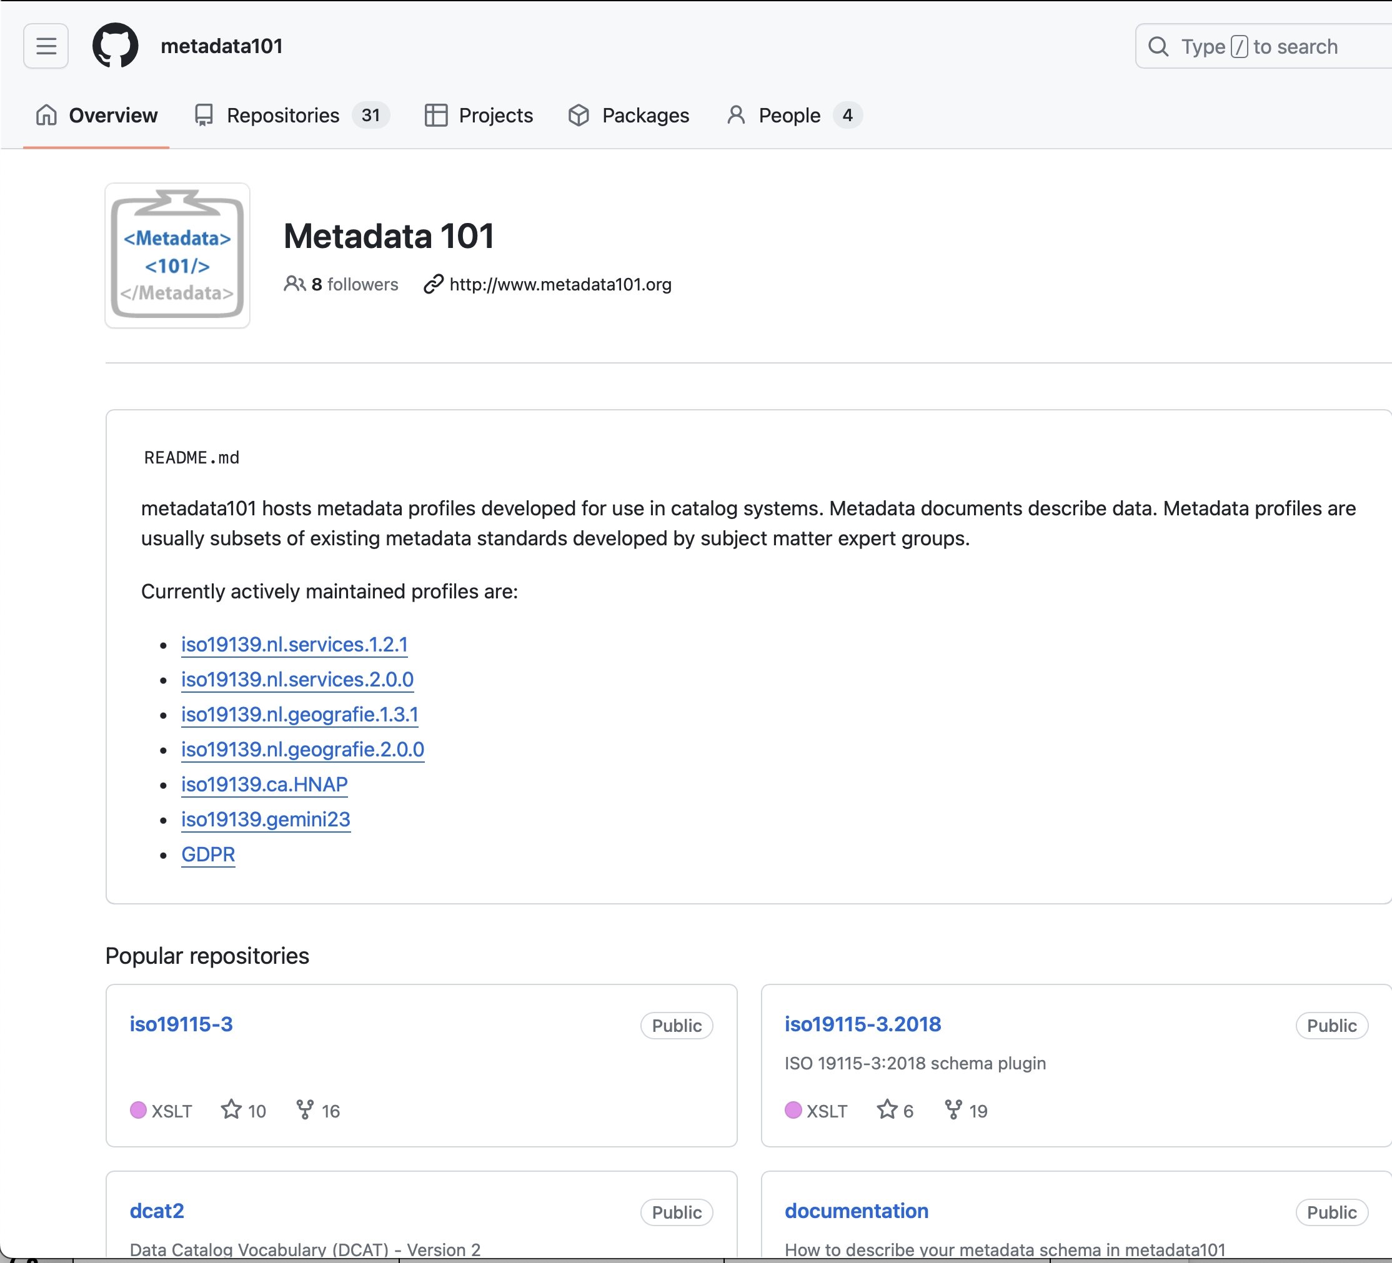

Slide 12
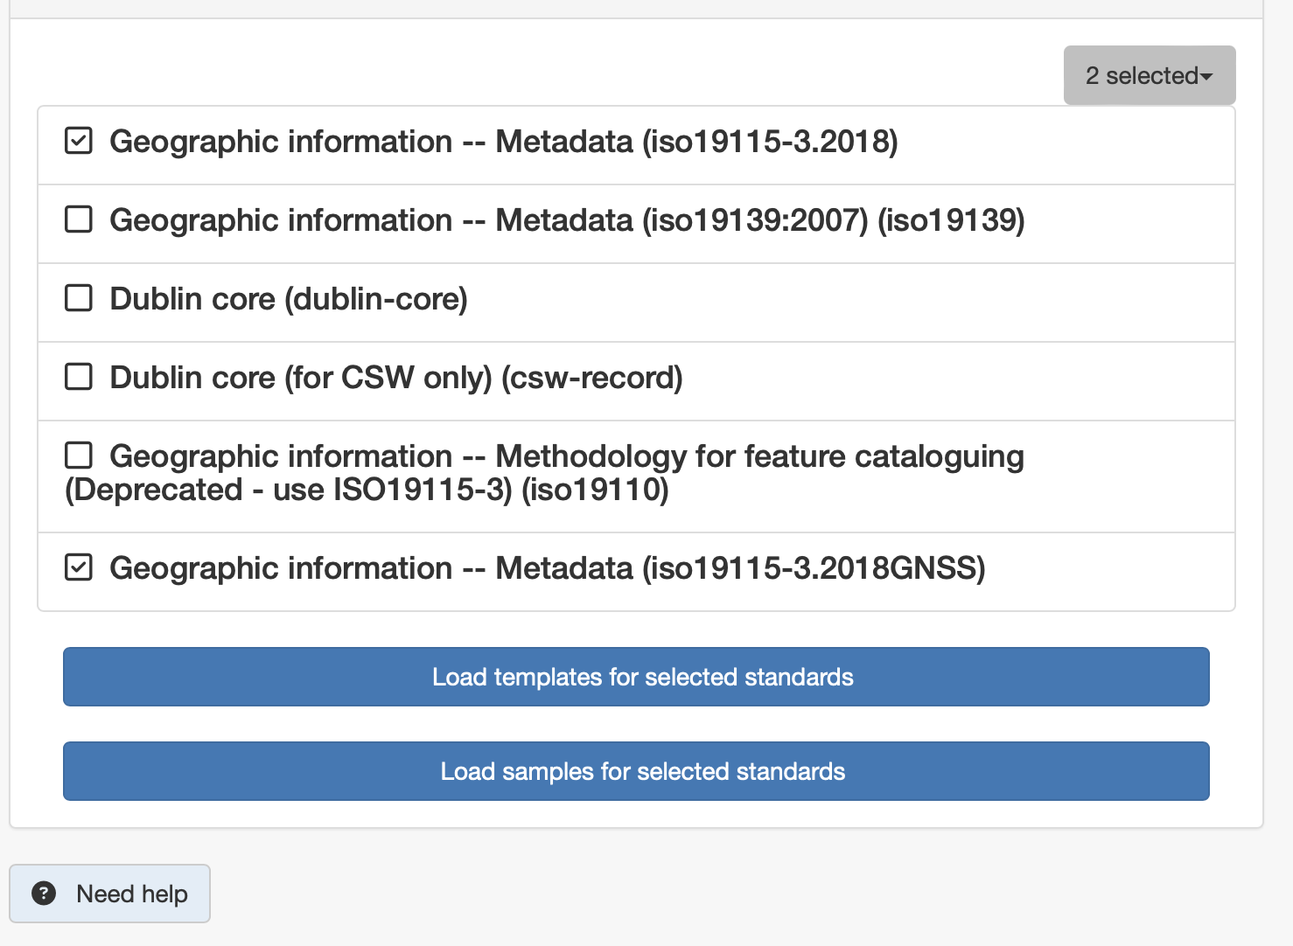
GNSS Profile Example

Slide 13
Limitations
Only available to those who deploy supported versions of GeoNetwork opensource (3.12.x and above)
May lack some interface styling and UI controls available in the current ANZMetLite v2. (Itemised list to be confirmed)
Users would be responsible for their own upgrades and technical support. (Unless other arrangements are made)
This plugin would be based on ISO19115-1:2018 as currently deployed to ANZMetLite v2. (ISO19115-3:2023 would require more effort)

Slide 14
Required Tasks
The primary task will be to isolate ANZMetLite v2 profile so it can stand alongside the default ISO19115-3:2018 schema. This involves:
Isolation of function names to prevent conflicts
Ensuring ANZMetLite v2 records can be distinguished from standard ISO19115-3:2018. (May require minor editing of current templates and records in order to access these tools.
Testing against standard GeoNetwork 4.2.x installs and review results with MDWG
Repeat the process for GeoNetwork 3.12.x
Create installation instructions.
Upload Schemas to Metadata 101 repository

Slide 15
Work Item | Days Effort
Isolate Plugin Functions 4.2.x | 2
Identification of ANZ MetLite v2 records ( & modification of templates records) | 0.5
Test 3.12.x against Standard GeoNetwork install | 1
Isolate Plugin Functions 3.12.x | 1.5
Identification of ANZ MetLite v2 records ( & modification of templates records) | 0
Test 3.12.x against standard GeoNetwork install | 1
Create installation instructions and upload to Metadata101 | 1
TOTAL | 7

Slide 16
Int’l Metadata
Standards Initiatives

Slide 17
Activities Underway
ISO 19115-4 JSON encoding
OGC GeoDCAT
Metadata Codesprint
Sydney - Nov. 24 to align with ISO TC 211
OGC TC Meeting next week in Delft

Slide 18
ISO 19115-4
JSON Encoding of ISO 19115-1
With associated standards (ISO 19157, 19115-2, etc.)
Pushing to ensure that latest updates to ISO 19115-1 are included
Likely to leverage GeoJSON
Scope still unclear - full encoding or subset?

Slide 19
OGC GeoDCAT
OGC committed to adopting and supporting GeoDCAT Standard
Based on SEMIC (INSPIRE EU) GeoDCAT-AP and its updates
Aligned with DCAT 3.0
Byron Cochrane co-chair of this effort
What are MDWG wishes for this?

Slide 20
Metadata Codesprint
OGC Initiative
Hybrid online / in-person
In-person Sydney, Nov to align with ISO TC 211
Need a host / venue

