Slide 1
ANZ MDWG Roadmap v2 analysis of stakeholder requirements
29-31 July 2020
ANZ MDWG Meeting No 7

Slide 2
Survey summary:
The survey
  Conducted in April 2020
  22 organisations provided responses
Survey aim:
  Identify adoption of ISO 19115-1 (-3) within organisations
  Part 1 – to define issues/challenges and the priority in addressing these
  Part 2 – to define requirements and their priorities

Slide 3
Analysis Approach:
Analysis of responses
Grouping and standardisation using the survey 1 classification schemas
Normalisation against number of participants
Provision of summary tables and bar charts for the Survey 2
Provision of comparison tables and bar charts for Surveys 1 and 2

Slide 4
Approach for the Roadmap v2:
Review of Survey results
Summary report on the responses
Identify any trends
Review and endorse Survey report by ANZ MDWG
  Confirmed by the preliminary review of Technical MDWG
Agree on priorities and recommendations
Create MDWG Roadmap v2

Slide 5
Adoption of the ISO 19115-1 (-3)
No of organisations | No of responses
Total responding | 22
Yes, Adoption ISO 19115-1 or Ability to produce the ISO 19115-3 (xml) | 8 12
No, Adoption ISO 19115-1 | 9
Not sure | 1

Slide 6
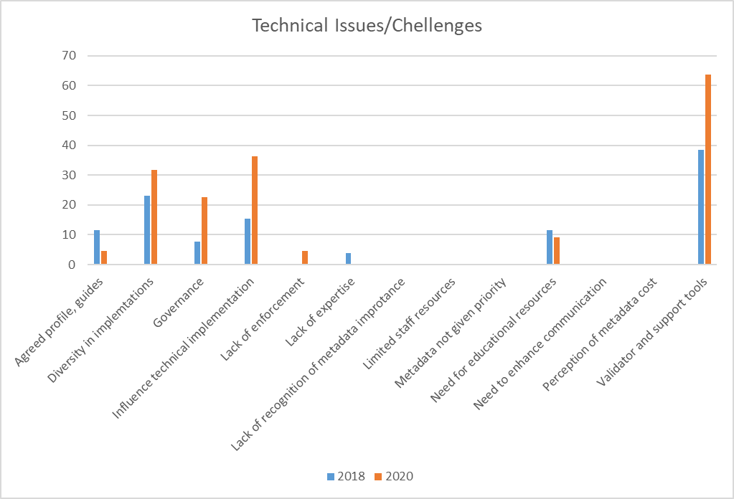
Technical Issues/Challenges
Issue/Challenge category | 2018 | 2020
Agreed profile, guides | 12 | 5
Diversity in implementations | 23 | 32
Governance | 8 | 23
Influence technical implementation | 15 | 36
Lack of enforcement | 0 | 5
Lack of expertise | 4 | 0
Lack of recognition of metadata importance | 0 | 0
Limited staff resources | 0 | 0
Metadata not given priority | 0 | 0
Need for educational resources | 12 | 9
Need to enhance communication | 0 | 0
Perception of metadata cost | 0 | 0
Validator and support tools | 38 | 64

Slide 7
Support Issues/Challenges
Issue/Challenge category | 2018 | 2020
Agreed profile, guides | 8 | 32
Diversity in implementations | 0 | 0
Governance | 4 | 9
Influence technical implementation | 8 | 0
Lack of enforcement | 0 | 0
Lack of expertise | 12 | 18
Lack of recognition of metadata importance | 0 | 0
Limited staff resources | 0 | 0
Metadata not given priority | 4 | 0
Need for educational resources | 58 | 14
Need to enhance communication | 23 | 0
Perception of metadata cost | 0 | 0
Validator and support tools | 0 | 0

Slide 8
Resourcing Issues/Challenges
Issues/Challenges | 2018 | 2020
Agreed profile, guides | 15 | 0
Diversity in implementations | 4 | 0
Governance | 8 | 0
Influence technical implementation | 4 | 0
Lack of enforcement | 0 | 0
Lack of expertise | 38 | 0
Lack of recognition of metadata importance | 0 | 0
Limited staff resources | 54 | 41
Metadata not given priority | 73 | 9
Need for educational resources | 4 | 0
Need to enhance communication | 0 | 0
Perception of metadata cost | 23 | 5
Validator and support tools | 0 | 0

Slide 9
Policy Issues/Challenges
Issues/Challenges | 2018 | 2020
Agreed profile, guides | 58 | 18
Diversity in implementations | 4 | 23
Governance | 38 | 45
Influence technical implementation | 0 | 0
Lack of enforcement | 62 | 50
Lack of expertise | 0 | 0
Lack of recognition of metadata importance | 50 | 41
Limited staff resources | 0 | 0
Metadata not given priority | 4 | 0
Need for educational resources | 46 | 18
Need to enhance communication | 42 | 0
Perception of metadata cost | 0 | 0
Validator and support tools | 0 | 0

Slide 11
 | Classification | Metadata Issue/Challenge description
1 | Agreed profile, guides | Lack of guides to help implementing standards. The standard is too big - what is the "bare minimum" metadata and what is the value of optional fields
2 | Diversity in implementations | Different ways of implementing standard limits ability to harvest from different catalogues. Lack of consistent use of same terms.
3 | Governance | Lack of spatial policy office to organise or direct for standards. Policy to regulate agreed standards, must be enforced and well communicated. Lack of coordination - who is in charge for metadata, open data, catalogues for governments
4 | Influence from technical implementation | Lack of understanding of standard by software systems means standard is not implemented correctly. Technical implementation does not always equal usability. Self-filling fields can de-value that metadata.
5 | Lack of enforcement | Lack of whole of government policy mandate means there is no mandate to capture metadata. Need to have a policy to ensure that metadata comes with all data contracted. Lack of internal mandate of policy enforcement to put metadata correctly.
6 | Lack of expertise | Lack of experts on implementation of standards. Lack of 'skilled' developers. Implementation training for stakeholders/data custodians. Lack of workforce planning to replace retiring experts
7 | Lack of recognition about importance of metadata | Value proposition of metadata not well understood by management. Many education systems, but not for metadata. The open data policy does not outline the detailed need of metadata. Metadata policy is onerous to apply and not understood
8 | Limited staff resources | Lack of resources to embed metadata into policy and to develop enterprise approach. Supporting users in constructing metadata requires resources. Bottlenecks in creating/updating metadata and publishing services due to number of people.
9 | Metadata not given priority | Lack of support from senior management to assign additional resources. Metadata is not part of initial business and is generally an afterthought. Metadata creations is someone else's problem.
10 | Need for educational resources | Lack of understanding of who the metadata is for and how to best support different users. Lack of guides for implementing standards and easy to use/understand documentation on standards. Need to show tool tips and examples.
11 | Need to enhance communication | Lack of communication about metadata understanding between agencies and states. Lack of management communication to stakeholders on requirements of agreed metadata standard and why it is needed.
12 | Perception of metadata cost | Metadata is expensive to maintain and update it. Not enough consideration for cost of generating metadata.
13 | Validator and support tools | Lack of tools to support metadata capture. Lack of tools to harvest information to automatically complete metadata. Automatic way to validate metadata. Tools to integrate with other metadata from non-spatial domains

Slide 12
Summary for Issue/Challenges analysis
The main changes in responses between surveys include:
Need for communication and education - Significant drops
  Issues were addressed through the work undertaken in the first roadmap
Needs for a metadata profile and guidelines – Decreased
  Refocus towards data specific metadata profiles and their
Diversity in implementation - Shifted focus to technical and policy matters
  Suggests interest in the evaluation of technical implementations to achieve a desired impact
Lack of expertise – Dropped
  Recognition of available expertise within the MDWG
Lack of priority for metadata its cost – Decreased
  Recognition and understanding of metadata is improving within the agencies

Slide 13
Requirements - 2020
Requirement Category | 2020
3rd Party integration | 0
Accessible expertise | 18
Business case for metadata benefits | 23
Education and examples | 23
Flexible, fit for purpose but Quality metadata | 18
Leadership | 41
Shared Infrastructure | 18
Transformation pathway | 27

Slide 14
Requirement comparison 2018 vs 2020
Requirement Category | 2018 | 2020
3rd Party integration | 12 | 0
Accessible expertise | 15 | 18
Business case for metadata benefits | 31 | 23
Education and examples | 12 | 23
Flexible, fit for purpose but Quality metadata | 62 | 18
Leadership | 38 | 41
Shared Infrastructure | 19 | 18
Transformation pathway | 12 | 27

Slide 15
 | Classification | Metadata Requirement description
1 | Flexible, fit for purpose but Quality metadata profile | Develop an easy to understand, flexible, fit for majority of purposes profile which clearly articulates what each element is and why It is important. Ensure the profile can be easily extended to meet the specific needs of individual organisation needs.
2 | Leadership | Need ongoing leadership identifying what is the preferable standard for implementation and management. Articulation on how to utilise the standard, education on the value and importance of metadata, and the ongoing monitoring and championship of metadata.
3 | Business case for metadata benefits | Clearly articulate the case for change to the new version of the metadata standards. The case needs to include benefits, dis-benefits, requirements and implications. This case needs to target decision makers, metadata system managers, and data custodians to improve the overall understanding of the importance, whilst providing a framework to assist decision making about planning requirements.
4 | Shared Infrastructure | Assess the viability of a hosted, federated metadata system to assist agencies without the capability, capacity and or business barriers to manage standards compliant metadata, which can be disseminated. Where does data.gov.au fit. Ensure tools are available to assist in the creation and compliance assessment of metadata records.
5 | Accessible expertise | Make discoverable what expertise is available to advise and assist end users on the implementation and management of the standard, profiles and technology options. Ensure best practice frameworks are easy to understand and can be utilised by all key stakeholders including technical experts, data managers and decision makers to support the uptake of the standards consistently.
6 | 3rd Party integration | Ensure the new profiles and supporting technologies can enable seamless integration between different users and application choices including crowd sourced data and common applications such as ESRI.
7 | Education and examples | Based off the agreed profile, develop a suite of examples, which clearly articulate what a quality metadata record looks like. This resource will provide real world examples, which can be easily adopted to meet the needs of non-expert.
8 | Transformation pathway | Develop a roadmap and a national picture to measure the status of metadata capability nationally. Ensure there is a clear path on how to migrate from existing standards base to the new standards, including associated tooling and mapping.

Slide 16
ANZ MDWG Roadmap v1 - Major achievements
ANZ MDWG work was effective in addressing issues
Trust in the group, level of expertise and quality of advice has increased
Recognised usefulness of produced communication and support materials
The groups is at a more mature/advanced stage
Shift in thinking: more focus on implementation, transitioning paths and ability to influence technical decisions
Looking for utilising expertise and improving governance
Improved collaboration with other ICSM WG, e.g. Geodesy WG
This indicates that the first roadmap actually resulted in the changes we wanted to see

Slide 17
Summary of requirements - Roadmap v2 Priorities (TBC)
Support for transformation pathways - Strong increase
Metadata validator and creation/editing tools – Significant increase
Need for expert support for data specific profiles and implementation examples - Increase
Improving technical governance - Increase

