Slide 1
Review of the ANZLIC/ICSM Metadata Working Group Roadmap
24 March 2020

Slide 2
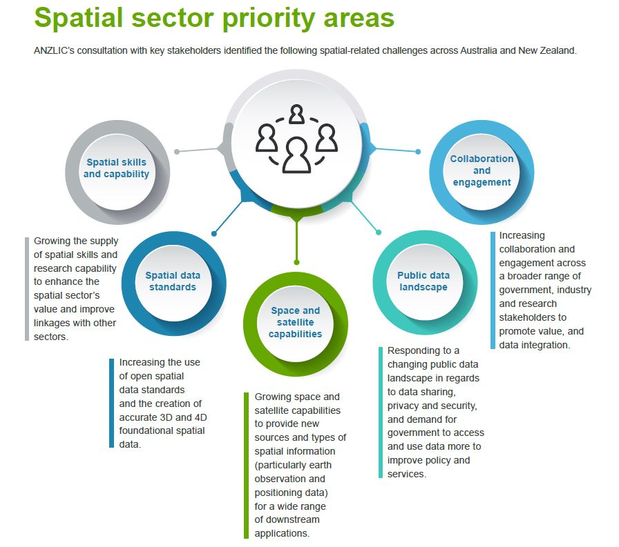
Standards
Standards
Standards

Slide 3
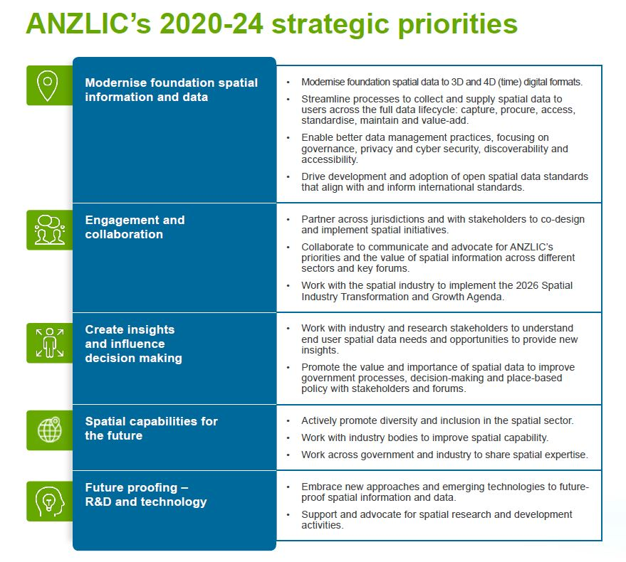
ANZLIC strategic plan and roadmap
Both ANZLIC and ICSM recognise the importance of standards in the delivery of the ANZLIC strategic Plan

Slide 4
Outcomes of ICSM Exec Meeting March 2020
A key message from various presentations, including the industry session, was for the need to have consistent, accurate, complete, standards compliant metadata. Without this, data cannot be FAIR, cannot be consumed by APIs.
ICSM also agreed to lead improvements to the Findability, Accessibility, Interoperability, Reusability (FAIR) of data.
The importance of metadata, standards, licencing and specifications was emphasised throughout the meeting and will be a critical component of the FSDF modernisation activities.
ICSM recognised the importance of the consistent use of profiles and the need for MDWG to support identification of the best elements to use for specific data types eg. imagery

Slide 5

Recap of MDWG Workshop Results (2018)
Two activities organised to collect view of participants
Activity 1: Metadata issues and challenges
Participants asked to identify as many issues that they face with metadata
Issues were then grouped, counted, categorised and graphed

Slide 6
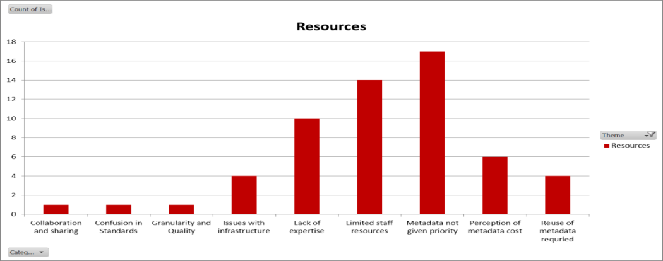
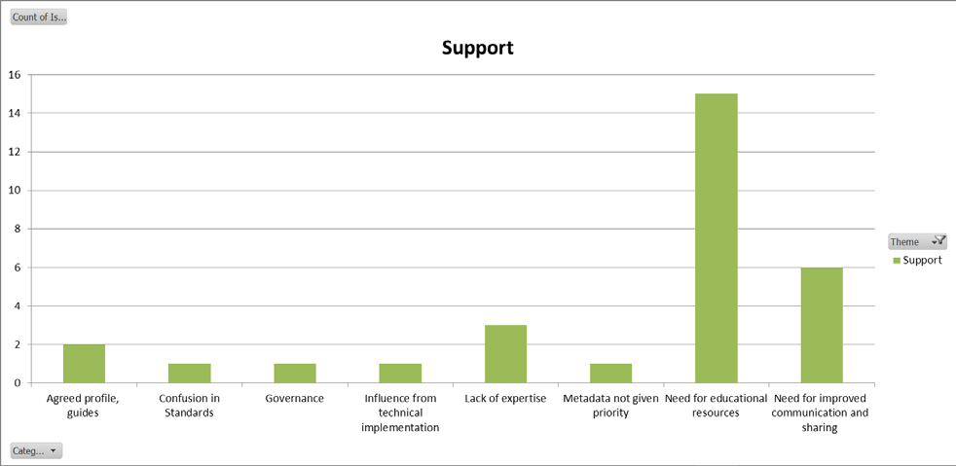
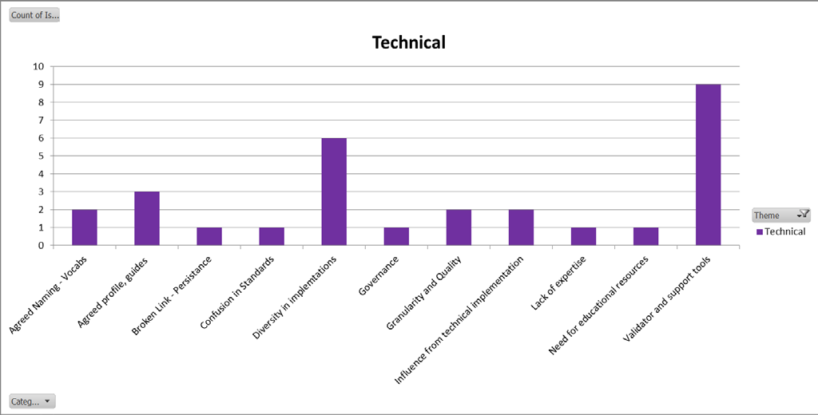
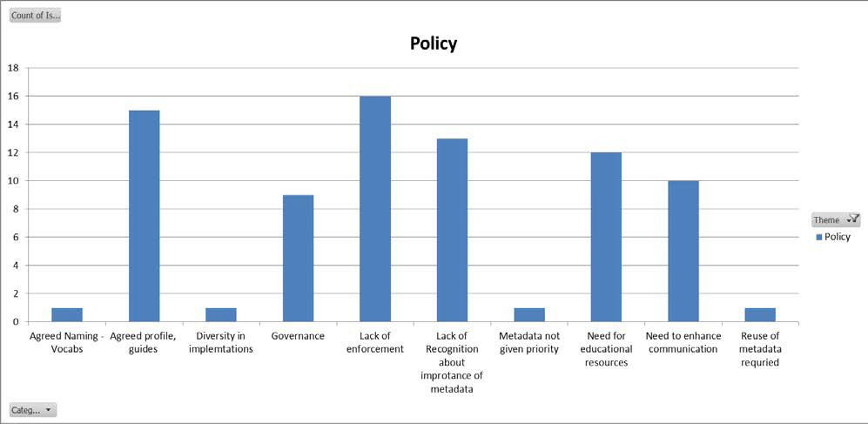
Categorised Issues and Challenged

Slide 7

Key Findings
The need for guides, profiles, tools and supporting documentation so that users can consistently apply metadata in the same way and to reduce confusion and diversity in approaches.
The need for communication material to support education and help inform managers, data custodians and user of the importance of metadata
The need to build up skills and resources to support metadata application and reduce the potential burden of maintenance and upkeep.

Slide 8
Recap of Workshop Results (2018) Requirements
Participants asked to list requirements for their agency
requirements to improve metadata capability
Requirements grouped, counted and graphed

Slide 9
Summary
Workshop defined issues, challenges and requirements
Information fed into Roadmap Working Group
Issues and requirements informed work of Profile Working Group
Result
Roadmaps for Metadata Working Group developed based on requirements identifed in workshop report.

Slide 10
ANZ MDWG Roadmap V1
Tranche 1:
Development a new profile for agreed core elements within the new 19115-1 standard
The profile forms the basis for a best practice framework
Tranche 2:
Development Metadata Best Practice (cookbook) for the new standard
Why it is important, how it is implemented and what resources are available to support user implementations
Tranche 3:
Publication the Metadata Best Practice and communication
Managing the framework and monitoring the potential changes

Slide 11
Tranche1: Development a list of core elements
Workshop Requirement Addressed: Flexible, fit for purpose and quality metadata profile

Slide 12
Tranche2: Development Metadata Best Practice
Workshop Requirements Addressed: Flexible, fit for purpose and quality metadata profile; Business case for metadata benefits; Leadership

Slide 13
Tranche3: Publication, Communication, Management and Maintenance
Workshop Requirements Addressed: Education and Examples; Leadership; Transformation pathway; 3rd Party integration

Slide 14
Activity 1: Current metadata issues, challenges and barriers
Round Table discussion
    What issues / challenges does my agency face in managing a metadata system (policy, infrastructure, standards implementation, other)
Record of Discussion
    Open provided template spreadsheet
    Individually write what issues / challenges does my agency face in managing a metadata system (policy, infrastructure, standards implementation, other)
    Based on your group discussion, classify each issue and record it in a document
Report, the three most common issues your table has identified from all agencies

Slide 15
Activity 2: Current requirements to improve metadata consistency
Round Table discussion
  Record each agency that already moved to the ISO 19115-1 or can produce the ISO 19115-3 XML
  What is required in your agency to move to the latest standard (policy, infrastructure, standards implementation, other)
  What level of granularity does metadata need to address (considering GDA2020, Linked Data etc)
Record of Discussion
  Open provided template spreadsheet
  Individually write what is required in your agency to move to the latest standard (policy, infrastructure, standards implementation, other)
  Based on your group discussion, classify each requirement and record it in a document
Present to all the three most common requirements your table has identified

