Slide 1
We acknowledge the Traditional Owners of the land on which our research infrastructure and community operate across the Australian continent and pay our respects to Elders past and present.
We recognise the connection they have with land, sea, sky and waterways for tens of thousands of years.
Notes:
SLIDE TIP: Please feel free to personalise this Acknowledgement of Country. Know whose Country you are on – resources like the AIATSIS Map of Indigenous Australia (https://aiatsis.gov.au/explore/map-indigenous-Australia) are a useful starting point. But go further. Know the difference between and Ackowledgement of Country and a Welcome to Country. Some tips on giving a confident Acknowledgement of Country: https://charlie.csu.edu.au/2018/05/30/5-tips-for-confidently-acknowledging-country-nrw2018/

Slide 2
Adding ISO 19115-3 XML capability to github’s geopython ecosystem
Vincent Fazio
CSIRO Mineral Resources
March 19 2024

Slide 3
Why upgrade to ISO 19115-3 ?
Richer metadata - easier to adhere to FAIR principles
e.g. Add a “Sponsor” role
ISO 19139:2007
ISO 19115-3:2018
http://portal.auscope.org.au/geonetwork/srv/eng/catalog.search#/home

Slide 4
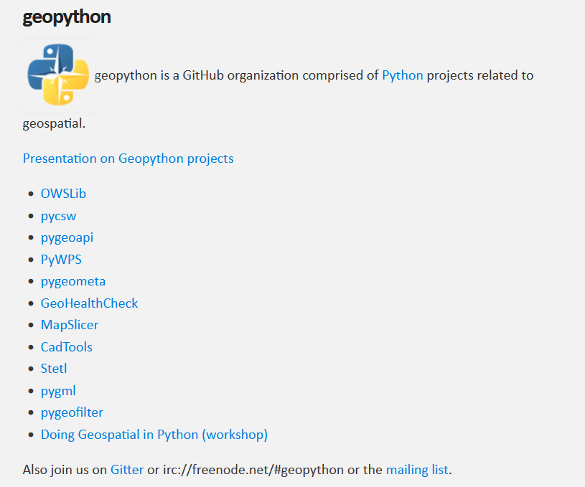
https://geopython.github.io/
geopython is a collection of geospatial Python packages
Github URL: https://github.com/geopython
Of interest are: OWSLib and pycsw
What is geopython?
http://portal.auscope.org.au/geonetwork/srv/eng/catalog.search#/home

Slide 5
What is OWSLib?
OWS stands for OGC Web Service
As its name suggests it provides client-side access to OCG Web Services
OGC-compatible services (https://www.ogc.org/)
Geoserver
(https://geoserver.org)
ESRI ArcGIS
Python script using OWSLib
(https://www.esri.com)
Geonetwork
(https://geonetwork-opensource.org)
PYCSW
(https://pycsw.org/)
Notes:
Creates two kinds of records: services and datasets. We use the dataset kind.

Slide 6
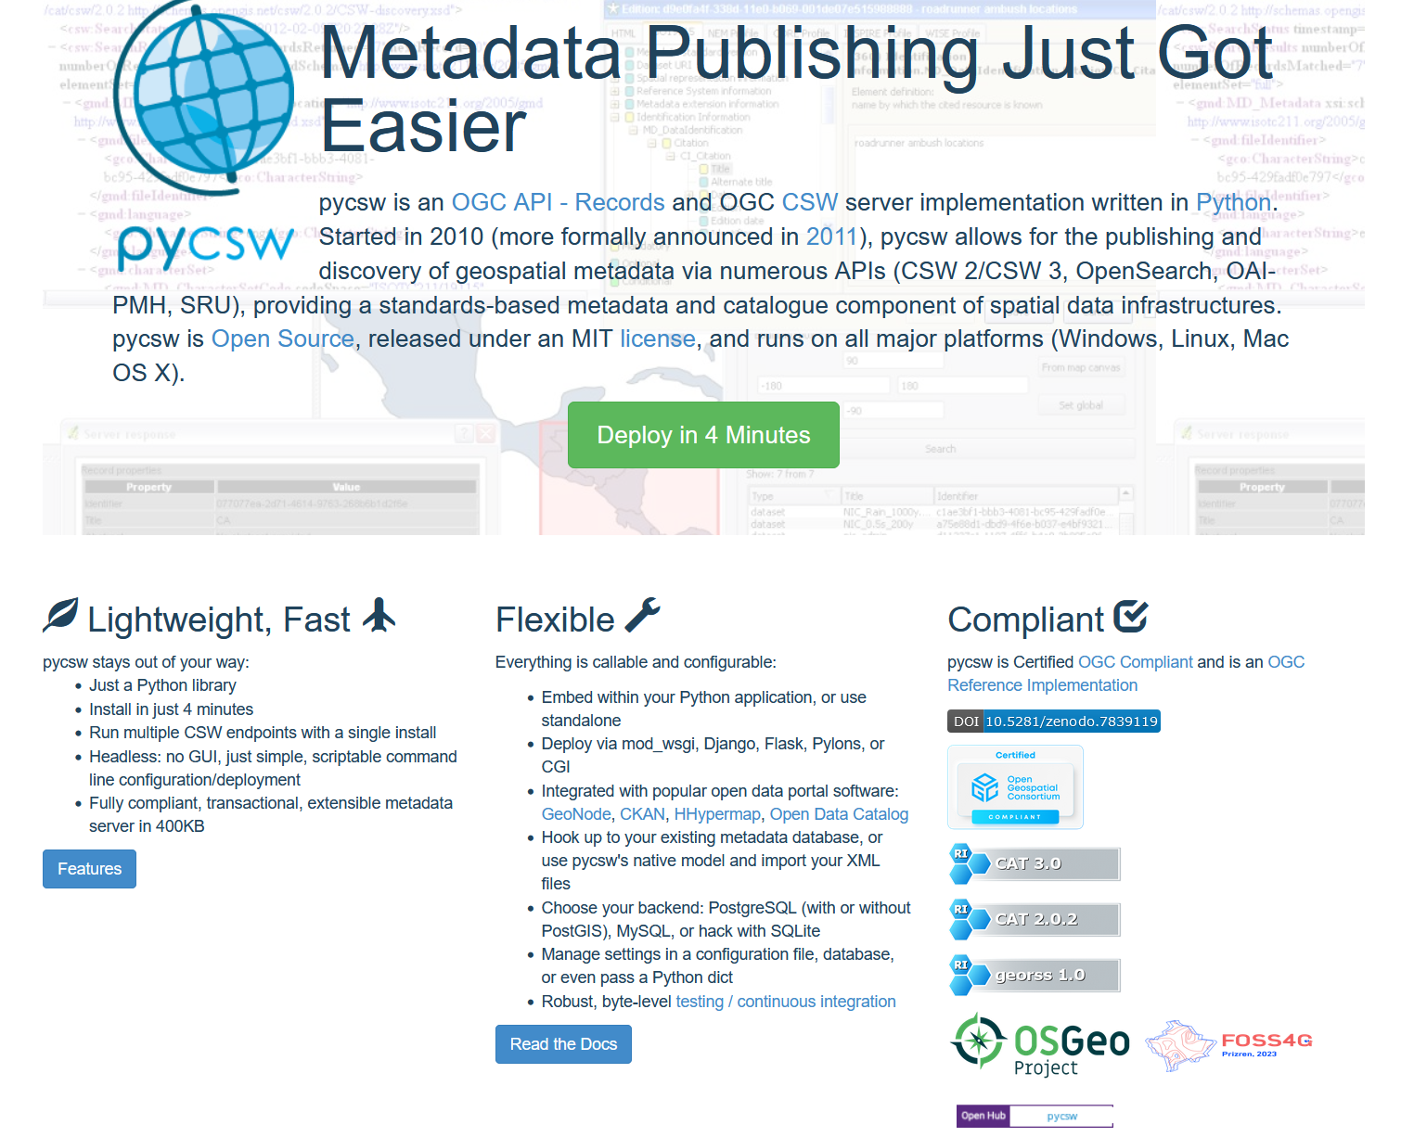
What is PyCSW?
Open-source OCG CSW server written in Python
Basic, fast, lightweight
Deployed by many services https://github.com/geopython/pycsw/wiki/Live-Deployments
Outputs older ISO 19139:2007 XML
(https://pycsw.org/)

Slide 7
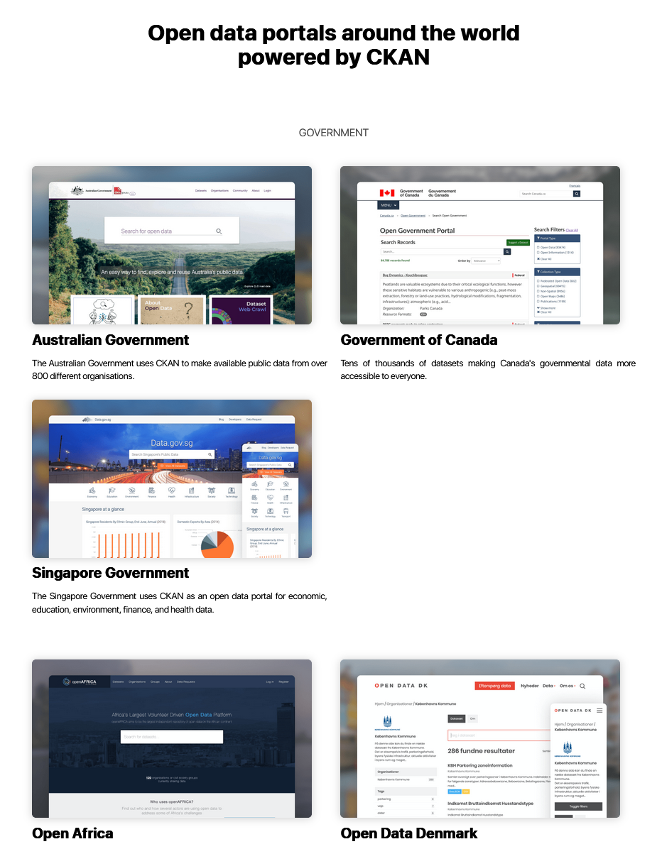
Catalogues and software powered by pycsw
CKAN https://ckan.org/
GeoNode https://geonode.org/
Koordinates https://koordinates.com/

Slide 8
The changes - in more detail
OWSLib
- Read ISO 19115-3 XML catalogues via CSW interface e.g. geonetwork, ESRI ArcGIS
- Process the “MetadataURL” field in the OGC ‘GetCapabilities’ response if the URL references ISO 19115-3 XML
pycsw
- Outputs ISO 19115-3 XML
https://server/csw?service=CSW&request=GetRecords&version=2.0.2&resultType=results&elementsetname=full&typenames=mdb:MD_Metadata&outputschema=http://standards.iso.org/iso/19115/-3/mdb/2.0
- Even if a record was inserted in as ISO 19139 XML, it can still be output as ISO 19115-3 XML
- Added new funder field
- Added geometry fields to support 3D volumes

Slide 9
What does the upgrade do?
Many catalogues and data services will be able to process and output ISO 19115-3 XML e.g. CKAN et al.
Will PYCSW/OWSLib support every namespace, tag, attribute & value in ISO 19115-3 XML?
No. But all viable ISO 19139 fields in use by pycsw/owslib were mapped to ISO 19115-3
Missed were a few less commonly used ISO 19115-3 elements that could not be supported by pycsw without more extensive changes, e.g. some types of data quality representations
If need be, these can be implemented as future github pull requests

Slide 10
Progress report: github pull requests
Under review:
https://github.com/geopython/OWSLib/pull/900
In draft, contingent on the PR#900 merge:
https://github.com/geopython/pycsw/pull/933

Slide 11
Acknowledgements
Thanks to:
Byron Cochrane (Openwork Ltd)
Melanie Barlow (ARDC)
Nik Lieb (UWA)
for their advice and encouragement.
Funding: AuScope Pty Ltd

